Slide 1
Gender and labour-market outcomes
Andrew E. Clark (Paris School of Economics – CNRS)
http://www.parisschoolofeconomics.com/clark-andrew/

Slide 2
BROAD QUESTION
“Why do some groups do less well in the labour market than others?”
Subsidiary question:
“Should we be doing anything about it?”
It is interesting to look at this question with respect to gender as this is not a matter of choice: there is no endogeneity problem (as there is with industry, location, trade-union membership or education, for example).

Slide 3
Outcomes can be in terms of:
Getting a job (the employment rate)
Wages
Job quality (stability/interest/effort/satisfaction…)
Promotions
We’ll mostly concentrate on wages.
Employment
The percentage of employment accounted for by women in G7 countries in 1978 and 2019 has risen by six to eleven percentage points in most countries.

Slide 4
% of Employment accounted for by Women (OECD)
1978 1998 2011 2019
Germany 38.9% 43.6% 46.5% 46.9%
Canada 38.3% 45.5% 47.9% 48.0%
USA 41.2% 46.2% 47.0% 47.2%
France 39.0% 44.5% 47.5% 48.6%
Italy 31.1% 36.5% 41.3% 42.6%
Japan 38.5% 40.9% 42.6% 45.1%
UK 39.5% 44.9% 46.8% 47.6%
The 2019 figure is remarkably similar across G7 countries, with the exception of Italy and Japan.
These figures are for all employment; if we look at employees only, then the situation is even more egalitarian.
In the UK in 2002 there were more female employees than there were male employees (SE is overwhelmingly male).

Slide 5
Number of women in employment in France:
1965 6.5M
2000 11M
2010 12.5M
2019 13M
Female LF participation rates in France (25-54):
1962 40%
1990 73%
2000 78%
2010 83%
2018 84% (c.f. Male rate = 93%)

Slide 6
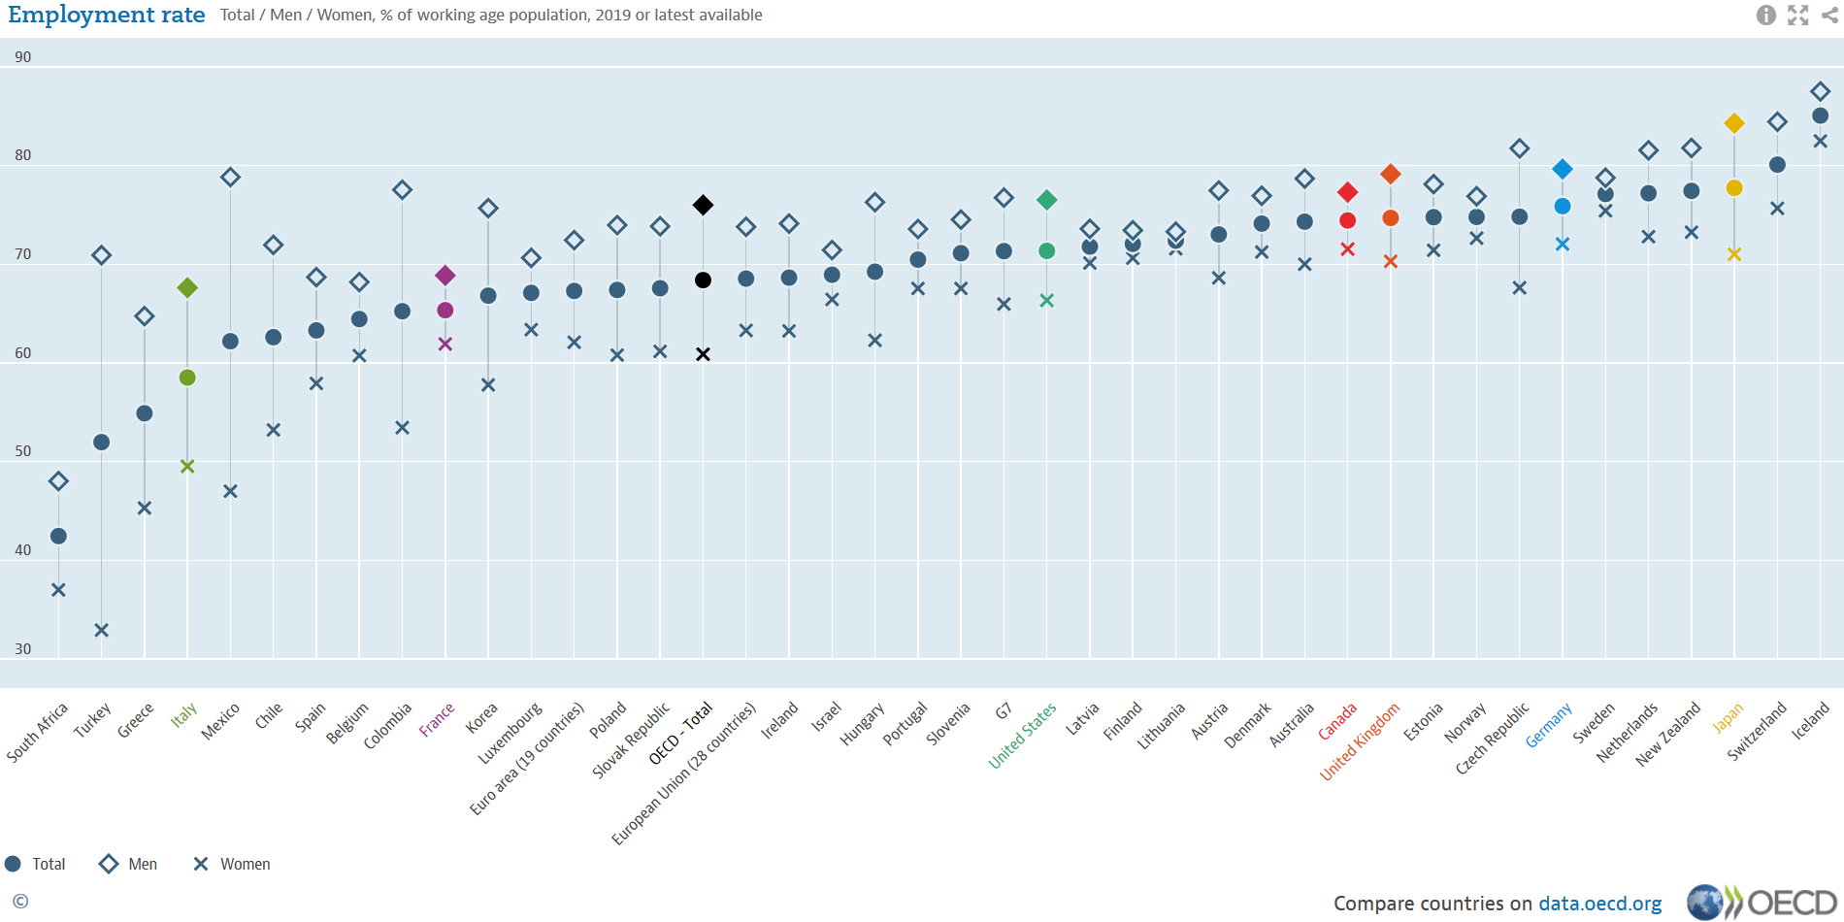
Male employment rates continue to be higher than those of women, with notable differences between countries

Slide 7
France is relatively equal, but with low employment rates: both for men and women.
2019 OECD Figures for male and female employment rates (15-64):
M F
OECD 76.3 61.3
UK 79.7 71.6
France 68.8 62.4

Slide 8
Low French figures partly reflect low employment rates for younger workers (15-24):
M F
OECD 44.7 38.8
UK 51.3 49.1
France 32.1 27.5
Greece 15.8 12.2
The employment rate of 15-24 year olds in France was 54% in 1975.
This includes part-time work
The non-employed include students, but also NEET

Slide 9
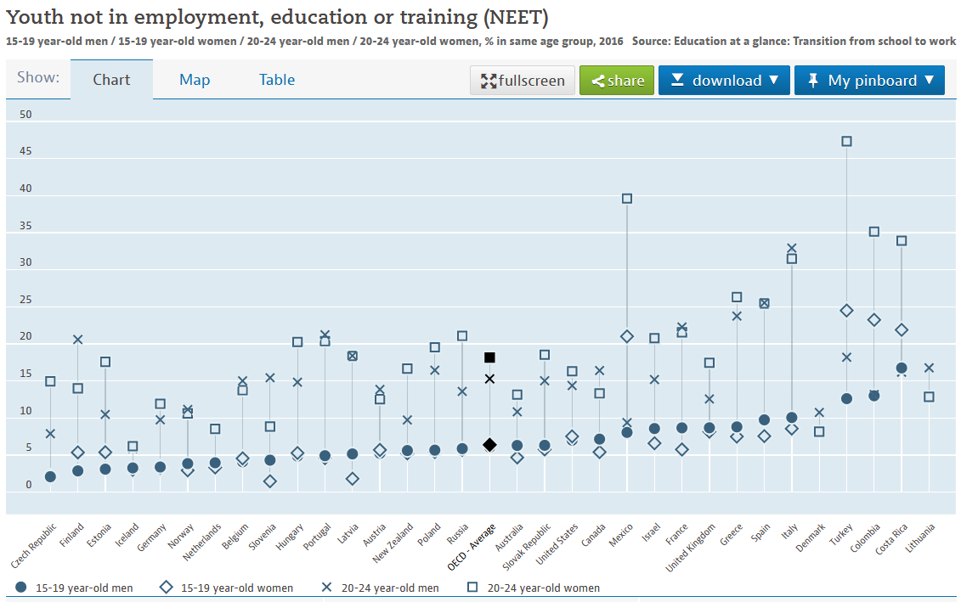
OECD, 20-24. Men = 15.3, Women = 18.2
UK, 20-24. Men = 12.6, Women = 17.5
France, 20-24. Men = 22.3, Women = 21.6

Slide 10
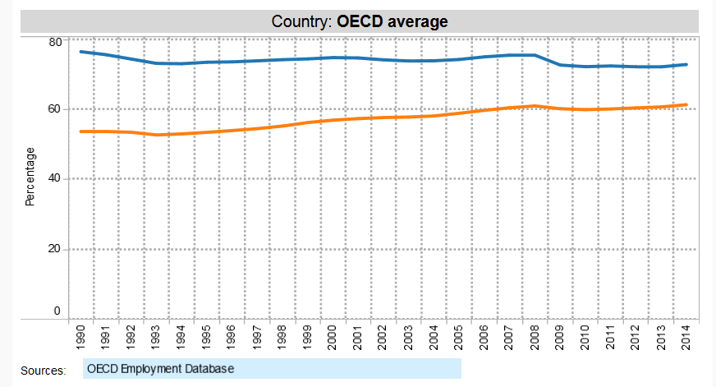
Women are catching up in terms of employment rates
Partly because men were heavier hit by the recession, but the trend gap is falling: from 23% in 1990 to 18% in 2000, and 11.5% in 2014.
The OECD Gender Employment Gap has exactly halved in a generation

Slide 11
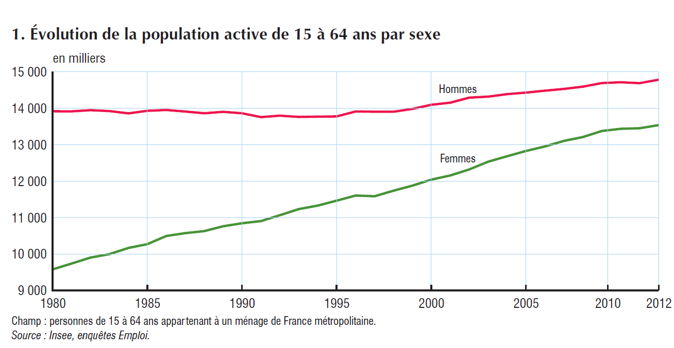
France in detail: catching-up in terms of labour-force participation
2017 figures: Men = 15.4M, Women = 14.3M
The gap is now 1M, as compared to 4M+ in 1980

Slide 12
France in detail: catching-up in terms of labour-force participation. As a percentage

Slide 13
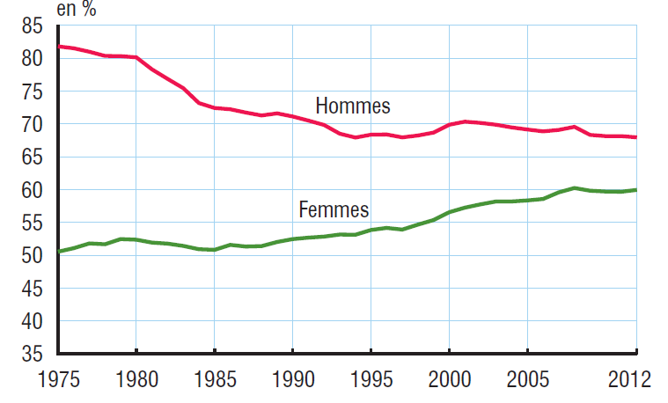
And especially in terms of the employment rate: long-run figures

Slide 14
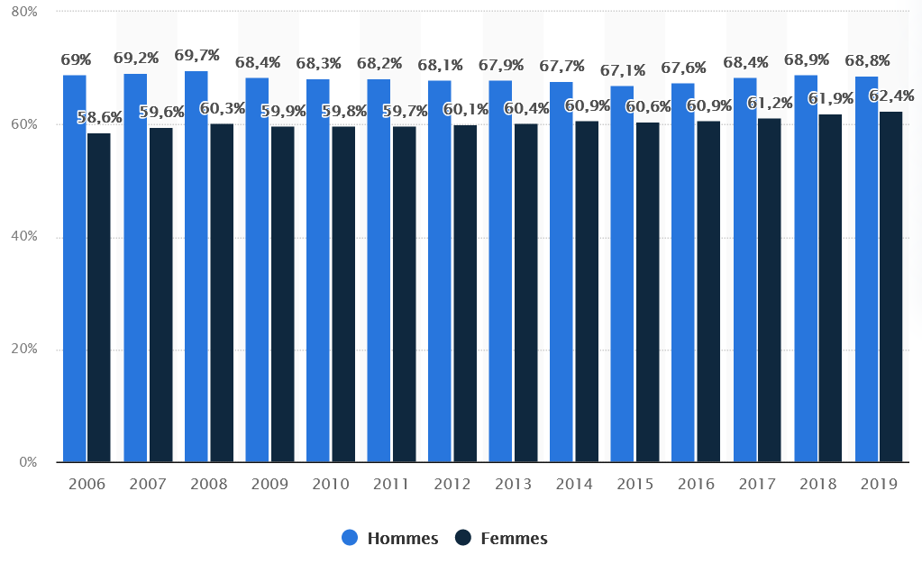
And especially in terms of the employment rate: recent
The gap has dropped from > 30% points to 6% over the past 40 years

Slide 15
The UK gap is closing too, but without the French collapse in male employment

Slide 16
One fact that is consistent with rising female employment is the continuous rise in female wages (in a labour-supply perspective).
The “raw ratio” of male to female wages was around 2/3 for a long time; has more recently risen to something like 4/5.
Wage rises have both a substitution and an income effect. For those who do not work, there is only a substitution effect, which will increase employment.
Participation decision:
V(Y₀ + w₁h₁, 24-h₁) > V(Y₀, 24)
Rising wages encourage participation.

Slide 17
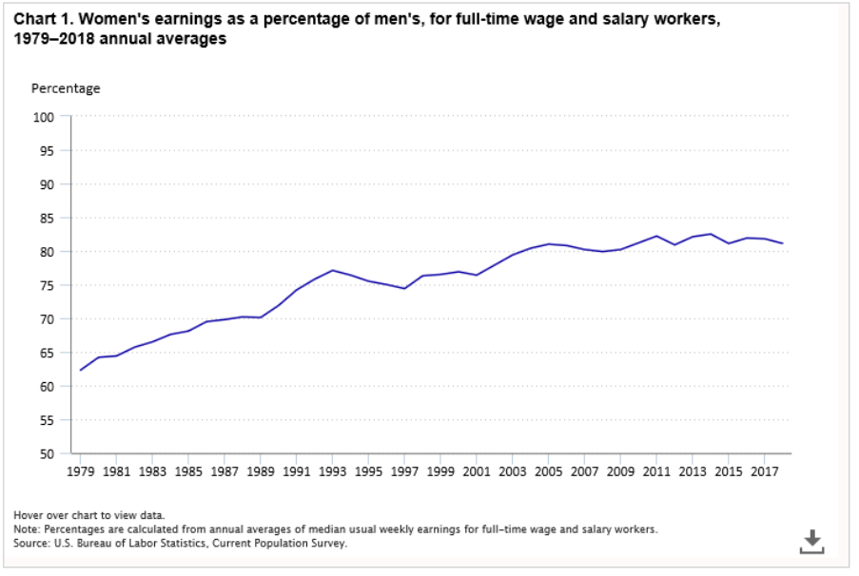
This figure rose from 63% in 1979 to the low 80s from 2010 onwards
Notes:
17

Slide 18
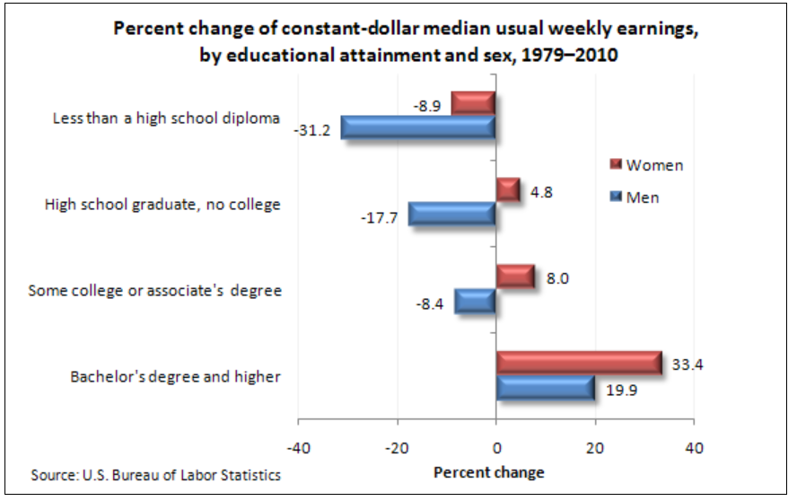
Notes:
18

Slide 19
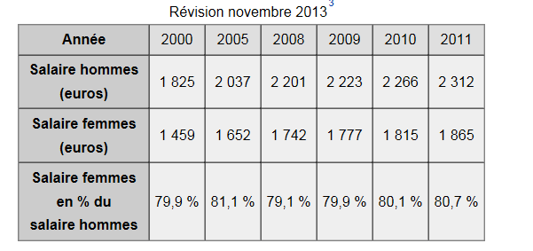
2015 figures: 2438 Euros and 1986 Euros, for a ratio of 81.5%
2018 figures (most recent): 2547 and 2148 Euros, ratio of 84.3%
These are FT equivalent figures.
Notes:
19

Slide 20
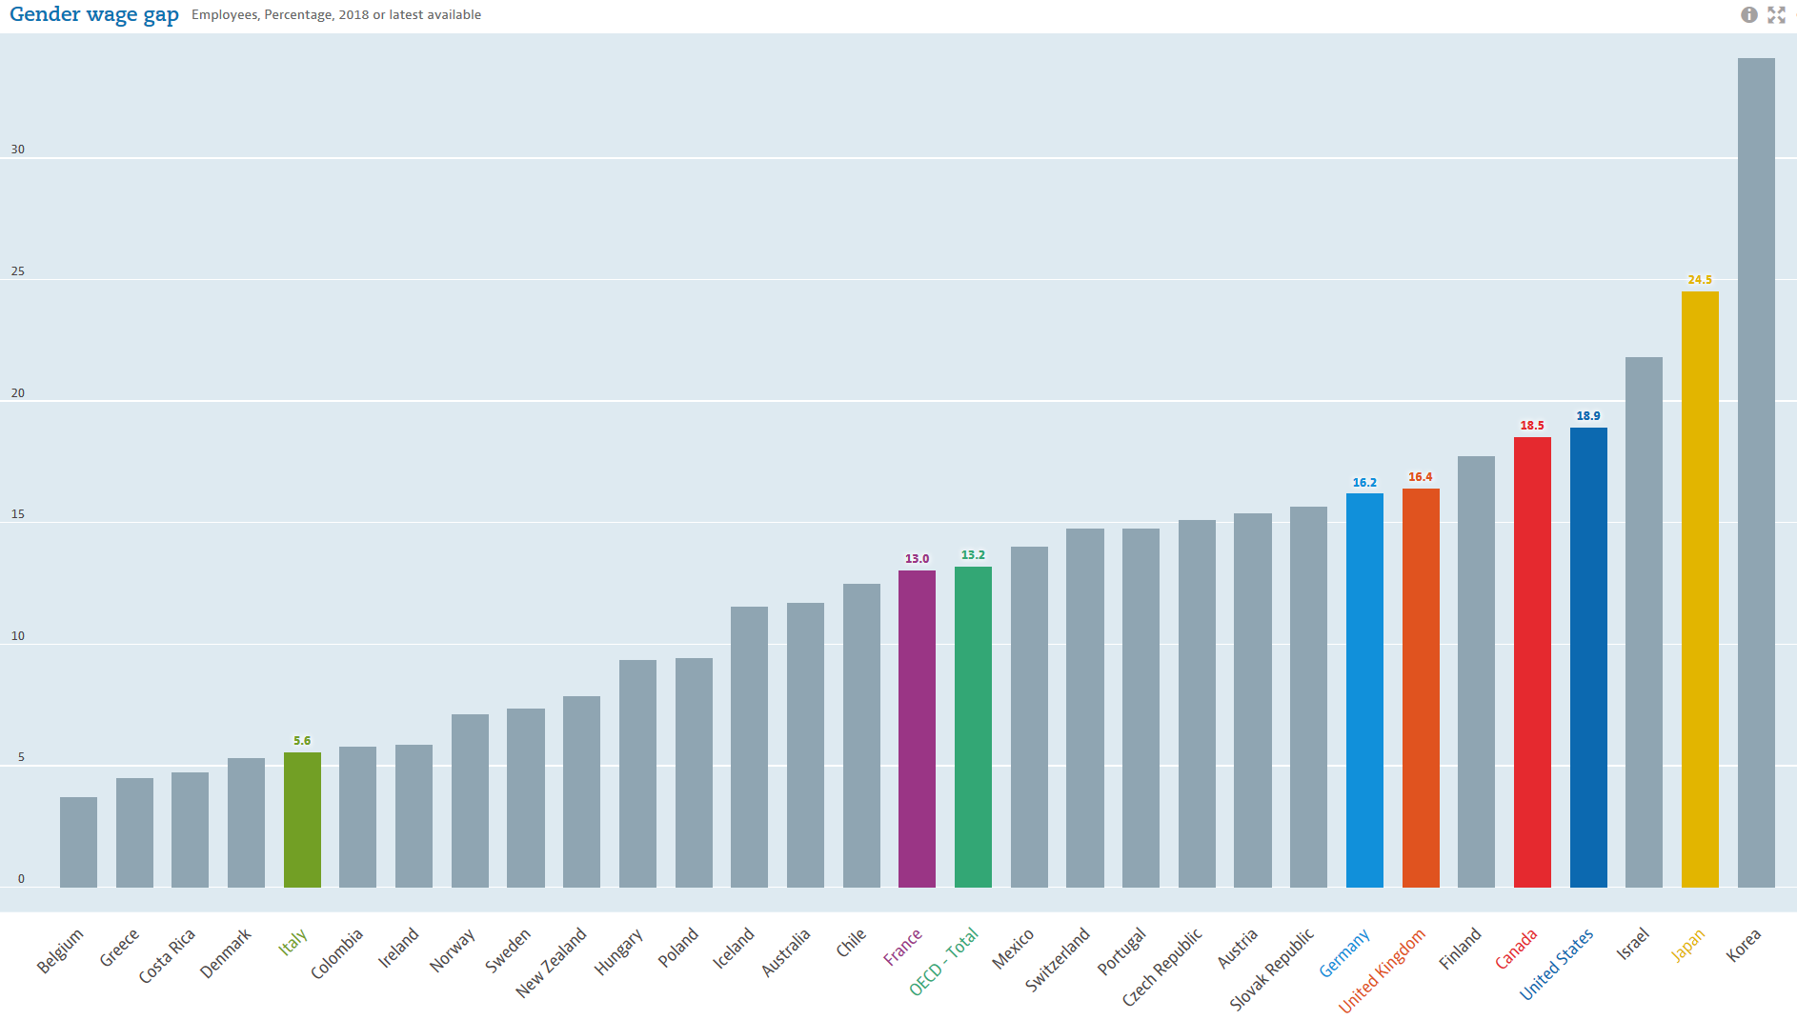
OECD Figures
Notes: The gender wage gap is unadjusted and defined as the difference between male and female median wages divided by the male median wages.
Notes:
20

Slide 21
So in many countries, there has been substantial progress in the position of women on the labour market.
There is a definite movement towards equality in terms of the percentage who are in employment, and in terms of relative wages.
But does that mean that it’s “job done” in terms of labour-market equality?
Or is there still some gender discrimination on the labour market?

Slide 22
Women’s educational attainment has outstripped that of men for some time now.
Note that this is a flow statement, not a stock one.

Slide 23
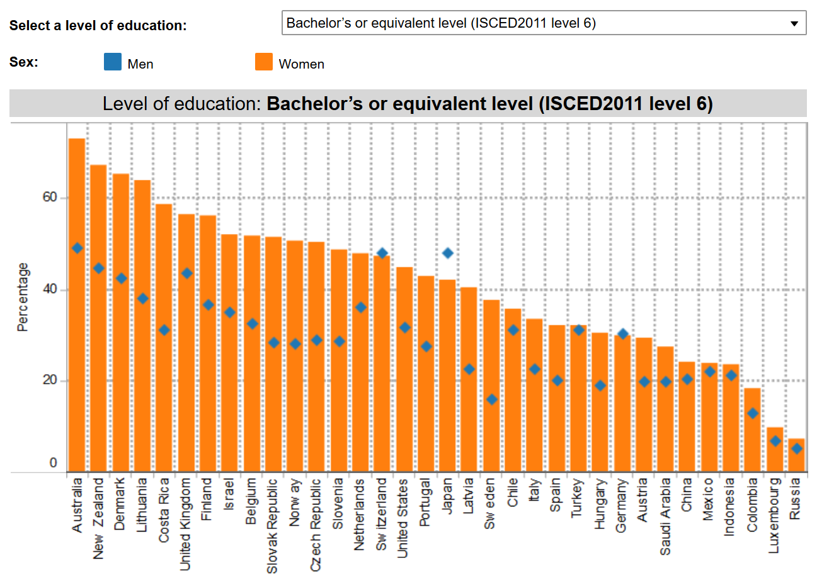
Notes:
23

Slide 24
US: All cohorts of U.S. women born since 1960 have had higher average years of schooling than their male counterparts (Charles and Luoh, 2003
Notes:
24

Slide 25
The CNRS awards Silver Medals every year to a small number of researchers.
In Social Sciences, there are typically between 2 and 4 such medals p.a.
2014-2021: 9 men and 15 women (62.5% F).
Notes:
25

Slide 26
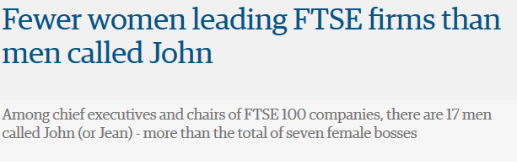
But this has not (yet) led to greater labour-market success
The same is true for men called David
Notes:
26

Slide 27
Although the UK is actually better than the OECD average in terms of female managers
UK
Notes:
27

Slide 28
There has been progress in the UK in terms of the female share of MPs in Parliament
2017: 208 (32%) 2019: 220 (34%)
Notes:
28

Slide 29
The percentage of women in Parliament, 2021
Source: UNDP Gender Page
Notes:
29

Slide 30
Most attention has probably been paid to sex discrimination in wages: if this exists, it applies to over 50% of employees….
Wages
The key question that all theories of discrimination have to address is:
How can discrimination persist in a profit-maximising world?

Slide 31
Think of this in a piece-rate way.
w_{F} = α_{F}Q_{F}; w_{M} = α_{M}Q_{M;} α_{F} < α_{M}. Women are paid less per piece.
But this implies that women’s cost of production is lower: w_{F}/Q_{F} < w_{M}/Q_{M}
A non-discriminatory firm will hire women, rather than men, as this is profit-maximising.
Demand for women will rise, and for men will fall, until equilibrium between wages is restored (α_{M} = α_{F}).

Slide 32
Theories of Discrimination
Taste for Discrimination
Disutility from coming into contact with certain groups: it may be preferable to incur a cost to avoid this.
Can present this in terms of employers, employees or customers. Think of firms.
That they are willing to pay money to avoid hiring certain groups underlines that they cannot be maximising profit. Firms are maximising some function that includes profit… and something else.

Slide 33
U = f(Π, % Men).
+ +
Π
I₁
% Men

Slide 34
Imagine that F and M perfect substitutes in production (same productivity, same pay): then the isoquant (showing how profit and % Men trade off against each other) is horizontal. Utility maximisation by the firm produces a 100% male workforce.
Π
Q₁
I₁
100%
% Men
For any given level of profit, firms will maximise their utility by having a male workforce.

Slide 35
This drives home that:
In order for women to be employed, their wages (at equal productivity) have to be lower than men’s (so that the isoquant curve above slopes downwards).
If w_{F} < w_{M}, then the firm sacrifices profit to “buy” discrimination.

Slide 36
Π₂ (all women, no men) is greater than Π*, but produces lower utility.
Π
Π₂
Π*
I₁
% Men
One way of thinking about this heuristically is that, while men cost w in wages, women cost w+d:
d < 0: the firm likes women
d = 0: sex-neutral
d > 0: the firm doesn’t like women.
As “d” increases, the firm’s indifference curves become steeper.

Slide 37
Market level: there are some discriminatory firms, and some non-discriminatory firms.
w_{F}/w_{M}
S₁
S₂
1
N_{a}
N_{F}
The demand curve is kinked at N_{a}. Non-discriminatory employment up to this point. Employment beyond N_{a} requires discriminatory employers, so that w_{F} < w_{M}. Measured wage differences between men and women depend on three things:
The position of the supply curve
The number of non-discriminatory employers (position of N_{a})
Taste for discrimination amongst discriminatory employers (slope after kink).

Slide 38
The same kind of result will be found from
Customer discrimination
Customers may prefer to have their car serviced by a man, or be served by a woman in a plane, and will pay a higher price for this service.
Employee discrimination
Certain groups of employees may not like working with other groups, and will require higher wages in order to do so.
Does occupational segregation reflect this phenomenon?

Slide 39
Pop Quiz Pause…
How discriminatory are you?
Take the Implicit Association Test
https:\\implicit.harvard.edu\implicit

Slide 40
Key question: why don’t non-discriminatory firms drive out discriminatory firms?
Answers in the “taste for discrimination” sense
They are, but it takes time (see slow rise in w_{F}/w_{M} over past 30-40 years).
There is no drive to do so when there is no competitive pressure: market power, or public sector.
Akerlof. Discrimination is a social norm, and it is costly to deviate from the norm (but how does this norm come about?).

Slide 41
A testable implication of employer discrimination is that (ceteris paribus) profits should rise with the percentage of female workers.
Hellerstein, Neumark and Troske (2002) have tested this on US data, and found evidence in favour of it.
Sano repeated the analysis in Japan and finds that it holds only in industries with high concentration:
the interpretation is that only firms in non-competitive industries can engage in discrimination at the expense of profits.

Slide 42
What do we know about individuals’ preferences over gender?
Regarding employee discrimination, the 2015 European Working Conditions Survey asked individuals about the gender composition of workers who share the same job title at their workplace, with responses
“mostly men”
“mostly women”
“approximately equal numbers of men and women”
We also know the gender of the immediate supervisor

Slide 43
There is a strong match between own gender and that of co-workers:
Men Women
Mostly women 9% 68%
Mostly men 69% 9%
Approximately equal 22% 23%
And between own gender and the boss’s gender:
Immediate boss
is a woman 14% 53%

Slide 44
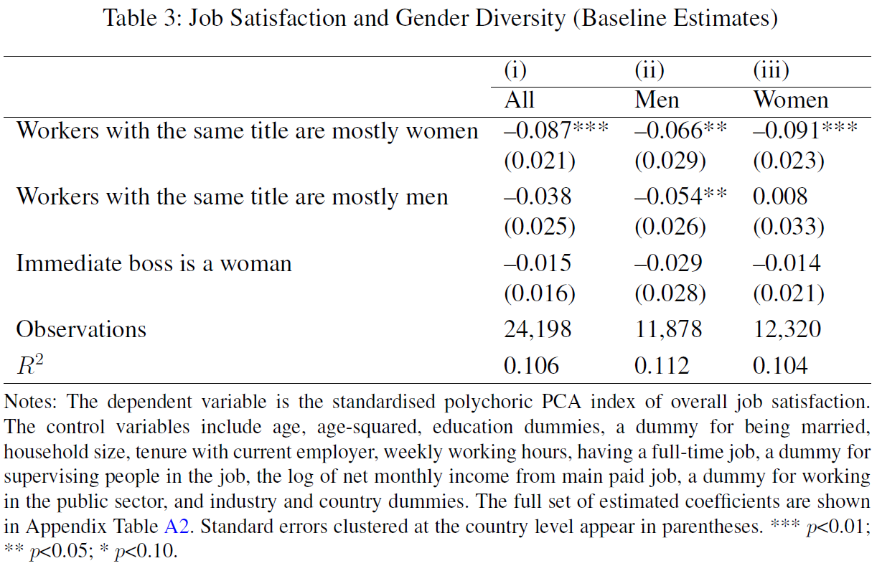
Correlate workplace gender variables with a standardised job satisfaction index (there is no overall life satisfaction question in the EWCS, unfortunately).

Slide 45
There is a preference for gender diversity amongst men.
Women have higher job satisfaction in gender-equal and male-dominated workplaces, as opposed to female-dominated workplaces.
We find only little evidence that these preferences are instrumental (as workplace gender is correlated with wages, hours of work, and working conditions).
Workers across Europe are equally happy with male and female bosses.

Slide 46
What about customer gender discrimination?
Most products are not gendered… but films are
The Bechdel test was invented in 1985 by cartoonist Alison Bechdel, as a way of measuring gender equality in film-making: to pass, movies must feature at least two named women having a conversation with each other about something or somebody other than a man.

Slide 47
ESPN blog FiveThirtyEight examined 1,615 films released between 1990 and 2013 in an effort to test the theory that female-centric movies are less likely to make money for studios. 53% pass the test.
The average gross return for a film that passed the test was $2.68 (£1.61) for each dollar spent, compared to just $2.45 (£1.47) for a film that failed the test. This was despite male-centric movies receiving higher budgets: an average of $48.4m (£29m) to just $31.7m (£19.9m) for those that passed the test.

Slide 48
Bechdel at the Box Office: Gender Inequality and Cinema Success in 58 Countries
Andrew E. Clark
Paris School of Economics - CNRS
Conchita D’Ambrosio
University of Luxembourg
Giorgia Menta
University of Luxembourg

Slide 49
Box-Office Revenue Data
Data on each film’s yearly box-office revenues, disaggregated by country, were taken from the online website of Box-Office Mojo, owned by the Internet Movie Database (IMDb), Inc.
Box Office revenue is matched to the film’s Bechdel score.

Slide 50

Screen shot from BoxOfficeMojo
We took all films in all years available in 58 different countries. A lot of copying and pasting.

Slide 51
The final dataset consists of 63,238 observations on 2,912 films, each observed in at least 2 of the 58 countries in the sample for which we observe box-office performance, and for which we have a Bechdel score.
The time span ranges from 2001 to 2016. All dollar values are in real terms.

Slide 52
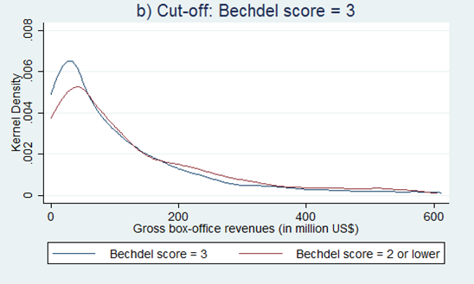
Bechdel films earn less

Slide 53
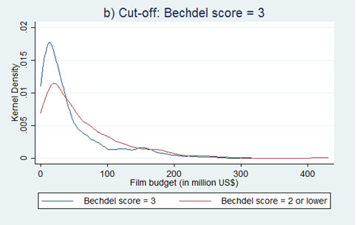
But Bechdel films also have lower budgets

Slide 54
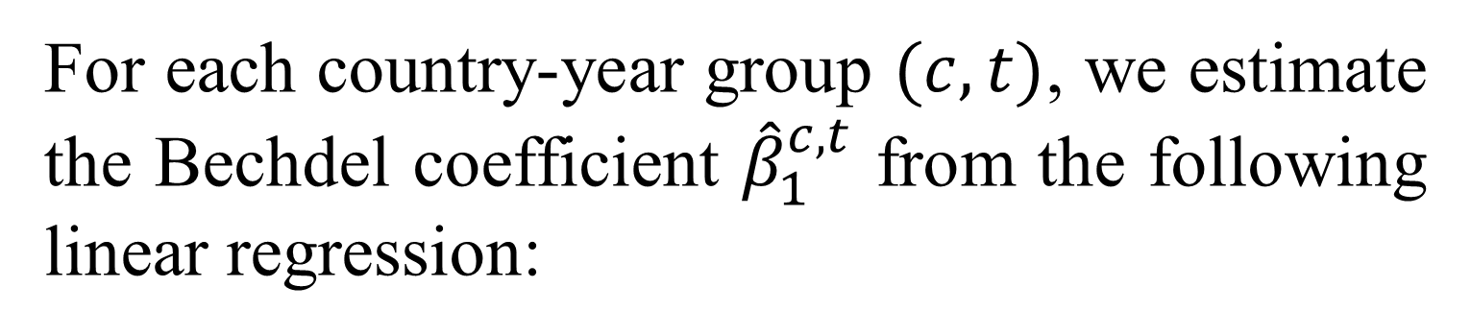
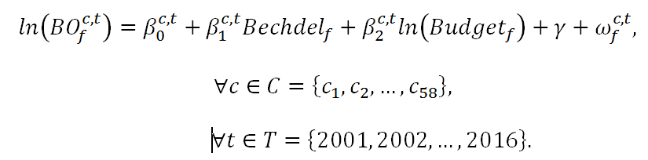
BO is the box-office revenue and γ is a set of dummies for the month of the film’s release.

Slide 55
Gender Inequality Data
Female to Male LFP ratio (between 0 and 1).
UN Gender Development Index (GDI): the ratio of female to male HDI.
UN Gender Inequality Index (GII): reproductive health, empowerment (women’s share of parliamentary seats and attainments in secondary or higher education levels) and LFP.

Slide 56
This produces a set of country-year Bechdel coefficients. We only include (c,t) cells with at least 60 observations.
We then see how these estimated coefficients are related to the Gender Inequality measures above.
We use FGLS, as the dependent Bechdel variable is an estimate.

Slide 57
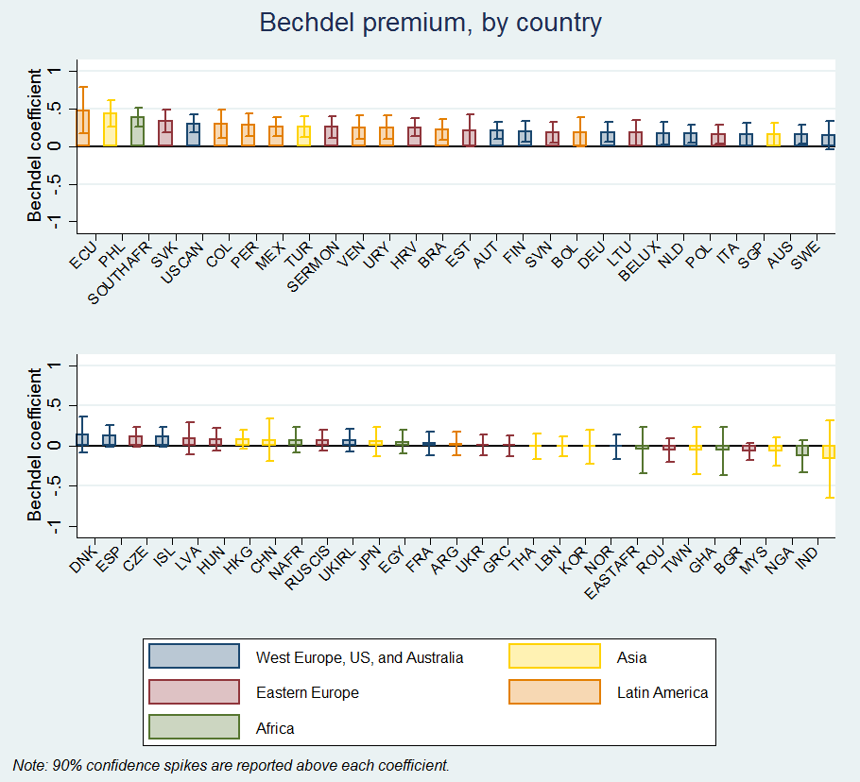
Bechdel across countries
Most countries have a positive Bechdel coefficient, and none have a significantly negative one.
Estimates are more negative in some ex-Communist countries and in the Far East (Japan, Korea, Thailand, Taiwan)

Slide 58
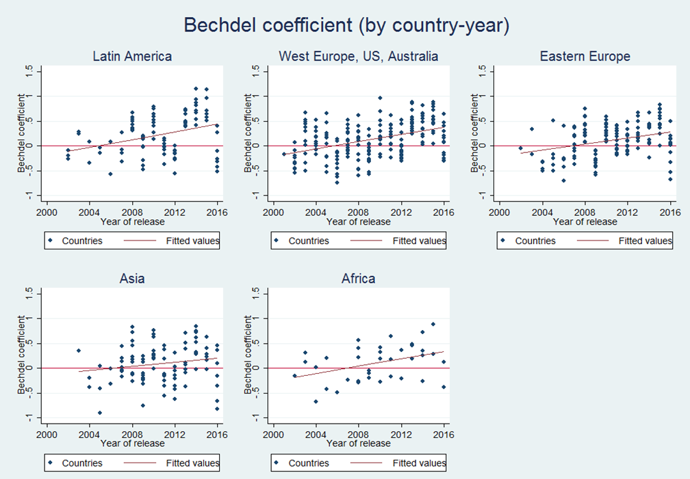
The Bechdel bonus rises over time

Slide 59
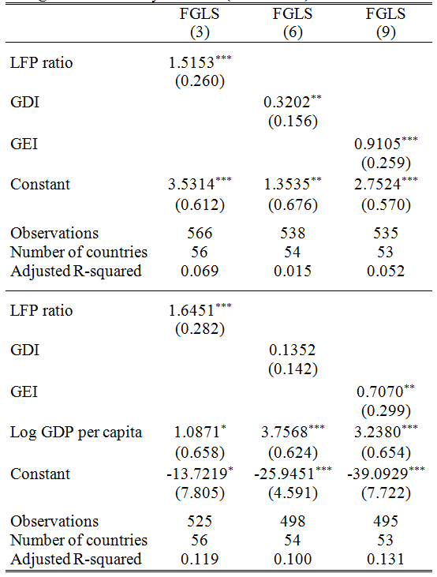
Panel. Country-years with higher Bechdel coefficients have more favourable LFP, GDI and GEI ratios

Slide 60
Other Major Theories.
Statistical Discrimination
The key here is asymmetric information
Firms make inferences about an individual worker based on average characteristics of the group to which they belong.
Here, employers believe that women are less productive than men due to lower average levels of schooling maybe: apply stock characteristics to flow individuals.

Slide 61
Four points:
Statistical Discrimination may be based on beliefs, rather than facts.
Statistical Discrimination can explain why adjustment is slow (run hot water into a cold bath).
Effect of SD should disappear over time, as firm learns each individual’s “real” productivity: a theory of new hires?
If beliefs are unfounded, women will be bid away from SD firms by other firms with better beliefs: good information will drive out bad.

Slide 62
Dual Labour Markets
There are Primary and Secondary Sectors
High wages Low wages
Secure Unstable
Good conditions Bad conditions
Women tend to be found in the secondary sector.
But why?
Efficiency wages?
Specific Human Capital?

Slide 63
A dual labour market can however arise under Occupational Crowding: some groups are explicitly excluded from certain jobs.
  If woman are excluded from “good” jobs, they will be forced into the remaining types of jobs, in which wages will consequently fall.
  These entry barriers could be due to regulations, norms, or self-selection.
USA: Married women were forbidden from teaching and office jobs from the end of the 19th Century up to the 1950s.
The Netherlands: Married women were excluded from public-sector jobs from 1937 to 1957. Many large companies followed the same rule, and laid off women as soon as they married or became pregnant.
Notes:
63
Objectif de ce genre de mesure : réduire la pression sur le marché du travail des hommes dans des périodes de pénurie d’emploi.

Slide 64
Marriage
Specialisation within the couple. Gains from trade. Which just so happens to be men in the labour market, and women in domestic tasks.
Certainly matches observed tendencies in employment rates and hours of domestic work per week (F=28, M=14 in France).
UK Figures
Work Housework
M 45 5
F 30 19

Slide 65
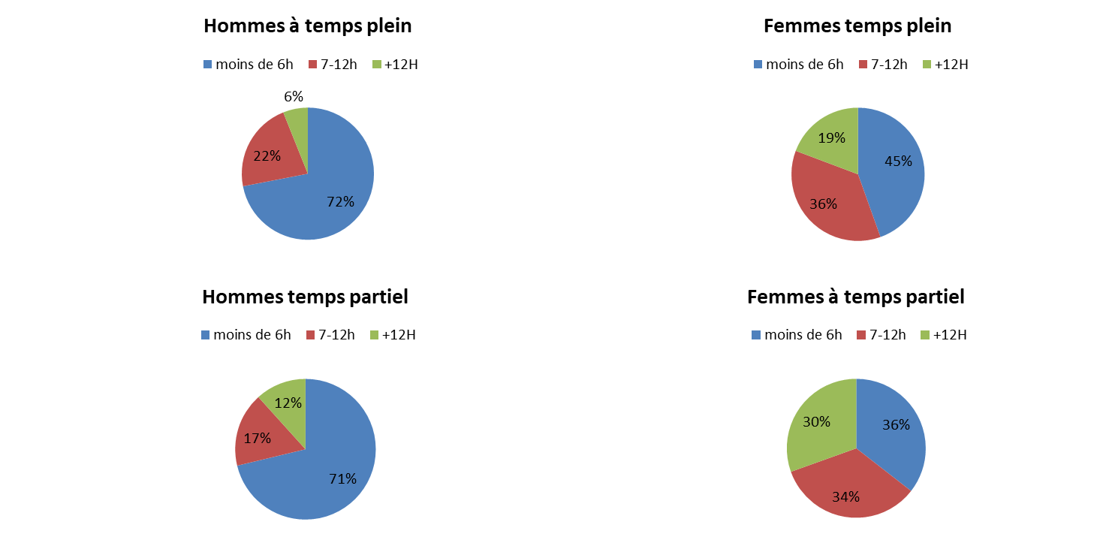
The distribution of housework in France

Slide 66
This matters because it probably leads to career interruptions for women, and the associated loss of human capital. All labour-market interruptions reduce earnings
One year of unemployment reduces wages by 5% (M) and 4% (F);
One year of inactivity reduces wages by 6% (M) and 2% (F).
The β is smaller for F than for M, but the incidence is far higher, which can explain women’s lower wages (w = β’X, remember).

Slide 67
Personnel Economics
There are good jobs (A) and bad jobs (B). The distribution of ability is the same for Men and Women. (otherwise this would be a boring theory). There are two time periods.
Bad (non-investment) job for an individual with ability of δ. This produces the following outputs at times 1 and 2:
q₁^{B} = δ
q₂^{B} = δ
Good (investment) job.
q₁^{A} = γ₁δ
q₂^{A} = γ₂δ

Slide 68
There is learning in job A. We have:
γ₁< 1 < γ₂ (this is the investment)
γ₁+ γ₂ > 2 (such that investment is worthwhile)
All workers work in period 1; will they do so in period 2?
The value of time in period 2 is a random variable ω, with (key assumption):
F_{m}(ω) > F_{f}(ω) (distribution for F stochastically dominates that for M: F cdf is to the right)
Women have better non-job opportunities in period 2 (and thus are more likely not to work).

Slide 69
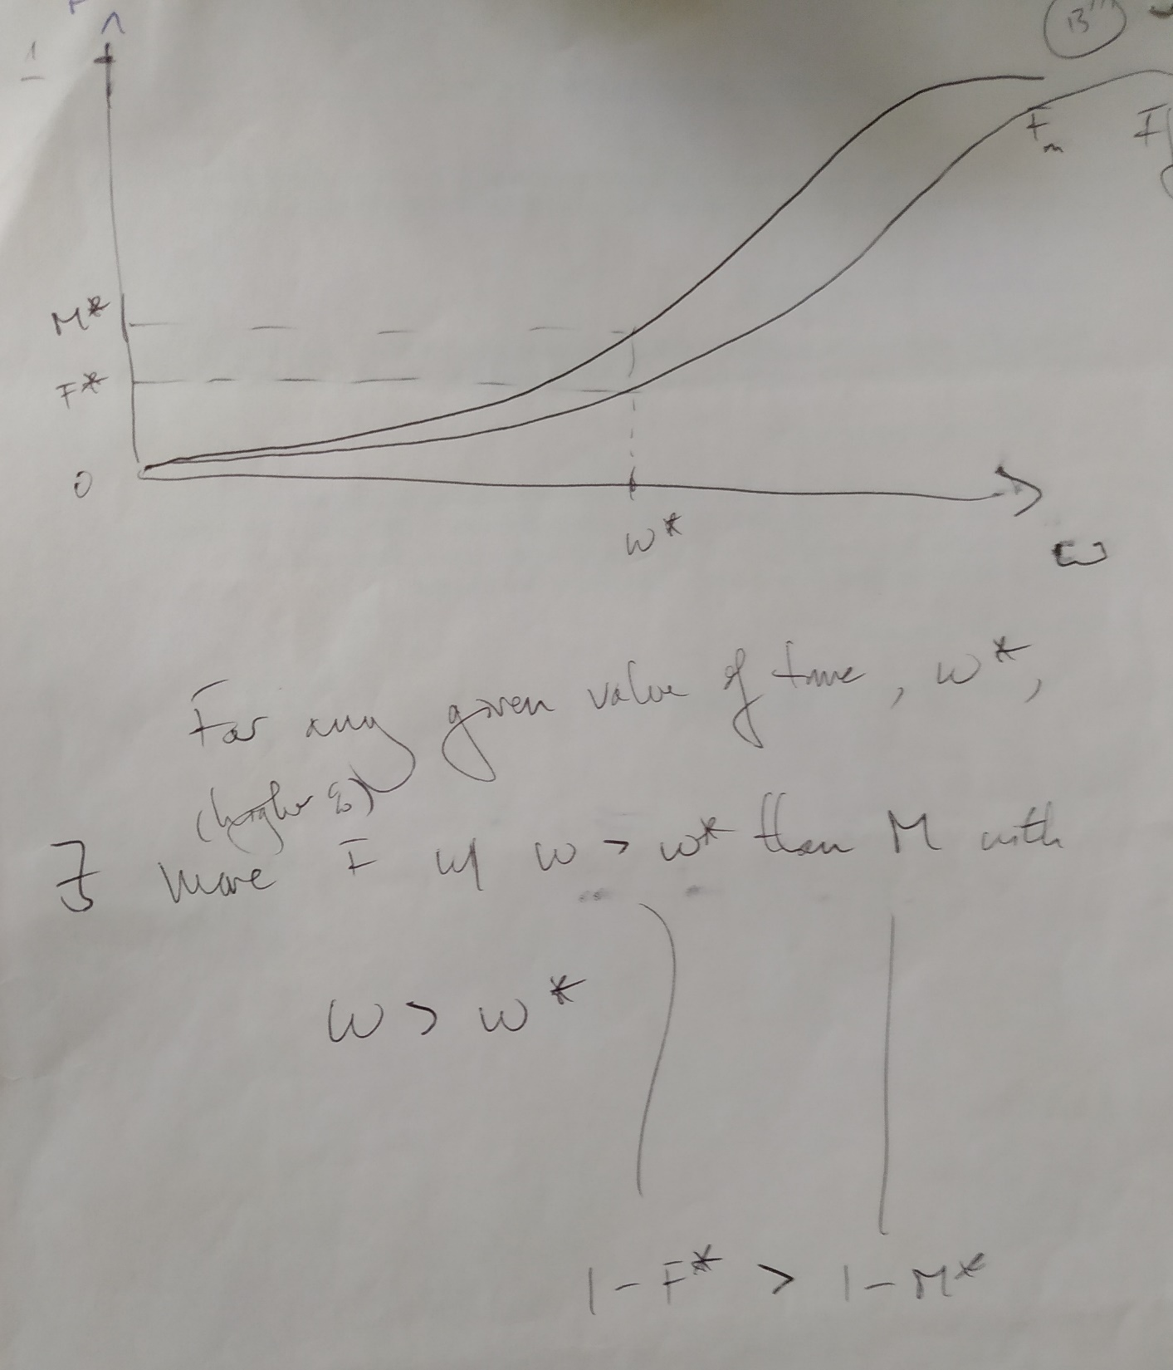

Slide 70

Which jobs do workers prefer?
A worker in job B has expected output of:
They will definitely receive δ in period 1.
In period 2, if the value of time “at home” ω they draw is lower than δ, they will go to work (and produce δ); if it is higher than δ then they do not work (and receive ω).

Slide 71

Which jobs do workers prefer?
There is an analogous calculation in the investment job, A, with expected output of:
They will definitely receive δγ₁ in period 1.
In period 2, if the value of time “at home” ω they draw is lower than δγ₂, they will go to work (and produce δγ₂); if it is higher than δγ₂ then they do not work (and receive ω).

Slide 72

Which jobs do workers prefer?
Worker choice depends on the comparison of the returns from jobs A and B.
The difference in the expected return (the advantage of job A) is given by D(δ):
D(δ) has the form below.

Slide 73
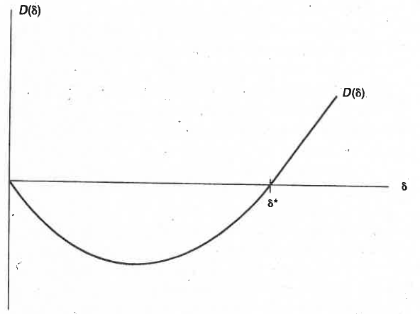
D(δ) starts at zero, because if
you have productivity of
zero it doesn’t matter which
job you take.
As δ rises:
The first period disadvantage of job A rises
The second period advantage of job A rises
The probability that you work in the second period rises
Unsurprisingly, low δ’s (δ < δ*) are better off in non-investment jobs, high δ’s are better off in investment jobs (sorting by ability).

Slide 74
So far, so unsurprising. The key result of this piece of analysis is that the D(δ) function, which determines δ*, depends on F(ω). This latter is not the same for men and women, and Lazear shows that δ_{F}* > δ_{M}*: the cut-off ability point to take the investment job is higher for women (because there is a greater chance that they won’t be in employment in period 2).
As a result, the average ability of women in investment jobs will be greater than the average ability of men in the same job (selection is more rigorous for the former). And the average ability of women in non-investment jobs will be higher as well…
Women are penalised by “better” outside options.

Slide 75
The quality cut-off for the investment job is higher for women than for men.
Given five individuals with productivity of (1, 2, 3, 4, 5), say that the threshold is four for men to take the good job
1 2 3 4 5
But for women it is five
1 2 3 4 5
Average productivity in bad job for M and F is (2, 2.5); in the good job it is (4.5, 5)

Slide 76
Note that this is not a theory of discrimination by the firm
The firm is neutral here
The only variable it could change would be the return to investment: γ₂ - γ₁
A flatter wage profile would reduce the M-F difference, but lead to fewer people becoming educated

Slide 77
Signalling
This builds on statistical discrimination.
Real productivity of a worker i, q_{i}, is unobservable.
But we observe a signal s_{i}^{j} for this worker i (who is in group j – here the groups are men and women):
s_{i}^{j} = q_{i} + ε_{i}^{j}, where q and ε are independent of each other.
Both q and ε are random variables:
ε_{i}^{j} ~ N(0, σ²_{εj}) – a productivity draw with zero mean but group-specific standard deviation
q_{i} ~ N(α, σ²_{q}) - The distribution of ability (q) is the same for men and women
Women’s productivity signals are considered to be less precise (as they are interpreted by men?): σ²_{εF} > σ²_{εM}

Slide 78
Wage = expected productivity. It can be shown using Bayes’ Rule (Phelps, 1972) that the employer’s best estimate of productivity is as follows:
w_{i}^{j} = E(q_{i} | s_{i}^{j}) = (1-ρ²_{j})α + ρ²_{j}s_{i}^{j}
The key parameter here is ρ_{j}: the correlation coefficient between q and the signal s_{i}^{j}.
ρ²_{j} = σ²_{q}/(σ²_{q} + σ²_{εj})
Implications:
If there is no correlation between the signal and productivity then everyone paid at average productivity of α.
Perfect signal implies that individuals are paid at their own productivity signal of q_{i} = s_{i}^{j}.

Slide 79
What about sex differences?
We have ρ²_{F} < ρ²_{M}
Then women with a positive signal (of s_{i}^{j} > α) receive less than a man with the same signal (because believe woman’s signal less).
BUT ALSO:
Women with a negative signal (of s_{i}^{j} < α) receive more than a man with the same signal (ditto).
There is no difference in average wages by sex (average wages are α) – can’t predict average wage discrimination. But the slope in ability is flatter for women.
Lundberg and Startz add human capital to Phelps’ model. This is chosen by workers. Costs the same M/F, but less well-rewarded for F (because put less weight on signal), therefore they’ll choose less of it in equilibrium). This produces average wage differences (the α’s are no longer the same).

Slide 80
Do we know that ρ²_{F} < ρ²_{M}?
Place, Todd, Penke, and Asendorpf, “The Ability to Judge the Romantic Interest of Others”, Psychological Science, Jan. 2009, Vol. 20 Issue 1, p22-26
Test this ability using 3min videos of individuals on speed dates: at the end of the real speed date, individuals wrote down whether they were interested in seeing the other person again.
Can an outside observer predict that romantic interest?
Participants watched shortened video clips that were either 10s or 30s long and came from the beginning, middle, or end of the date.
Observers predicted interest successfully using stimuli as short as 10s, and they performed best when watching clips of the middle or end of the speed date.
There was considerable variability between daters, with some being very easy to read and others apparently masking their true intentions.
Male and female observers were equally good at predicting interest levels.
Both sexes they were more accurate when predicting male interest: Predictions of female interest were just above chance.

Slide 81
Do outcomes reflect preferences?
Niederle and Vesterlund, QJE, 2007
I’m not going to argue that women have a preference for lower pay…. but are they less competitive, so that they prefer piece rates over tournaments?
Four explanations of women entering tournaments less
F don’t like to compete
M are overconfident
F are more risk-averse
M are less-averse to feedback

Slide 82
Tackled experimentally:
A real Maths task, under both piece rates and tournaments. Add up five two-digit numbers
Answer filled in on computer screen.
Individuals told whether they’re right or wrong, and then go on to a new problem.
Running sum of scores (correct and incorrect) displayed on screen.
Five minutes to solve as many problems as possible.
No calculators!

Slide 83
NB. There are no gender differences in Maths ability scores in the US.
Individuals play in rows of four: 2M and 2F.
Told that they are playing with other row members.
Two or three of these rows per experiment.
20 row groups in the experiment (thus 80 people)
4 tasks per experiment; one randomly-drawn one is paid.
$5 show-up fee
$7 completion fee.
The task in one of the four following payment schemes is randomly drawn for task payment.

Slide 84
Payment Schemes:
Piece rate of 50 cents per correct answer.
Tournament. Each individual per row who gets the most correct answers receives $2 per correct answer
Choice between 1) and 2).
If individuals choose the tournament then their task 3 score is compared to others’ scores in task 2 (so that there is no externality on others from choosing the tournament – avoids altruism issues).
4) Choice of payment scheme for results from 1): piece rate or tournament (no actual performance of task here).

Slide 85
Confidence:
Individuals are also asked how well they think they did in tasks 1) and 2). Guess their rank from 1 to 4. Paid $1 for each correct answer.
Experiment lasts 45 mins on average, with average earnings of almost $20.
Results
As in the national figures, there are no sex differences in number of correct answers in tasks 1 and 2 (where there is no choice over the compensation scheme.
Average no. of problems solved correctly in task 1 is 10.5, and 12 in task 2 (tournaments work!).
There is equally no difference in the sex of the winners in task 2: 11M and 9F.

Slide 87
When they have the choice (in task 3), there is a substantial sex difference in the percentage of respondents who choose the tournament:
F 35%
M 73%
Despite there being no sex difference in actual performance.
Explanations
Risk-aversion
Consider those with 14 correct answers in task 2. If they produce the same performance in task 3, they have a 47% chance of winning (looking at the distribution of number of correct answers).

Slide 88
Expected value of tournament is 0.47*$2*14 = $13.16
Value of piece rate (sure thing) is $0.50*14 = $7
Of those with 14+ correct answers in Table 2, 8/12 F and 3/12 M refuse this gamble (or better).
Same thing for those with fewer than 12 correct answers. P(win)=5.6%.
EV of tournament is 0.056*11*$2 = $1.23
Value of piece rate is 11*$0.50 = $5.50
Of those with 11 or fewer correct answers in Table 2, 11/18M and 5/17F accept this gamble (or worse).

Slide 89
Too many high-performing women refuse tournaments… and too many low-performing men accept them.
Women would have to be exceptionally risk-averse and men exceptionally risk-loving

Slide 90
2) Over-confidence
Both Men and Women are overconfident (in that they predict that their rank will be higher than it actually turns out to be).
75% of men predict rank 1.
43% of women predict rank 1.
This explains part of the difference in tournament entry.
3) Taste for competition
Look at choices in Task 4, where tournament choice does not involve a competitive performance. Even here, men choose tournaments more than do women.
Remainder of difference suggested to result from risk aversion, feedback aversion, or some other preferences.

Slide 91
My notes on this work.
This does assume that men and women are free to choose their compensation scheme. When they aren’t (piece rate in task 1; tournament in task 2), men and women do just as well as each other.
Even when there is sorting, and men way more likely to choose tournaments, unclear that women end up earning less (women don’t enter tournaments when they should…but men enter tournaments when they shouldn’t).

Slide 92

Testing for discrimination: is it really that easy?
17% d'écart de salaire
100% d'inégalités

Slide 93
Testing for discrimination
Men and women differ in many ways: this calls for multivariate regression analysis.
Simple approach. There is a fixed wage premium for being male. Estimate:
Ln w_{i} = A + β’X_{i} + γF_{i} + ε_{i}
Test of discrimination: estimated value of γ < 0.
B) The value of β may not the same for men and women: observable characteristics differently rewarded.
“the prices paid by employers for given productive characteristics are systematically different for different demographic groups”

Slide 94
We then estimate:
Ln w_{i} = A_{i} + β_{i}’X_{i} + ε_{i}
The average difference between men’s and women’s wages is:
Ln w_{M} – ln w_{F} = A_{M} - A_{F} + (β_{M}’X_{M} - β_{F}’X_{F})
= A_{M} - A_{F} + (β_{M} - β_{F})’X_{M} + β_{F}’(X_{M} - X_{F})
Three sources of pay differences:
Differences in pay with same X and β: (A_{M} - A_{F})
Different rewards to characteristics: (β_{M} - β_{F})
Different characteristics: (X_{M} - X_{F})
This is known as the Oaxaca or Blinder decomposition

Slide 95
What variables do we put in X?
Standard stuff: age, education, occupation, region, hours, experience etc.
These are all observable. The X’s explain a fair amount of the raw wage difference.
USA 1988 France 2000
Raw w_{F} /w_{M} = 0.72 0.75
w_{F} /w_{M} | X = 0.88 0.88
Labour-market experience is an important variable.
Is the rest discrimination? How do we know whether we’ve measured all of the relevant RHS variables?
Panel data no use in cleaning these out as male/female fixed over time.
Unobserved higher skill or discrimination?

Slide 96
Other things to know
1) Much regression analysis holds different X’s constant when looking at the partial correlation between women and earnings.
But these X’s can themselves be the results of discrimination
Human-capital decisions will be taken as a function of the wages on offer, or of the wage profile.
If women expect their education to be less-well rewarded, they will invest less in education

Slide 97
2) What do men and women say about their jobs?
In Anglo-Saxon countries at least, women seem to report higher levels of job satisfaction than do men.
Most of the observable characteristics of jobs are less good for women than men.
So there must be an unobservable in the other direction.
This could be some measure of job quality that doesn’t appear in surveys.
Or it could be a relative-utility term, whereby outcomes are evaluated relative to expectations, and women have lower expectations [U = U(y, y*)].
Increasing women’s job quality may therefore bizarrely reduce their job satisfaction (if effect on expectations greater than the effect on outcomes). We see a shrinking job-satisfaction gap in the BHPS over time.

Slide 98
We mostly don’t know much about expectations, although they would seem important.
Schwandt (2014) uses direct information on well-being aspirations in SOEP data by asking individuals how satisfied they think that they will be with their life in five years’ time. This is compared to the satisfaction that the individuals then actually report in this panel survey five years later.
Forecast error = E_{t}(Sf_{t+5}) - Sf_{t+5}
Individual predictions are systematically wrong.

Slide 99
Errors in particular move from an overprediction of satisfaction when young to an underprediction when older
Could this explain the “satisfaction smile”?

Slide 100
Expectations may also explain the small or zero effect of education on happiness.
Clark, Kamesaka and Teruyuki (2015): education is associated with greater happiness but also higher happiness aspirations (higher aspirations act as a deflator).
If education raises aspirations faster than outcomes, it will be negatively correlated with subjective well-being.

Slide 101
3) Differences in the mean level, or the variance?
One way in which men and women differ is in their chromosomes.
M = XY
F = XX
The genes for intellectual function are located on the X chromosome
Any recessive allele will be expressed much more frequently amongst men than amongst women: at the allele frequency for men, but at the allele frequency squared for women.

Slide 102
Take colour-blindness (red-green), as discussed by the British Physicist and Chemist John Dalton.
RG colour blindness is caused by the lack of the R or G visual pigment gene on the X chromosome (Dalton lacked the G gene). The allelic frequency is somewhere around 7% (differs across populations)
On average 7%-8% of men are RG colour blind, but only 0.5% (= 7% of 7%) of women.

Slide 103
There is no average difference in intellectual ability by sex.
But if ability is genetically-determined, the variance of men’s ability might be larger. In this case, there would be more men than women at both ends of the ability distribution.
This could help explain average wages if the returns to ability are non-linear

Slide 104
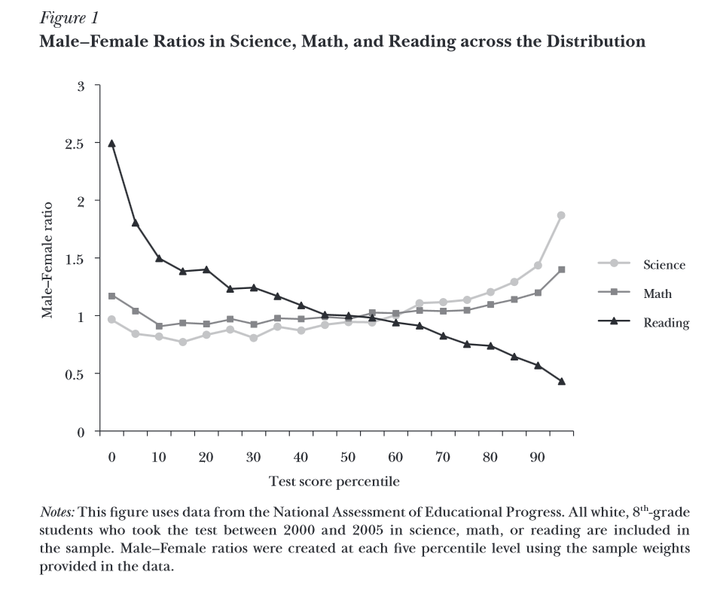
There are sometimes more men than women at the tails of the ability distribution (Pope and Sydnor, JEP, 2010).

Slide 105
Johnson, W., Carothers, A., and Deary, I. (2009). "A Role for the X Chromosome in Sex Differences
in Variability in General Intelligence?". Perspectives on Psychological Science, 4, 598-611.

Slide 106
Experiments on Discrimination
Econometrics is difficult to do properly. Turn to natural experiments.
Goldin and Rouse, AER, (2000).
Make hiring sex-blind….literally.
Symphony orchestras. Candidates audition in front of conductor and other orchestra members.
Prior to 1970, identity of candidate known.
In the 1970s and 1980s blind auditions were adopted: candidates play behind a screen.

Slide 107
Pre-1970: 10% of new hires were women;
1990s: 35% of new hires were women.
Part of this reflects rising female labour supply.
But Econometric analysis suggests that 1/3 of the rise was due to the “sex-blind” screen (i.e. women were only offered just over half of the jobs that they should have been offered on the basis of ability alone).

Slide 108
Audit or correspondence methods
Audit methods involves face-to face interaction
Like sending black then white individuals to ask about renting a flat.
Or seeing what prices different people are charged for drinks in New Orleans bars.
The correspondence method involves no face-to-face interaction (CVs of fictitious individuals).

Slide 109
Bertrand and Mullainathan, AER, (2004).
The effect of race on hiring
Correspondence method
Résumés sent in response to help-wanted ads in Chicago and Boston newspapers. Some CVs of higher quality (qualifications) than others. Four CVs sent in response to each advertisement.
They responded to 1300 ads and sent around 5000 CVs. Randomly assign a non-White sounding name to one of the low-quality and one of the high-quality CVs.

Slide 110
There are then two white and two non-white names in each batch of CVs.
Something like: Emily, Greg, Lakisha, Jamal.
White names receive 50% more interview offers (White-name CVs need to send 10 CVs to get a callback; non-White name CVs need to send 15).
Higher quality CV increases callback rate by 30% for Whites, but by less for non-Whites.
The discrimination gap in hiring rises with education.

Slide 111
These methods have also been used to evaluate discrimination in the labour market with respect to:
Gender (Petit and Duguet, Annales d'Economie et de Statistique, 2005).
Homosexuality: sexual orientation signaled by experience in a gay campus organization (Drydakis, 2015a; Tilcsik, 2011), participation in a gay or lesbian organization (Patacchini et al., 2015; Drydakis, 2009; 2011; 2014), or the gender of the applicant’s spouse (Ahmed et al., 2013).
Obesity (Rooth, Journal of Human Resources, 2009).

Slide 112
Firms that Discriminate are More Likely to Go Bust
Pager, D., Western, B. and Bonikowski, B. “Are Business Firms that Discriminate More Likely to Go Out of Business?”, Sociological Science.
2004 Audit study on discrimination in New York using job applicants with similar resumes but different races.
Find significant discrimination in callbacks.
What had happened to those firms by 2010?
36% of the firms that discriminated failed but only 17% of the non-discriminatory firms failed.

Slide 113
Bear in Mind…
Theories of discrimination have to explain both the cross-section finding (women earn less than men), and any time-series trend in outcomes.

Slide 114
References
Akerlof, G.A. (1976). "The Economics of Caste and of the Rat Race and Other Woeful Tales". Quarterly Journal of Economics, 90, 599-617.
Becker, G.S. (1957). The Economics of Discrimination . Chicago: University of Chicago Press.
Ben Yahmed, S. (2017), “Gender wage discrimination and trade openness. Prejudiced employers in an open industry”, ZEW Discussion Paper No. 17-047.
Bertrand, M., Chugh, D., & Mullainathan, S. (2005). "Implicit Discrimination". American Economic Review, 95, 94-98.
Bertrand, M., and Mullainathan, S. (2004). "Are Emily and Greg More Employable Than Lakisha and Jamal? A Field Experiment on Labor Market Discrimination". American Economic Review, 94, 991-1013.
Clark, A.E. (1997), “Job Satisfaction and Gender: Why are Women so Happy at Work?”, Labour Economics, 4(4), pp.341-372.
Clark, A.E., D'Ambrosio, C., and Zhu, R. (2021). "Job Quality and Workplace Gender Diversity in Europe". Journal of Economic Behavior and Organization, 183, 420-432.
Clark, A.E., Kamesaka, A., and Tamura, T. (2015). "Rising Aspirations Dampen Satisfaction". Education Economics, 23, 515-531.
Conseil d’Analyse Economique (1999), Egalité entre femmes et hommes : aspects économiques, La Documentation Française,.
Croson, R., and Gneezy, U. (2009). "Gender Differences in Preferences". Journal of Economic Literature, 47, 448-474.

Slide 115
Economic Policy Institute. State of Working America Wages 2019 (https://www.epi.org/publication/swa-wages-2019/).
Goldin, C. (2014). "A Grand Gender Convergence: Its Last Chapter". American Economic Review, 104, 1091-1119.
Goldin, C., and Rouse, C. (2000). "Orchestrating Impartiality: The Impact of "Blind" Auditions on Female Musicians". American Economic Review, 90, 715-741.
Hellerstein, J., Neumark, D., and Troske, K. (2002). "Market Forces and Sex Discrimination". Journal of Human Resources, 37, 353-380.
Johnson, W., Carothers, A., and Deary, I. (2009). "A Role for the X Chromosome in Sex Differences in Variability in General Intelligence?". Perspectives on Psychological Science, 4, 598-611.
Laroque, G. & Salanié, B. (2003), Institutions et emploi : les femmes et le marché du travail en France, Economica.
Lazear, E. & Rosen, S. (1990), “Male-Female Wage Differentials in Job Ladders”, Journal of Labor Economics 8(1), pp.S106-S123.
Lundberg, S. & Startz, R. (1983), “Private Discrimination and Social Intervention in Competitive Labor Markets”, American Economic Review, 73(3), pp.340-347.
Niederle, M., & Vesterlund, L. (2007). "Do Women Shy Away from Competition? Do Men Compete Too Much?". Quarterly Journal of Economics, 122, 1067-1101.
Phelps, E. (1972), “The Statistical Theory of Racism and Sexism”, American Economic Review, 62(4), pp.659-661.
Reskin, B., & Bielby, D. (2005). "A Sociological Perspective on Gender and Career Outcomes". Journal of Economic Perspectives, 19, 71-86.

Slide 116
Rosén, A. (2003), “Search, Bargaining and Employer Discrimination”, Journal of Labor Economics, 21(4), pp.807-829.
Schwandt, H. (2016). "Unmet Aspirations as an Explanation for the Age U-shape in Wellbeing". Journal of Economic Behavior and Organization, 122, 75-87.
Sousa-Poza, A., & Sousa-Poza, A.A. (2000). "Taking Another Look at the Gender/Job-Satisfaction Paradox". Kyklos, 53, 135-152.

