Slide 1

Looking for Labour-Market Rents
With Subjective Data
Andrew E. Clark
Paris School of Economics - CNRS
Subjective Survey Data in Labour Market Research
Institute for Labour Law and Industrial Relations in the European Union (IAAEU). Trier, Germany
October 7th 2016

Slide 2
I think that this is a third-generation happiness paper
The first generation asked “Who is happy?”
The second generation asked “What do happy people do?” (work on quits, productivity, children divorce, longevity etc.)
The third generation takes the estimated coefficients from subjective well-being equations to tell us something about preferences or markets.

Slide 3
Economists didn’t always take subjective well-being information very seriously.
And seemed to have a quite serious aversion to self-reported data in general.
But as Alan Blinder wrote in the 1990s: “Physicists and chemists do not ask their subjects why they behave as they do, so we shouldn’t either – or so we think. But is that a scientific attitude? If molecules could talk, would chemists refuse to listen?”

Slide 4
It so happened that Alan Blinder was talking about theories of wage stickiness at the same time [Blinder, A., Canetti, E. Lebow, D. and Rudd, J. (1998), Asking About Prices: A New Approach to Understanding Price Stickiness, Russell Sage Foundation]
But one of my mentors in the analysis of subjective well-being took it as support for self-report variables in general:

Slide 5
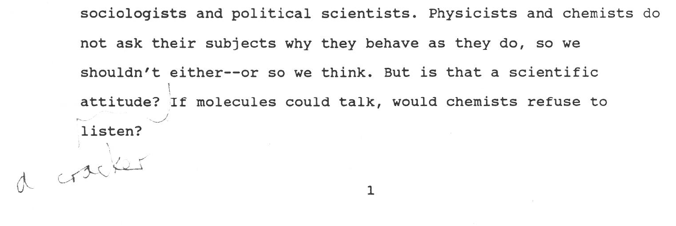
It so happened that Alan Blinder was talking about theories of wage stickiness at the same time [Blinder, A., Canetti, E. Lebow, D. and Rudd, J. (1998), Asking About Prices: A New Approach to Understanding Price Stickiness, Russell Sage Foundation]
But one of my mentors in the analysis of subjective well-being took it as support for self-report variables in general:

Slide 6
There are some issues regarding the nature of the labour market where subjective well-being data seems of great use.
Is unemployment voluntary or involuntary?
Why are some people self-employed and others employees?
What is the attraction of the public sector, and for whom?

Slide 7
The question I would like to talk about today is of the same type, and regards sectors in the labour market.
Why do some sectors of the labour market pay systematically more than do others?

Slide 8
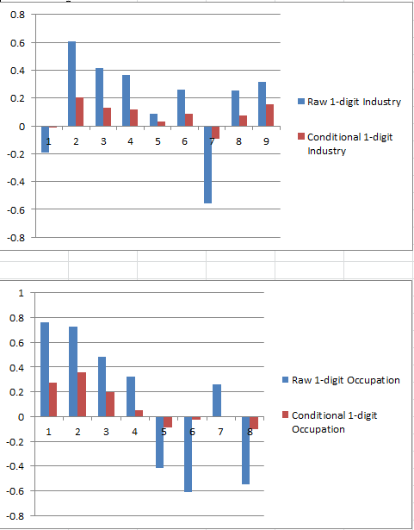
There are large industry and occupational wage differentials.
Industry (conditional):
χ²(9) = 186.8
Occupation (conditional):
χ²(8) = 604.2

Slide 9
These differences are large. Relative to the omitted industry category: -43% to +84% raw; -9% to +23% conditional.
Relative to the omitted occupation category: -45% to +114% raw; -9% to +43% conditional.

Slide 10
We can of course run wage equations, and include individual fixed effects to try to understand these sizable differences.
But job disamenities are unobserved, and we can’t difference them out (when you change industry/occupation, you change job disamenities too)
What can we do then?

Slide 11
A general principle: if one status on the labour market is better than another, then we expect it to be associated with a higher level of subjective well-being.
So do the above wage differences translate into satisfaction differences?
This is a version of the does income bring happiness debate.
But in the context of the labour market it is worth bearing in mind that there is no reason why it should if it is simply compensating for unobserved job disamenities.

Slide 12
We wonder whether the substantial wage differences represent rents or compensating differentials:
- Are high-wage jobs “better” than low-wage jobs?
I use eleven waves of British Household Panel Survey (BHPS) data
Method: Two stages.
Estimate wage and job satisfaction regressions
Correlate the estimated occupational coefficients from a wage equation with those from a utility (job satisfaction) equation.
A positive correlation implies that (inexplicably) high-wage occupations are also (inexplicably) high satisfaction occupations, which sounds like rents. Ditto for the industry coefficients.

Slide 13
Results
OCCUPATION coefficients are POSITIVELY AND SIGNIFICANTLY correlated: especially for younger workers and for men.
However, there are NO SIGNIFICANT CORRELATIONS at the INDUSTRY level.
This result holds for both level and panel first-stage regressions.
Interpretation
Occupational wage differences are partly rents; industry wage differences are not.

Slide 14
Wage and job satisfaction regressions.
The utility function of worker i in occupation o, U_{io}, is assumed to be linear in wages, job disamenities, D_{o}, and a raft of other individual and job characteristics, X_{i}:
U_{io} = λ’X_{i} + φw_{io} - γD_{io} (1)
In this utility function, the compensating differential offered by firms for D_{o} will be just enough to keep the worker on the same indifference curve: a unit of D is compensated by extra income of γ/ φ.

Slide 15
The wage of worker i in occupation o is argued, for simplicity, to depend on the same X’s as does utility in (1), compensation for the disamenities in that occupation, D_{o}, and an occupation specific rent, α_{o}:
  w_{io} = ψ’X_{i} + α_{o} + βD_{o} (2)
Note we assume worker homogeneity. From the utility function, the compensating differential for D is β=γ/φ.
Substituting for w_{io} and β in (1) yields
U_{io} = θ’X_{i} + φα_{o} (3)

Slide 16
I estimate job satisfaction and wage equations (2) and (3).
I have no information on α_{o} or D_{o}:
these are picked up by two-digit occupational and industry dummies. In the wage equation, the estimated coefficients on these dummies will pick up both rents and disamenities (α_{o} + βD_{o}); in the utility (job satisfaction) equation, the estimated coefficients will only reflect rents (φα_{o}).

Slide 17
The empirical strategy is therefore to see if the systematic differences in utility/job satisfaction across occupations are correlated with their counterparts in a standard wage equation.
Correlate: the estimate of α_{o} + βD_{o} with that of φα_{o}.
Strong correlation => the rent component of wage differentials is substantial.
Weak correlation => the rent element, α_{o}, is small.

Slide 18
Data
BHPS Waves 1 to 11.
Employees 16 to 65 only: 27 000 observations; 7000 different individuals.
[http://www.iser.essex.ac.uk/bhps]
The proxy utility measure is overall job satisfaction (which predicts quits, absenteeism, and productivity). Measured on a one to seven scale:

Slide 19
BHPS: Overall Job Satisfaction
“All things considered, how satisfied or dissatisfied are you with your present job overall”
Value Frequency Percentage
Not Satisfied at All 1 521 1.9%
2 772 2.9%
3 1966 7.3%
4 2177 8.1%
5 5718 21.3%
6 11595 43.2%
Completely Satisfied 7 4088 15.2%
‑‑‑‑‑- ‑‑‑‑‑‑--
  Total 26837 100.0%

Slide 20
Ridiculous number of other control variables in both the wage and job satisfaction regressions:
Age and Age‑squared, Male, Education Dummies, Regional Unemployment Rate, Union member, Trade Union Recognition, Temporary contract, Race dummies, Health dummies, Manager/Supervisor, Log hours, Marital status dummies, Job Tenure and Job Tenure Squared, Firm Size dummies, Renter, Promotion Opportunities, Second job, Organisation type dummies, Work time dummies, Incentive Payments, Pension Member, Region and Wave Dummies.

Slide 24
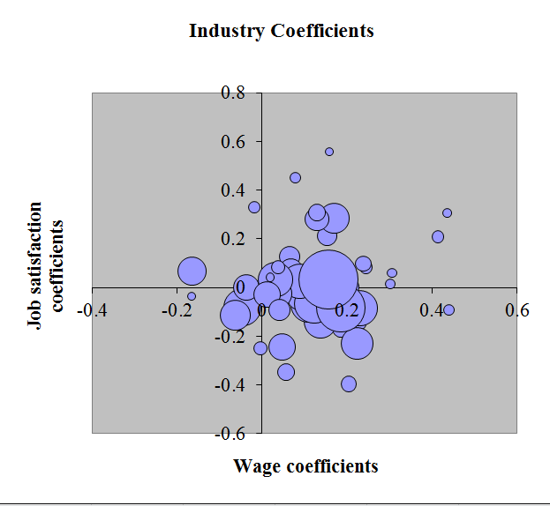
Figure 1. The Relation between Estimated Industry Coefficients in Wage and Job Satisfaction Regressions (Results for Men)

Slide 25
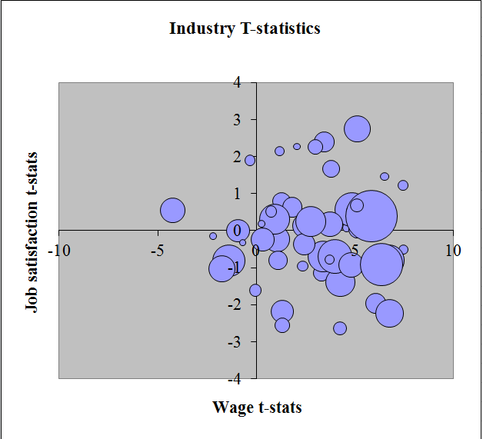
Figure 1. The Relation between Estimated Industry Coefficients in Wage and Job Satisfaction Regressions (Results for Men)

Slide 26
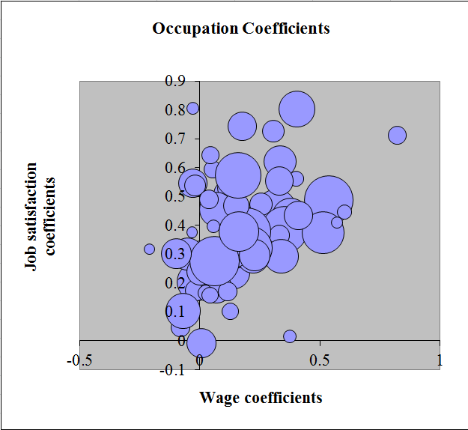
Figure 1. The Relation between Estimated Occupation Coefficients in Wage and Job Satisfaction Regressions (Results for Men)

Slide 27
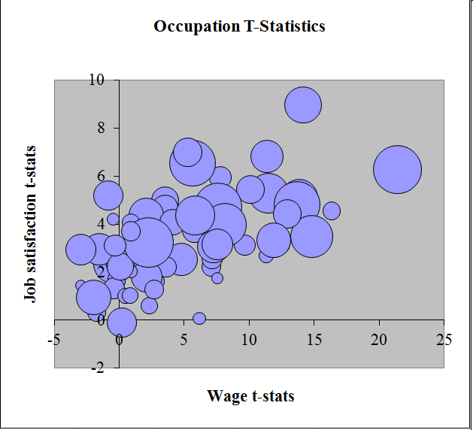
Figure 1. The Relation between Estimated Occupation Coefficients in Wage and Job Satisfaction Regressions (Results for Men)

Slide 29
Note: Bold = significant at the five per cent level; Italic = significant at the ten per cent level.

Slide 30
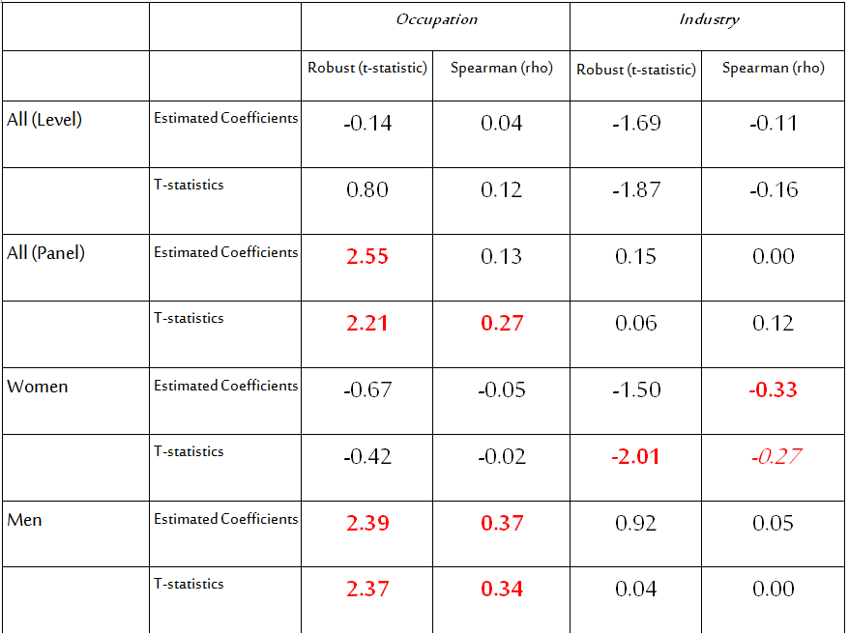
Update: Waves 12 to 18 (with SIC92 instead of SIC80)

Slide 31
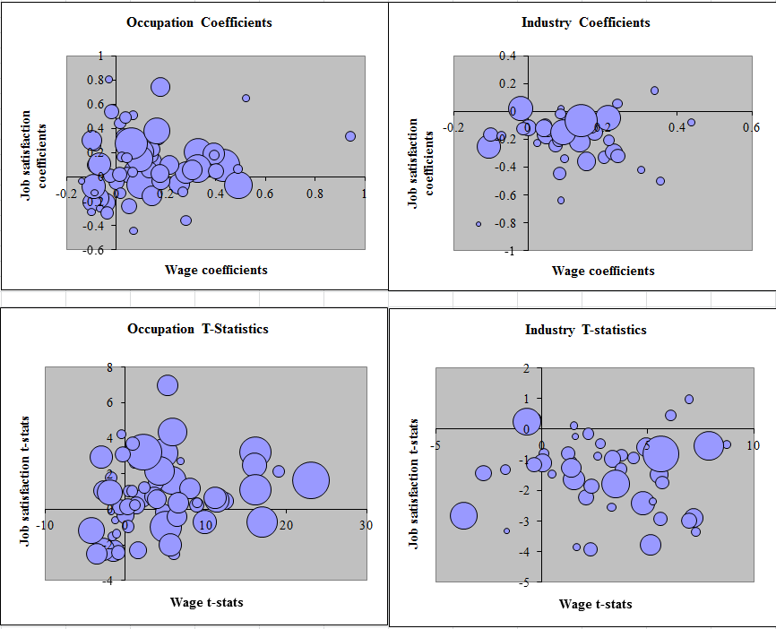

Slide 32
INTERPRETATIONS
Omitted variables (ability, unemployment rate etc)
The same results are found in both panel and level regressions
Controlling for the local unemployment rate doesn’t change anything.
Controlling for thirteen-level education doesn’t either.

Slide 33
INTERPRETATIONS
Endogenous choice of occupation/heterogeneity
Panel results are the same as level results.
If there is sorting, we’d expect higher correlations for older workers (who have already sorted): we find the opposite.
Try and control for tastes for income and hard work:
  marital status, number and ages of children, spouse’s labour force status, spouse’s income.
  Parents’ labour force status, parents’ occupation.
A number of these attract significant estimates, but the correlation between the occupation coefficients in wage and job satisfaction regressions stays the same, as does that for industry coefficients.

Slide 34
I think that the occupational differences reflect rents.....
Here’s why:
Table 3. Getting to the Good Jobs: Occupations
Use BHPS Spell data to see how individuals get to not high and high-quality jobs (as defined by negative or insignificant, and positive significant occupation dummy estimates in Table 1's job satisfaction regressions respectively).

Slide 35
Job Quality by Previous Labour Force Status
Job Quality
Not High High N
Previous LF status
Employed/self‑employed 65.2 34.8 9599
Unemployed 77.4 22.6 3564
Looking after family 70.6 29.4 1304
F‑T education 78.0 22.0 1137
Something else 69.8 30.2 1037
Total 69.4 30.6 16641
χ²(4) = 227.9

Slide 36
Why did they leave their last job?
Job Quality Δ occ Δ occ job
Not High High N wage sf
coeff*100 coeff*100
Reason last job ended
Promoted 55.4 44.6 2412 3.26 1.54
Left for better job 67.6 32.4 3238 2.08 0.76
Made redundant 74.4 25.6 644 ‑1.74 0.38
Dismissed or sacked 84.3 15.7 108 ‑0.91 ‑1.23
Temporary job ended 70.6 29.4 795 0.52 ‑0.37
Other reason 67.1 32.9 2061 ‑1.16 0.08
Total 65.3 34.7 9258 1.32 0.72
χ²(5) = 164.6

Slide 37
High-rent occupations are then reached:
* From EMPLOYMENT (no surprise).
* Via PROMOTION, rather than via voluntary mobility.
* And there is evidence of JOB-QUALITY LADDERS at the firm level.

Slide 38
Occupations that are associated with wage rents are those that are considered to be higher status (whereas those with higher explained and unexplained parts of wages are not)
RENTS AND SOCIAL STATUS

Slide 42
    Conclusion:
There are occupational rents. They aren’t competed away because firms control access to them, rather than workers.
Why do firms allow rents to exist? Perhaps to incite effort, as in tournament theory (evidence of job ladders)
Firms can only supply tournaments across occupations, not across industries. The industry wage structure then likely reflects other phenomena.

