Slide 1
Income Comparisons, the Easterlin Paradox and Public Policy
Andrew E. Clark (Paris School of Economics - CNRS)
http://www.parisschoolofeconomics.com/clark-andrew/

Slide 2
You might think that money might help us to achieve the variety of different kinds of well-being that have been put forward as important in the literature.
Being poor certainly prevents us from doing many things that we would like to do.
What does the data say?
Notes:
2

Slide 3
One of the first, and most original, researchers in this area is Dick Easterlin (University of Southern California).
He asked two questions:
Are richer individuals/countries happier than poorer individuals/countries?
As countries get richer, does everyone become happier?
We might expect the answer to these two questions to be the same.
Notes:
3

Slide 4
I here present some of the results from:
Easterlin, R. A. (2005). “Diminishing Marginal Utility of Income? Caveat Emptor”. Social Indicators Research. pp. 243-255.
This specifically deals with the case of Japan.
Japan was a relatively poor country in the 1950s/early 1960s, but then experienced unprecedented growth.
Notes:
4

Slide 5
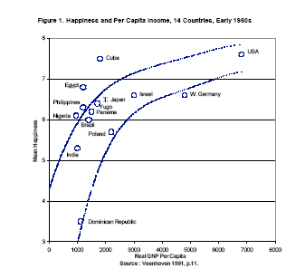
Fact 1. Richer countries are happier countries.
The blue lines show the estimated relationship between income and happiness
Japan
Japan was in the middle of the income distribution in the early 1960s, and had a middling level of happiness
Data Source: Cantril (1965).
Notes:
5

Slide 6
So what happened as Japan became richer?
Look at annual indices (1962=100) of life satisfaction and real GNP per capita for Japan, 1958-1987
Between 1962 and 1987 Japan experienced unprecedented economic growth, with GNP per capita (in real terms)rising 3.5-fold: growing from 22 to 77 percent of the United States level in 1962
We might then imagine that Japan would follow the blue lines above: as Japan became richer, it would become happier.
Notes:
6

Slide 7
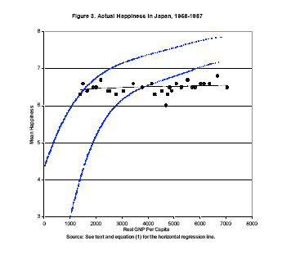
In fact, happiness remained constant despite Japan’s remarkable economic growth
What “should” have happened
What did happen
Notes:
7

Slide 8
Are the Japanese unusual in this respect?
Not necessarily: the time-series of life satisfaction over a 30-year period is flat in five European countries (World Database of Happiness, 1973-2004)
Notes:
8

Slide 9
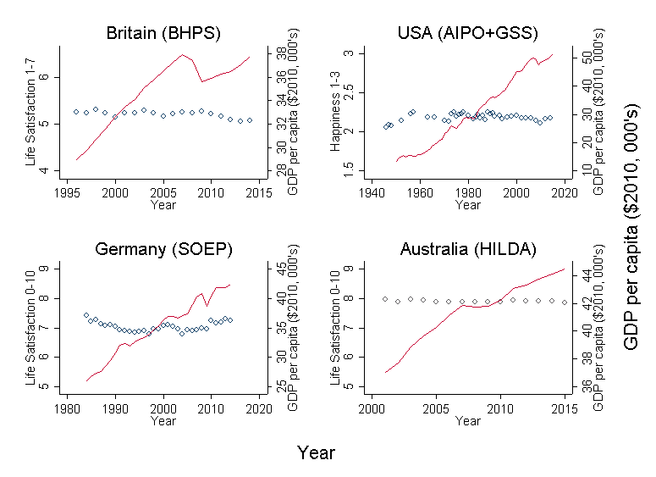
And in four of the best-known long-run surveys, despite rising GDP

Slide 10
This is the Easterlin Paradox:
Richer countries are happier at any given point in time
But as countries become richer over time they do not become happier.
The challenge to social science is to try to explain why this might come about.
Notes:
10

Slide 11
This finding has generated a considerable amount of controversy: it just MUST be wrong
One point to remember is that the Easterlin Paradox is a statement of why continuous GDP growth may not increase social welfare in the long-run.
It is not a theory of recessions not mattering: we shouldn’t be surprised if life satisfaction and the economic cycle are correlated in the short run
After all, unemployment is a robust significant indicator of individual subjective well-being
Notes:
11

Slide 12
Recent work has considered (and reconsidered) the time–series evidence suggesting that the average well-being lines over time above are “really” flat
One well-known contribution is Stevenson and Wolfers (2008)
There are issues with data comparability over time in Japan: the questions changed over time
Notes:
12

Slide 13
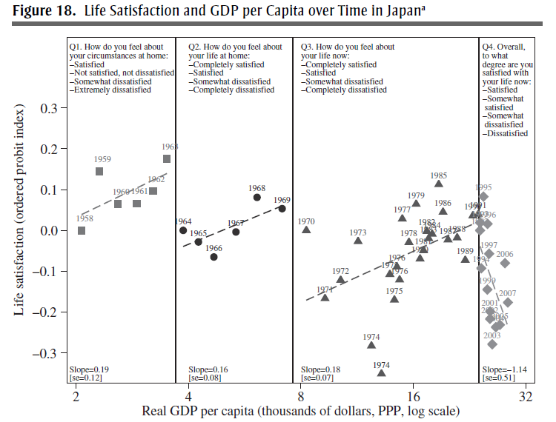
Notes:
13

Slide 14
But…
SW agree that there is no time trend in life satisfaction in the GSS data.
Although there is a positive trend in both happiness and life satisfaction in the World Values Survey.
Easterlin points out that the trend in WVS happiness scores came from a change in the way the happiness question was administered.
And one of the two positive life satisfaction slopes is entirely driven by the recovery of transition countries.
While the other relies on two data points (and so wouldn’t survive a jackknife analysis)
Notes:
14

Slide 15
It is easy to lose the will to live when reading the attacks and counter-attacks.
There are fundamental issues with the analysis of time-series happiness data.
Notes:
15

Slide 16
It is easy to lose the will to live when reading the attacks and counter-attacks.
There are fundamental issues with the analysis of time-series happiness data.
1) It is time-series happiness data. So we are making strong statements off of differences in slopes estimated using 20, or 10, or 4 observations.
Notes:
16

Slide 17
It is easy to lose the will to live when reading the attacks and counter-attacks.
There are fundamental issues with the analysis of time-series happiness data.
It is time-series happiness data. So we are making strong statements off of differences in slopes estimated using 20, or 10, or 4 observations.
There are never any control variables (age, sex, education, country of birth, urban/rural, labour force status, marital status, and so on): how much of this is a composition effect?
Notes:
17

Slide 18
It is time-series happiness data. So we are making strong statements off of differences in slopes estimated using 20, or 10, or 4 observations.
There are never any control variables (age, sex, education, country of birth, urban/rural, labour force status, marital status, and so on): how much of this is a composition effect?
There are never any macro control variables
It is easy to imagine macro “omitted variables” which may obscure the effect of income: inequality, crime, pollution etc.
Notes:
18

Slide 19
Perhaps we should stop looking at time series
We often appeal to the notion of relative utility, whereby
W = W(Y, Y*, …) to explain the Easterlin Paradox.
So let’s turn the question around: Do we have evidence for a role of some benchmark or comparison income in individual well-being?
Notes:
19

Slide 20
BROAD IDEA
A common idea across the Social Sciences: well-being or utility depends on some kind of comparison process of what you have relative to a reference level.
Comparisons can be over “things” or over money.
An example. Two people, A and B, who live next to each other, both like cars.
W_{A} = W(Car_{A},.....)
W_{B} = W(Car_{B},.....)
Where “W” is the individual’s well-being function.
Notes:
20

Slide 21
Key question: What happens to A’s well-being and behaviour if B buys a new car?
Standard economic theory: Nothing
Comparisons/relative utility: Something
If A compares her car to B’s, then we could write A’s “happiness function” as
W_{A} = W(Car_{A}, Car_{A}/Car_{B},....)
Well-being partly depends on how good my car is relative to my neighbour’s
Notes:
21

Slide 22
This might sound like a ridiculous proposition.
It isn’t, at least not in the Netherlands.
Kuhn, P., Kooreman, P., Soetevent, A., and Kapteyn, A. (2011). "The Effects of Lottery Prizes on Winners and their Neighbors: Evidence from the Dutch Postcode Lottery". American Economic Review, 101, 2226-2247.
Each week, the Dutch Postcode Lottery (PCL) randomly selects a postal code and distributes prizes to lottery participants in that code.
Notes:
22

Slide 23
There are 430 000 postcodes in the Netherlands (for 17M people). An average postcode includes around 20 households.
Tickets cost between € 6.25 and € 6.75 over the paper’s sample period.
A winning participant wins €12,500 per ticket. In addition, one participating household in the winning postcode receives a new BMW.
Households in postcodes are surveyed six months after the prize was won.
Notes:
23

Slide 24

PCL nonparticipants who live next door to winners have significantly higher levels of car consumption than other nonparticipants
(sig. levels are all relative to column 2, the non-participants in non-winning PCs)
Notes:
24

Slide 25
Applied to Income, instead of Cars:
Income and Subjective Well-Being (SWB)
Standard model: W = W(Y, ....)
Comparisons: W = W(Y, Y*, ....)
This is analogous to the car example. The variable Y* is “comparison income”: the income to which we compare/income of the reference group.
Does well-being, W, fall as reference-group income, Y*, rises?
Notes:
25

Slide 26
I mostly consider evidence here resulting from direct measurement of “W”, via job satisfaction, life satisfaction, mental stress etc.
Validated by physiological/neurological studies, third-party raters, and (most importantly) future behaviours such as divorce, unemployment duration, quitting one’s job, and morbidity and mortality.
There is nothing to stop us looking at behaviours too: I think of the analysis of behaviour and proxy measures of utility as complements, not substitutes.
Notes:
26

Slide 27
To whom do we compare?
Peer group/people like me
Others in the same household
Spouse/partner
Myself in the past
Friends
Neighbours
Work colleagues
“Expectations”
Notes:
27

Slide 28
We typically know nothing about these comparisons. Wave 3 of the European Social Survey (22 countries) helps here.
How much do people compare?
Notes:
28

Slide 29
The importance of comparisons differs widely across countries
Notes:
29

Slide 30
Income and comparison intensity are negatively correlated, both within and between countries
Notes:
30

Slide 31
We also know to whom they compare
Notes:
31

Slide 32
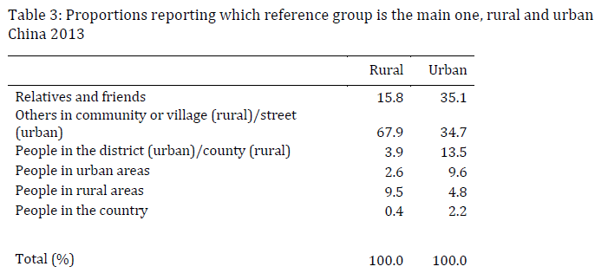
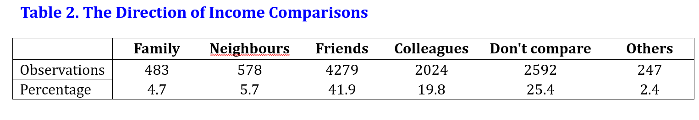
Who compares to whom in China:
and Japan:

Slide 33
In general, we do not know and impose a reference group, such as people like me, neighbours or family.
In British Household Panel Study (BHPS) data:
Job satisfaction often rises with own income
But job satisfaction falls as others’ income rises.
This holds for the income:
Of “people like you” (same characteristics, same type of job).
Of your partner.
Of other adults in the same household.
that you yourself earned in the same job one year ago.
Notes:
33

Slide 34
Clark and Oswald (1996). BHPS Data on 5000 Employees
Log income (y) -0.02 0.11 -0.001
(0.039) (0.050) (0.04)
Log comparison income (y*) --- -0.20 ---
(0.062)
Log NES comparison income (y**) --- --- -0.26
(0.073)
“Comparison Income” predicted from a Mincer Earnings equation (note: requires exclusion restrictions to avoid multicollinearity);
“NES comparison income” matched in from another data set by hours of work, and thus avoids identification problems (but assumes reference group defined by hours of work).
Notes:
34

Slide 35
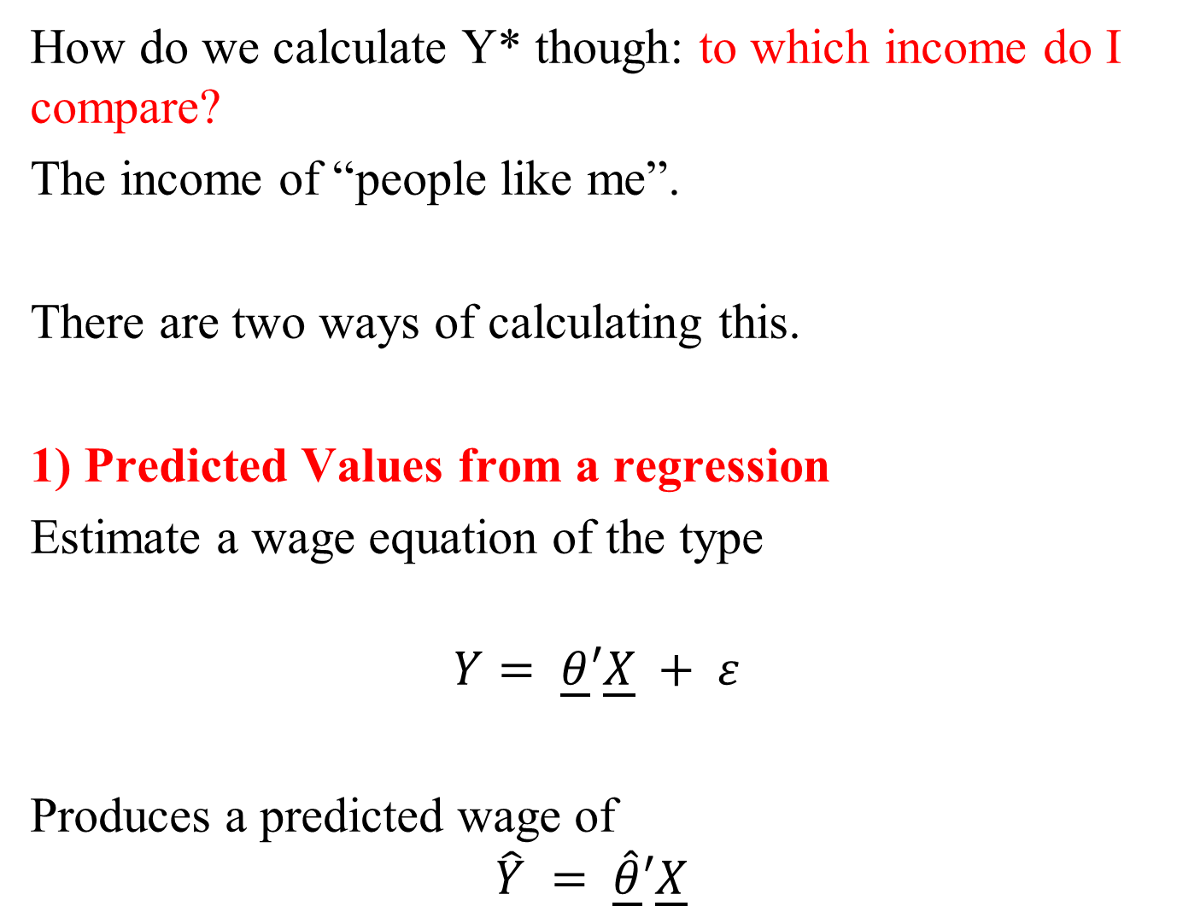
How do we calculate Y* though: to which income do I compare?
The income of “people like me”.
There are two ways of calculating this.
1) Predicted Values from a regression
Estimate a wage equation of the type
$$Y= \underline{θ}′\underline{X} + ε$$
Produces a predicted wage of
$$\hat{Y} = \hat{\underline{θ}}′\underline{X}$$
Notes:
35

Slide 36
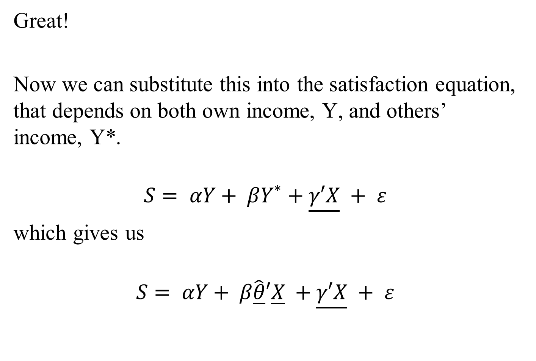
Great!
Now we can substitute this into the satisfaction equation, that depends on both own income, Y, and others’ income, Y*.
$$S= αY+ βY^{∗}+\underline{γ′X} + ε$$
which gives us
$$S= αY+ β\hat{\underline{θ}}′\underline{X} +\underline{γ′X} + ε$$
Notes:
36

Slide 37
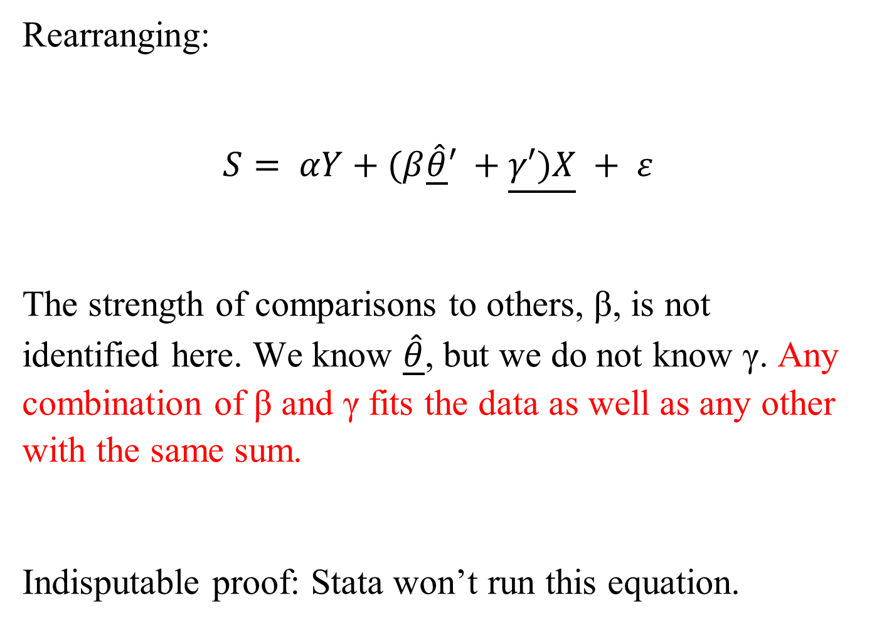
Rearranging:
$$S= αY+(β\hat{\underline{θ}}′ +\underline{γ′)X} + ε$$
The strength of comparisons to others, β, is not identified here. We know $\hat{\underline{θ}}$, but we do not know γ. Any combination of β and γ fits the data as well as any other with the same sum.
Indisputable proof: Stata won’t run this equation.
Notes:
37

Slide 38
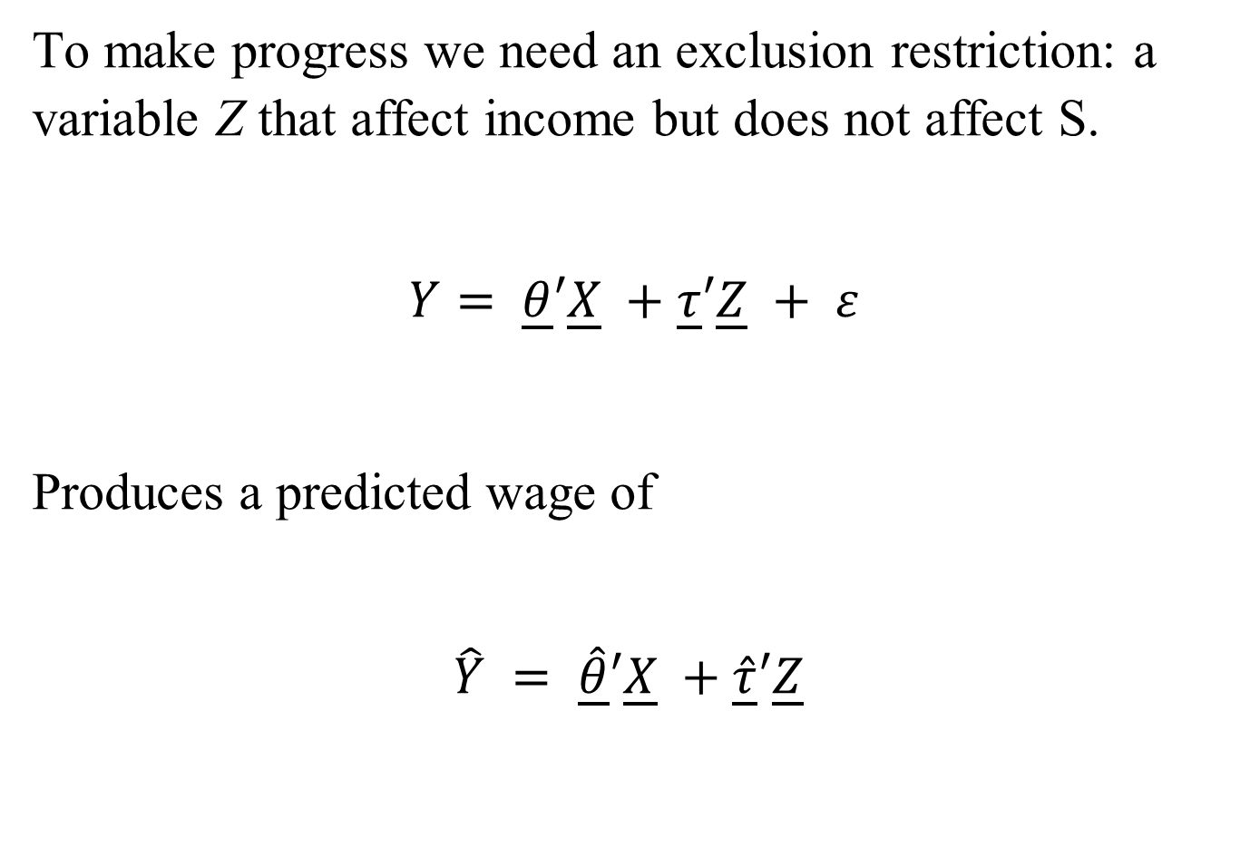
To make progress we need an exclusion restriction: a variable Z that affect income but does not affect S.
$$Y= \underline{θ}′\underline{X} +\underline{τ}′\underline{Z} + ε$$
Produces a predicted wage of
$$\hat{Y} = \hat{\underline{θ}}′\underline{X} +\hat{\underline{τ}}′\underline{Z}$$
Notes:
38

Slide 39
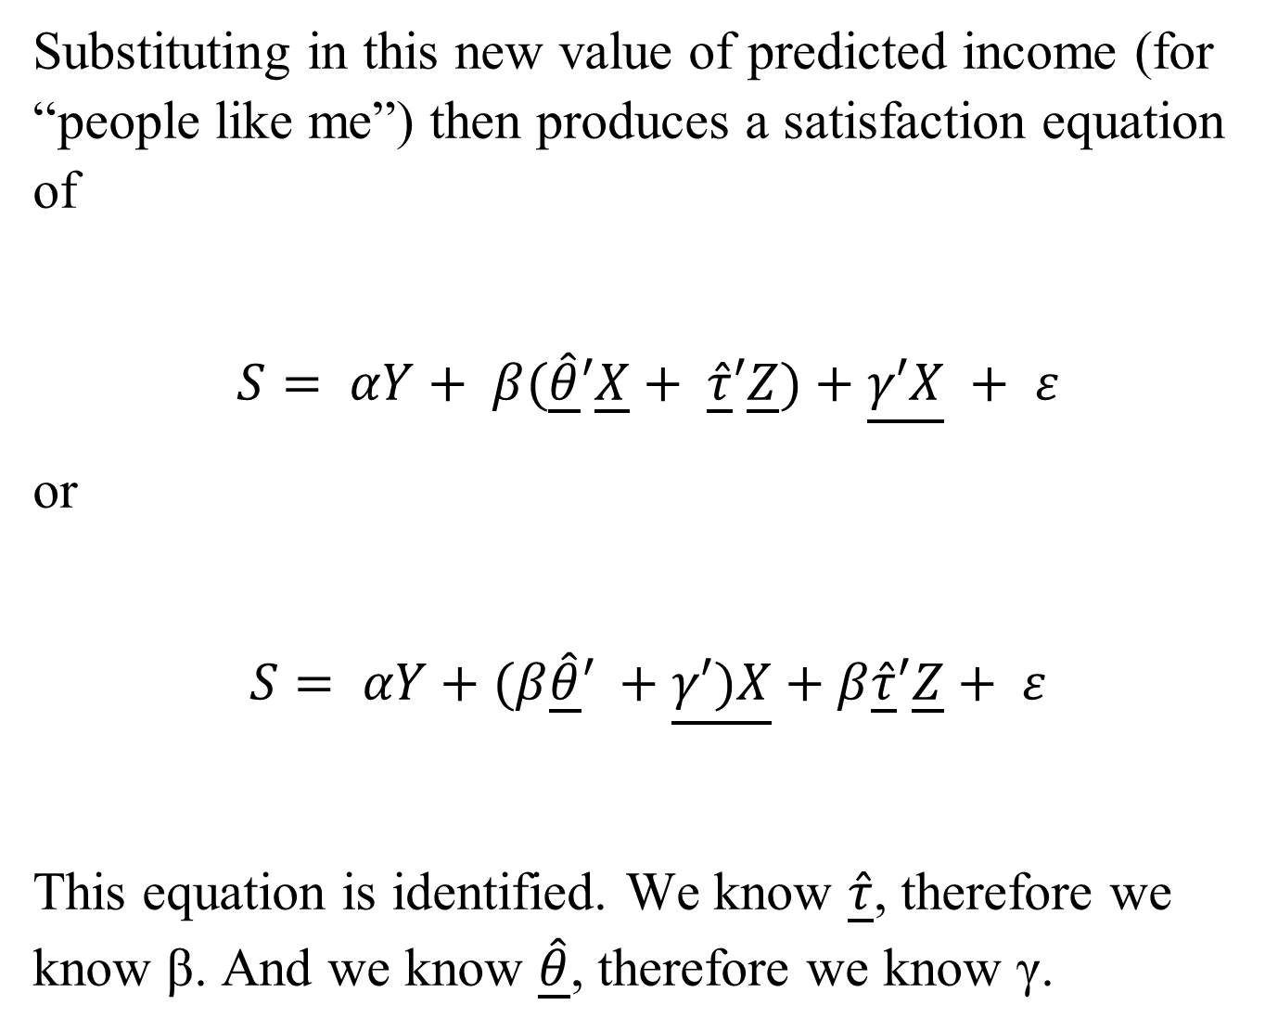
Substituting in this new value of predicted income (for “people like me”) then produces a satisfaction equation of
$$S= αY+ β(\hat{\underline{θ}}′\underline{X}+ \hat{\underline{τ}}′\underline{Z})+\underline{γ′X} + ε$$
or
$$S= αY+(β\hat{\underline{θ}}′ +\underline{γ′)X}+β\hat{\underline{τ}}′\underline{Z}+ ε$$
This equation is identified. We know $\hat{\underline{τ}}$, therefore we know β. And we know $\hat{\underline{θ}}$, therefore we know γ.
Notes:
39

Slide 40
The only challenge that remains: try to find a sensible Z that only affects subjective well-being via its effect on earnings.
…. Good luck with that. So we can instead turn to:
Cell Means
An alternative is not to calculate a parametric predicted value of Y*, but rather a non-parametric cell-mean.
Notes:
40

Slide 41
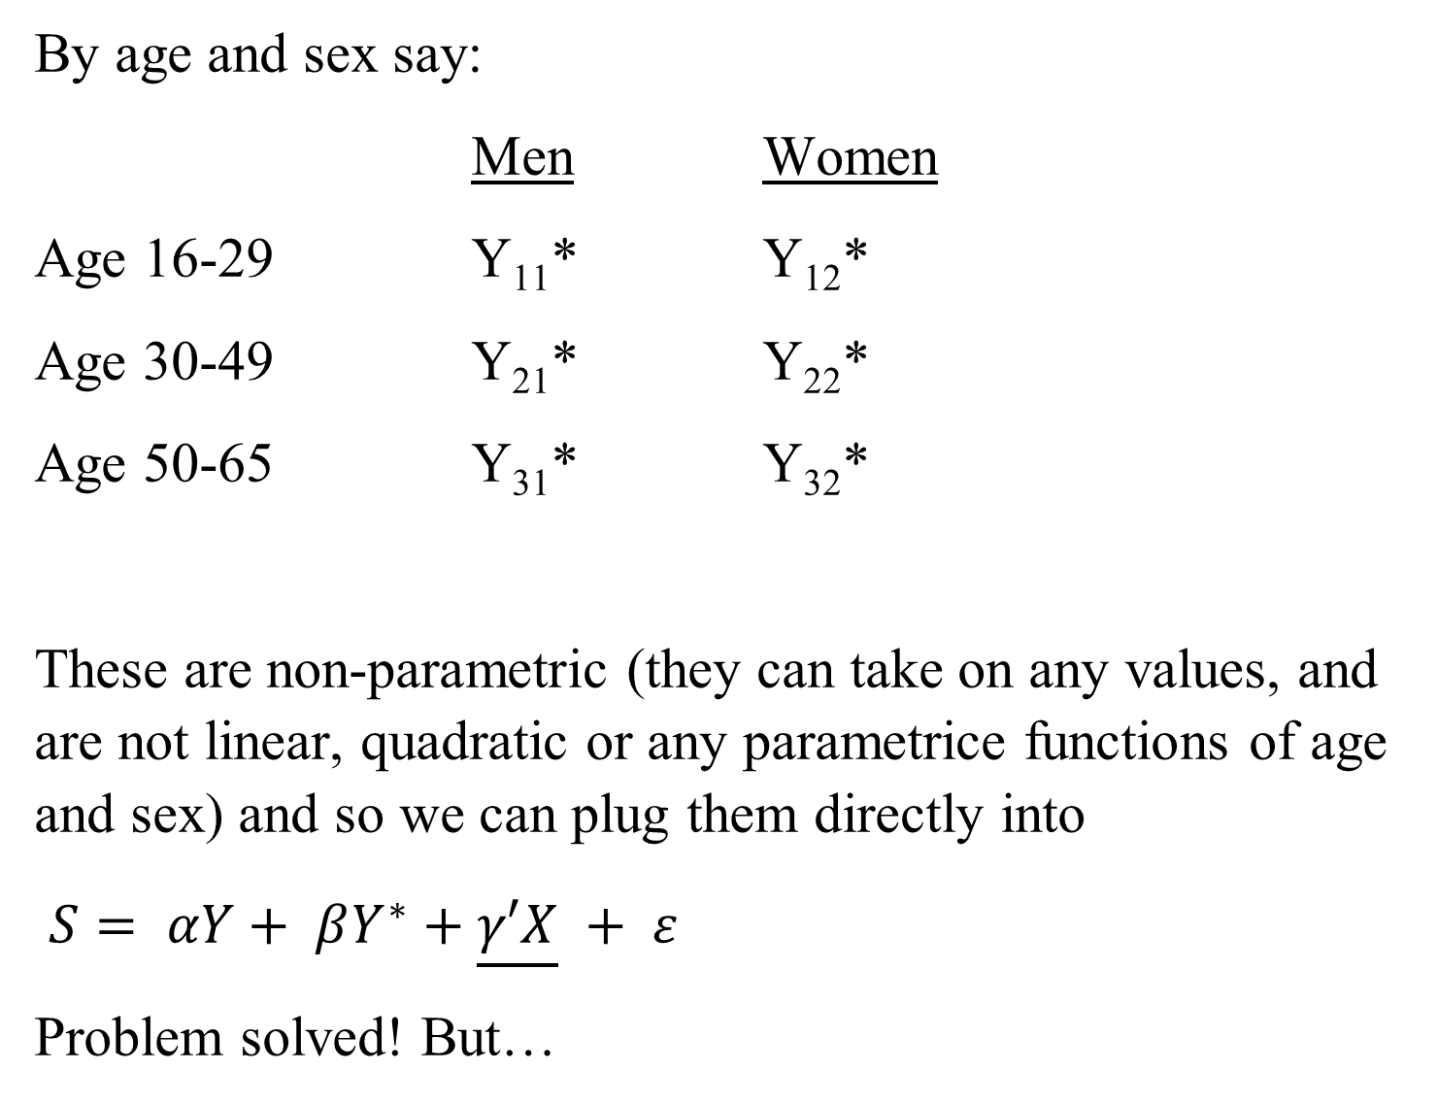
By age and sex say:
Men Women
Age 16-29 Y₁₁* Y₁₂*
Age 30-49 Y₂₁* Y₂₂*
Age 50-65 Y₃₁* Y₃₂*
These are non-parametric (they can take on any values, and are not linear, quadratic or any parametrice functions of age and sex) and so we can plug them directly into
$S= αY+ βY^{∗}+\underline{γ′X} + ε$
Problem solved! But…
Notes:
41

Slide 42
We lose a huge numbers of degrees of freedom with cell means. When we predict from a regression we have many thousands of different values of Y* from the different combinations of the variables in the X vector in the income regression.
Above, we instead have only six different values of Y*.
We can improve this figure by adding more dimensions to the calculation of the mean income values of Y*: age (3), sex (2), region (18), occupation (10) and industry (10). But this quickly brings us up to almost 11 000 different cells. Even in a large dataset like the SOEP or the BHPS, most of these cells will be empty.
Notes:
42

Slide 43
Clark (1996). BHPS Data on 5000 Employees
Estimated only on couples where both partners are in work. Includes other standard control variables.

Slide 44
Comparisons to the past: Clark (1999). BHPS Data
Two waves only. Estimated on individuals who did not change job or get promoted between the two waves.

Slide 45
The results with respect to past income show that the more you earned in the past, the more you need to earn now in order to be just as satisfied: wages are habit-forming.
A pay rise produces the following job satisfaction profile:
Job satisfaction
Time

Slide 46
Pay rises are good at the time, but then you get used to them. How can a firm keep its workers satisfied then? By starting them at a relatively low wage and giving them constant pay rises: profile C.
In work on hypothetical preferences over income profiles, individuals choose C over A, even though they lose money by doing so (Frank and Hutchens; Loewenstein and Sicherman)

Slide 47
Even a small amount of comparison to the past produces sharply-rising consumption profiles.
Implication: we can’t deduce the marginal utility of a good without knowing the whole consumption profile.

Slide 48
Therefore, when we look at the effect of own pay and others’ pay on satisfaction, we find the following kind of stylised relationships:
Income DOES bring happiness... As long as you get it and no-one else does
Satisfaction
Own pay (y), holding y* constant

Slide 49
Satisfaction
Others’ pay (y*), holding y constant

Slide 50
Satisfaction
Pay rises for everybody (y/y* constant)
These broad findings have been replicated many times.
Ferrer-i-Carbonell for Germany and Luttmer for the US for life satisfaction and local area average incomes:

Slide 51
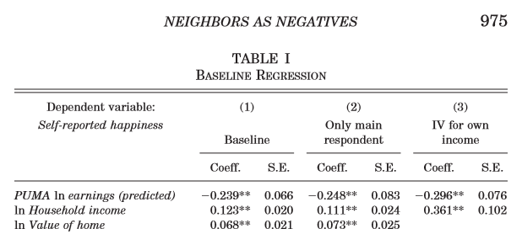
Luttmer (2005) US National Survey of Families and Households

Slide 52
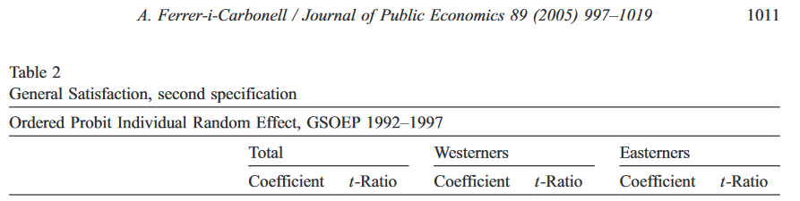
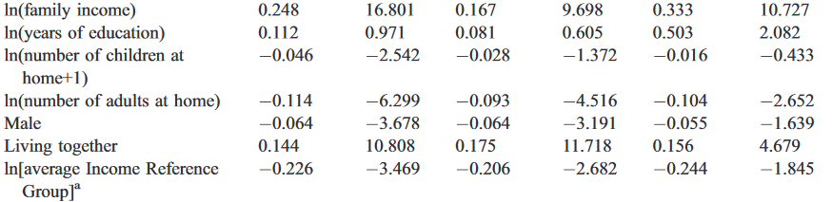
Ferrer-i-Carbonell (2005) SOEP

Slide 53
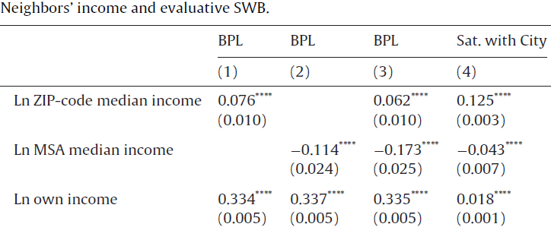
Ifcher et al. (2018) Gallup Healthways

Slide 54
Three reasons to reconsider these comparison-income results:
  The Danish
  Tunnels
  Altruism and Self-image

Slide 55
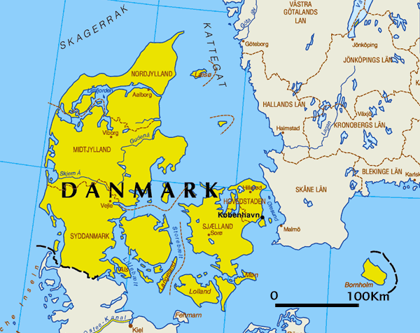
1) This is Denmark

Slide 56
From January 1, 2007, Denmark has been split up into five Regions: two in Zealand, two in Jutland, and one covering Funen and Southern Jutland.
We use new geo-referenced data, based on a geographical grid of size 100*100 meters (i.e. 10 000 square meters, or a hectare) covering the entire country.

Slide 57
Some of these grid cells are uninhabited, others are only very thinly inhabited: around two-thirds of inhabited hectare cells contain under five households.
Data confidentiality: Statistics Denmark aggregates to produce clusters of neighbouring hectare cells with a minimum of 150 (600) households.
Adjusted by Damm and Schultz-Nielsen (2008) to produce a classification
Constant over time
Marked out by physical barriers (roads, rivers)
Compact
Contiguous
Homogenous in terms of type and ownership of housing (don’t mix flats and houses).

Slide 58
Figure 1
Small neighbourhoods in the area of Taastrupgård, Høje Tåstrup
Source: Damm and Schultz-Nielsen (2008).

Slide 59
We have information on individuals from the Danish part of the European Community Household Panel.
Including a measure of “satisfaction with economic conditions” (on a 1-6 scale).
All Danes have a Danish Personal Identification number (CPR).
Match the CPR of the ECHP respondent to tax records to obtain their income.
Match the CPR to the hectare cell cluster to see where the individual lives.
Obtain income information for all of the other individuals who live in the same cluster: full information on the income distribution at a very-local level.

Slide 60
Economic Satisfaction, Income and Rank within Small Neighbourhoods: Panel Results

Slide 61
So individuals like living with richer (very close) neighbours. This probably reflects local public goods or social capital. In this sense, were we able to hold public goods and social capital constant, then I would expect the sign on neighbours’ income to become negative.
This is what column 3 effectively does. It holds average neighbourhood income constant, and looks at rank effects. Consistent with previous work, this is positive.
People like having rich neighbours…and being on top of the pile.

Slide 62
2) Tunnels
Early examples: Senik (2004) and Clark, Kristensen and Westergård-Nielsen (2009).
Some work has found well-being to positively correlated with reference group income or earnings: the more others earn, the happier I am.
Could demonstrate Hirschman’s tunnel effect (Hirschman and Rothschild, 1973): while others’ good fortune might make me jealous, it may also provide information about my own future prospects.
The distinction between status and signal depends on how likely you are to end up in the future with your reference group’s current income. Senik considers a very unstable labour market (Russia); Clark et al. examine the average earnings of other workers within the same firm.
But how pervasive are signal effects in general?

Slide 63
3) Altruism
People are often observed to give away money or donate to charity.
The survey of 616 experiments in the Dictator game in Engel (2011) concluded that dictators give on average 28% of the sum of money to be divided.
Why do they do so, if relative income increases well-being?

Slide 64
Dunn, E., Aknin, L., and Norton, M. (2008). "Spending Money on Others Promotes Happiness". Science, 319, 1687-1688.
Individuals are forced to be generous: they are given an envelope with either $5 or $20 to spend that day.
Half are told to spend the money on themselves, and the other half on someone else.
Spending money on others produces greater happiness than spending money on oneself.

Slide 65
Is well-being then not relative in income?
Individual well-being may be affected by both envy and altruism.
The objects of these two feelings are probably not the same: when individuals give gifts or donate, they may not do so for those in their reference group.

Slide 66
Conclusion:
There are comparison effects both spatially (between groups) and over time with respect to income.
These two phenomena can explain the Easterlin paradox
FIGURE 1: Happiness and Real Income Per Capita in the US, 1973-2004

Slide 67
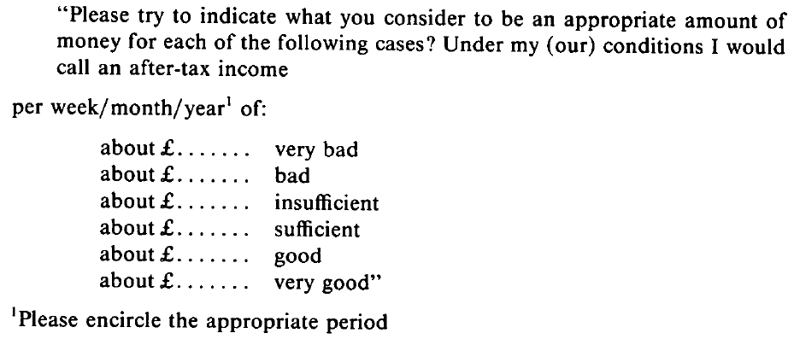
Subjective Well-Being Measures are not the only possible way of showing comparison effects.
The Leyden approach. Invert the question: Who needs more money to have a good life?
Initiated by Bernard Van Praag.
Ask individuals to assign income levels (per period) to six or nine different verbal labels (such as "excellent“,"sufficient" and "bad").

Slide 68
Van Praag can then estimate for each individual a lognormal “Welfare Function of Income” (the jump in income required to go from one label to another becomes increasingly large).
The resulting individual estimated means (μ_{i}) and variances (σ_{i}) – there is one curve for each person i – are then used as dependent variables in regressions to show which types of individuals require a higher level of income to be satisfied, and which individuals have welfare valuations that are more sensitive to changes in income.
Those with higher reference group income, and who had earned more in the past, had higher values of μ.

Slide 69
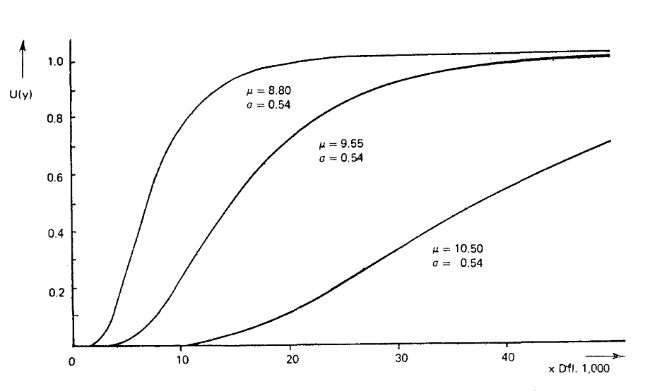
Those with higher values of μ use lower verbal well-being labels at any given level of income

Slide 70
2) Ask people. Preference for rising income profiles, and preferences for lower absolute incomes:
A: Your current yearly income is $50,000; others earn $25,000.
B: Your current yearly income is $100,000; others earn $200,000.
56% prefer A over B.
Positionality differs by life domain. In Solnick and Hemenway (2005) this is stronger for income and clothes, and weaker (20%) for vacations and flowers at home.

Slide 71
3) Experimental.
a) Ultimatum game: responders frequently reject offers that are under 25% of the total sum; as such the the vast majority of offers are between 40% and 50% of the sum.
Individuals then seem to anticipate that others have relative utility functions

Slide 72
b) Zizzo and Oswald (2001): subjects can pay to burn each other’s money (“economic destruction games”).
An initial betting round gives an unequal distribution of wealth. Some subjects advantaged.
Burning round: majority of subjects chose to do so, even though it costs them real earnings. The average subject had half of her earnings burnt, and richer subjects were burnt more often.

Slide 73
c) (as with the colonoscopy experiments…) the change in pain predicts overall evaluations
Hand in a bucket of cold water. Within-subject: one hand in each trial.
i) 14C (59F) for 60 seconds.
ii) 14C for 60 seconds, gradual rise to 15C over 30 seconds.
Pain dial: first sixty seconds equally painful and rising in i) and ii); pain then level or fell in additional 30 seconds in ii).
a) ii) is considered less painful overall, and some say it was quicker.
b) Participants indicate which trial they would repeat if they had to: 70% choose ii).

Slide 74
d) McBride (2010) introduces a novel way of calculating aspirations directly in a matching pennies game, where individuals play against computers.
The computer chooses heads or tails according to (known) probability distributions (for example 80% heads, 20% tails).
After each round of playing, individuals report their satisfaction with the outcome.
Introduce social comparisons in some of the treatments (by telling the individual the outcomes of the other players).
Aspiration effect identified by varying the heads and tails probabilities played by the computer. Each subject has five pennies to play. When paired with a 80% heads, 20% tails computer, the best strategy is to always play heads, which gives an expected payoff of four pennies. When paired with a 65% heads, 35% tails computer, the best strategy is still to always play heads, but now the expected payoff is only 3.25 pennies.
Results: satisfaction is
i) higher the more one wins
ii) lower the more others win
iii) lower the higher was the aspiration level.

Slide 75
4) Natural Experiments
Card et al. (2012): the revelation of information on others' earnings.
The natural experiment here is a court decision that made the salary of any California state employee public knowledge.
A local newspaper set up a website making it easy to find this information.
Following this website launch, Card et al. informed a random subset of employees at three UC campuses about the site.

Slide 76
Some days later, all employees on the three campuses were surveyed.
Compare the treatment group (informed about the website) to others to reveal the impact of information on others' salaries.
The reference group was defined here as co-workers in the same occupation group (faculty vs. staff) and administrative unit in the university.

Slide 77
The survey found lower job satisfaction for those with pay below the reference group median and a greater intention to look for a new job.
The effect on both for those who were relatively well-paid was insignificant.
There is some evidence of an actual quitting effect on those who were found to be in the bottom earnings quartile in the reference group.

Slide 78
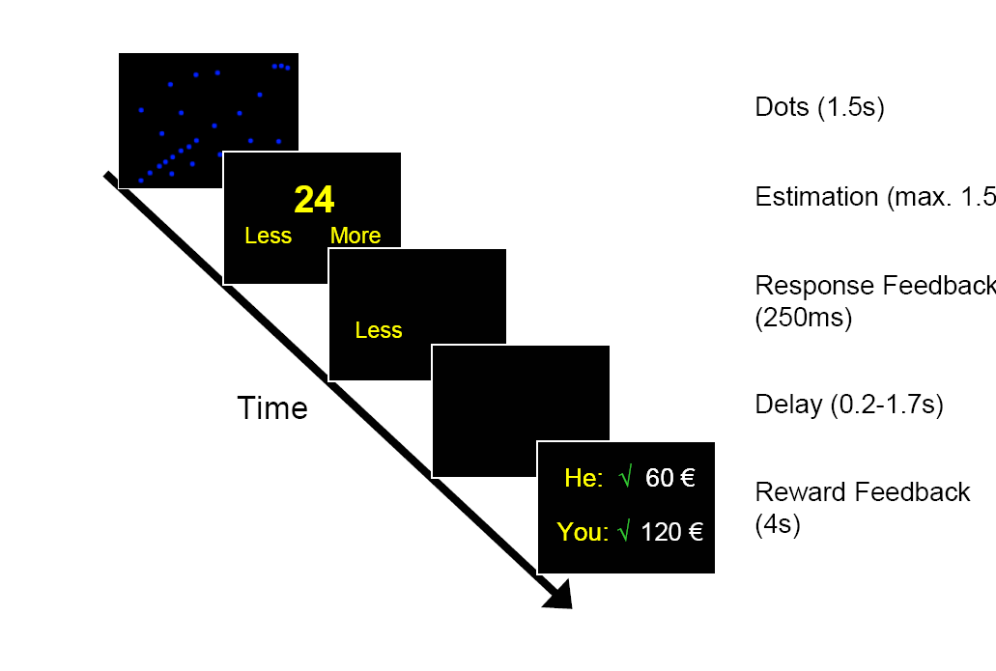
5) Neuro. Fließbach, K., Weber, B., Trautner, P., Dohmen, T., Sunde, U., Elger, C., & Falk, A. (2007). "Social comparison affects reward-related brain activity in the human ventral striatum". Science, 318, 1305-1308.

Slide 79
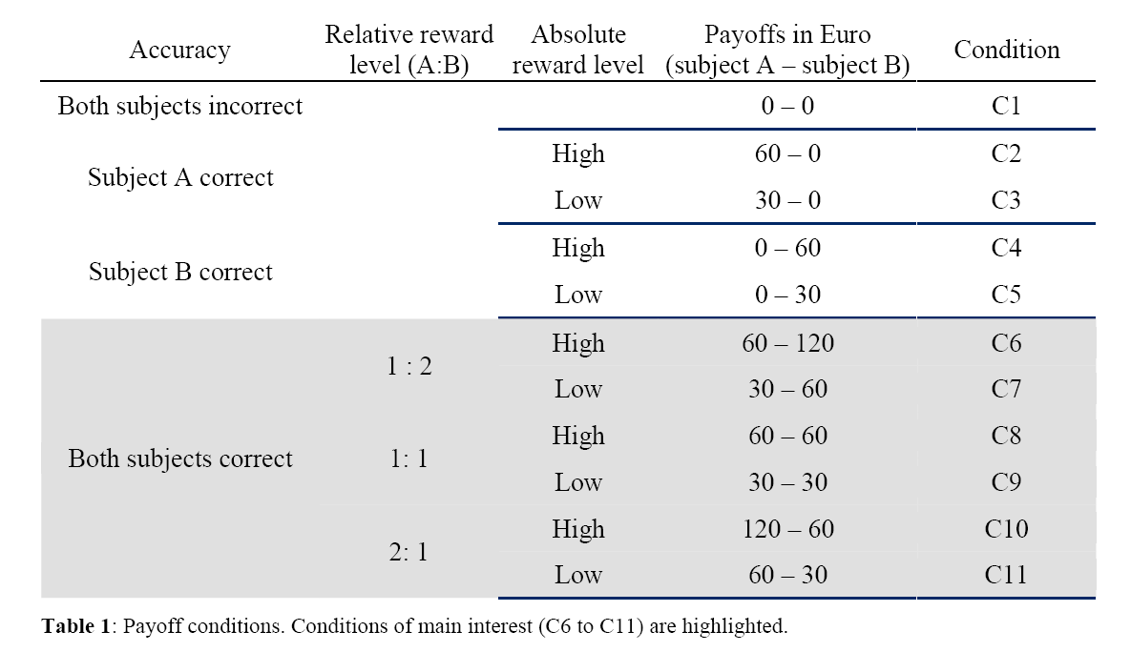
Payoffs vary according to whether the individual gets the task right, and also randomly when the task is correct

Slide 80
Brain activity measured via BOLD blood flow in various voxels.
Particular attention paid to the ventral striatum: the “neural circuitry of reward”
This kind of striatal activity has been shown to predict both hedonic outcomes (subjective well-being) and physiological outcomes (cortisol output: the body’s response to stress)

Slide 81
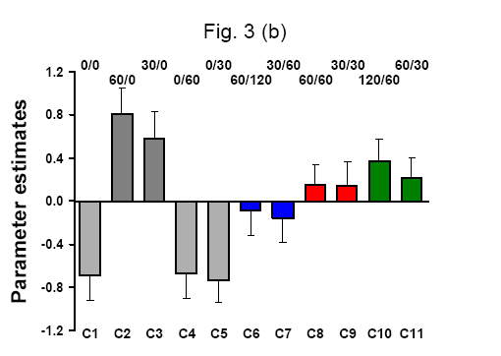
Brain activation depends on relative income: compare C6, C8 and C11 (where the individual receives 60 Euros), and C7 to C9.

Slide 82
What Changes in Micro Analysis if Utility is Relative?
A lot….
All Individual Behaviour is determined by the trade-off between marginal benefit and marginal cost. Under relative utility, the marginal benefit of some behaviour may well depend on behaviour in the reference group.
This can produce following behaviour, or on the contrary deviance.
Consider an additive comparisons model:

Slide 83
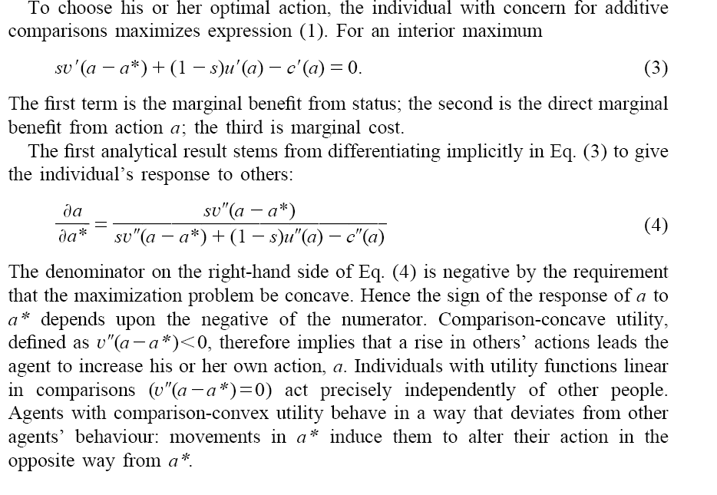

Slide 84
As your a* rises, what do I do?
Actions depend on their marginal benefit compared to their marginal cost
a* does not affect the mc… but it does change the marginal benefit
V(.)
a-a₂*
a-a₁*
a-a*
a₂* > a₁*. As your action rises, the marginal benefit of my own action rises when the relative-utility function V(.) is concave: following.

Slide 85
a₂* > a₁*. As your action rises, the marginal benefit of my own action falls when the relative-utility function V(.) is convex: devation.
V(.)
a-a₂*
a-a₁*
a-a*
Last, when the relative-utility function V(.) is linear, there is no change in the slope and therefore no change in my own action: indifference.

Slide 86
One example of following is the Arms Race. An illustration in work hours
U^{A} = U(Y^{A}, Y^{B}, H^{A}); U₁₂ > 0
+ - -
With Y=αH, so that
U^{A} = U(α^{A}H^{A}, α^{B}H^{B}, H^{A})
Individual A chooses her H^{A}:
α^{A}U₁ = -U₃ (1)
(the marginal utility of income equals the marginal utility of leisure)

Slide 87
Stage 1
B gets lucky and receives a pay rise. What happens to A as α^{B} rises?
The utility of A falls (U₂ < 0)
A’s marginal utility of income, U₁, rises (because U₁₂ > 0: this is the positive cross-partial derivative, as in the concavity example above)
Therefore, Equation (1) no longer holds: A will increase her hours of work in order to get back to equilibrium (a higher value of H^{A} will increase the marginal utility of leisure for A).

Slide 88
Stage 2
But B’s utility function is the mirror image of A’s. The effect of higher H^{A} for B is exactly the same as that of α^{B} for A.
So B will increase her hours of work in response to A’s longer hours.
Stage 3
Which in turn leads A to increase her hours of work in response to B’s longer hours.
And so on….
There is then the possibility of everyone working too much (with associated tax implications), in that there are equilibria of hours (and so income) that are Pareto-dominated.

Slide 89
2) A taste for rising income profiles can explain why wages rise faster than productivity. Also explains wage compression within firms, and wage secrecy. And optimal rising consumption profiles.
3) Poverty: defined in terms of income or utility? There is no longer a monotonic relationship between the two.
4) Relative utility makes the distribution of welfare more unequal than the distribution of income would imply; and if the poor compare more, then it will be asymmetric

Slide 90
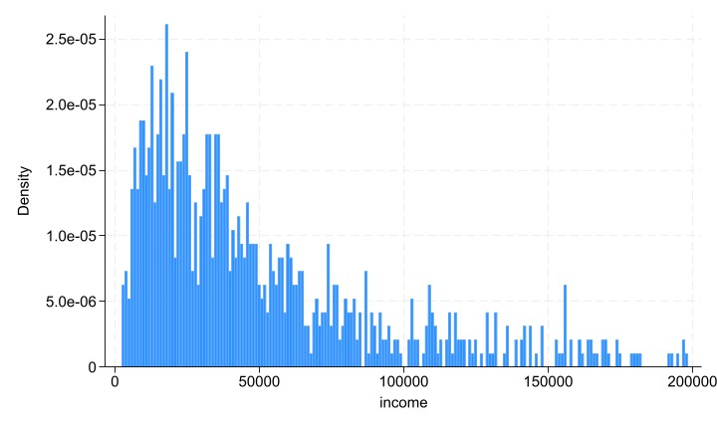
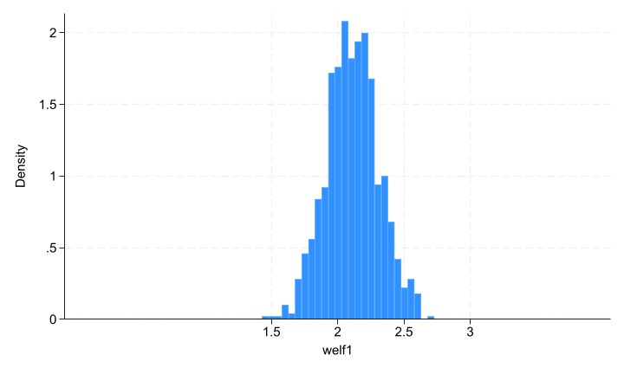
Log-normal income
Gives normal welfare: g welf1 = 0.2*ln(income)

Slide 91
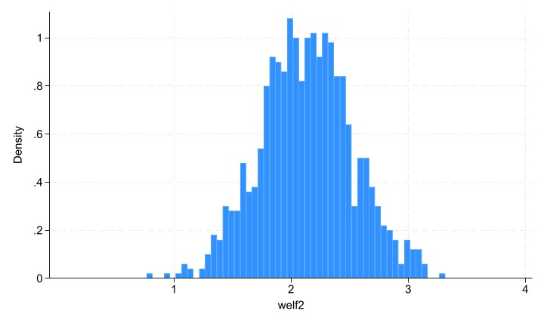
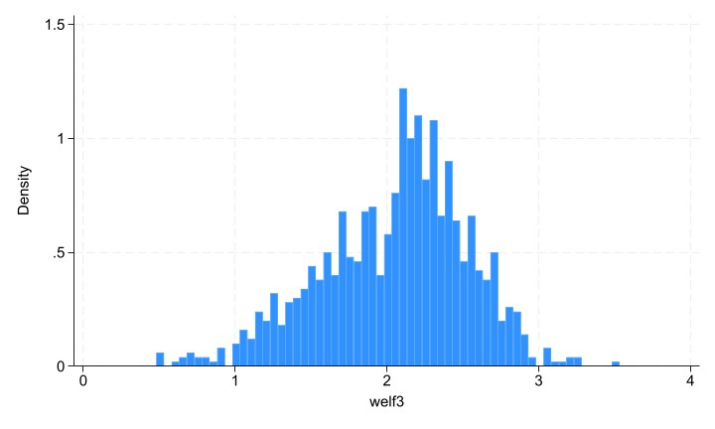
Which is stretched with comparisons: g welf2 = 0.2*ln(income) + 0.2*ln(income/35000)
And asymmetric when the poor compare more: g welf3 = 0.2*ln(income) + 0.2*ln(income/35000)*highy + 0.4*ln(income/35000)*lowy

Slide 93
5) Conspicuous consumption introduces externalities between individuals, which can be corrected by a tax. Taxing luxury cars will make no difference to utility if these are only consumed for rank reasons.
6) Migration. Now no longer only for income, but also for relative standing reasons. Anti brain-drain conclusion (Mexican Doctors).
7)Worker behaviour, such as quitting and effort (productivity) will depend not only on own income, but also income of others (e.g. Clark, Masclet and Villeval, 2010).

Slide 94
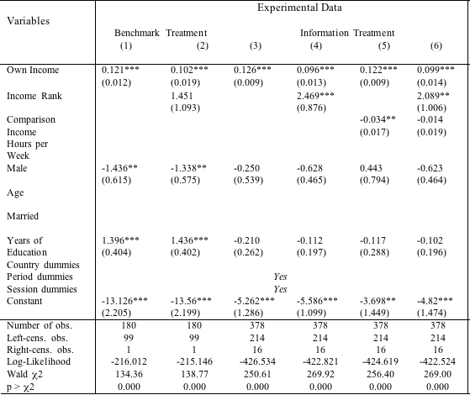
The rank-dependence of effort (Random-effect Tobit model)
Placebo test

Slide 95
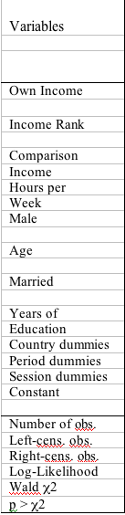
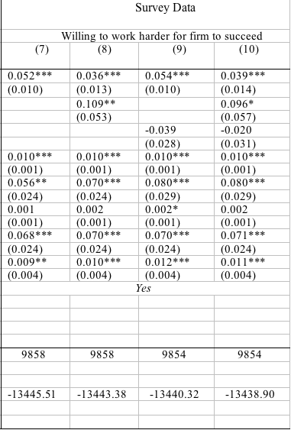

Slide 96
Macro Implication.
As a result of the Easterlin Paradox:
“Money/possessions aren’t making us any happier: we should spend our time concentrating on X instead”
Candidates for X:
A (good) job
Marriage/Family
Social Activities
Freedom/Democracy
Health
Religion
But what if we found the same phenomena of adaptation and comparisons there too? This is only rarely tested.

Slide 97
Public Policy
Important to note that policy can’t do anything about some of the things we know are important from 20 years of subjective well-being research.
Gender
Women often report higher life satisfaction scores than men...
but also higher psychological stress scores
Nolen-Hoeksema, S., and Rusting, C.L. (1999). "Gender differences in well-being". In D. Kahneman, E. Diener, and N. Schwartz (Eds.), Well-being: The foundations of hedonic psychology. New York: Russell Sage Foundation.

Slide 98
Policy can’t do anything about some of the things we know are important from 20 years of subjective well-being research.
Age

Slide 99
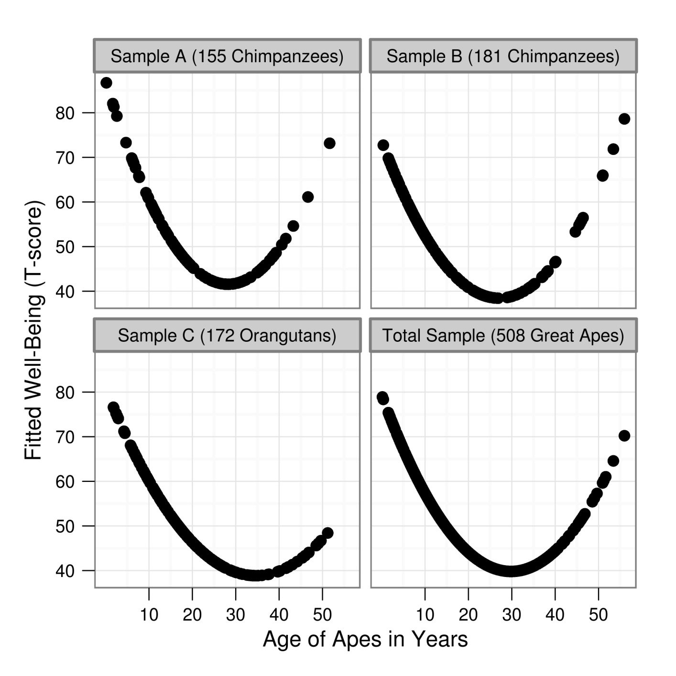
The “happiness smile” (or grimace) is almost ubiquitous. But we still are not sure what is behind it

Slide 100
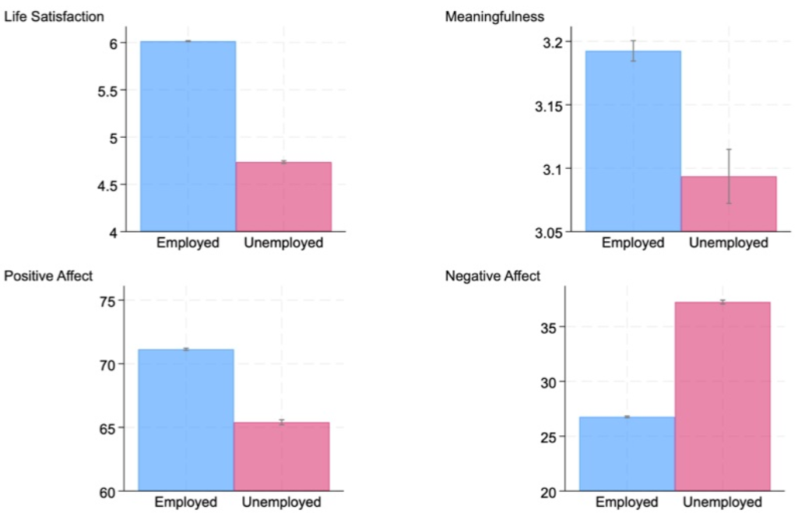
Well-being and Unemployment
Gallup Data (De Neve and Ward, 2025)
But do you adapt to unemployment, and is it relative?

Slide 101
Main results:
The psychological impact of unemployment is lower
When the regional unemployment rate is higher (estimated: no impact for regional unemployment of 20-25%).
When there is more unemployment in the household (estimated: no impact if all other adults in the household are unemployed too).
All of these effects are far stronger for men, especially prime-age men (16-50), than for women.

Slide 102
Social Comparisons with respect to Unemployment?
The well-being gap between employees and the unemployed is smaller in regions with greater unemployment: others’ unemployment moderates the effect of my own unemployment

Slide 103
Social Comparisons with respect to Unemployment?
Unemployment hurts less when I share it with other household members

Slide 104
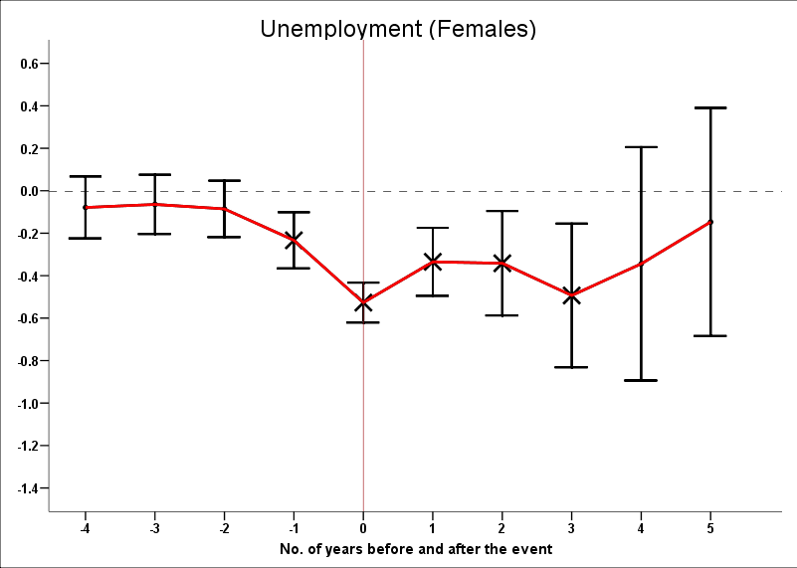
But there is little adaptation to unemployment
Unemployment starts bad, and stays bad

Slide 105
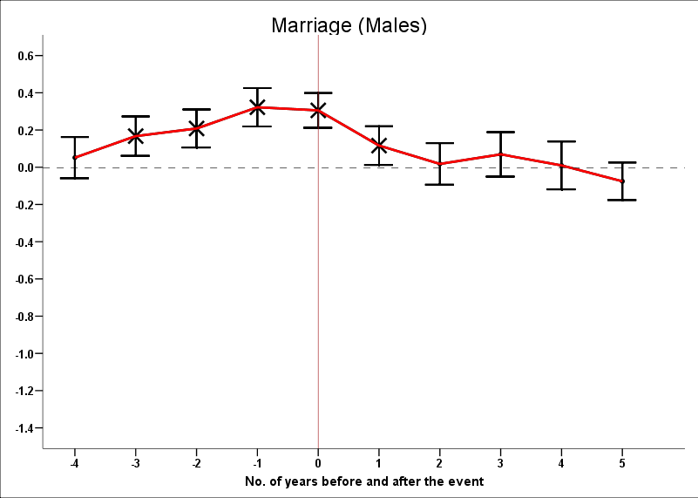
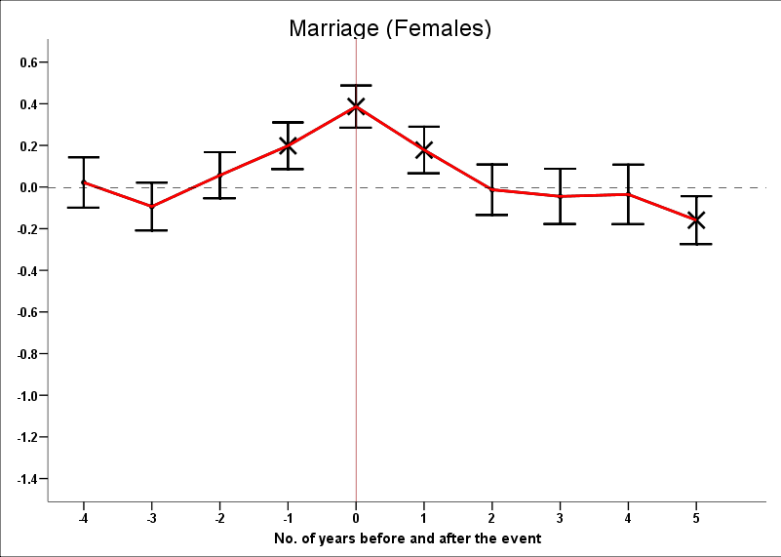
We get used to marriage

Slide 106
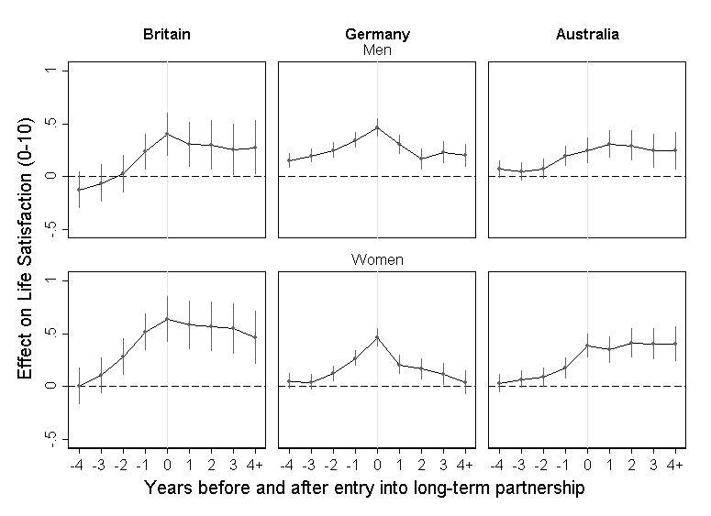
But not to the relationships that precede marriage

Slide 107
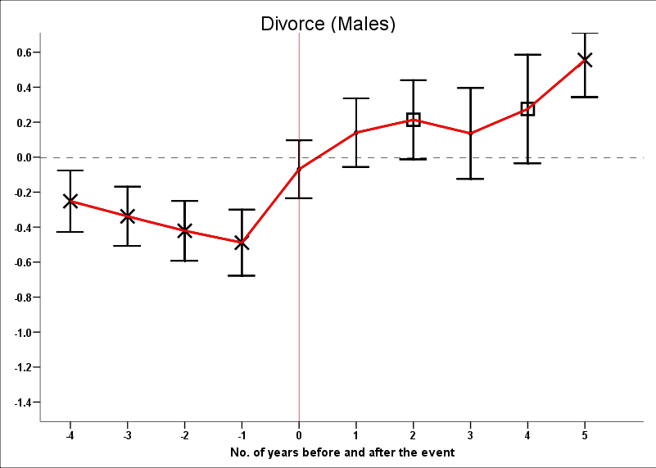
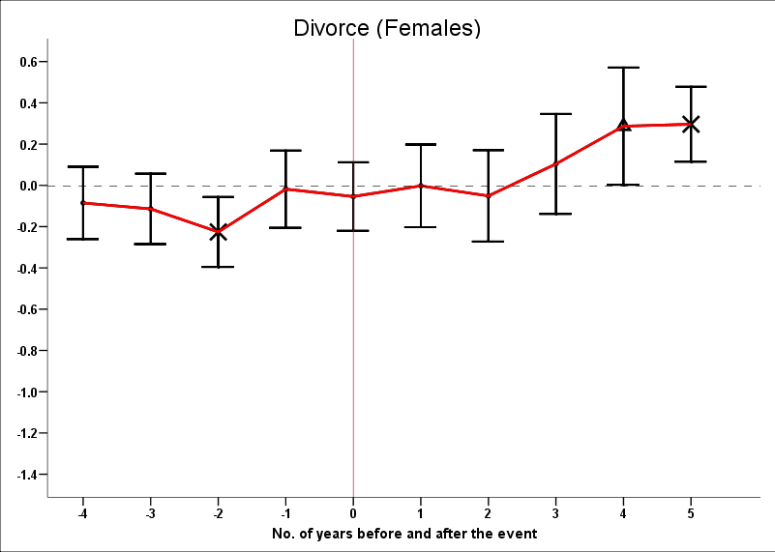
And we get used to divorce

Slide 108
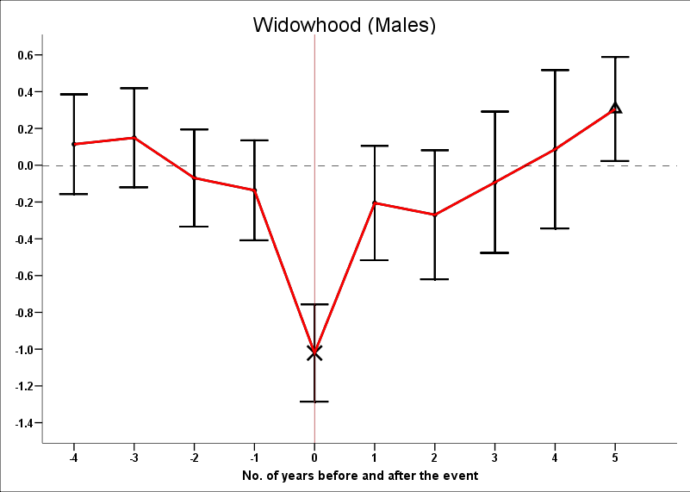
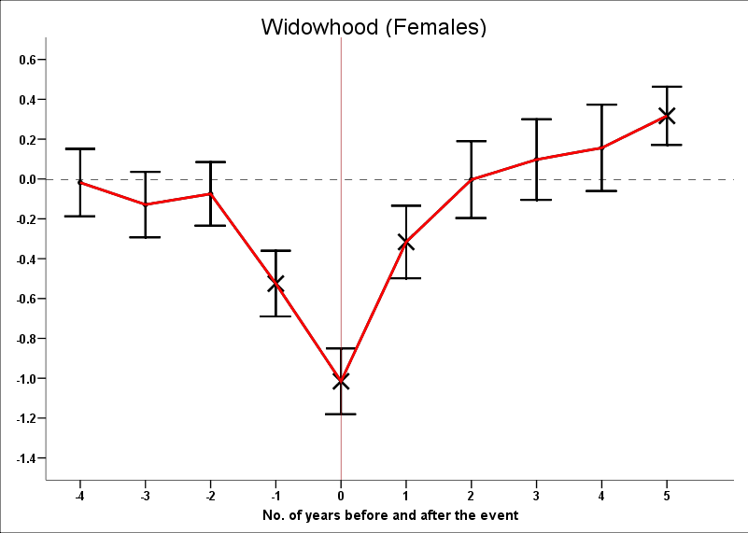
Even widowhood is worse at the beginning than afterwards

Slide 109
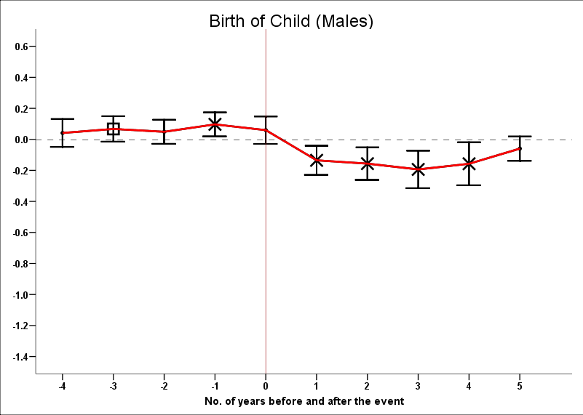
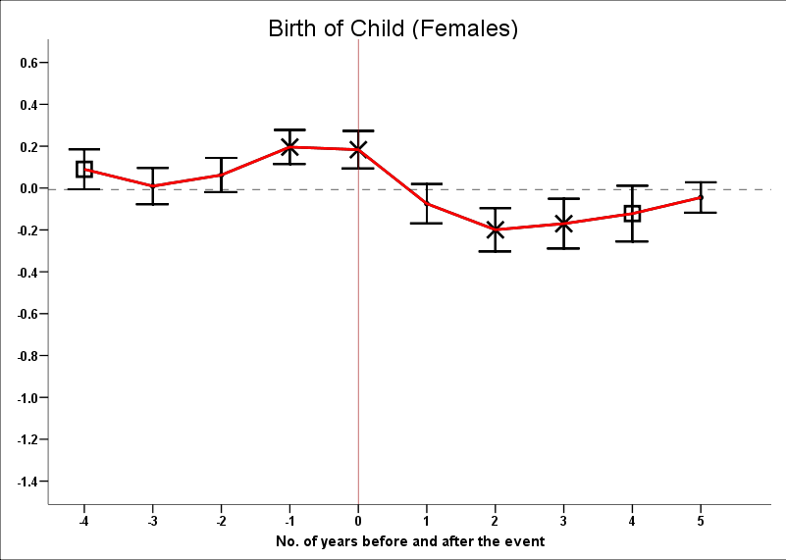
And we can’t even count on our children

Slide 110
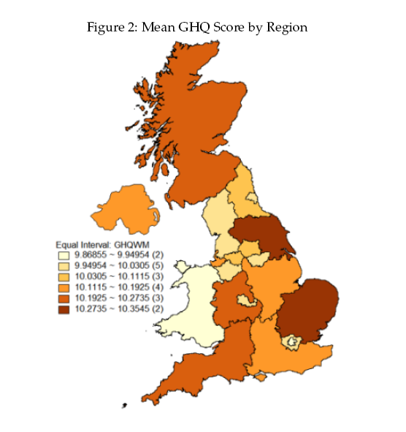
Social Comparisons with respect to Divorce?

Slide 111
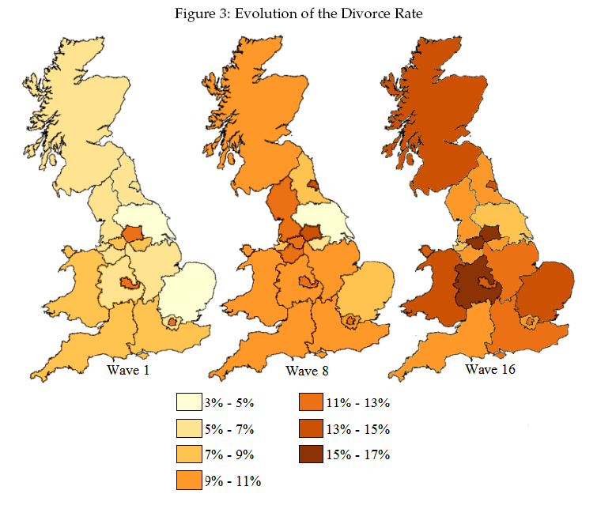

Slide 112
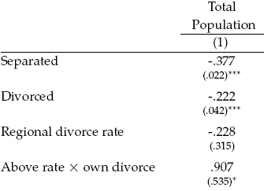
Own divorce hurts less in a high-divorce region
The estimated effect of divorce is zero in a region with a 25% divorce rate.
Is this a “plenty more fish in the sea” effect?

Slide 113
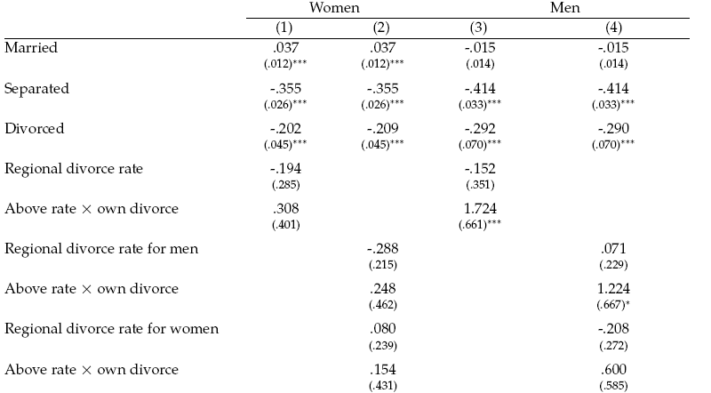
Not only: the largest effect is from the regional percentage of divorced men on male divorce

Slide 114
Adaptation to Poverty
We may adapt to income in general, but what about adaptation to poverty as a specific low-income state?

Slide 115
Poverty starts bad and stays bad

Slide 116
Social Comparisons and Health?
Work on European data has shown that :
My own health problems have less effect on my own well-being when the problems are shared by others in the same household.
Individuals feel less overweight as the average weight in the region rises
Within the household, couples where both are obese have similar mental stress levels to couples where neither is obese

Slide 117
Women like their partner to have the same BMI as they do (life satisfaction in the BHPS)

Slide 118
And… so do men

Slide 120
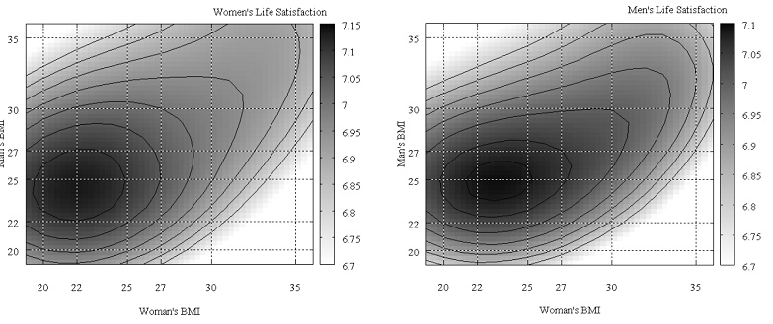
And for those of you who like it semi-parametrically, the “Happiness Hills”
The hill peaks are on a 45-degree line: your own weight doesn’t matter if it matches your partner’s

Slide 121
Social Comparisons and Religion?
Work on European Social Survey data shows that:
Religious individuals are happier when they live in religious regions
But atheists are happier when they live in religious regions too
Catholics get a happiness boost from being in a Catholic majority region
The religious “spillovers” are mostly positive

Slide 122
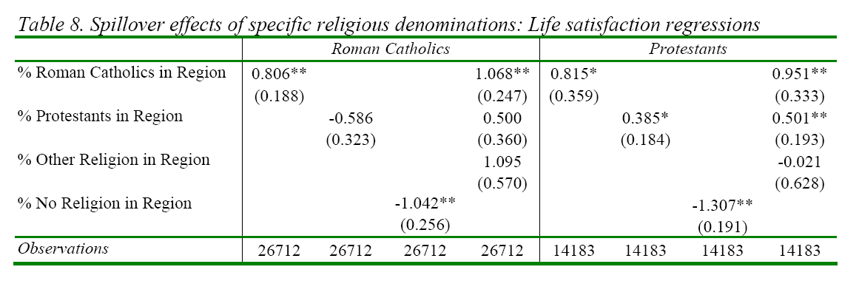
Spillover effects of specific religious denominations: Life satisfaction regressions

Slide 123
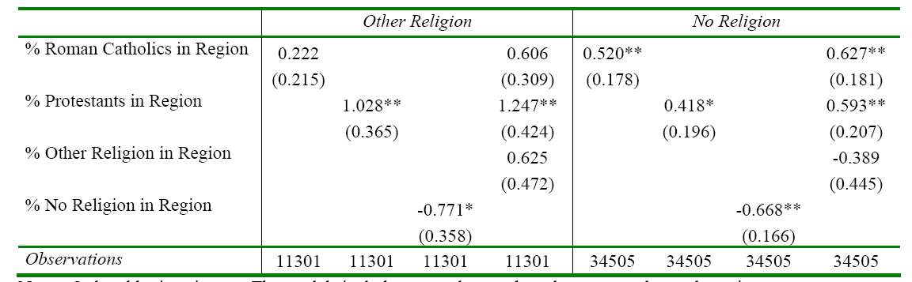
Spillover effects of specific religious denominations: Life satisfaction regressions
The religious like being with other religious; they don’t like being with atheists.
Atheists are more satisfied when they live in more religious regions too.
Atheists don’t like living with other atheists either.

Slide 124
  Conclusions
  Let’s switch from the extensive to the intensive margin. How much does the EP hold?
  Are comparisons cardinal or ordinal? If the latter, then the EP holds fully
  Who is in the reference group?
  Is this a rich country result?
  What is well-being anyway
    Life satisfaction?
    Happiness?
    Psychological functioning?
    Eudaimonia?

Slide 125
A Summary
We need to find domains of life that are non-rival to which we do not adapt…
Horizontal Intertemporal
Comparisons Comparisons
(Status) (Adaptation)
Income Yes Yes
Unemployment Yes (but small) No
Poverty ? No
Relationships ? No
Marriage/Divorce Yes Yes
Health Perhaps? Partial?
Social Activities Perhaps? No?
Freedom ? ?
Religion Perhaps? ?

Slide 126
Ideally want general statements about the whole world, not just one country.
But the best source of information over the World, the Gallup World Poll, does not yet have a long-enough time dimension for us to make definitive statements about GDP growth and subjective well-being.

Slide 127
Is everything really lost for GDP per capita?
Almost all discussion in the literature has looked at mean happiness.
We might not be so utilitarian though, in that we care about the distribution of happiness too.
Could give more weight to those at the bottom of the well-being distribution: misery-aversion.
Here GDP per capita does seem to play a role

Slide 128
Happiness inequality and GDP per capita across countries, WVS
Last available year (2000s)

Slide 129
Happiness inequality within Country over Time in Growing Countries, Selected Western countries (WVS)

Slide 130
Happiness inequality Over Time with Some periods of Negative or Zero Growth (WVS)

Slide 131
Happiness inequality Over Time during Periods of Decreasing GDP (WVS)

Slide 132
Single Country Results
United Kingdom (BHPS) West Germany (SOEP)

Slide 133
Single Country Results
Australia (HILDA) United States (GSS)

Slide 134
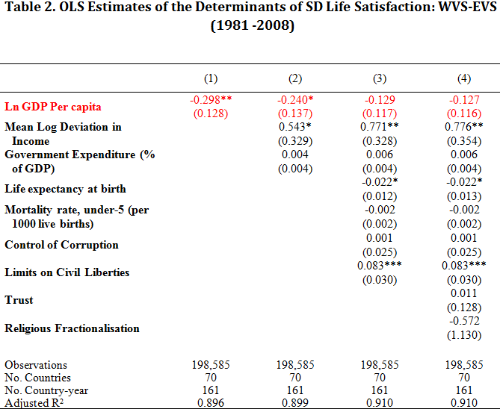
Income growth reduces happiness inequality, as do “social programmes”; income inequality increases happiness inequality

Slide 135
Social Comparisons and Social Capital?
Research on BHPS data shows that:
Individuals are happier when their levels of social capital (measured by social activities) are higher (but beware of causality)
Individuals are also happier when they live with other household members who are active socially
But, given own social capital and others’ social capital, there is a happiness boost from being the most active individual in the household.

Slide 136
Well-Being and Others’ Social Capital: WVS Evidence
Spillovers are defined at the regional (NUTS2) level. We drop regions with fewer than 50 observations. Others’ social capital measured by the regional median level
Own SK Activity 0.075**
(.011)
Regional SK Activity (median) -0.098+
(.059)
It is still good to be active oneself: but well-being is higher when others’ social activity is lower, as if there were comparisons in social capital. This can be seen in the coefficient on the continuous measure of others’ median social capital above.

Slide 137
Well-Being and Others’ Social Capital: ESS Evidence

Slide 138
References
Alpizar, F., Carlsson, F., and Johansson-Stenman, O. (2005). "How much do we care about absolute versus relative income and consumption?". Journal of Economic Behavior and Organization, 56, 405-421.
Card, D., Mas, A., Moretti, E., and Saez, E. (2012). "Inequality at Work: The Effect of Peer Salaries on Job Satisfaction". American Economic Review 102, 2981-3003.
Clark, A.E. (1996). "L'utilité est-elle relative? Analyse à l'aide de données sur les ménages". Economie et Prévision, 121, 151-164.
Clark, A.E. (1999). "Are Wages Habit-Forming? Evidence from Micro Data". Journal of Economic Behavior and Organization, 39, 179-200.
Clark, A.E. (2003). "Unemployment as a Social Norm: Psychological Evidence from Panel Data". Journal of Labor Economics, 21, 323-351.
Clark, A.E., D'Ambrosio, C., and Ghislandi, S. (2016). "Adaptation to Poverty in Long-Run Panel Data". Review of Economics and Statistics, 98, 591–600.
Clark, A.E., Diener, E., Georgellis, Y., and Lucas, R. (2008). "Lags and Leads in Life Satisfaction: A Test of the Baseline Hypothesis". Economic Journal, 118, F222–F243.
Clark, A.E., and Etilé, F. (2011). "Happy House: Spousal Weight and Individual Well-Being". Journal of Health Economics, 30, 1124-1136.
Clark, A.E., Flèche, S., Layard, R., Powdthavee, N., and Ward, G. (2018). The Origins of Happiness: The Science of Well-Being over the Life-Course. Princeton NJ: Princeton University Press.

Slide 139
Clark, A.E., Frijters, P., and Shields, M. (2008). "Relative Income, Happiness and Utility: An Explanation for the Easterlin Paradox and Other Puzzles". Journal of Economic Literature, 46, 95-144.
Clark, A.E., and Georgellis, Y. (2013). "Back to Baseline in Britain: Adaptation in the BHPS". Economica, 80, 496-512.
Clark, A.E., Kristensen, N., and Westergård-Nielsen, N. (2009). "Economic Satisfaction and Income Rank in Small Neighbourhoods". Journal of the European Economic Association, 7, 519-527.
Clark, A.E., Kristensen, N., and Westergård-Nielsen, N. (2009). "Economic Satisfaction and Income Rank in Small Neighbourhoods". Journal of the European Economic Association, 7, 519-527.
Clark, A.E., and Lelkes, O. (2008). "Deliver Us From Evil: Religion as Insurance". PSE, mimeo.
Clark, A.E., Masclet, D., and Villeval, M.-C. (2010). "Effort and Comparison Income". Industrial and Labor Relations Review, 63, 407-426.
Clark, A.E., and Oswald, A.J. (1996). "Satisfaction and Comparison Income". Journal of Public Economics, 61, 359-81.
Clark, A.E., and Oswald, A.J. (1998). "Comparison-concave Utility and Following Behaviour in Social and Economic Settings". Journal of Public Economics, 70, 133-155.
Clark, A.E., and Senik, C. (2010). "Who compares to whom? The anatomy of income comparisons in Europe". Economic Journal, 120, 573-594.
De Neve, J., and Ward, G. (2025). Why Workplace Wellbeing Matters. Cambridge, MA: Harvard Business Review Press.

Slide 140
Dunn, E., Aknin, L., and Norton, M. (2008). "Spending Money on Others Promotes Happiness". Science, 319, 1687-1688.
Easterlin, R. (2005). "Diminishing Marginal Utility of Income? Caveat Emptor". Social Indicators Research, 70, 243-255.
Easterlin, R. (2017). "Paradox Lost?". Review of Behavioral Economics, 4, 311-339.
Ferrer-i-Carbonell, A. (2005). "Income and well-being: an empirical analysis of the comparison income effect". Journal of Public Economics, 89, 997-1019.
Fließbach, K., Weber, B., Trautner, P., Dohmen, T., Sunde, U., Elger, C., and Falk, A. (2007). "Social comparison affects reward-related brain activity in the human ventral striatum". Science, 318, 1305-1308.
Frank, R.H., and Hutchens, R.M. (1993). "Wages, Seniority, and the Demand for Rising Consumption Profiles". Journal of Economic Behavior and Organization, 21, 251-276.
Ifcher, J., Zarghamee, H., and Graham, C. (2018). "Local neighbors as positives, regional neighbors as negatives: Competing channels in the relationship between others’ income, health, and happiness". Journal of Health Economics, 57, 263–276.
Kaiser, C., and Vendrik, M. (2019). "Different Versions of the Easterlin Paradox: New Evidence for European Countries". In M. Rojas (Ed.), The Economics of Happiness: How the Easterlin Paradox Transformed our Understanding of Well-being and Progress. New York: Springer.
Kuhn, P., Kooreman, P., Soetevent, A., and Kapteyn, A. (2011). "The Effects of Lottery Prizes on Winners and their Neighbors: Evidence from the Dutch Postcode Lottery". American Economic Review, 101, 2226-2247.

Slide 141
Loewenstein, G., and Sicherman, N. (1991). "Do Workers Prefer Increasing Wage Profiles?". Journal of Labor Economics, 9, 67-84.
Luttmer, E. (2005). "Neighbors as Negatives: Relative Earnings and Well-Being". Quarterly Journal of Economics, 120, 963-1002.
McBride, M. (2010). "Money, Happiness and Aspirations: An Experimental Study". Journal of Economic Behavior & Organization, 74, 262-276.
Nolen-Hoeksema, S., and Rusting, C.L. (1999). "Gender differences in well-being". In D. Kahneman, E. Diener, and N. Schwartz (Eds.), Well-being: The foundations of hedonic psychology. New York: Russell Sage Foundation.
Oparina, E., Clark, A.E., and Layard, R. (2025). "The Easterlin Paradox at 50". Brookings Discussion Paper.
Senik, C. (2004). "When Information Dominates Comparison: A Panel Data Analysis Using Russian Subjective Data". Journal of Public Economics, 88, 2099-2123.
Solnick, S., and Hemenway, D. (2005). "Are Positional Concerns Stronger in Some Domains than in Others?". American Economic Review, 95, 147-151.
Solnick, S.J., and Hemenway, D. (1998). "Is more always better?: A survey on positional concerns". Journal of Economic Behavior and Organization, 37, 373-383.
Stark, O., and Taylor, J.E. (1991). "Migration Incentives, Migration Types: The Role of Relative Deprivation". Economic Journal, 101, 1163-1178.

Slide 142
Stevenson, B., and Wolfers, J. (2008). "Economic Growth and Subjective Well-Being: Reassessing the Easterlin Paradox". Brookings Papers on Economic Activity, Spring, 1-102.
van Praag, B.M. (1971). "The Welfare Function of Income in Belgium: An Empirical Investigation". European Economic Review, 2, 337-369.
Weiss, A., King, J., Inoue-Murayama, M., Matsuzawa, T., and Oswald, A. (2012). "Evidence for a midlife crisis in great apes consistent with the U-shape in human well-being". Proceedings Of The National Academy Of Sciences Of The USA, 109, 19949-19952.
Zizzo, D.J., and Oswald, A.J. (2001). "Are People Willing to Pay to Reduce Others' Incomes?". Annales d'Economie et de Statistique, 63-64, 39-65.

