Slide 1
Job Quality, Insecurity and Intensity
Andrew E. Clark (Paris School of Economics - CNRS)
http://www.parisschoolofeconomics.com/clark-andrew/

Slide 2
Work is one of the most-central parts of our lives
80% of those of “prime working age” (25-54) are in employment in the OECD
This figure is 82% in the European Union (82% in France and 85% in Germany)
The figure for men is flat over time at around 90%.
But has risen sharply for women (67% in 1990 to 79% in 2022 in France; 60% in 1990 to 81% in 2022 in Germany)

Slide 3
Most employees are full-time:
84% in the OECD;
85% in the European Union;
87% in France
Full-time employees spend 1900 hours per year at work in the OECD (1700 in the European Union, and 1620 in France)
Average commuting time is around one hour per day in the EU and in France.

Slide 4
This gives a rough total of just under 2000 hours per year engaged in work: 8.4 hours per workday in the EU and 8 hours in France.
This is far more time than they spend on household and family care (3 hours per workday)
almost twice what is spent on leisure and associative life (5 hours)
and as much as spent sleeping. (Source: 2010 Harmonised European Time Use Survey)
Between the ages of 25 and 54 employees will spend the equivalent of 7 continuous years either at work or travelling to and from it.

Slide 5
All of which to say that the quality of a job matters
For the well-being of workers themselves
For firms, as happy workers are more productive.
This sounds intuitive, and can be demonstrated experimentally (in the lab: making workers happier, via a small gift for example, results in greater effort in a subsequent experimental task for the “firm”).

Slide 6
Or quasi-experimentally: Bellet et al. (2024), who use detailed administrative data on the behaviors and performance of all telesales workers at a large telecommunications company
Weekly survey reports of employee happiness
Variation in worker mood from visual exposure to weather—the interaction between call center architecture and outdoor weather conditions.
Happier workers convert more calls into sales, and (to a lesser extent) make more calls per hour
6
Notes:
6
Also the self-reported measures correlate with certain physiological states (brain activty)
But empirical results differ depending on what outcome measure is used
e.g see the Borooah paper on the reading list
self-assessed happiness question
v. usage of tranquilisers and antidepressants
v. thoughts of self-harm (inc suicide)

Slide 7
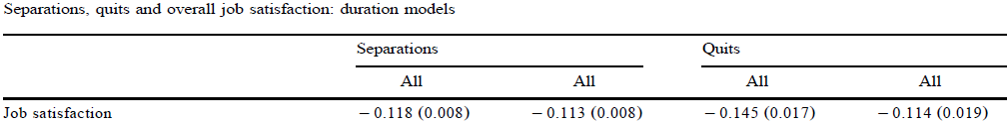
Not only are satisfied workers more productive, they are more likely to be there in the first place
Job satisfaction predicts absenteeism
and also worker quits (which are costly for the firm): an example from the BHPS

Slide 8
So What Makes a Good Job?
Two approaches.
Make up lists of the things that we think should matter in a job, and then calculate a weighted sum of these different characteristics: job quality indices. (JQ = ∑β’X).
2) Outsource this task to workers themselves, and ask them how happy they are in their job: often via job satisfaction questions.

Slide 9
Research Question:
Has everything been getting worse?

Slide 10
For the first approach, we do have some objective information on important job aspects.
Perhaps the most obvious is wages.
Notes:
10
Also the self-reported measures correlate with certain physiological states (brain activty)
But empirical results differ depending on what outcome measure is used
e.g see the Borooah paper on the reading list
self-assessed happiness question
v. usage of tranquilisers and antidepressants
v. thoughts of self-harm (inc suicide)

Slide 11
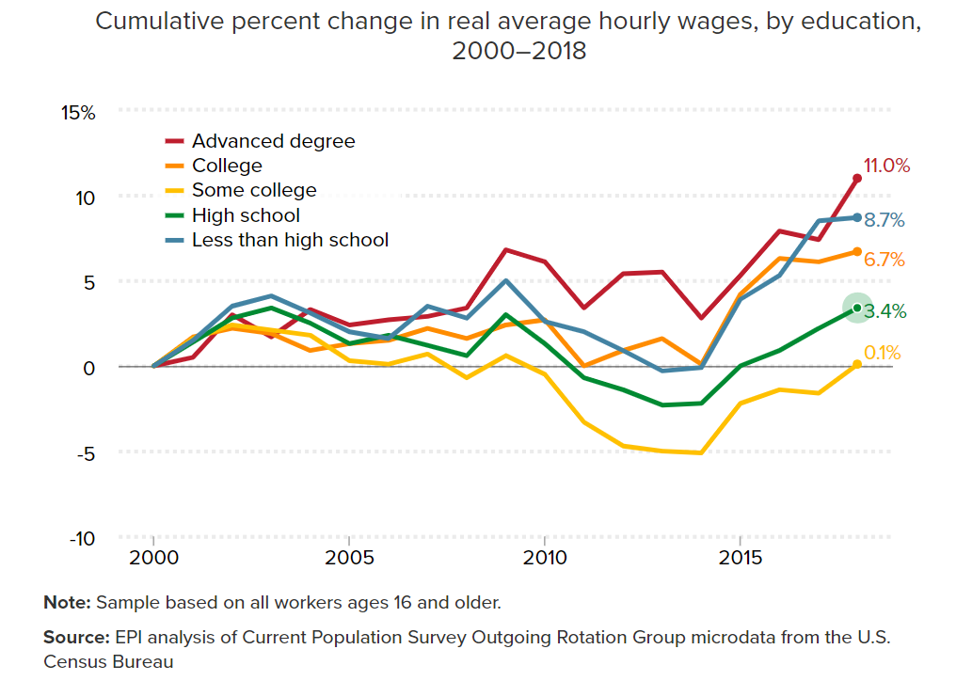
Higher wages are not always equally shared

Slide 12
Although evidence of rising income inequality in general is overall mixed
Notes:
12
Also the self-reported measures correlate with certain physiological states (brain activty)
But empirical results differ depending on what outcome measure is used
e.g see the Borooah paper on the reading list
self-assessed happiness question
v. usage of tranquilisers and antidepressants
v. thoughts of self-harm (inc suicide)

Slide 13
D
A
O
C

Slide 14
A second is hours of work.
Notes:
14
Also the self-reported measures correlate with certain physiological states (brain activty)
But empirical results differ depending on what outcome measure is used
e.g see the Borooah paper on the reading list
self-assessed happiness question
v. usage of tranquilisers and antidepressants
v. thoughts of self-harm (inc suicide)

Slide 15
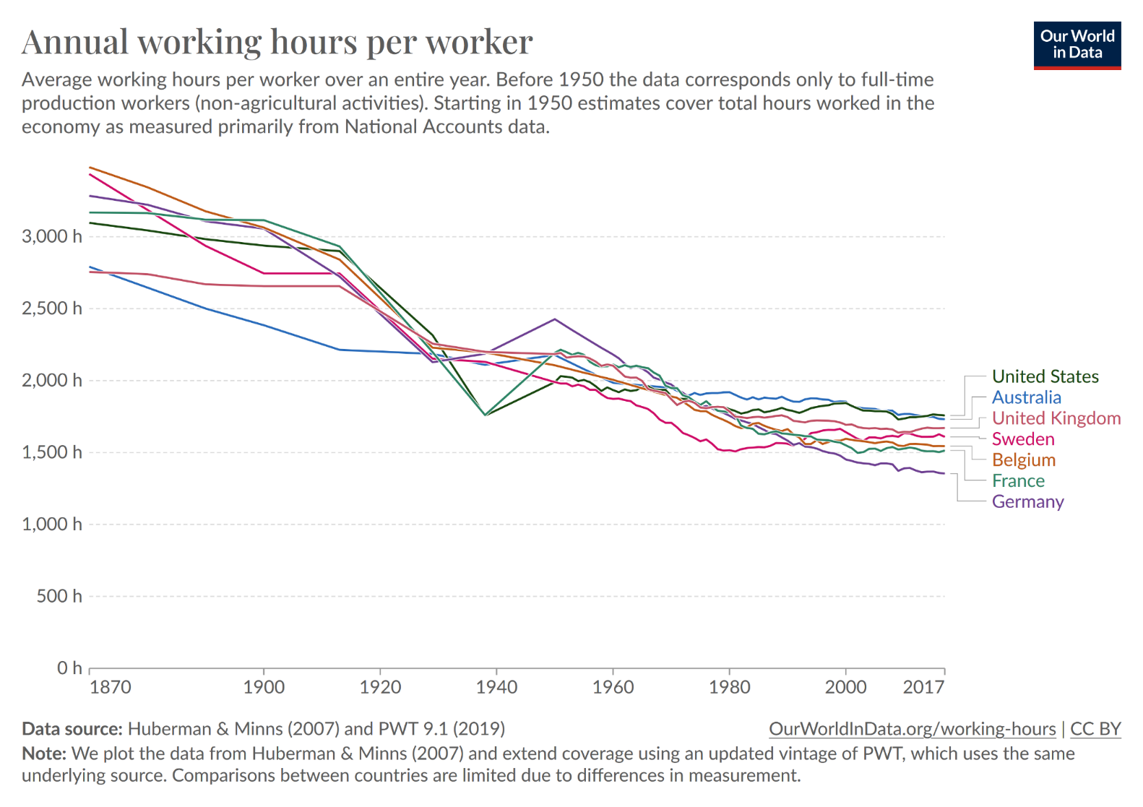
Continuing a very long-run time trend towards less work
(even if we won’t hit Keynes’s prediction of a 15-hour week by 2030)
Notes:
15
Also the self-reported measures correlate with certain physiological states (brain activty)
But empirical results differ depending on what outcome measure is used
e.g see the Borooah paper on the reading list
self-assessed happiness question
v. usage of tranquilisers and antidepressants
v. thoughts of self-harm (inc suicide)

Slide 16
There is also objective information on workplace accidents.
Notes:
16
Also the self-reported measures correlate with certain physiological states (brain activty)
But empirical results differ depending on what outcome measure is used
e.g see the Borooah paper on the reading list
self-assessed happiness question
v. usage of tranquilisers and antidepressants
v. thoughts of self-harm (inc suicide)

Slide 17
And workplace deaths
Notes:
17
Also the self-reported measures correlate with certain physiological states (brain activty)
But empirical results differ depending on what outcome measure is used
e.g see the Borooah paper on the reading list
self-assessed happiness question
v. usage of tranquilisers and antidepressants
v. thoughts of self-harm (inc suicide)

Slide 18
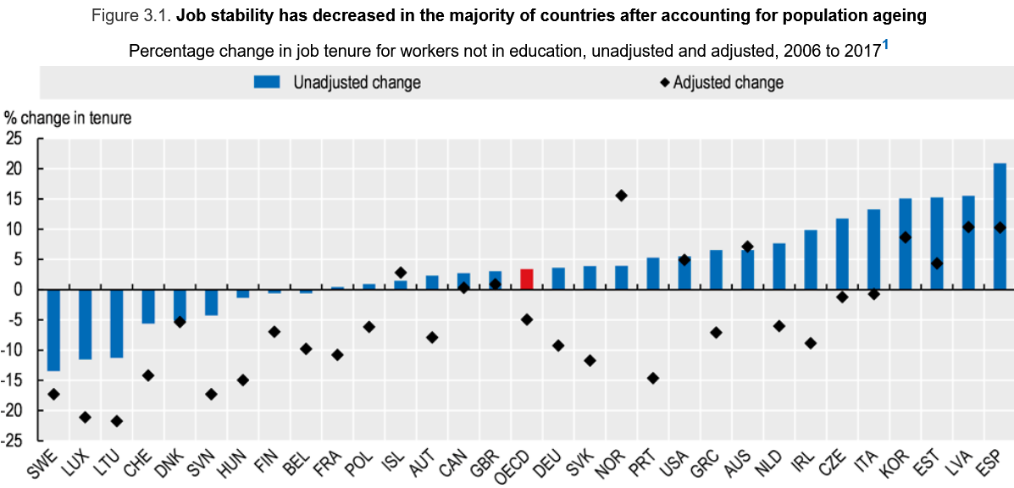
On the contrary, job tenure has been falling
Source: OECD Employment Outlook. The Future of Work (2019)

Slide 19
Although we should note that:
There is some evidence of shorter tenure above. But what is important for workers is involuntary job loss
What happens afterwards also matters: the consequences of job loss (unemployment benefits, unemployment duration, the characteristics of the new job). The advantages of flexicurity.

Slide 20
Other aspects of job quality are more difficult to measure objectively.
Opportunities for advancement
Hard physical work
Find your work stressful
Job is interesting, helps other people, useful to society
Autonomy
Good interpersonal relationships at work
+ potentially other things….

Slide 21
To make a statement about overall job quality (Who’s got it? How has it changed over time?), we need to add these various elements up.
We can ask employees to tell us which job aspects are important.

Slide 22
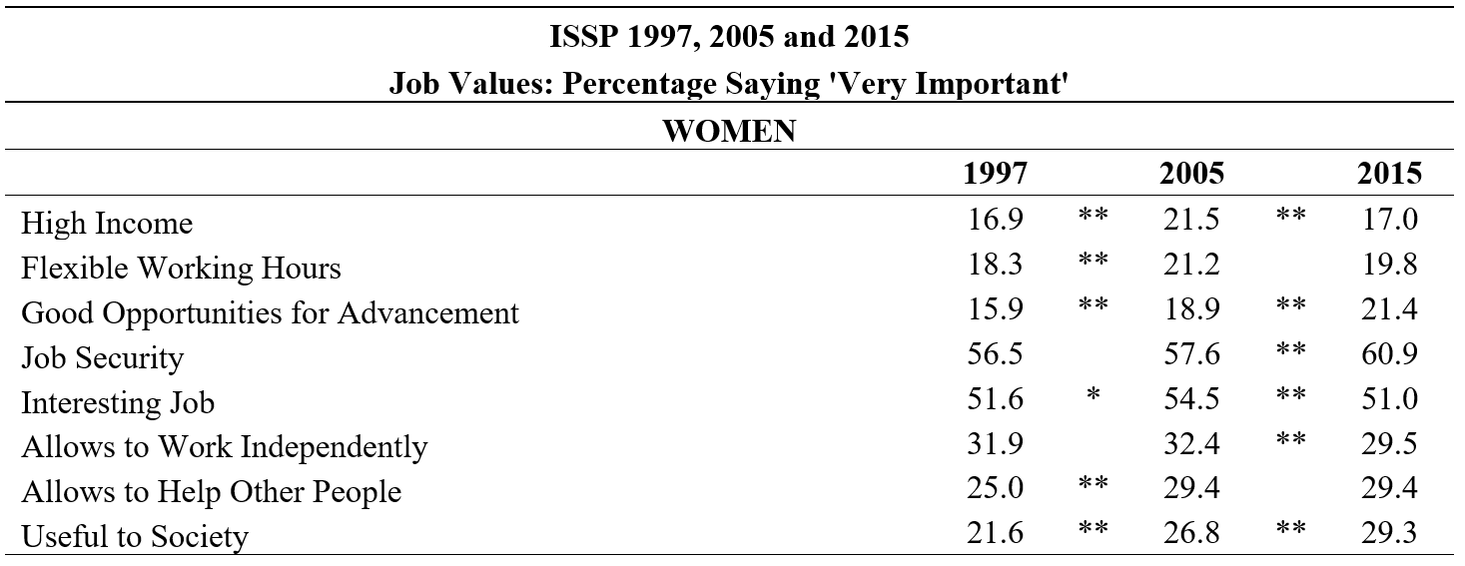
The job aspects that female workers overall report to be the most important are job security and job interest, followed (at a distance) by autonomy.

Slide 23
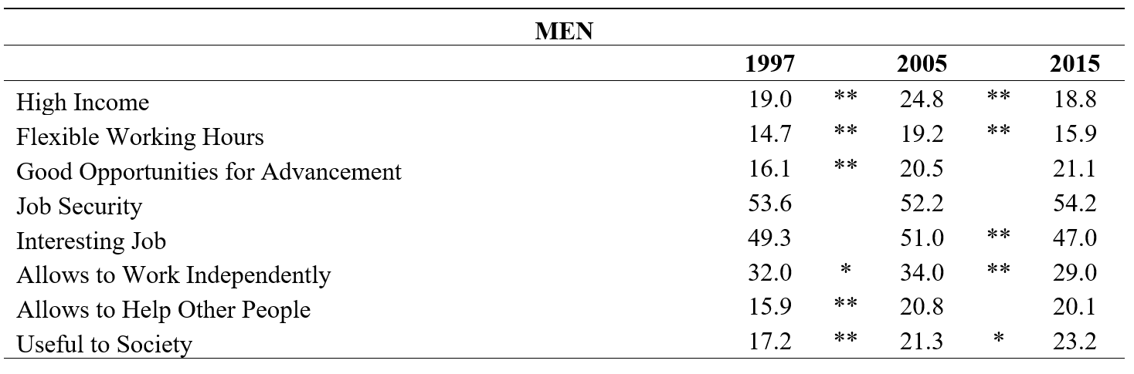
Exactly the same ranking holds for men

Slide 24
But in general, we do not have this kind of information on what job aspects are important for which employees.
And we also don’t know which other elements we should add to the list of job aspects.
Let’s make our life simple, and instead ask workers what they think.

Slide 25
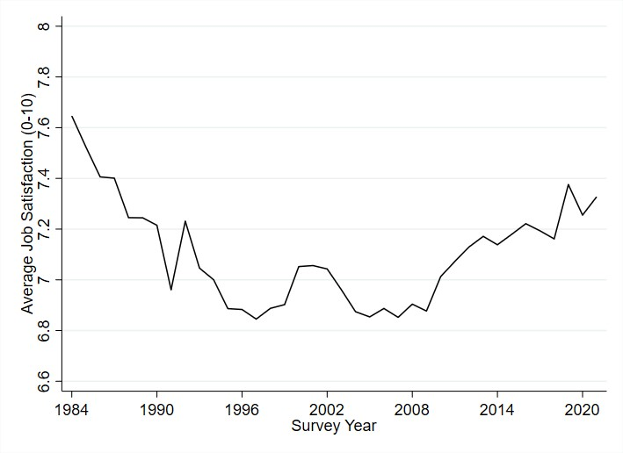
Job satisfaction has risen over time in Germany over the past 20 years (SOEP):

Slide 26
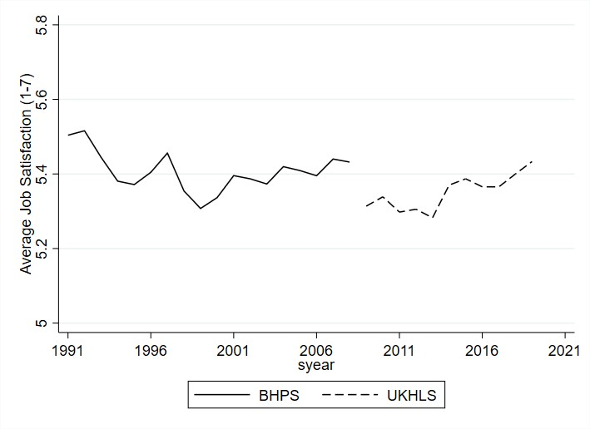
And in the UK (BHPS/UKHLS):

Slide 27
And in Australia (HILDA):

Slide 28
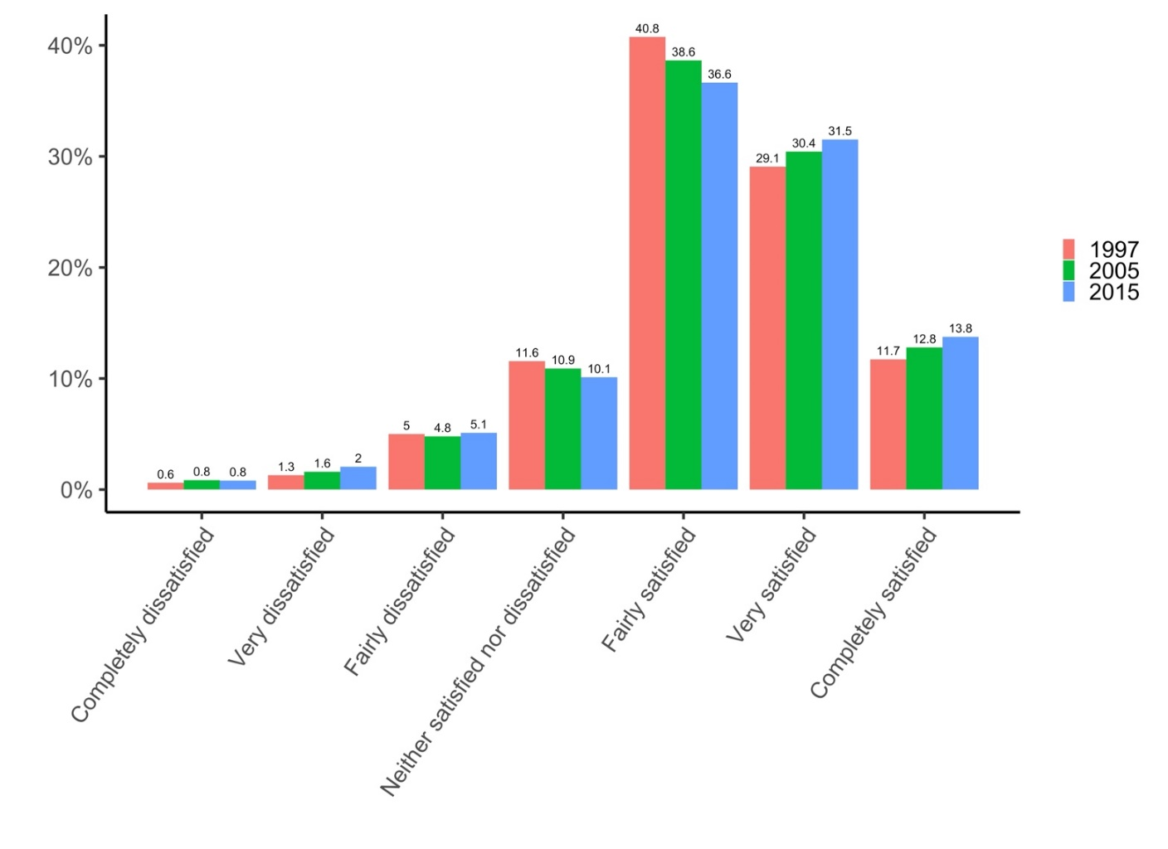
Also in the 13 countries that appear in the last three ISSP Work Orientations modules

Slide 29
This is mysterious, if we think that the World of Work has become more insecure.
But maybe it hasn’t.

Slide 30
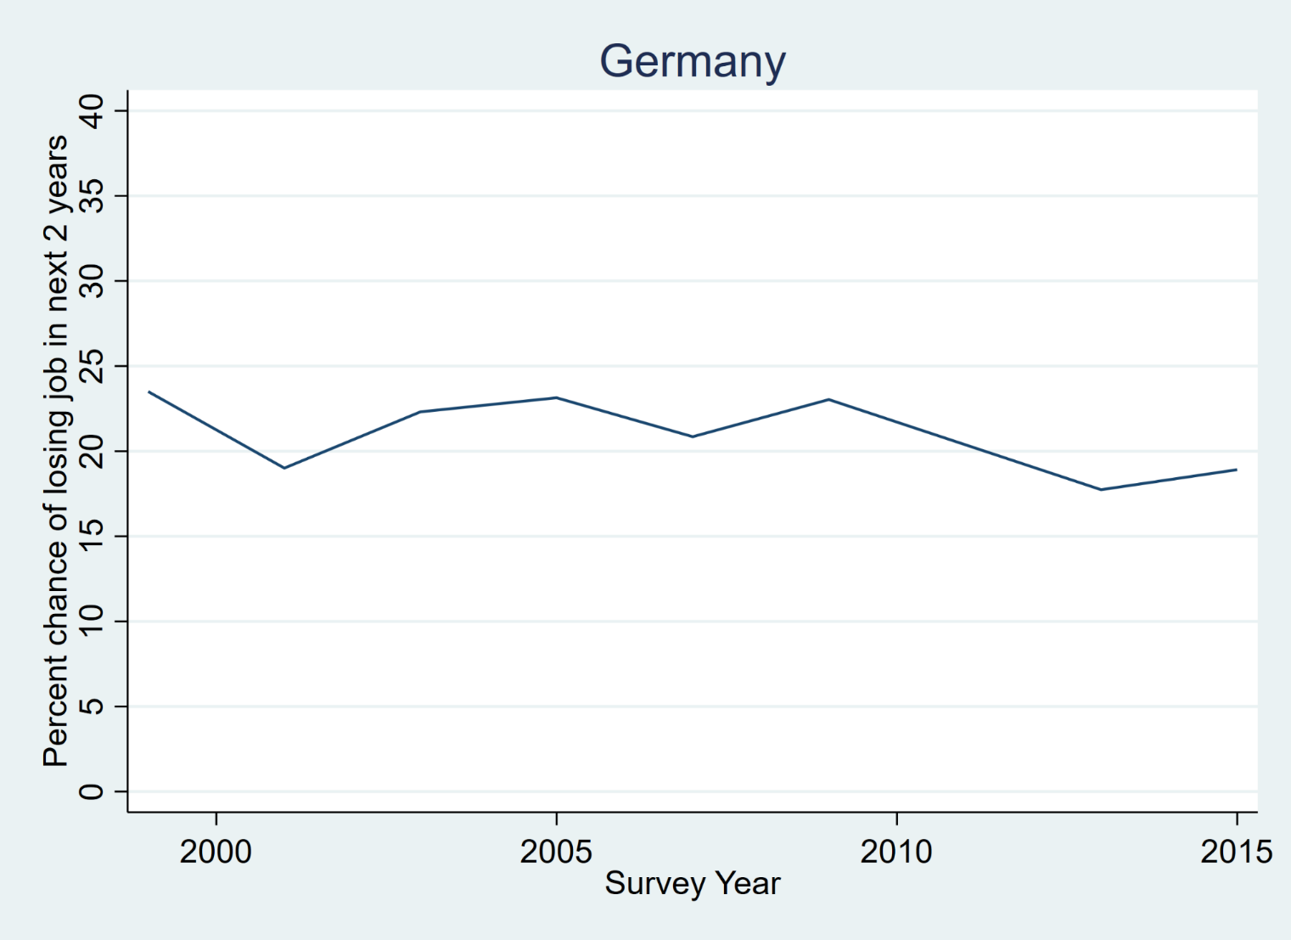
The self-reported Probability of Job Loss is fairly stable: SOEP, 1998-
Mean: around 20% probability of job loss in next two years

Slide 31
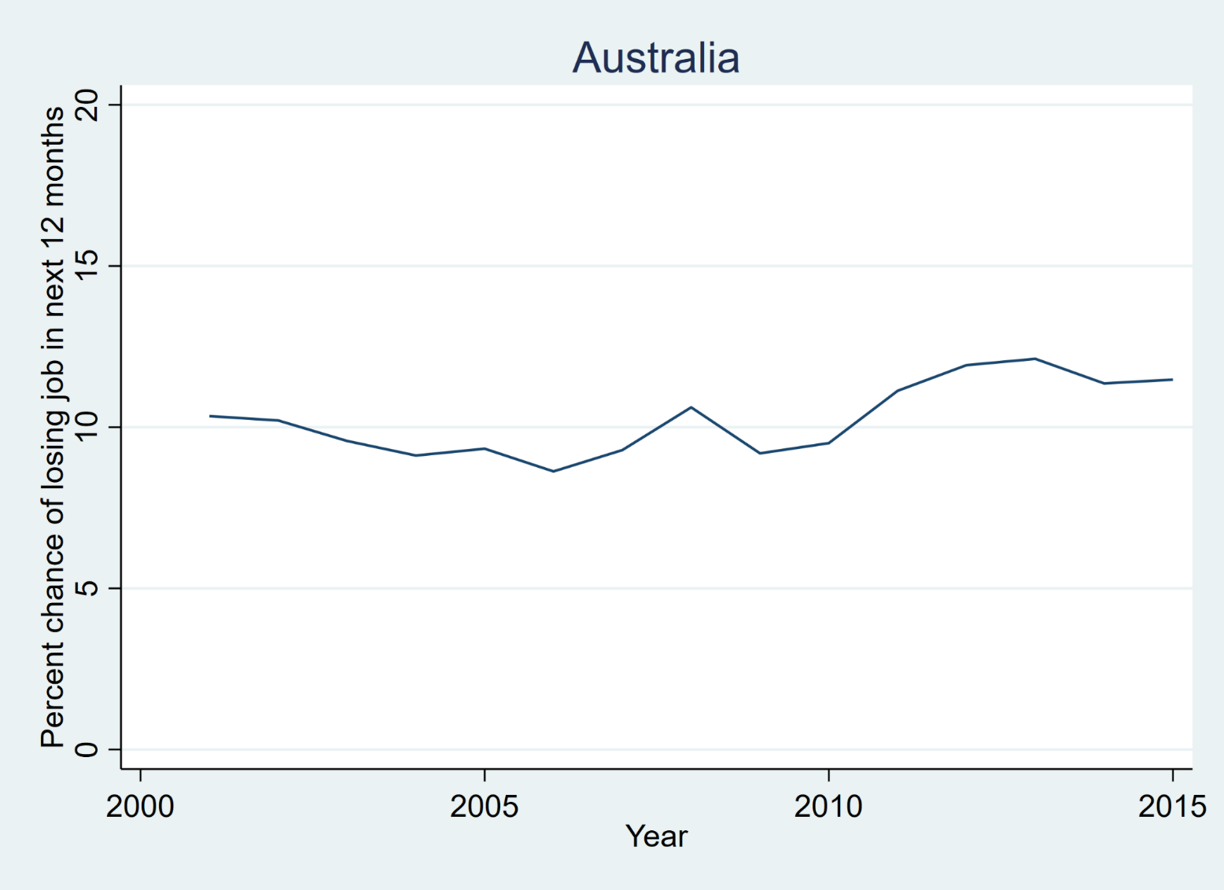
Ditto in Australia: HILDA
Mean: around 10% probability job loss in next 12 months

Slide 32
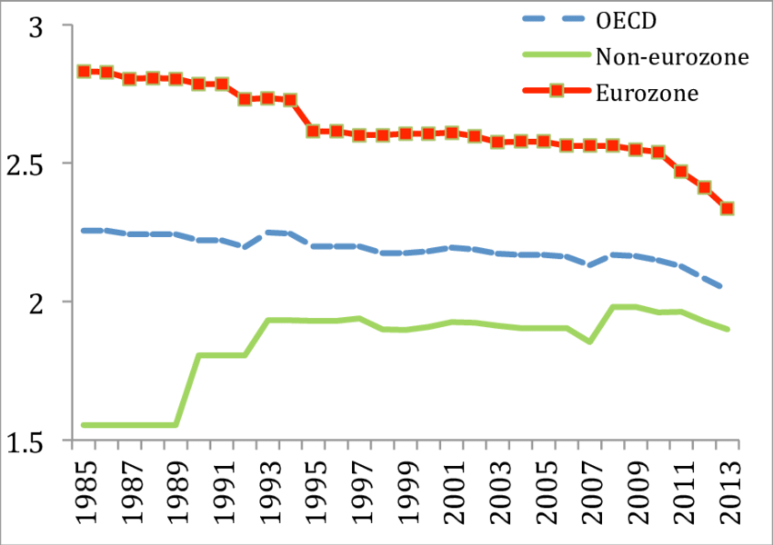
Some changes on the labour market may have made job loss more likely: less-stringent Employment Protection Legislation
OECD Employment Protection Legislation index

Slide 33
And since then… Belgium and Netherlands up; Lithuania, Slovenia, France, Italy and Portugal down. Most unchanged.

Slide 34
Less protection for the Employed from Trade Unions
Source: OECD Trade Union Dataset

Slide 35
But greater protection after job loss via unemployment benefits
Source: OECD Statistics

Slide 36
And protection from low wages
Source: OECD Statistics. Real Minimum Wages in Thousands of US Dollars 2020 PPP (Germany: MW started only in 2015)

Slide 37
Let’s put it all together: workers’ evaluation of their job security

Slide 38
ESS: perhaps a fall in security between 2004 and 2010 (but only two waves with information): effect of the Great Recession
Secure = Is Your Job Secure?: “True” or “Very True”

Slide 39
Long-run country panels. UK. BHPS up to 2008 (GR again)
Satisfied = Score of 6-7 on the 1-7 scale

Slide 40
Long-run country panels. Australia. HILDA up to 2020
Satisfied = Score of 8-10 on the 1-10 scale

Slide 41
Long-run country panels. Germany. SOEP up to 2020

Slide 42
Last, a general measure of financial insecurity (EU-SILC)

Slide 43
Equally, improvements in evaluations of income

Slide 44
And in workers’ evaluations of promotions

Slide 45
But not all news is good: work intensity has risen, and stressful work is ubiquitous

Slide 46
Work intensity and worker effort
In an efficiency-wage framework, effort will be higher as:
The cost of monitoring falls
The cost of firing shirking workers falls
The cost of shirking (foregone current and future wages) to workers rises
Remember that effort is not contractable: we are in the world of incentives.

Slide 47
Employment protection and effort
Consider absenteeism as an indicator of employee effort.
You can be absent because you’re sick, or because you shirk (“pulling a sickie”).
Most popular sick days are Monday and Friday
Sick days correlated with holidays and sporting events
Public-sector sick rates are 44% higher than in the private sector (selection of worse health to public sector?).
Effect of a probationary period before permanent job: Ichino and Riphahn (2005).

Slide 48
Employment protection and effort
The “standard” efficiency wage set-up is that the firm has to decide on costly monitoring (as a threat to workers) in order to maximise profits.
The situation here is different. In period 1, workers can be fired without cause. In period 2, they are protected and cannot be fired.
The firm has to decide on monitoring in period 1: its aim is to identify (and fire) as many “lazy” workers as it can.

Slide 52
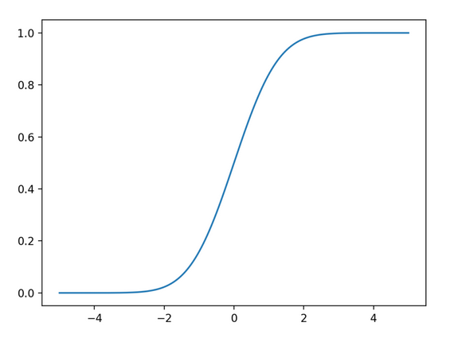
We read the probability of shirking off of the CDF function of V_{L}
θ_{L}
F_{L}(Wq)
This vertical line shifts to the right as monitoring rises or wages rise
Wq
V_{L}

Slide 56
In normal efficiency-wage theory, we can’t perfectly monitor worker effort, and set wages high enough to maximise profit
(the cost of higher wages is offset by workers’ greater effort due to the higher wages).
Here we don’t want to discourage shirking, but rather identify the maximum number of shirkers in the first period, so that we can costlessly sack them before they receive tenure.
The cost of monitoring is zero in this model.

Slide 57
Test the model on Italian data.
There is a probationary period with little protection (three months), followed by a sudden jump to a great deal of employment protection.
Data from a large Italian Bank (18 000 employees).
Information on 545 men and 313 women hired into white-collar positions (Jan. 1993 to Feb. 1995).
Observed over a full year following hiring.

Slide 58
The workers here are a fairly homogeneous group: young, with high-school education.
They calculate the number of days absent because “ill” per week (so that they have 52 x 858 observations).
A_{F}(9%) > A_{M} (5%): for family reasons?
But with a notable jump after 12 weeks of employment (end of probation).

Slide 61
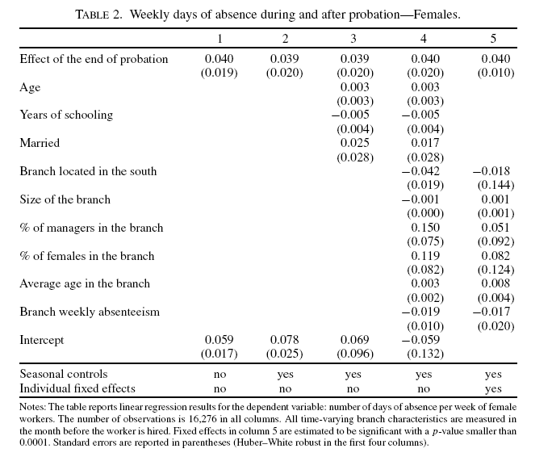

Slide 62
Jacob. Journal of Labor Economics. October 2013
2004 CB agreement between Chicago Public Schools and Chicago Teachers Union
Gives Principals the flexibility to dismiss teachers with less than 5 years experience without cause
Previously could dismiss teachers for enrollment or budgetary reasons (via LIFO); otherwise very difficult and time-consuming.
Ichino and Riphahn was a pre vs. post analysis. Here we can carry out a DiD analysis as there is a treated (<5 years) and a control (5+ years) group.

Slide 63
Annual teacher absence fell by 10%; frequent absence by 25%
Effect mostly between, but some evidence of a small within effect also.

Slide 64
Fixed and Variable Wages and Effort
Does effort always rise with wages, as standard efficiency-wage theory predicts? It may depend on how wages are received.
Traditional efficiency wage is e = e(w): effort rises with wages
Labour income might consist of a fixed and variable component:
Y = a + bX, where b is the piece rate for some output X.
Expect effort to rise with b, but what about a?

Slide 65
Mocan and Altindag. Economic Journal. December 2013
Evidence from a group we all know: MEPs.
Prior to July 2009, MEP salaries were determined by their home country: substantial variation across countries.
For example, the salary of a MEP from Poland was €29,043, whereas the salary of a member from Italy was €142,512.
Starting with the seventh term in the summer of 2009, MEP salaries were equalised to €91,983 and then increased slightly in each subsequent year.
This produced a large exogenous change in non-labour income for most MEPs.

Slide 66
Other salary elements:
Some MEPs live in their home country and receive travel expenses.
MEPs also receive allowances for their expenses related to costs of running their offices.
Each parliamentarian receives a per diem compensation for each day they attend the parliamentary sessions. This per diem pay, which was €262 in 2004, was increased each year and went up to €304 in 2011.
The base salary and per diem are our a and b respectively

Slide 67
The measure of effort here is attending the meeting days (for example, there were 63 European Parliament meeting days in 2008).
Examine the attendance record of each MEP (NB. this within analysis avoids any problem of selection: higher salaries encouraging less intrinsically-motivated MEPs).
Higher base salary reduces the marginal utility of income, and may then reduce effort (makes delta income less valuable compared to delta leisure).

Slide 68
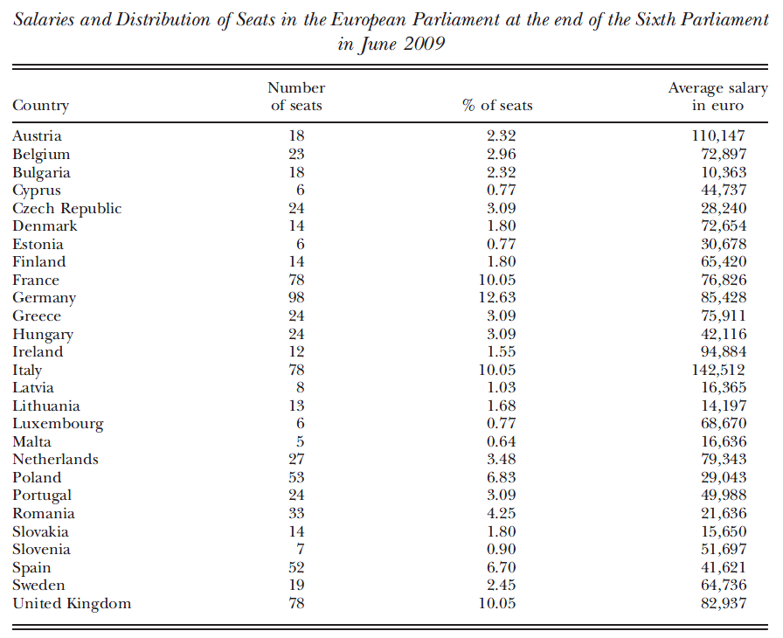
Salary losers from the reform were Italy, Austria and Ireland.

Slide 69
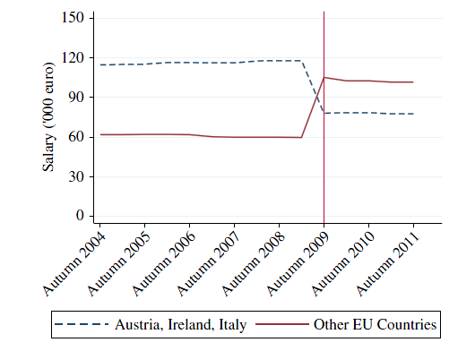
Post-reform difference not zero because these are PPP figures.

Slide 70
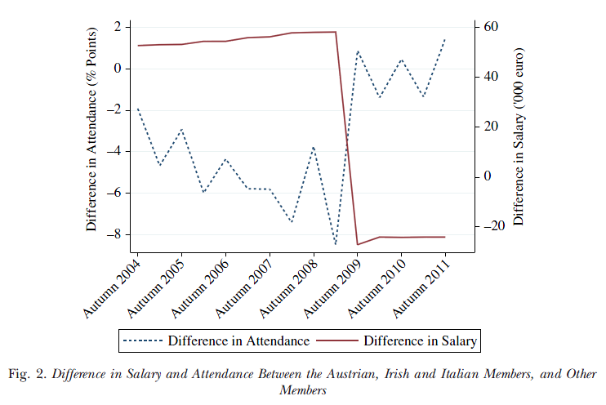
Red line shows delta salary between losers and winners; blue line shows delta attendance between the same two groups

Slide 71
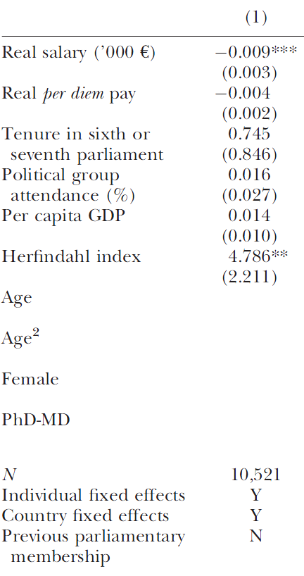
Effort falls with real fixed salary; no correlation with per diem (which is positive in some other specifications though).
Herfindahl index shows the extent of competition faced by MEPs in their home country (by the share of votes cast for each party in the country’s EU elections). Less competition at home (higher Herfindahl) brings greater attendance.

Slide 72
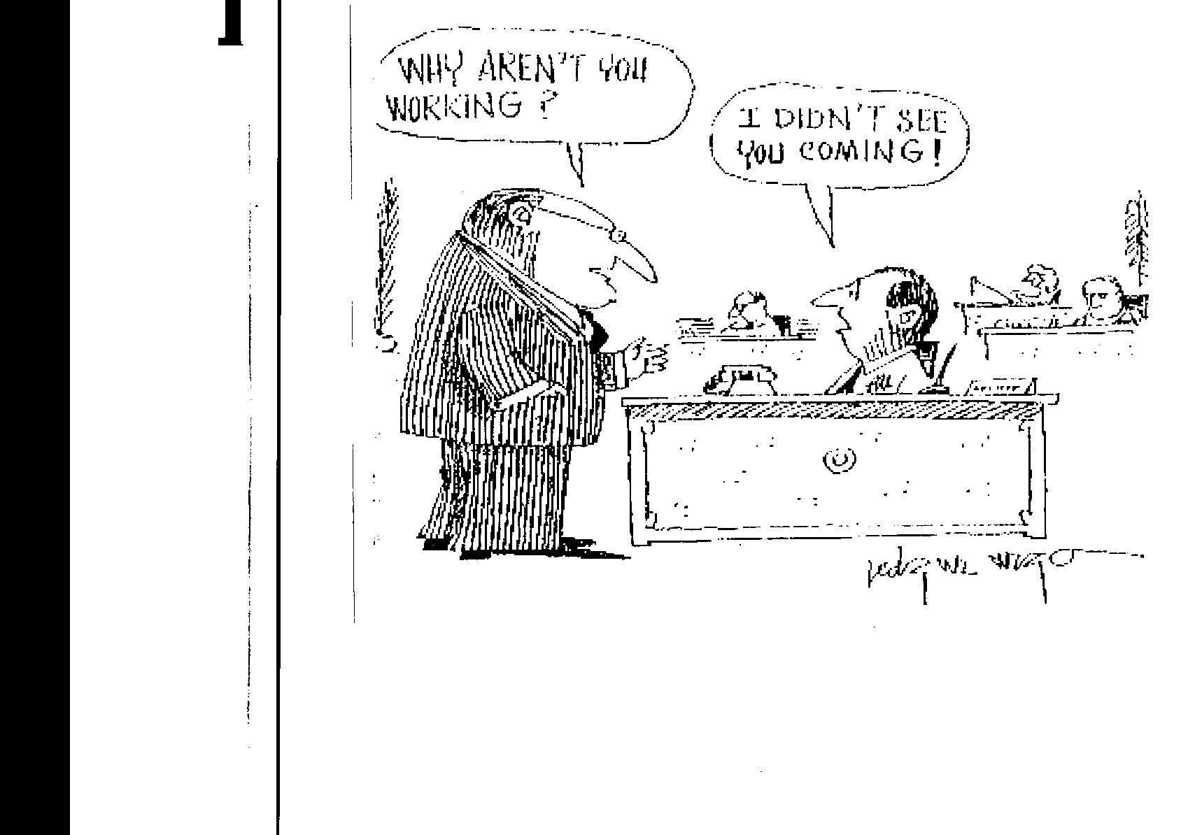
Does Monitoring Work?

Slide 73
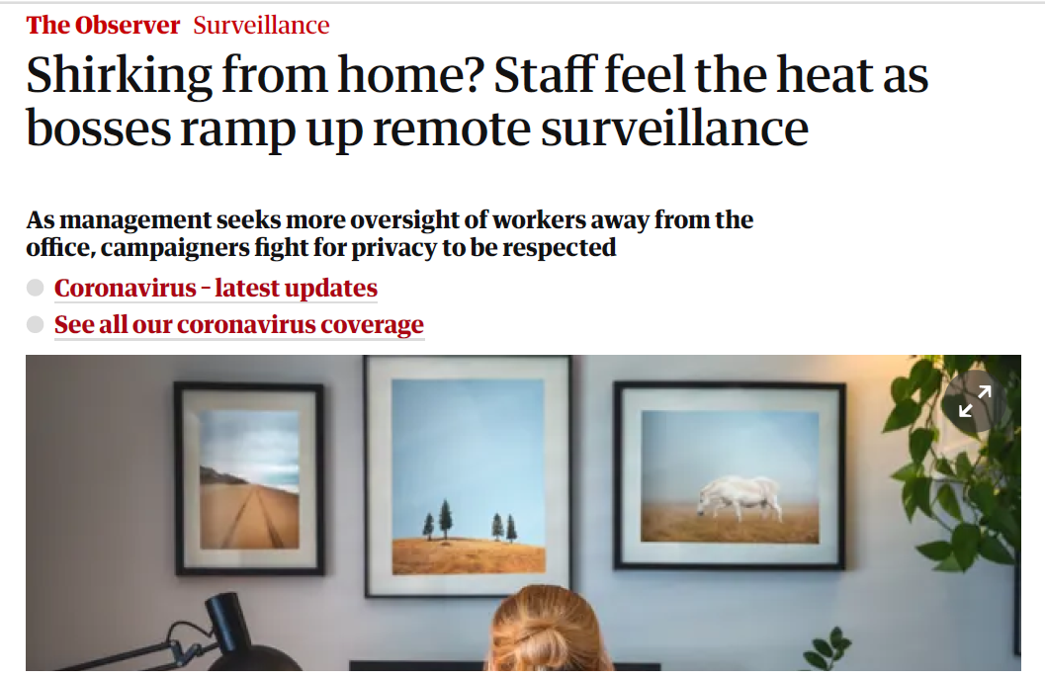
Currently relevant…

Slide 74
Nagin et al., AER (2002).
Employees are “rational cheaters”, and shirk more as monitoring falls.
The threat here is dismissal from the job.
Experimental approach. Call-centre operators at 16 sites, who are soliciting donations by ‘phone.
They are paid on a piece-rate plus a base salary: pay rises with no. successful solicitations (people who are rung and then say that they will donate).
This number of successful solicitations is self-reported.

Slide 75
Solicitor i rings ten numbers:
No. Self-report
No
Yes
No
No
No
Yes
No
Yes
No
Yes

Slide 76
Some time later (weeks, months), some of these pledges are actually received. The receipt of money cannot be linked to information on solicitor and telephone numbers rung. Say that only 75% of self-reported pledges are received. We cannot know whether any one individual cheated by reporting “too many” successful solicitations.
Check opportunistic behaviour via callback –ring back some of the numbers above (2, 6, 8, 10) which were reported as positives. Not all of them, as callback is expensive.
If the pledge is repudiated, logged as a “bad call”.
Note some bad calls may actually not be cheating, if the person called has changed their mind.
Operators who “cheat” have pay docked, and may be fired.

Slide 77
The employer varied the fraction of bad calls that were reported back to employees and supervisors (the observable monitoring rate) in four of the 16 sites.
At the same time, the actual monitoring rate was increased from 10% to 25% at these four sites.
But the number of bad calls reported back to employees and supervisors was “as if” the monitoring rate were 0%, 2%, 5% or 10%.
There was variation both across site and (within-site) over time in these rates.

Slide 78
As EW theory would predict, the number of “bad calls” responds to the call-back rate. The greater was the observed monitoring rate last week, the fewer bad calls were made this week.
Heterogeneity in worker response. Those with “positive attitudes” respond less to monitoring.
And attitudes are shown to be function of y*, estimated from a wage equation: the more others like me earn, the less positive are my attitudes, and the more responsive I am to opportunities to cheat…
Gift-exchange between relative wages and cheating

Slide 79
McVicar, Labour Economics (2008).
Considers job-search effort by the unemployed, rather than work effort by the employed.
Quasi-experimental: random variation due to the refurbishment of Benefit Offices in Northern Ireland.
The unemployed used to look for jobs at Job Centres, and draw benefits at Benefits Offices.
Benefits were received conditional on evidence of job search (“Job Seeker’s Agreement”).

Slide 80
Efficiency programme combines “jobs and benefits”, and required the refurbishment of Benefit Offices.
These were in turn shut during refurbishment, leading to the suspension of the fortnightly monitoring interviews (there was no substitute monitoring).
Subsequent periods of zero monitoring of the unemployed were associated with a 16% fall in all exits from unemployment.
This effect particularly strong for exits to employment: consistent with lower job-search effort.

Slide 81
Temporary Jobs and Work Effort.
Temporary employment is potentially a stepping stone to a good job.
Temporary workers are less-protected: they are easier to fire.

Slide 82
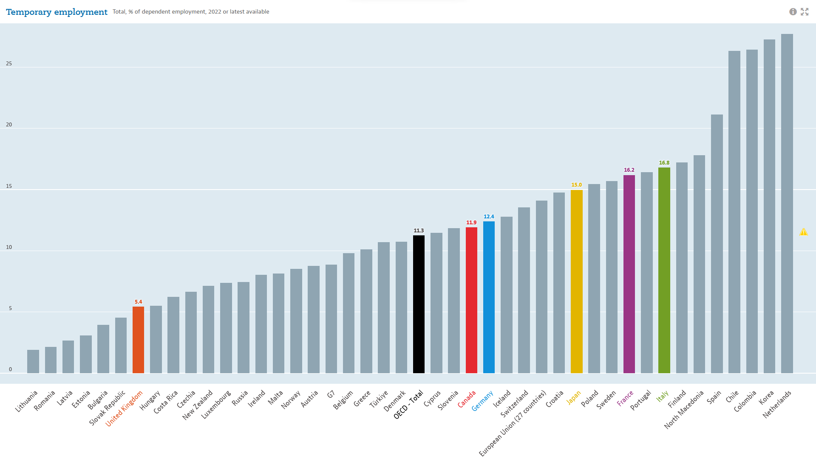

Slide 83
Temporary Jobs and Work Effort.
Temporary workers have a greater incentive to supply effort (the rewards are greater), in order to obtain a permanent job.
Engellandt and Riphahn, Labour Economics, 2005.
Swiss LFS data.
Effort measured by absenteeism and unpaid OT.
Definition of absenteeism pretty stringent: missed the week prior to the interview (Yes/No).

Slide 84
Engellandt and Riphahn observe that P(Temp → Perm) positively correlated with worker effort when Temporary.
Workers are assumed to prefer permanent to temporary jobs.
Perm Temp
Absence 1.2 0.8
UOT 20.6 27.7

Slide 85
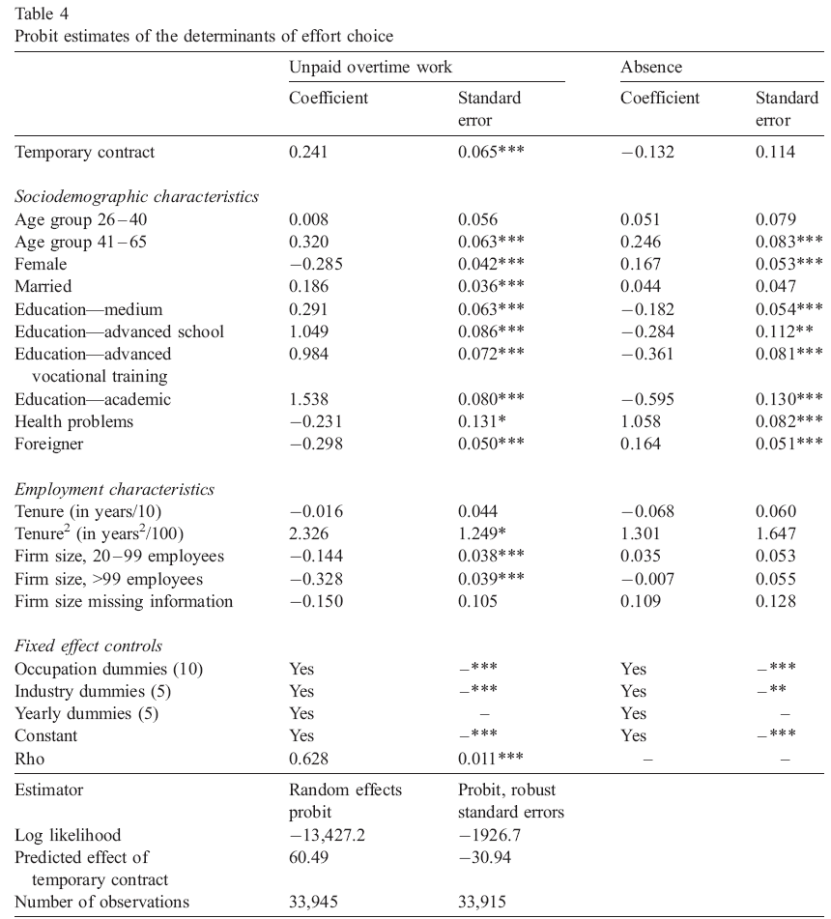

Slide 86
Extensions (to standard EW)
What about the workers, who have been pretty mute so far?
Think of a potential role for unions: effort might be bargained over.
Clark and Tomlinson (2001).
Data from Employment in Britain, 1992.
Measure discretionary effort:
“How much effort do you put into your job, beyond what is required”?
Immodest replies (N=2700):
Effort %
None 3
Little 6
Some 23
Lot 68

Slide 87
Regression for Effort
Econometrics shows that effort rises with:
Wage
Liking hard work (slope of IC)
Ease of dismissal
Performance pay
Effort falls with
f) Male
g) Unions
These are multivariate results, so the union effect is conditional on wages.

Slide 88
Regression for Effort
Note that this result is all the more surprising, in that firms with worse work conditions are more likely to unionise.
Union = α BadConditions + …. (1)
BadConditions = γ Union + …. (2)
α is positive but γ is negative.
The naïve regression (2) will then underestimate how much unions reduce risk.
We’d like to instrument unions (by a change in legislation)

Slide 89
The Psychology of Effort
Any role for income comparisons: e = e(y/y*)?
I feel hard done by (relatively) by my firm, so I provide less effort.
Clark, Masclet and Villeval (2010)
Mixed methods:
Survey data from the 1997 ISSP on discretionary effort;
A gift-exchange game in the laboratory.

Slide 90
2. Empirical strategy
Joint use of a lab experiment based on a gift-exchange game and
survey data from the 1997 International Social Survey Program
Experimental data: A direct measure of the willingness to contribute
Better control of the reference group
Survey data: Questions related to the willingness to exert effort
Large sample size with employed people
Possibility of cross-country comparisons
Offers a potential check of the external validity of experimental data

Slide 91

A lab experiment with between-firm comparisons
  Benchmark Treatment: Gift-Exchange Game
N=20 subjects, with 10 firms and 10 a priori similar employees
Stage 1: After being randomly matched with an employee, the firm offers a contract
Stage 2: The employee accepts or rejects
In case of rejection, both earn 0
In case of an acceptance, choice of level of effort
Convex cost function

Slide 92
Firm’s payoff: with v=120
Employee’s payoff:
with ‘transportation costs’=20
Feedback to the employee: own payoff
  Information Treatment
End of stage 1: employees (not firms) receive information on their reference group’s incomes before accepting the contract
Information set: income levels of 4 other employees
Theoretical predictions
Same SPNE in both treatments: e*=0.1 => w*=20

Slide 93
Experimental procedures
Regate software, GATE Lyon
120 participants from undergraduate classes in engineering and business schools
6 sessions (with 20 participants each): 2 sessions in the Benchmark Treatment (200 obs.) + 4 sessions in the Information Treatment (400 obs.)
10 repetitions with a Perfect Stranger matching protocol
At each of the 10 periods, in the Info Treatment, the set of 5 incomes
come from randomly chosen firms
80 different income distributions
60 minutes
Average earnings: € 14. Show-up fee: € 5

Slide 94
Survey data: 1997 Work Orientations module of the International Social
Survey Program (ISSP: http://www.issp.org)
11,987 individuals aged 16-65 in full or part-time jobs
17 countries
Key variables:
Earnings: individual, yearly earnings
Weekly hours of work
Discretionary effort at work (scaled from 1 to 5):
“I am willing to work harder than I have to in order to help
the firm or organization I work in to succeed”
= Equivalent to effort in the experiment

Slide 96
e_{i}=f(y_{i},y*, h_{i})
Reference group income y* = average values by broad demographic groups
(Leyden School- see van Praag and Frijters, 1999)
Average earnings calculated by
  - Country (17)
  - Sex
  - Education: 3 groups (10 or fewer years of education / 11 to 13 /
  over 13 years education)
  - Age groups: 3 groups (16 to 29 / 30 to 44 / 45 to 65)
  306 reference group income cells (= y*)
  Normalized earnings rank = 1- (rank in cell / #obs. in the cell)

Slide 97
Results:
Effort is strongly correlated with own absolute income
Effort increases with the rank in the income distribution, and falls with income in the reference group.

Slide 98
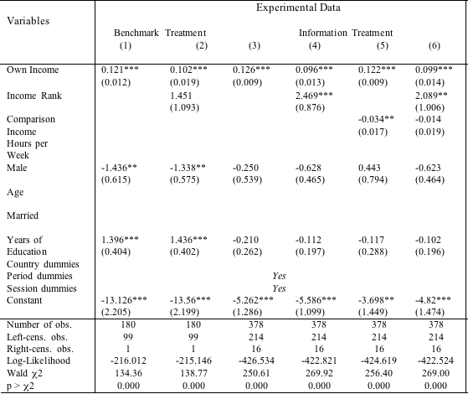
The rank-dependence of effort (Random-effect Tobit model)
Placebo test

Slide 99
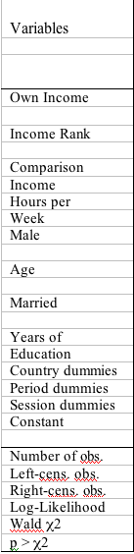
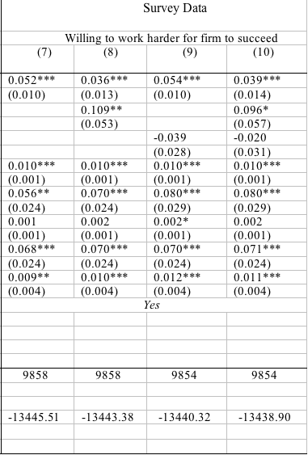

Slide 100
Effort and Comparisons over time
Hypothesis: past exposure to higher incomes may reduce the utility associated with current income and decrease the current level of effort
Not easy to test with field data because of the difficulty to ensure that ceteris paribus holds over long time-periods between waves.
Experimental data ideally suited to test models of habituation: same environment over time
Test: we estimate the influence of the running minimum and running maximum incomes and ranks on the current level of effort
Inspired by the peak-end transformation in psychology
(Redelmeier and Kahneman 96)

Slide 101
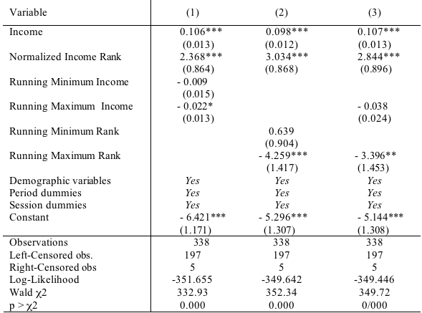
Past income matters! (Random-effect Tobit on experimental data only)

Slide 102
Perceived Fairness and Effort
In general, effort likely depends on how well the workers think that they are treated.
Krueger, A., and Mas, A. (2004). "Strikes, Scabs and Tread Separations: Labor Strife and the Production of Defective Bridgestone/Firestone Tires". Journal of Political Economy, 112, 253-289.
The Decatur (GA) tyre plant had a long and contentious strike in the mid-1990s.
Replacement workers were used during the strike, and then union workers rehired after the strike had ended.

Slide 103
Take a Diffference-in-Difference approach:
Compare Decatur to the other Bridgestone plants pre- and post- the dispute period.
Outcome variables: complaints from customers, and fatal accidents.
They find that just over 50% of fatal accidents were linked to these tyres due to excess defects associated with the labour dispute.

Slide 104
Effort and Loss-Aversion
Abeler, J., Falk, A., Goette, L. And Huffman, D., "Reference points and effort provision". American Economic Review, April 2011.
Experimental approach.
Subjects work on a tedious task: counting the number of zeros in tables that consisted of 150 randomly ordered zeros and ones.
Two stages
During the first stage, subjects had four minutes to count as many tables as possible. They received a piece rate of 10 cents per correct answer for sure.

Slide 105
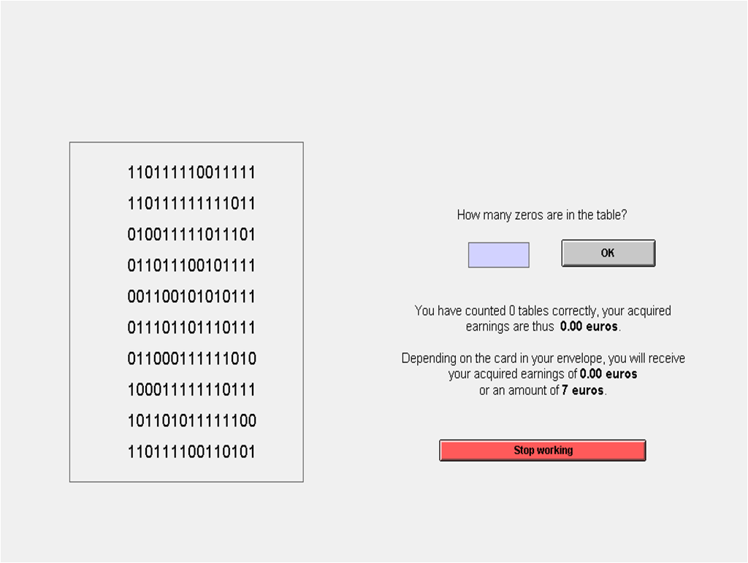
Count zeros in tables shown on the screen
  Boring and pointless task
  Very low intrinsic motivation
  Output of no intrinsic value to the experimenter

Slide 106
In the second (and main) stage, the task was again to count zeros, but there were two main differences compared to the first stage.
First, they could now decide themselves how much and for how long they wanted to work. At most, they could work for 60 minutes.
How much subjects chose to work is the main outcome variable in the analysis of effort.
The second difference was that subjects did not get their accumulated piece rate earnings from the main stage for sure. Before they started counting in the main stage, they had to choose one of two closed envelopes. They knew that one of the envelopes contained a card saying “Acquired earnings” and that the other envelope contained a card saying “3 Euros.” But they did not know which card was in which envelope.
Uncertainty is resolved only after they have stopped working

Slide 107
There were two main treatments. The only difference between these treatments was:
the amount of the fixed payment: 3 Euros or 7 Euros. Treatments were assigned randomly to subjects.
If the fixed payment is f, the piece rate is w and effort is e:
Optimal effort e* is independent of the fixed payment, f.

Slide 108
This makes sense, and underlines an important economic truth: for a variable (price, others’ actions, whatever) to affect my behaviour, it must affect the net marginal utility (= marginal utility – marginal cost) from my actions. A deadweight effect on utility is like a sunk cost and won’t change behaviour.
The findings are that those in the 7 Euro fixed payment treatment work significantly longer before stopping.
How can this be explained?
Is this just tracing out a labour supply curve? Have we just shown dH/dw > 0?
No, because you receive f (with probability of 0.5) whether you work for 30 seconds or the full hour.

Slide 109
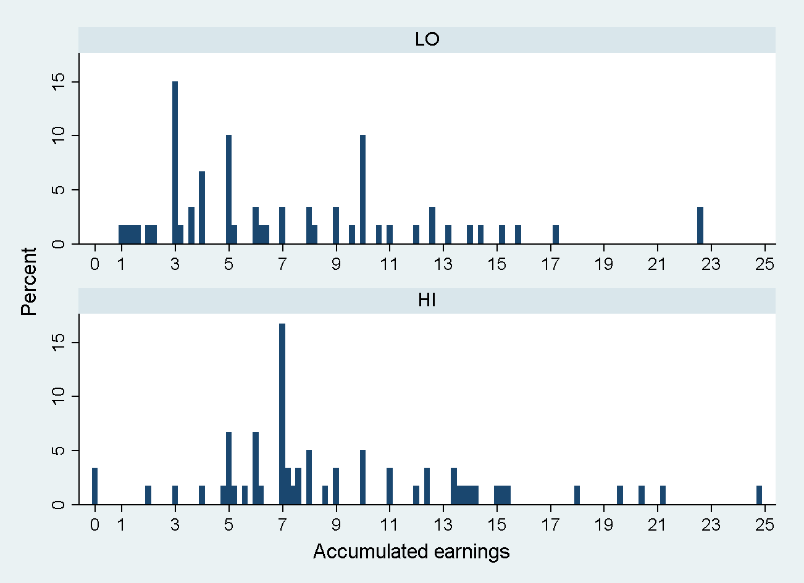
Many subjects stop when accumulated earnings equal the fixed payment (continuous updating of no. of tables correctly evaluated).
HI vs. LO (N=120)
Stopping at 3 euros
LO: 15.0 %
HI: 1.7 %
U-test: p=0.009
Stopping at 7 euros
LO: 3.3 %
HI: 16.7 %
U-test: p=0.015
Stopping at f modal choice in both treatments
(Note: piece rate is 20 cents per table in this main stage)

Slide 110
Mann-Whitney U-test
Also known as a Wilcoxon Rank-Sum Test
Non-parametric test of the null that two populations are the same.

Slide 111
The authors argue that f affects H via the marginal utility of piece rate earnings (=we, which are received with probability of 0.5).
Often, people compare their outcome to some reference point, as in loss aversion (Kahneman & Tversky 1979)
Examples:
Paying an unexpectedly high price for a good
Not getting an expected wage increase
Being rejected after a "revise & resubmit" vs. being rejected directly
Specifically, f acts as a benchmark, and earning less than f (from the piece rate payment) is perceived as a loss. Individuals are loss-averse and thus act to reduce the chance that this happens.

Slide 112
Conclusion
Overall job satisfaction has been rising in the 21st Century
No overwhelming evidence that job security has fallen on average
But Job Intensity may have risen
Wages went up (and increased worker effort: lose more by shirking)
The cost of monitoring fell
Easier to sack shirkers: EPL has fallen in many countries.
Declining unionism

Slide 113
References
Abeler, J., Falk, A., Goette, L., and Huffman, D. (2011). "Reference Points and Effort Provision". American Economic Review, 101, 470-492.
Arai, M., and Thoursie, P. (2005). "Incentives and Selection in Cyclical Absenteeism". Labour Economics, 12, 269-280.
Askenazy, P. (2004). Les désordres du travail. Paris: Le Seuil.
Booth, A.L., Francesconi, M., and Frank, J. (2002). "Temporary Jobs: Stepping Stones or Dead Ends?". Economic Journal, 112, F189-F213.
Clark, A.E. (2003). "Unemployment as a Social Norm: Psychological Evidence from Panel Data". Journal of Labor Economics, 21, 323-351.
Clark, A.E. (2005). "What Makes a Good Job? Evidence from OECD Countries". In S. Bazen, C. Lucifora, and W. Salverda (Eds.), Job Quality and Employer Behaviour. Basingstoke: Palgrave Macmillan.
Clark, A.E. (2005). "Your Money or Your Life: Changing Job Quality in OECD Countries". British Journal of Industrial Relations, 43, 377-400.
Clark, A.E., Knabe, A., and Rätzel, S. (2010). "Boon or Bane? Others' Unemployment, Well-being and Job Insecurity". Labour Economics, 17, 52-61
Clark, A.E., Masclet, D., and Villeval, M.-C. (2010). "Effort and Comparison Income". Industrial and Labor Relations Review, 63, 407-426.
Clark, K., and Tomlinson, M. (2001). "Effort and Earnings: Evidence from the Employment in Britain Survey". University of Manchester, mimeo.

Slide 114
Engellandt, A., and Riphahn, R. (2005). "Temporary contracts and employee effort". Labour Economics, 12, 281-299.
Green, F. (2006). Demanding Work: The Paradox of Job Quality in the Affluent Economy. Princeton: Princeton University Press.
Green, F., and Tsitsianis, N. (2005). "An Investigation of National Trends in Job Satisfaction in Britain and Germany". British Journal of Industrial Relations, 43, 401-429.
Ichino, A., and Riphahn, R. (2005). "The Effect of Worker Protection on Worker Effort: Absenteeism During and After Probation". Journal of the European Economic Association, 3, 120-143.
Jacob, B. (2013). "The Effect of Employment Protection on Teacher Effort". Journal of Labor Economics, 331, 727-761.
Kahneman, D., and Tversky, A. (1979). "Prospect Theory: An Analysis of Decision Under Risk". Econometrica, 47, 263-291.
Krueger, A., and Mas, A. (2004). "Strikes, Scabs and Tread Separations: Labor Strife and the Production of Defective Bridgestone/Firestone Tires". Journal of Political Economy, 112, 253-289.
Manning, A., and Mazeine, G. (2020). "Subjective Job Insecurity and the Rise of the Precariat:Evidence from the UK, Germany and the United States". CEP, Discussion Paper No 1712

Slide 115
McVicar, D. (2008). "Job search monitoring intensity, unemployment exit and job entry: Quasi-experimental evidence from the UK". Labour Economics, 15, 1451-1468.
Mocan, N., and Altindag, D. (2013). "Salaries and Work Effort: An Analysis of the European Union Parliamentarians". Economic Journal, 123, 1130–1167.
Nagin, D., Rebitzer, J., Sanders, S., and Taylor, L. (2002). "Monitoring, Motivation, and Management: The Determinants of Opportunistic Behavior in a Field Experiment". American Economic Review, 92, 850-873.
Redelmeier, D., and Kahneman, D. (1996). "Patients' memories of painful medical treatments: real-time and retrospective evaluations of two minimally invasive procedures". Pain, 66, 3-8.
Ripahn, R. (2004). "Employment protection and effort among German employees". Economics Letters, 85, 353-357.
Schmitz, P. (2005). "Workplace surveillance, privacy protection, and efficiency wages". Labour Economics, 12, 727-738.
OECD. (1997). "Is Job Insecurity on the Rise in OECD Countries?". OECD Employment Outlook.

