Slide 1
The Measurement and Validity of Well-being
Andrew E. Clark (Paris School of Economics - CNRS)
http://www.parisschoolofeconomics.com/clark-andrew/

Slide 2
What Do You Want from Life?
We all want to live a good life
And we all want to live in a Society that is doing well.
But how do we know if we are?
Notes:
Objective list – based on assumptions about basic human needs & rights
Preference satisfaction
Preferences inferred via the choices people make
Because in economic theory utility is what is maximised when people choose between alternatives
Greater WB comes from ability to satisfy more prefs
Kahneman refers to this as decision utility (in contrast to experienced utility)
Mental state
Survey accounts
Back to the Benthamite view of utility as hedonic quality of experience
In some situations the choice (pref) based and survey based accounts coincide but in many they diverge i.e. we do not always choose what increases our own SWB

Slide 3
Social Science agrees that these are important questions
What it doesn’t agree on is how to measure the good life.
Very broadly speaking, there are three approaches. Each is associated with a different discipline.
3
Notes:
3
Objective list – based on assumptions about basic human needs & rights
Preference satisfaction
Preferences inferred via the choices people make
Because in economic theory utility is what is maximised when people choose between alternatives
Greater WB comes from ability to satisfy more prefs
Kahneman refers to this as decision utility (in contrast to experienced utility)
Mental state
Survey accounts
Back to the Benthamite view of utility as hedonic quality of experience
In some situations the choice (pref) based and survey based accounts coincide but in many they diverge i.e. we do not always choose what increases our own SWB

Slide 4
Three concepts of well-being
Economics: Preference satisfaction / desire fulfilment
  Revealed preference: preferences are inferred from the choices people make
  One allocation is better than another if it is chosen when the other one could have been chosen instead.
  Individuals get what they want (emphasis on the role of resources, preferences and prices)
  Well-being:
  the more you satisfy your preferences and fulfil your desires the higher your well-being is considered to be
4
Notes:
4
Objective list – based on assumptions about basic human needs & rights
Preference satisfaction
Preferences inferred via the choices people make
Because in economic theory utility is what is maximised when people choose between alternatives
Greater WB comes from ability to satisfy more prefs
Kahneman refers to this as decision utility (in contrast to experienced utility)
Mental state
Survey accounts
Back to the Benthamite view of utility as hedonic quality of experience
In some situations the choice (pref) based and survey based accounts coincide but in many they diverge i.e. we do not always choose what increases our own SWB

Slide 5
1) Preference satisfaction accounts
Concerns:
  How much do you prefer one allocation to the other? Need repeated observations on choice.
  Externalities: “anti-social” preferences or, more generally,
  Spillovers. What if what you want is bad for me? Pollution or conspicuous consumption.
  Internalities: Do people want/know what is good for them? No role for Adaptation.
  How do we price public goods then, like the environment, inflation and inequality?
Notes:
Generally choices observed via market behaviour
e.g. if you will pay £2.80 for a pint for £2.20 for a coffee that shows your strength of pref for the good.
But what about non-marketed goods? e.g. parks on clean air
Economists have development techniques to elicit monetary values for non-marketed goods.
This approach implicitly assumes that more choice will not reduce WB – we saw last week that it might
Concerns
Misguided prefs –
Anti- social prefs

Slide 6
Concerns:
  We need to know preferences to make SWB statements – the same choice can be associated with different preferences, and therefore different levels of subjective well-being (see Fleurbaey and Blanchet, “Beyond GDP”).
  Choice is therefore probably better for within statements about well-being (where we can assume that preferences stay the same), but less good for between statements (Does i have greater well-being than j? – which is a central policy question)
  To be sure that we have estimated preferences correctly, we need to know what the choice set was: easy to manipulate in laboratory settings but far more difficult in the real world. What is the choice set for education, relationships, occupation and so on?
Notes:
Generally choices observed via market behaviour
e.g. if you will pay £2.80 for a pint for £2.20 for a coffee that shows your strength of pref for the good.
But what about non-marketed goods? e.g. parks on clean air
Economists have development techniques to elicit monetary values for non-marketed goods.
This approach implicitly assumes that more choice will not reduce WB – we saw last week that it might
Concerns
Misguided prefs –
Anti- social prefs

Slide 7
Three concepts of well-being
Sociology: Let’s make lists!
  These lists include the elements of success
  Or lists of what you do NOT have: Multidimensional Deprivation/Functioning Failures
7
Notes:
7
Objective list – based on assumptions about basic human needs & rights
Preference satisfaction
Preferences inferred via the choices people make
Because in economic theory utility is what is maximised when people choose between alternatives
Greater WB comes from ability to satisfy more prefs
Kahneman refers to this as decision utility (in contrast to experienced utility)
Mental state
Survey accounts
Back to the Benthamite view of utility as hedonic quality of experience
In some situations the choice (pref) based and survey based accounts coincide but in many they diverge i.e. we do not always choose what increases our own SWB

Slide 8
2) Lists
Objective lists appear all over social science, describing attributes considered to be valuable.
  They often figure in Macroeconomic debates over country performance
  The Misery Index or Okun index (unemployment rate plus inflation)
And are widely used in policy debates about which region/country/firm etc. is doing better than others
  unemployment rate; suicide rate; education level; access to green space; income inequality; etc.
Notes:
e.g. food, shelter, health, security, freedom
what John Rawls called ‘primary goods’
exist independent of personal perception
Polices target certain measures e.g. Millennium Development Goals (nxt slide)
Policies not usually concerned with whether or not these things make people feel better but intuitively we feel they will.
What should be on the list?
Some needs are likely to be universal e.g. food and shelter but others are specific to cultural contexts e.g. individual freedom
Relative importance?
e.g. Is shelter more important than food?
See Maslow (2 slides on)
Paternalistic if people do not endorse the choices of what they should have.
Of course we can also have subjective assessment of objective things
e.g. actual income/wealth is objective, perceived wealthiness or satisfaction with wealth is subjective
Sen argues that the satisfaction of these needs provides people with the capabilities to develop their own WB – more next week.

Slide 9
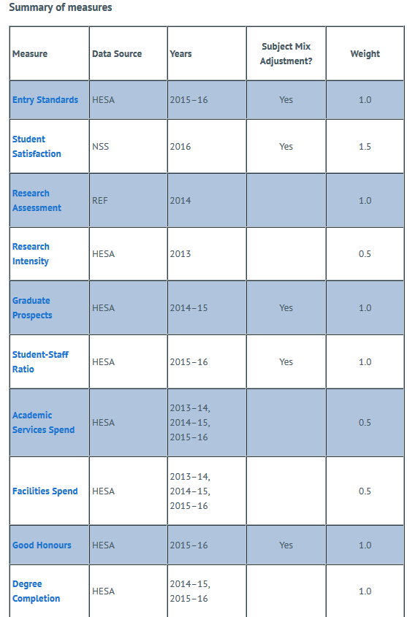
Not only countries/regions, but also universities. The Complete University Guide rankings:
Notes:
e.g. food, shelter, health, security, freedom
what John Rawls called ‘primary goods’
exist independent of personal perception
Polices target certain measures e.g. Millennium Development Goals (nxt slide)
Policies not usually concerned with whether or not these things make people feel better but intuitively we feel they will.
What should be on the list?
Some needs are likely to be universal e.g. food and shelter but others are specific to cultural contexts e.g. individual freedom
Relative importance?
e.g. Is shelter more important than food?
See Maslow (2 slides on)
Paternalistic if people do not endorse the choices of what they should have.
Of course we can also have subjective assessment of objective things
e.g. actual income/wealth is objective, perceived wealthiness or satisfaction with wealth is subjective
Sen argues that the satisfaction of these needs provides people with the capabilities to develop their own WB – more next week.

Slide 10
There are major concerns about “list” measures:
  Paternalism: who decides what is included?
  What should be on the list? How do we know that we have included everything that matters?
  Are the items really independent of each other? Leads to the possibility of double counting (student satisfaction depends on Graduate prospects and student-staff ratio)
  How can the items be compared? We need weights
  Are the weights the same for everyone?
10
Notes:
10
e.g. food, shelter, health, security, freedom
what John Rawls called ‘primary goods’
exist independent of personal perception
Polices target certain measures e.g. Millennium Development Goals (nxt slide)
Policies not usually concerned with whether or not these things make people feel better but intuitively we feel they will.
What should be on the list?
Some needs are likely to be universal e.g. food and shelter but others are specific to cultural contexts e.g. individual freedom
Relative importance?
e.g. Is shelter more important than food?
See Maslow (2 slides on)
Paternalistic if people do not endorse the choices of what they should have.
Of course we can also have subjective assessment of objective things
e.g. actual income/wealth is objective, perceived wealthiness or satisfaction with wealth is subjective
Sen argues that the satisfaction of these needs provides people with the capabilities to develop their own WB – more next week.

Slide 11

Capabilities as a list
Amartya Sen’s “capability approach”
A challenge to utilitarianism (we all know what is best for ourselves)
Start from a conception of what makes a good human life: people, not goods
Capability Approach:
  what people are free to do as well as what they actually do.
  opportunities result from ‘capabilities’ – what you can do. Brings us back to the idea of the choice set above.
  these are distinct from ‘functionings’ – what you do: role of responsibility
Notes:
11
Sen – now aged 77. “Mother Theresa of Economics”
Edcated in India and then at Cambridge.
1998 Nobel Prize in Econ for contributions to welfare economics
practical solutions to reduce the impact of famine
Opportunities to live a good life are what matter, rather than the accum of resources per se
Sen’s argument is largely a philosophical one
He states that there are some things we good all agree were needed to provide opportunities but he has always avoided giving a prescriptive list of these

Slide 12
One example: Nussbaum’s list of capabilities
1. Life: not dying prematurely
2. Bodily health: good health; adequately nourished; shelter
3. Bodily integrity; mobility; free from violence; choice in sex and reproduction
4. Senses, imagination, and thought: education, religion, art
5. Emotions: attachments, love
6. Practical reason: form conception of the good, planning of life
7. Affiliation: social interaction; respect and dignity
8. Other species: concern and relation to animals, plants, nature
9. Play: laugh, play, enjoy recreational activities
10. Control over one’s environment: political participation; property, employment.
Notes:
12
Martha Nussbaum – american philosophy collaborated with Sen during the 1980s.
Argues that these 10 should be supported by al societies
Should be the focus of political activity
Could argue endlessly about what is on this list.
e.g. the last one implies personal freedom. Sen argues that freedom is always good but can be used in bad ways.
They are each necessary and societies should not neglect one to promote another
But how can they be measured?
Some are easy – life expectancy, health…
But what about – bodily integrity and emotions

Slide 13


Human Development Index (HDI)
Based on Sen’s idea of capabilities
Rationale: GDP per capita gives an incomplete picture of development and well-being
  can be supplemented by information on the opportunities people have
UNDP has published the HDR every year since 1990; this includes the HDI by country.
Notes:
13
Developed for the UN Dev Prog in 1990
Describes the progress of all countries in the world
HDI developed for each country so countries can be ranked by HDI
An attempt to measure WB more broadly than simply by GDP

Slide 14
United Nations Development Report 1990
“Human development is a process of enlarging peoples choices. The most critical of these wide ranging choices are to live a long and healthy life, to be educated and to have access to resources needed for a decent standard of living.”
“No one can guarantee human happiness, and the choices people make are their own concern. But the process of development should at least create a conducive environment for people, individually and collectively, to develop their full potential and to have a reasonable chance of leading productive and creative lives in accordance with their needs and interests”
Notes:
14
The parallels with Sen’s capabilities approach are clear.
Data availability constraints mean that in reality we simply supplement info on GDP with info on health and education

Slide 15
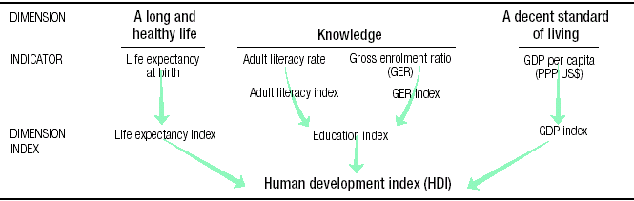
The Human Development Index
GER is the sum of the enrolment rates in primary, secondary and tertiary education
Notes:
15
Each dimension is represented by an indicator
In case of educ 2 indicators
Each dimension is equally weighted
(Within educ adult lit rate weighted 2/3, sch enrol 1/3.)
Has been criticised for addign apples and oranges
e.g. chances of good life – wealth and educ
With outcomes – life expectancy
Also these are crude indicators
life expectancy is only of value if life remains satisfying in old age

Slide 16
To calculate each dimension index …
No extra HDI points for going over the maximum value
Notes:
16
To convert each indicator into an index
Use max and min values from the data
x index = [x – min(x)] / [max(x) - min(x)]
Get an idex for each indicator and to get HDI simply average the 3 indicators

Slide 17
Each indicator index …
Notes:
17

Slide 18
Each dimension is equally weighted
Within education, the adult literacy rate is weighted 2/3, and gross enrolment 1/3.
Income is expressed in logs, so that an extra dollar has a larger HDI “hit” for poorer countries
= (lnY – ln(Ymin))/(ln(Ymax) – ln(Ymin))

Slide 19
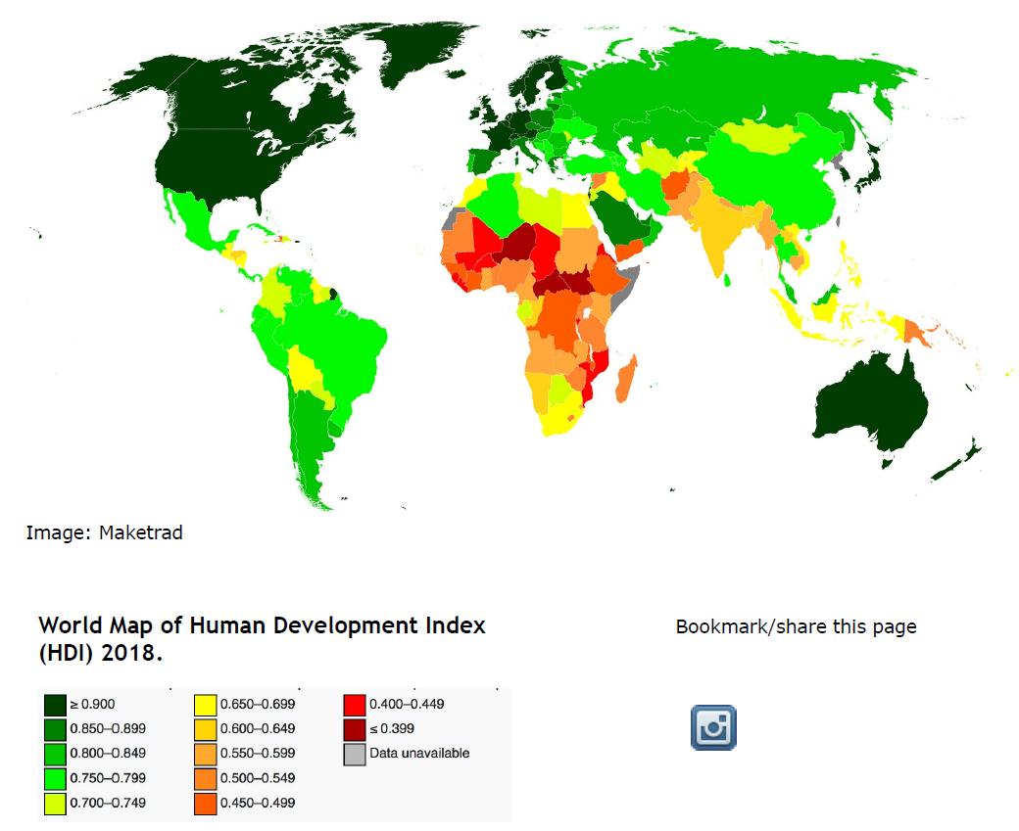

Slide 20
Will this make any difference?
We have HDI = (Y+H+Ed)/3
But if H=H(Y) and Ed=Ed(Y) then we may not learn anything new.
As it turns out, the HDI and GDP per capita rankings are not the same.

Slide 21
HDI data from UNDR
Notes:
21

Slide 22
The last column shows that the ranking of countries by GDP per capita and by HDI is not the same
Some countries do better than their GDP would imply (the Scandinavians, Madagascar)
Others do worse
The HDI adds new information to answer the question of how well a country is doing
Despite their relatively high incomes, none of the oil-producing countries has a high HDI
Notes:
22
The gains from development may not accrue equally to all groups in society
Key groups here defined by gender
Women will not automatically benefit from development – or at least not to the same extent as men
So further extension of HDI to incorporate male/female inequality

Slide 23
The ranking of countries by GDP per capita is not the same as that by HDI
But overall these figures remain similar.
Take 2018 figures on HDI ranking and GDP per capita (in PPP) ranking: the Spearman rank correlation coefficient is 0.96.
While the Spearman rank correlation coefficient between HDI ranking and the cross-country rank in a measure of subjective well-being (the Cantril ladder from the Gallup World Poll) is 0.83.
Notes:
23
The gains from development may not accrue equally to all groups in society
Key groups here defined by gender
Women will not automatically benefit from development – or at least not to the same extent as men
So further extension of HDI to incorporate male/female inequality

Slide 24
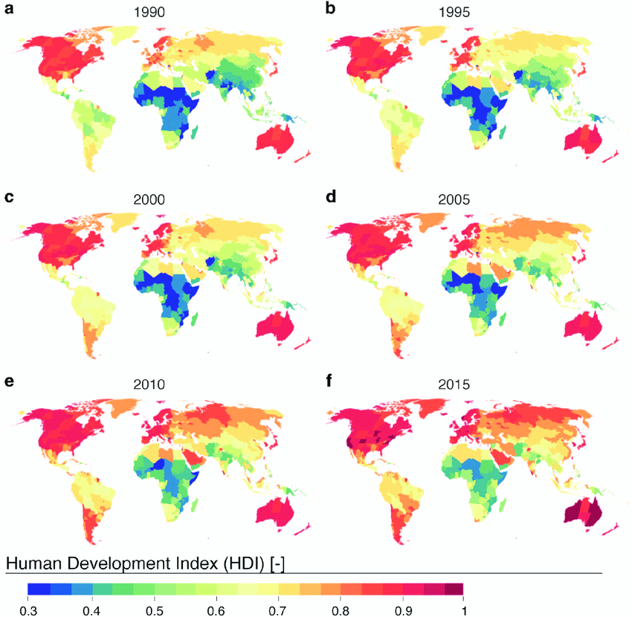
The World has improved over time

Slide 25
Due to the log specification, the GDP index in the HDI is concave: (lnY – ln100)/(ln40 000 – ln100)
Consider a rise in GDP from 5 000 to 10 000
5 000: GDP index = (ln5 000 – 4.61)/(10.60 – 4.61) = 3.91/5.99 = 0.65
10 000: GDP index = (ln10 000 – 4.61)/(10.60 – 4.61) = 4.61/5.99 = 0.77
A rise in the GDP index of 0.12
And if GDP rises to 15 000?
GDP index = (ln15 000 – 4.61)/(10.60 – 4.61) = 5.01/5.99 = 0.84
An increase of 0.07: an extra 5 000 of GDP gets you twice as much HDI if you start from 5 000 rather than from 10 000.
In fact, a rise from 10 000 to 15 000 produces much less HDI than does a rise from 500 to 1 000.

Slide 26
And if GDP rises to 15 000?
GDP index = (ln15 000 – 4.61)/(10.60 – 4.61) = 5.01/5.99 = 0.84
An increase of 0.07: an extra 5 000 of GDP gets you twice as much HDI if you start from 5 000 rather than from 10 000.
In fact, a GDP rise from 10 000 to 15 000 produces a much smaller jump in HDI than does a rise from 500 to 1 000.

Slide 27
This illustrates the decreasing returns from the log function: if W = αlnY then dW/dY = α/Y.
Consider a poor country with Y₀ and a rich country with 10Y₀.
The effect of higher income in the poor country, α/Y₀, is ten times larger than that in the rich country, α/10Y₀.

Slide 28
Martin Ravallion calls such indices “mashup indices of development”
20th Human Development Report (UNDP, 2010) changed the measures used for these core dimensions, and how they are aggregated.
Gross national income (GNI) has replaced GDP (National=what is produced by all residents of that country; domestic what is produced within the country), both still at purchasing power parity (PPP) and logged.
Some changes to the way in which Education and Health are ranked
Three core dimensions continue to be on a common (0, 1) scale.

Slide 29


Aggregation used to be arithmetic mean:
Now geometric: introduces additional concavity
The motivation was to avoid countries doing well while having poor outcomes on one of the indices (e.g. high income but terrible health).

Slide 30
What changed with the geometric HDI?
With the additive HDI, an extra year of LE in every country was worth 1/3*(1/85-25) = 0.0055.
In the geometric HDI, the effect of health now depends on the level of both income and education.

Slide 31
With perfect income and education indices of 1, the HDI is the cube root of the health index; with worse income and education, the contribution of health is increasingly devalued.
The value of life with geometric HDI:
There is much less social-welfare value in keeping poor or badly-educated people alive

Slide 32
The HDI is one “top-down” way of weighing objective lists.
Although as we have seen, weights are controversial.
An alternative is to not use weights at all, but simply provide a list of things that we would all like to see.
The dashboard or traffic-light approach to well-being
Which unfortunately means we can only make well-being statements via Pareto Dominance

Slide 33
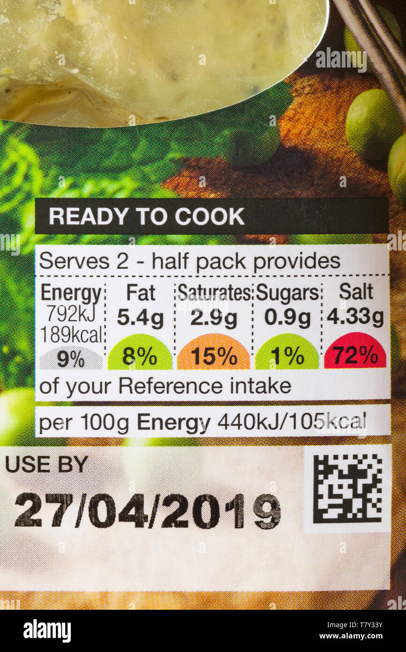
As used in food products
But how do fat, saturates, sugars and salt combine to produce health?

Slide 34

United Nations Millennium Development Goals
(2000, to be achieved by 2015)
34
http://www.undp.org/
Notes:
34
Adopted by world leaders in the year 2000 and set to be achieved by 2015,
most broadly supported, comprehensive and specific development goals the world has ever agreed upon.
8 goals provide concrete, numerical benchmarks for tackling extreme poverty in its many dimensions.
both global and local, tailored by each country to suit specific development needs.
The eight MDGs break down into 21 quantifiable targets that are measured by 60 indicators.

Slide 35
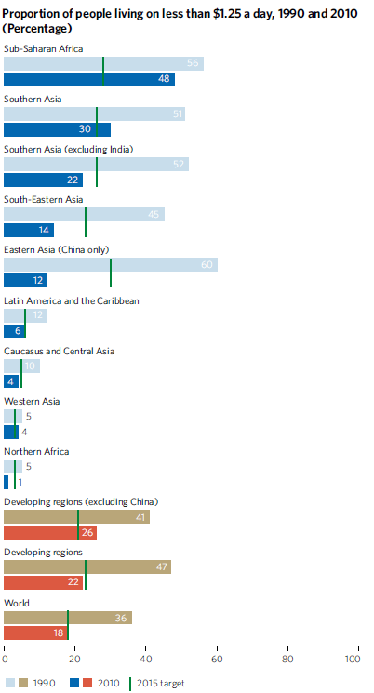
Target 1A: Halve, between 1990 and 2015, the proportion of people living on less than $1.25 a day

Slide 36
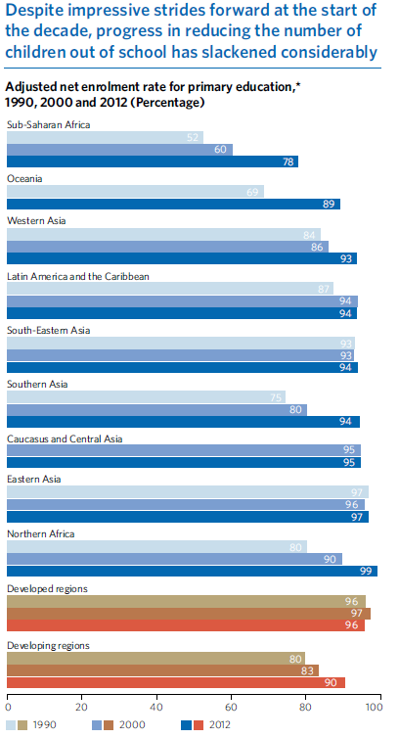
Target 2A: By 2015, all children can complete a full course of primary schooling, girls and boys

Slide 37
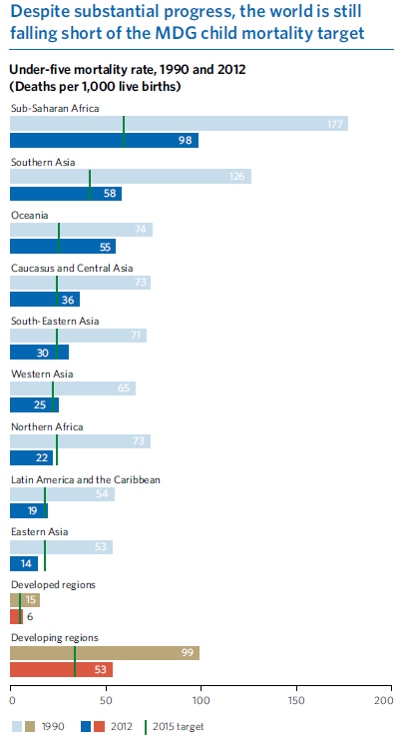
Target 4A: Reduce by two-thirds, between 1990 and 2015, the under-five mortality rate

Slide 38
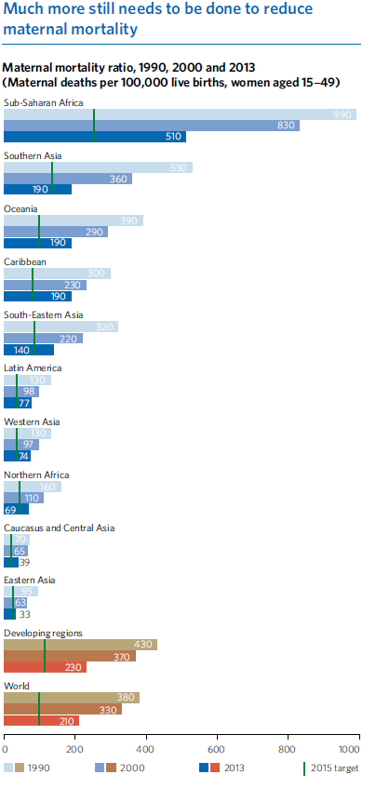
Target 5A: Reduce by three quarters, between 1990 and 2015, the maternal mortality ratio

Slide 39
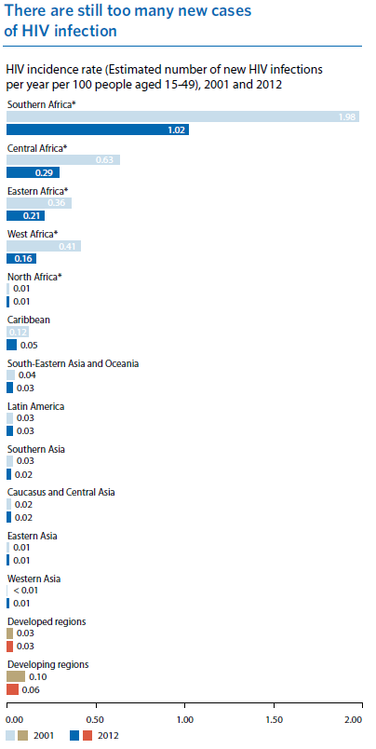
Target 6A: Have halted by 2015 and begun to reverse the spread of HIV/AIDS

Slide 40
In September 2015, the MDGs were replaced by the Sustainable Development Goals.
The SDGs apply to all countries, not only developing ones.
These cover most of the MDGs, plus an emphasis on inequality, the environment, peace, economic growth, and human rights.

Slide 41

Same principle: Each goal has targets. No 6. (Water) has 8 targets, for example.
Each target has indicators. Target 6.3 is “improve water quality by reducing pollution”, and it has two indicators.
6.3.1 Proportion of domestic and industrial wastewater flows safely treated
6.3.2 Proportion of bodies of water with good ambient water quality
The 17 Goals have 169 targets and 231 indicators in total.

Slide 42
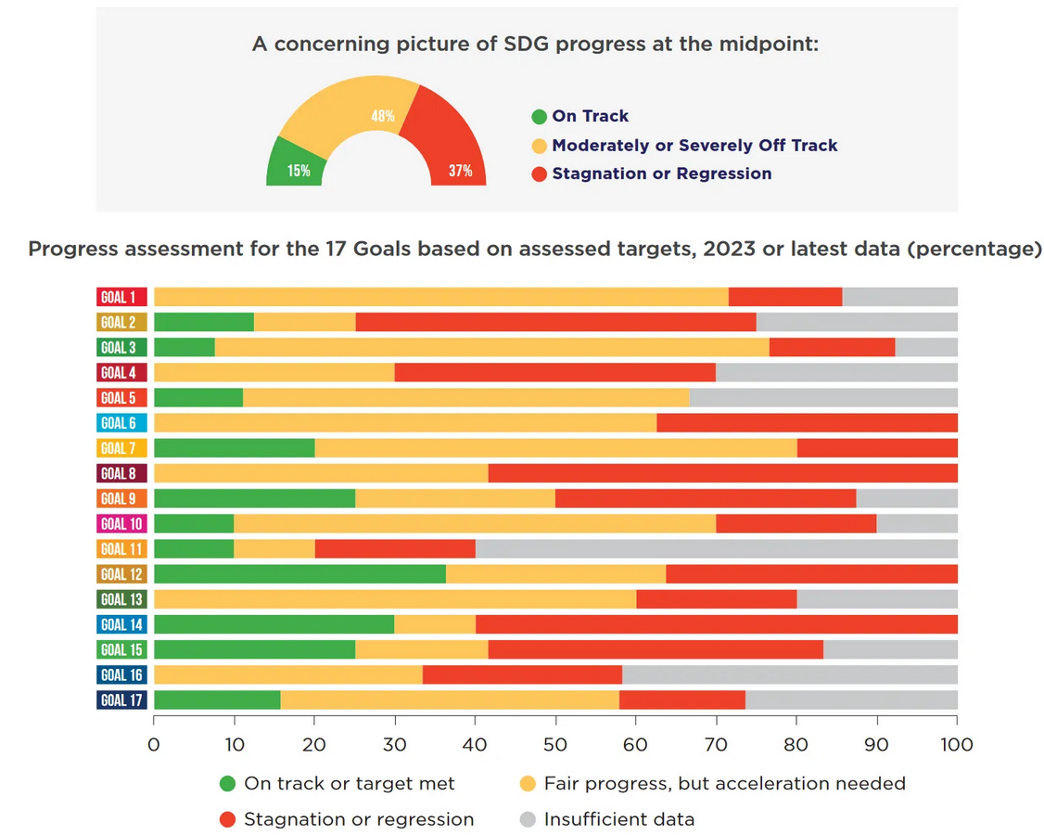

Slide 43
Alternatively, we can restore consumer sovereignty (as it were), and let individuals assign their own preferred weights to the posited various different dimensions of the Good Life.

Slide 44
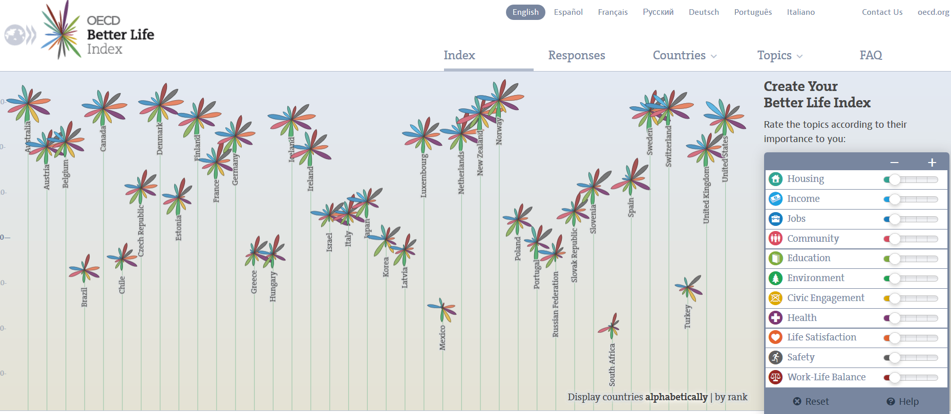
“There is more to life than the cold numbers of GDP and economic statistics”
You can use this tool to create country rankings, equally weighting countries

Slide 45
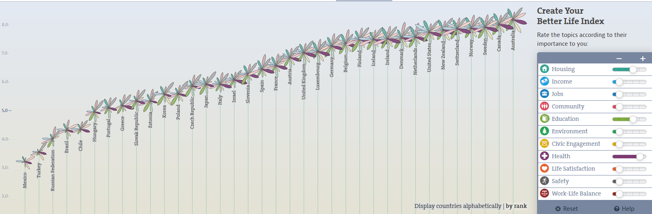
Or over-weighting some topics (here housing, education and health)

Slide 46
Three concepts of well-being
Psychology: Let’s actually ask people how they are doing
46
Notes:
46
Objective list – based on assumptions about basic human needs & rights
Preference satisfaction
Preferences inferred via the choices people make
Because in economic theory utility is what is maximised when people choose between alternatives
Greater WB comes from ability to satisfy more prefs
Kahneman refers to this as decision utility (in contrast to experienced utility)
Mental state
Survey accounts
Back to the Benthamite view of utility as hedonic quality of experience
In some situations the choice (pref) based and survey based accounts coincide but in many they diverge i.e. we do not always choose what increases our own SWB

Slide 47
3) Mental state accounts
These accounts provided by individual can be cognitive/evaluative: how has my life gone so far?
1) Self-reported satisfaction (cognitive/evaluative)
  “how satisfied are you with your life?”
2) Self-reported eudaimonia (cognitive/evaluative)
  Meaning and purpose in life
  Or a series of feelings from moment to moment
3) Self-reported mood or emotions (affect)
  happy / sad / excited / bored etc.
Notes:
subjective accounts rejected by many economists - not objectively observable
But implicit assumption - people are good judges of their overall QoL
psychological distinction between affect and cognition,
life satisfaction more associated with the cognitive or evaluative component
mood more associated with affect
Positive and negative affect are distinguished.
Concerns
Adaptive preferences – Sen.
A poor person may have adjusted their expectations downwards and therefore be satisfied with very little. Is it OK if a very poor person says they are completely satisfied? Does that mean there is no onus on society to provide them with more? If satisfied the deprived may have little motivation to change their circumstances
A rich person may say they are not satisfied because their expectations are being adjusted upwards. But objectively their life is improving.
Personality traits
Some people have a tendency to report higher or lower levels of WB
But for policies – evidence should come from a representative sample
Tendency for people to habituate to changes in income, health etc
Aspirations change in line with objective circumstances

Slide 48
Examples: British Household Panel Survey (BHPS - http://www.iser.essex.ac.uk/ulsc/bhps/)
Satisfaction is single-item
Here are some questions about how you feel about your life. Please tick the number which you feel best describes how dissatisfied or satisfied you are with the following aspects of your current situation.
Your life overall
[ 1 ] [ 2 ] [ 3 ] [ 4 ] [ 5 ] [ 6 ] [ 7 ]
not satisfied at all completely satisfied
This question is also asked about domains of life:
e.g. health, income, house, partner ...
Notes:
… hand out questionnaires
Examples of SWB questions.
Similar questions asked in many large scale social surveys in different countries
The responses to these types of questions are gradually starting to be taken seriously by policy makers.

Slide 49
The General Health Questionnaire 12
(GHQ-12): Multiple-item
Have you recently:
    1. been able to concentrate
    2. lost much sleep over worry
    3. felt that you were playing a useful part in things
    4. felt capable of making decisions
    5. Felt constantly under strain
    6. felt you could not overcome difficulties
    7. been able to enjoy normal activities
    8. been able to face up to problems
    9. Been feeling unhappy and depressed
    10. been Losing confidence
    11. been thinking of yourself as worthless
    12. been feeling reasonably happy
Six positive and six negative questions
Notes:
Each question has a choice of four options (scored 0 to 3) in which the presence or intensity of the state over the last few weeks is related to its usual frequency or intensity, thereby creating a 36 point Likert scale. See: Goldberg, D. P. & Williams, P. (1988).

Slide 50
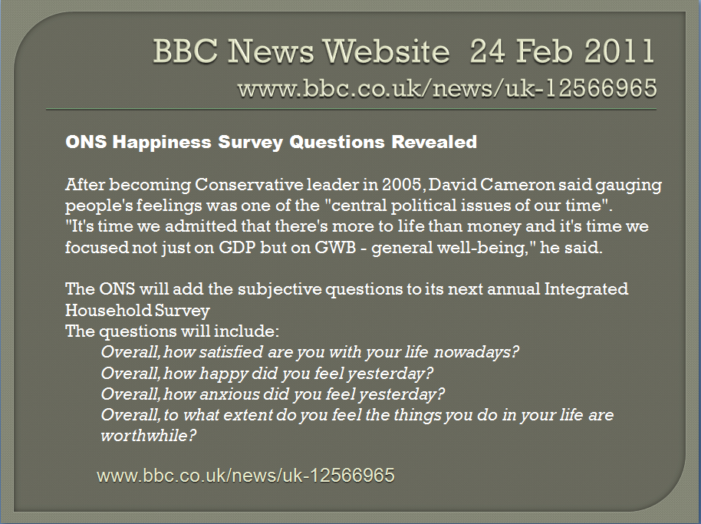
These “behave” the way we think that they should:
Notes:
1 – not satisfied at all
7 – completely satisfied

Slide 51
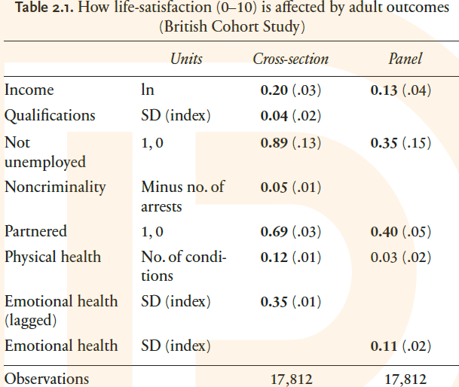
    To maximise well-being, we maximise the weighted sum of all the domains that the individual considers to be important.
    If we focus on only one domain, such as health or income, we may end up making individuals worse-off, if we sacrifice “too much” of the other domains in order to improve health.
51
Notes:
51
Also the self-reported measures correlate with certain physiological states (brain activty)
But empirical results differ depending on what outcome measure is used
e.g see the Borooah paper on the reading list
self-assessed happiness question
v. usage of tranquilisers and antidepressants
v. thoughts of self-harm (inc suicide)

Slide 52
There are Some Huge Pluses:
  ‘Subjective’ well-being: this is democratic and not paternalistic. You decide what the good life is.
  Intuitively understood: there are few missing values
  Takes care of the issue of weights over different domains: each individual implicitly uses their own
Notes:
subjective accounts rejected by many economists - not objectively observable
But implicit assumption - people are good judges of their overall QoL
psychological distinction between affect and cognition,
life satisfaction more associated with the cognitive or evaluative component
mood more associated with affect
Positive and negative affect are distinguished.
Concerns
Adaptive preferences – Sen.
A poor person may have adjusted their expectations downwards and therefore be satisfied with very little. Is it OK if a very poor person says they are completely satisfied? Does that mean there is no onus on society to provide them with more? If satisfied the deprived may have little motivation to change their circumstances
A rich person may say they are not satisfied because their expectations are being adjusted upwards. But objectively their life is improving.
Personality traits
Some people have a tendency to report higher or lower levels of WB
But for policies – evidence should come from a representative sample
Tendency for people to habituate to changes in income, health etc
Aspirations change in line with objective circumstances

Slide 53
There are Some Huge Pluses:
  It includes any kinds of externalities/spillovers between individuals
  Automatically takes into account adaptation/mis-wanting
  And public goods
Notes:
subjective accounts rejected by many economists - not objectively observable
But implicit assumption - people are good judges of their overall QoL
psychological distinction between affect and cognition,
life satisfaction more associated with the cognitive or evaluative component
mood more associated with affect
Positive and negative affect are distinguished.
Concerns
Adaptive preferences – Sen.
A poor person may have adjusted their expectations downwards and therefore be satisfied with very little. Is it OK if a very poor person says they are completely satisfied? Does that mean there is no onus on society to provide them with more? If satisfied the deprived may have little motivation to change their circumstances
A rich person may say they are not satisfied because their expectations are being adjusted upwards. But objectively their life is improving.
Personality traits
Some people have a tendency to report higher or lower levels of WB
But for policies – evidence should come from a representative sample
Tendency for people to habituate to changes in income, health etc
Aspirations change in line with objective circumstances

Slide 54
Measuring well-being: Now or Later?
Well-being is a flow variable: we experience it (or the lack of it) continuously.
So we can either
Try to measure that flow at a point in time
Or ask individuals to provide us with an evaluation of the flow they have felt up to that date.
Life as you live it, or life as you remember it?
Notes:
But SWB measures can still guide policy

Slide 55
Experienced Utility (life as lived)
Experience sampling method (ESM)
Participants carry palm top instrument.
Random selection of times of day as participant goes about daily life.
Rating of various feelings such as “happy” or “frustrated/annoyed”.
Record what they are doing.
Aggregate each ‘moment’ to obtain time profile of affect.
Notes:
Kahneman argues that this is close to the concept that Edgeworth and Bentham imagined utility was:
Edgeworth imagined a ‘hedonimeter’ that continuously records an individual’s utility – in the sense of momentary positive or negative feelings
Less prone to comparisons with other people and possibly even our own historical experiences
Happiness is then defined as the integral of utility over time

Slide 56
Advantages of ESM
Real, experienced utility, as life events are lived.
No bias and distortion due to recall
Disadvantages of ESM
Costly
Possibly disruptive (eg. while driving)
Non-random response

Slide 57
Day reconstruction method (DRM)
Reconstruct previous day into a series of episodes, using a retrospective Time Use Diary
Where, doing what, with whom
Rating of various feelings such as “happy” or “frustrated/annoyed”.
U-index: proportion of time in negative emotion.
Or percentage of time in pleasurable activities, or meaningful ones

Slide 58
For each of the episodes that individuals identify during the day, they are asked the following questions:

Slide 60
4 positive, 8 negative questions

Slide 61
Advantages of DRM
Less costly than ESM
Disadvantages of DRM
Element of recall: possible bias: it’s not how people felt then and there
Cognitively demanding: evaluation of twelve emotions per episode.

Slide 62
Evidence from ESM/DRM
Activity | % of sample | Time (hrs) | Net affect
Intimate relations | 11 | 0.21 | 4.74
Socialising after work | 49 | 1.15 | 4.12
Dinner | 65 | 0.78 | 3.96
Exercising | 16 | 0.22 | 3.82
Watching TV | 75 | 2.18 | 3.62
Cooking | 62 | 1.14 | 3.24
Shopping | 30 | 0.41 | 3.21
Childcare | 36 | 1.09 | 2.95
Working | 100 | 6.88 | 2.65
Commuting | 61 | 0.43 | 2.03
Notes:
How do you interpret the numbers?
Sample of 909 working women in Texas around the year 2000.
Get a lot of enjoyment out of things we don’t spend much time doing

Slide 63
Decision Utility (life as remembered)
Life satisfaction questions
Advantages
Easy to administer
Quick
Everyone understands them
Disadvantages
Cognitive rather than affective
So we might see neglect of duration, with some episodes forgotten entirely and others mis-remembered

Slide 64
SWB vs. HDI
How does country-level average subjective well-being relate to the country-level education, income and health information used in the HDI?
HDI assumes that
All three are positive components of well-being
They all have the same weight
64
Notes:
64

Slide 65
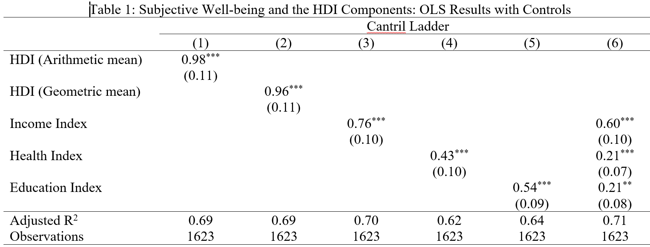
SWB vs. HDI
Results from Yin et al. (2023). Data from UN at country-year level, 1990 to 2018. Components are positive, but do not have the same weight
65
Notes:
65

Slide 66
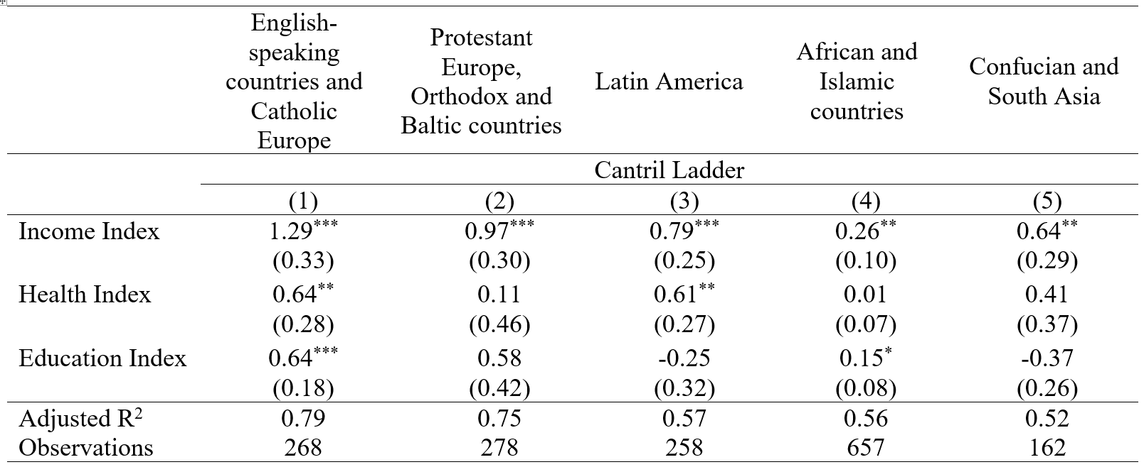
SWB vs. HDI
The fit is much better for richer countries:
66
Notes:
66

Slide 67
Issues with Measuring Satisfaction
1) Social Desirability
Possible bias if we ask individuals sensitive questions: they want to look good in front of the interviewer.
“computer-assisted self-interviewing (CASI) and self-completion (SC) paper questionnaires are generally preferred to face-to-face interviewing as a way of assuring a greater degree of confidentiality and inducing more truthful responses”
This is why the GHQ questions discussed above are a drop-off questionnaire. Self-reporting means that individuals are more likely to report their true response to questions like
“have you recently been thinking of yourself as worthless”
67
Notes:
67

Slide 68
Some BHPS results, from Conti, G., and Pudney, S. (2011). "Survey design and the analysis of satisfaction". Review of Economics and Statistics, 93, 1087-1093.
Oral interviews conducted by an interviewer tend to produce more positive reports of satisfaction than private self-completion questionnaires – the “let’s put on a good show for the interviewer” effect.
When children are present during the interview, adult interviewees tend to give still more positive responses – the “not in front of the children” effect.
The presence of the interviewee’s partner during the interview tends to depress the level of reported satisfaction – the “don’t show your partner how satisfied you are” effect, which we speculate may have something to do with the desire to maintain a strong bargaining position within the relationship.
68
Notes:
68

Slide 69
2) Which response scale?
Even if the question is a good one, on what scale would we want responses?
A well-being question can be answered on a three-point scale (GSS), a four-point scale (Eurobarometer), etc.
May want an odd number of response categories in order for there to be a natural neutral.
The split ballot results in Hendrik et al. (2024) suggest only little difference in mean satisfaction and the correlates of satisfaction according to the number of response categories.
69
Notes:
69

Slide 70
3) Labelling categories?
A small change can have large effects…
Job satisfaction labels in the BHPS changed from Wave 1 to Wave 2
Label for category one changed. In Wave 2 all seven categories were labelled, as opposed to only three of them in Wave 1.
70
Notes:
70

Slide 71
Could this have any effect? Compare the JS distributions in Waves 1, 2 and 3.
Huge rise in the use of response six, now that it is labelled. The only three labelled responses in Wave 1 attracted “too many” responses.
This particularly seemed to affect women
71
Notes:
71

Slide 72
4) Question Ordering
Does it matter where the question appears?
“Context effects are defined as an effect of preceding items or experiences on responses to subsequently presented items”
May work via either a shift in affect (e.g. negative mood causing subsequent questions to be rated more negatively) or a shift in attention to particular experiences caused by the context items.
72
Notes:
72

Slide 73
Gallup Healthways Wellbeing Index poll: a telephone poll of 1,000 Americans each day, contains the Cantril Self-Anchoring Striving Scale (Cantril, 1965): this also appears in the Gallup World Poll of more than 150 countries, representing more than 98% of the world's population.
Please imagine a ladder with steps numbered from zero at the bottom to 10 at the top.
The top of the ladder represents the best possible life for you and the bottom of the ladder represents the worst possible life for you.
On which step of the ladder would you say you personally feel you stand at this time? (ladder-present)
On which step do you think you will stand about five years from now? (ladder-future)
Notes:
73
HDR 2004 put Australia 3rd in the word and ahead of all other English speaking countries
1 = Norway
2= Sweden
UK not in top 10.
But is we use subjective well-being measures Aus has a much lower ranking

Slide 74
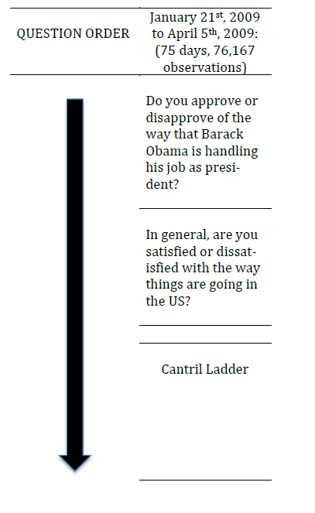
For a period, in the US survey, the Cantril ladder was preceded by questions about the President and the US economy:
74
Notes:
74

Slide 75
Gallup subsequently ran a RCT, dividing respondents into 500 who received the political questions, and 500 who did not (“split ballot” approach).
The main effect of the context questions is sharply negative, reducing the Cantril scores by 2/3 of a point.
The size of this well-being effect depends on the answers given to the preceding context questions. Reduced well-being results from thinking that the US is not going in the right direction (not from the Obama questions).
75
Notes:
75

Slide 76
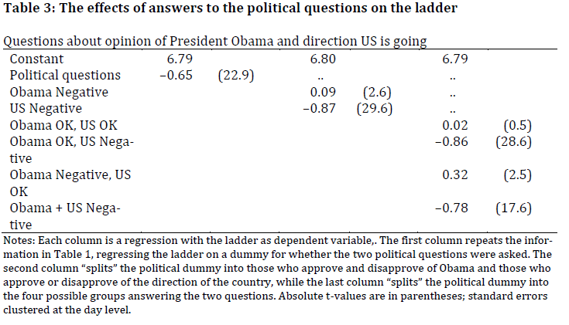
76
Notes:
76

Slide 77
If everyone has the same opinion of the US economy, and everyone is affected equally, then context questions are just like adding or taking away a fixed number, and won’t change well-being rankings or well-being regression estimated coefficients (apart from the constant).
But if not, then we can make ranking errors.
In the Gallup data, sex and age rankings were unaffected, but the ranking of subjective well-being by race changed drastically.
77
Notes:
77

Slide 78
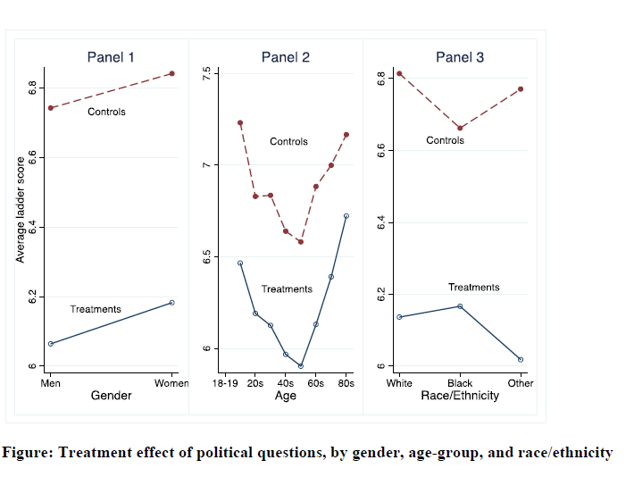
Treatment effect of priming larger for Whites (-0.65) than for Blacks (-0.5); largest for “Other” (-0.75)
78
Notes:
78

Slide 79
Is Happiness Everything?
Do questions about happiness and satisfaction pick up everything that is important about individual lives?
Or could there be “non-happiness” elements that are important too?
W = W(H), or W = W(H, Z)?
Notes:
79
HDR 2004 put Australia 3rd in the word and ahead of all other English speaking countries
1 = Norway
2= Sweden
UK not in top 10.
But is we use subjective well-being measures Aus has a much lower ranking

Slide 80
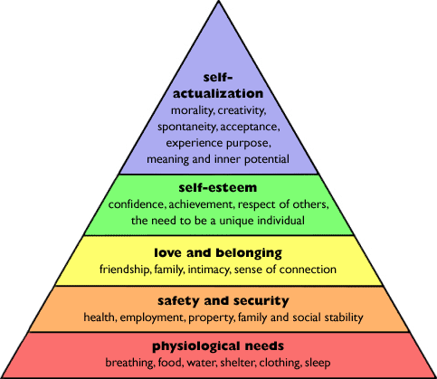
Maslow’s Hierarchy of Needs
80
Notes:
80
Maslow's hierarchy of needs is a theory in psychology, proposed by Abraham Maslow in his 1943 paper A Theory of Human Motivation.
The objective lists we are talking about here focus on the bottom two levels but there is little guidance as to which of these are most important and say how important is shelter in relation to security
Sometimes the items may be in conflict with each other -
e.g. people have a right to private property but access to health care and education may necessitate the restriction of private property rights

Slide 81
This is relevant in the context of the debate over hedonia vs. eudaimonia.
Eudaimonia refers to the idea of flourishing or developing human potential, as opposed to pleasure, and is designed to capture elements such as mastery, relations with others, self-acceptance and purpose.
Practically, eudaimonic well-being is measured by questions on autonomy, determination, interest and engagement, aspirations and motivation, and a sense of meaning, direction or purpose in life.
Arguably picked up by last of the four ONS questions.
Notes:
81
HDR 2004 put Australia 3rd in the word and ahead of all other English speaking countries
1 = Norway
2= Sweden
UK not in top 10.
But is we use subjective well-being measures Aus has a much lower ranking

Slide 82
These “behave” the way we think that they should:
Notes:
1 – not satisfied at all
7 – completely satisfied

Slide 83
Here is a measure of flourishing, based on Huppert and So (2009).
All of these six questions on the right were asked in Wave 3 of the European Social Survey
Notes:
83
HDR 2004 put Australia 3rd in the word and ahead of all other English speaking countries
1 = Norway
2= Sweden
UK not in top 10.
But is we use subjective well-being measures Aus has a much lower ranking

Slide 84
The first two of these are defined by Huppert and So as “core features”, in that someone who is flourishing has to agree with these statements. The measure they propose of flourishing is thus agreement with the first two questions, plus agreement with at least three of the next four questions.
Fifty six percent of the ESS sample is flourishing according to this definition.
The second measure we appeal to is based on the New Economics Foundation (2008), and measures i) Vitality, ii) Resilience and Self-Esteem, iii) Positive Functioning, Supportive Relationships, And Trust and Belonging.
Each of these three is constructed as the unweighted sum of the answers to a number of z-score transformed questions (such that each of the questions has a mean of zero and a variance of one).
Notes:
84
HDR 2004 put Australia 3rd in the word and ahead of all other English speaking countries
1 = Norway
2= Sweden
UK not in top 10.
But is we use subjective well-being measures Aus has a much lower ranking

Slide 85
Vitality consists of answers to questions on how much of the time during the past week the individual felt tired, felt that everything they did was an effort, could not get going, had restless sleep, had a lot of energy, and felt rested when they woke up in the morning, plus the respondent's general health and whether their life involves a lot of physical activity.
All of these are recoded so that higher values reflect greater vitality.
Notes:
85

Slide 86
Similarly, resilience and self-esteem is given the sum of the answers to the four following z-score transformed questions:
"In general I feel very positive about myself“
"At times I feel as if I am a failure“
"I’m always optimistic about my future“
"When things go wrong in my life, it generally takes me a long time to get back to normal".
Again, all of these are recoded so that higher numbers reflect greater resilience.
Notes:
86

Slide 87
Last, positive functioning is determined by the answers to the following questions:
"In my daily life I get very little chance to show how capable I am“
"Most days I feel a sense of accomplishment from what I do“
"In my daily life, I seldom have time to do the things I really enjoy“
"I feel I am free to decide how to live my life“
"How much of the time during the past week have you felt bored?“
"How much of the time during the past week have you been absorbed in what you were doing“
"To what extent do you get a chance to learn new things?“
"To what extent do you feel that you get the recognition you deserve for what you do?“
"I generally feel that what I do in my life is valuable and worthwhile"
Notes:
87

Slide 88
First approach: Are these correlated?
Eudaimonia scores are fairly closely correlated with hedonic measures of happiness and satisfaction
“Taking all things together, how happy would you say you are?” (0 = “Extremely Unhappy” and 10 = “Extremely Happy”.
“All things considered, how satisfied are you with your life as a whole nowadays?”, with answers on a 0 to 10 scale.
Notes:
88
HDR 2004 put Australia 3rd in the word and ahead of all other English speaking countries
1 = Norway
2= Sweden
UK not in top 10.
But is we use subjective well-being measures Aus has a much lower ranking

Slide 89
Someone with high life satisfaction or happiness is fairly likely to also be flourishing, have vitality, resilience and functioning as well.
Notes:
89
HDR 2004 put Australia 3rd in the word and ahead of all other English speaking countries
1 = Norway
2= Sweden
UK not in top 10.
But is we use subjective well-being measures Aus has a much lower ranking

Slide 90
A second simple way of evaluating the difference, if any, between hedonic and eudaimonic measures of well-being is to carry out a regression analysis using "standard" socio-demographic variables as controls.
Here’s the regression table, just to prove that we did it….

Slide 92
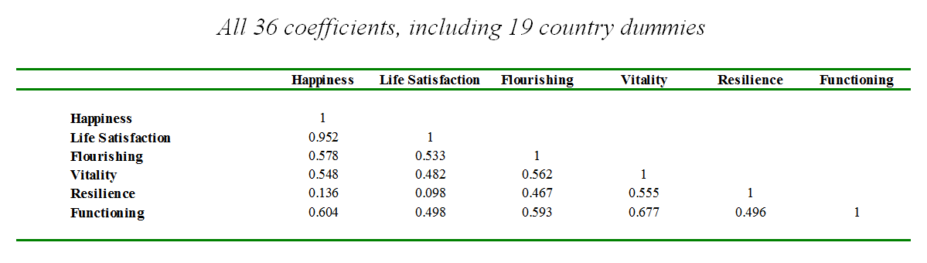
Are the data patterns in these regressions the same?
Notes:
92
HDR 2004 put Australia 3rd in the word and ahead of all other English speaking countries
1 = Norway
2= Sweden
UK not in top 10.
But is we use subjective well-being measures Aus has a much lower ranking

Slide 93
The measures of happiness and life satisfaction produce extremely similar data shapes. Some say that satisfaction is more cognitive, but we don’t see that here.
The correlation between the hedonic measures and the eudaimonic measures, in terms of how they fit the observable explanatory variables, is reasonably high.
There is, however, one exception, with respect to resilience. This concept does not seem to be particularly closely related to either happiness or satisfaction.
Notes:
93
HDR 2004 put Australia 3rd in the word and ahead of all other English speaking countries
1 = Norway
2= Sweden
UK not in top 10.
But is we use subjective well-being measures Aus has a much lower ranking

Slide 94
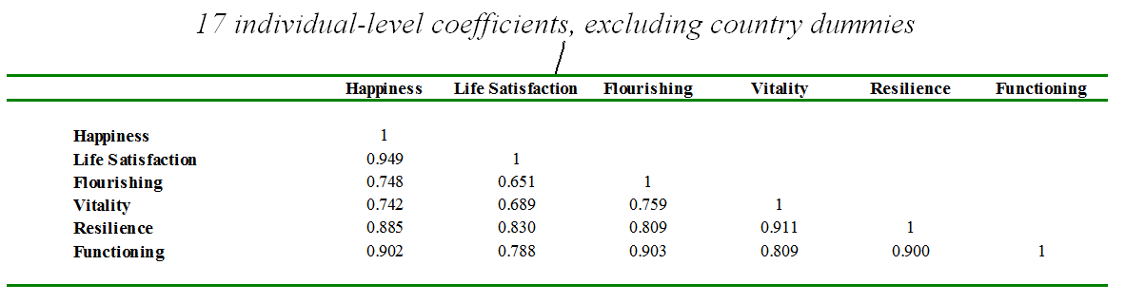
This difference is cross-country: within countries, the measures produce similar coefficients
A Belgian who is satisfied has high resilience;
A Swede who is flourishing is happy
Notes:
94
HDR 2004 put Australia 3rd in the word and ahead of all other English speaking countries
1 = Norway
2= Sweden
UK not in top 10.
But is we use subjective well-being measures Aus has a much lower ranking

Slide 95
The same approach is taken by Helliwell (2012), comparing country-by-country rankings of life satisfaction and the Cantril ladder in Gallup World Poll data.
The correlation between the country rankings for life satisfaction and the Gallup ladder responses - asked of the same respondents, and in the same survey - is very high (r=0.935). Analysis of the resulting data show that while there were significant differences in average scores, with the mean of life satisfaction being higher by about 0.5 on the 11-point scale, the two variables are explained by the same factors, including the same effects of income .
Notes:
95
HDR 2004 put Australia 3rd in the word and ahead of all other English speaking countries
1 = Norway
2= Sweden
UK not in top 10.
But is we use subjective well-being measures Aus has a much lower ranking

Slide 96
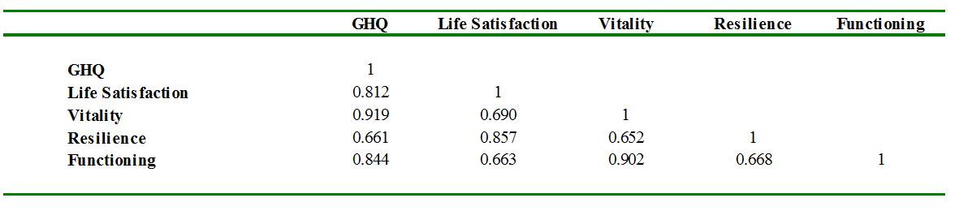
We can do the same thing in the BHPS
Notes:
96
HDR 2004 put Australia 3rd in the word and ahead of all other English speaking countries
1 = Norway
2= Sweden
UK not in top 10.
But is we use subjective well-being measures Aus has a much lower ranking

Slide 97
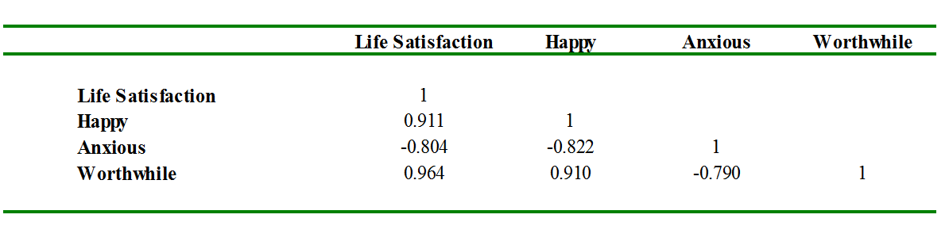
And in the ONS data itself
Notes:
97
HDR 2004 put Australia 3rd in the word and ahead of all other English speaking countries
1 = Norway
2= Sweden
UK not in top 10.
But is we use subjective well-being measures Aus has a much lower ranking

Slide 98
Third approach: predicting behaviour
Benjamin et al. (2012), “What Do You Think Would Make You Happier? What Do You Think You Would Choose?”, American Economic Review.
They consider a series of sequence of hypothetical pairwise-choice scenarios.
Notes:
98

Slide 99
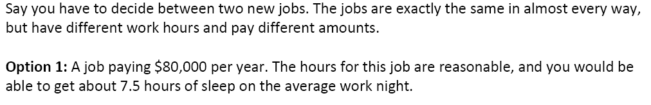
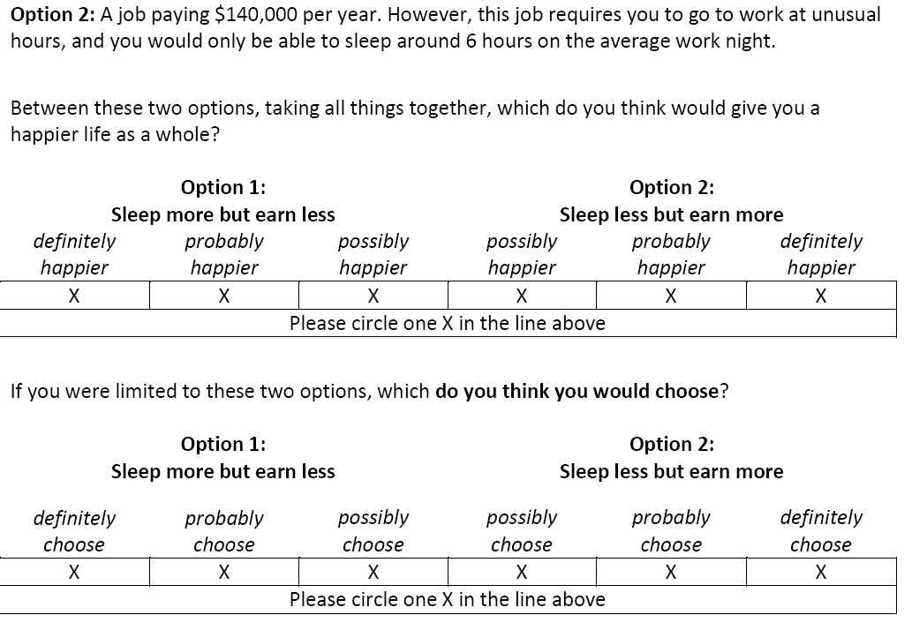

Slide 100
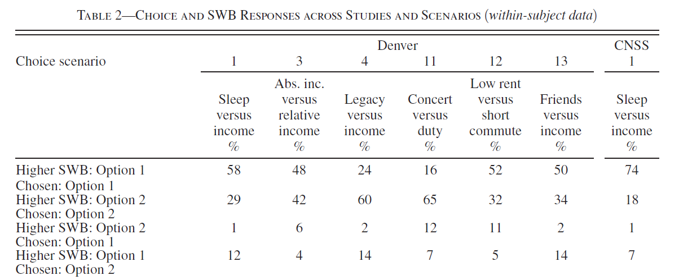
Individuals don’t always choose the option that they say will make them happier:
Although across all the columns, only around one person in seven does not do so
Notes:
100

Slide 101
In a student sample, respondents are asked the hypothetical choice and overall happiness questions, as well as the effect of the choice on eleven non-SWB aspects of life:
Family happiness
Health
Life's level of romance
Social life
Control over your life
Life's level of spirituality
Life's level of fun
Social status
Life's non-boringness
Physical comfort
Sense of purpose
Notes:
101

Slide 102
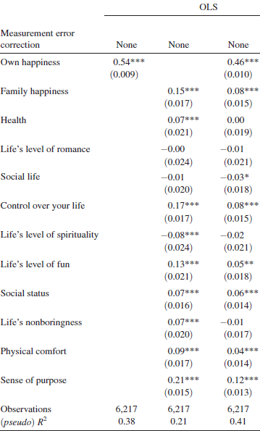
OLS choice regressions:
Notes:
102

Slide 103
As shown by the R², 0.38 of the variation in choice is explained by SWB (own happiness) alone.
Regressing choice on both SWB and the eleven non-SWB aspects yields a barely higher R² of 0.41.
But:“the four scenarios we designed to be representative of typical important decisions facing our college-age Cornell sample…socialize versus sleep, family versus money, education versus social life, and interest versus career… are among the scenarios with the lowest univariate R² and, correspondingly, the highest incremental R² from adding non-SWB aspects as regressors”
Eudaimonia may then matter much more in certain real-life situations
Notes:
103

Slide 104
Validation: Do these numbers mean anything?

Slide 105
Cross-Rater Validity
It is presumed that asking A how happy she is will provide information about her unobserved real level of happiness.
A simple validity check is then to ask B whether he thinks A is happy.
Individuals do seem to be able to a large extent to recognise and predict the satisfaction level of others
105
Notes:
105
Also the self-reported measures correlate with certain physiological states (brain activty)
But empirical results differ depending on what outcome measure is used
e.g see the Borooah paper on the reading list
self-assessed happiness question
v. usage of tranquilisers and antidepressants
v. thoughts of self-harm (inc suicide)

Slide 106
Friends and family reports of how happy they believe the respondent is correlate with the respondent’s own report.
Another obvious choice is the interviewer: again, the answer the interviewer gives tallies with that of the respondent.
Respondents are sometimes given open-ended interviews in conjunction with standard questions about their well-being. When third parties, who do not know the respondent, are played these open-ended interviews their evaluation of the respondent’s well-being matches well with the respondent’s own reply
106
Notes:
106
Also the self-reported measures correlate with certain physiological states (brain activty)
But empirical results differ depending on what outcome measure is used
e.g see the Borooah paper on the reading list
self-assessed happiness question
v. usage of tranquilisers and antidepressants
v. thoughts of self-harm (inc suicide)

Slide 107
Respondents shown pictures or videos of others accurately identify whether the individual shown to them was happy, sad, jealous, and so on.
This is also the case when respondents were shown individuals from other cultures
Individuals in the same language community have a common understanding of how to translate internal feelings into a number scale, simply in order to be able to communicate with each other.
Respondents translate verbal labels, such as 'very good' and 'very bad', into roughly the same numerical values.
A tempting conclusion is that an evolutionary advantage accrues to the accurate evaluation of how others are doing.
107
Notes:
107
Also the self-reported measures correlate with certain physiological states (brain activty)
But empirical results differ depending on what outcome measure is used
e.g see the Borooah paper on the reading list
self-assessed happiness question
v. usage of tranquilisers and antidepressants
v. thoughts of self-harm (inc suicide)

Slide 108
Physiological and Neurological Evidence
There is a strong positive correlation between emotional expressions like Duchenne smiling (both zygomatic, mouth, AND orbicularis oculi, cheek, muscles), frowning, and answers to well-being questions
Recent work has looked at the relationships between positive and negative states, on the one hand, and neurological measures, on the other
Obtaining physical measures of brain activity is an important step in showing that individuals’ self-reports reflect real phenomena
108
Notes:
108
Also the self-reported measures correlate with certain physiological states (brain activty)
But empirical results differ depending on what outcome measure is used
e.g see the Borooah paper on the reading list
self-assessed happiness question
v. usage of tranquilisers and antidepressants
v. thoughts of self-harm (inc suicide)

Slide 109
Particular interest has been shown in prefrontal brain asymmetry.
In right-handed people, positive feelings are generally associated with more alpha power in the left prefrontal cortex (the dominant brain wave activity of awake adults are called alpha waves), and negative feelings with more alpha power in the right prefrontal cortex (approach and avoidance).
Relationship initially suggested by the observations of patients with unilateral cortical damage
More recently has been explored using techniques to measure localised brain activity, such as electrodes on the scalp in Electro-encephalography (EEG) or scanners in Magnetic Resonance Imaging (MRI)
109
Notes:
109
Also the self-reported measures correlate with certain physiological states (brain activty)
But empirical results differ depending on what outcome measure is used
e.g see the Borooah paper on the reading list
self-assessed happiness question
v. usage of tranquilisers and antidepressants
v. thoughts of self-harm (inc suicide)

Slide 110
Urry et al. (2004) consider 84 right-handed individuals (from the Wisconsin Longitudinal Study)
They answer questions on positive and negative affect, measures of hedonic well-being using global life satisfaction scores, and measures of eudaimonic well-being.
Brain activity is measured via EEG.
Left-right brain asymmetry is shown to be associated with higher levels of positive affect, and with both hedonic and eudaimonic well-being.
110
Notes:
110
Also the self-reported measures correlate with certain physiological states (brain activty)
But empirical results differ depending on what outcome measure is used
e.g see the Borooah paper on the reading list
self-assessed happiness question
v. usage of tranquilisers and antidepressants
v. thoughts of self-harm (inc suicide)

Slide 111
In general, brain asymmetry is not only associated with measures of subjective well-being, but general measures of wellness of the organism’s functioning.
Brain asymmetry is also associated with physiological measures, such as cortisol and corticotropin releasing hormone (CRH)
These are involved in response to stress, and with antibody production in response to influenza vaccine.
111
Notes:
111
Also the self-reported measures correlate with certain physiological states (brain activty)
But empirical results differ depending on what outcome measure is used
e.g see the Borooah paper on the reading list
self-assessed happiness question
v. usage of tranquilisers and antidepressants
v. thoughts of self-harm (inc suicide)

Slide 112
How does brain asymmetry come about?
Probably a role for genetics: the form of a certain gene regulating the serotonin system (5HTT) is a predictor of neuroticism, which is related to left-right asymmetry
There is also a role of early social experiences in determining some aspects of brain circuitry.
L-R balance can be manipulated in adults by showing pleasant or unpleasant pictures or films.
In a controlled experiment those randomly assigned to a meditation group (compared to a neutral control) showed an increase in left-right brain activation
The meditation group also showed an increase in antibody production in response to influenza vaccine (cf the control)
112
Notes:
112
Also the self-reported measures correlate with certain physiological states (brain activty)
But empirical results differ depending on what outcome measure is used
e.g see the Borooah paper on the reading list
self-assessed happiness question
v. usage of tranquilisers and antidepressants
v. thoughts of self-harm (inc suicide)

Slide 113
How does brain asymmetry come about?
The different parts of the brain can be stimulated via magnetic fields: transcranial magnetic stimulation (TMS)
“An electrical generator operating in very short on–off bursts produces a series of strong magnetic fields in a wire coil, generally in the shape of a figure 8, that is mounted on a paddle and positioned on or near a patient's forehead or scalp.”
“The main psychiatric use of TMS is in the treatment of depression. For this purpose, therapists usually place the coil over the left prefrontal cortex, just behind the forehead, where fMRI and other brain scans suggest that activity is often low in depressed persons.”
113
Notes:
113
Also the self-reported measures correlate with certain physiological states (brain activty)
But empirical results differ depending on what outcome measure is used
e.g see the Borooah paper on the reading list
self-assessed happiness question
v. usage of tranquilisers and antidepressants
v. thoughts of self-harm (inc suicide)

Slide 114

Recent work by Klein-Flugge: Amygdala connections
Amygdala
Why?
One of the key regions for regulating and expressing emotions
Removal or disruption alters fear and anxiety responses (Murray, Adolphs, Bernadi, DalMonte and others)
Abnormal amygdala metabolism in depression (PET work: Drevets et al.)
Task-related abnormal activity in depression (e.g. happy vs sad faces)
Interface in terms of connections: autonomic + PFC (e.g., Price et al 2003)

Slide 115
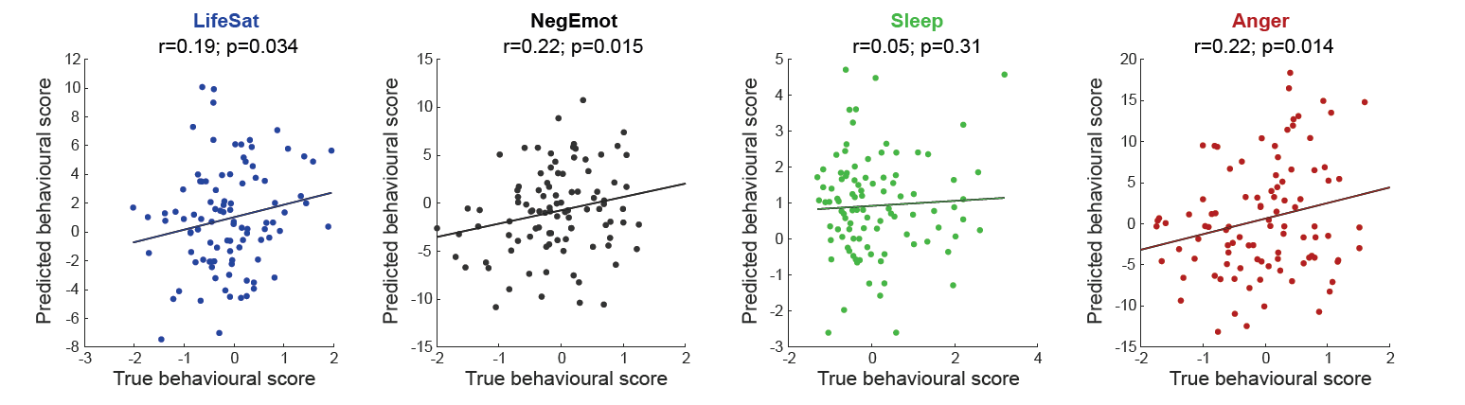
Out-of-sample predictions:
Use weights estimated in 3T cohort to predict behavioural dimensions in 7T cohort
Klein-Flügge, Jensen, Takagi, Priestley, Verhagen, Smith, Rushworth, Nat Hum Beh, 2022

Slide 116
SWB scores are correlated with observable characteristics in ways that make sense
Variables often associated with higher SWB:
  Being in employment
  Having good health
  Being married
  Being female
  Having higher income
  Not having children
  Mid-life crisis: being young; or being old
116
Notes:
116
Also the self-reported measures correlate with certain physiological states (brain activty)
But empirical results differ depending on what outcome measure is used
e.g see the Borooah paper on the reading list
self-assessed happiness question
v. usage of tranquilisers and antidepressants
v. thoughts of self-harm (inc suicide)

Slide 117
This is also true at the more aggregate level
Oswald and Wu (Science, 2010) look at life satisfaction scores (1-4) using US BRFSS data from 2005-2008.
Run satisfaction regressions on individual demographics and 49 State dummies.
This gives a State-by-State picture of well-being.
Satisfaction with life is lowest in New York.
The particularly high-satisfaction states are Louisiana and Hawaii.
117
Notes:
117
Also the self-reported measures correlate with certain physiological states (brain activty)
But empirical results differ depending on what outcome measure is used
e.g see the Borooah paper on the reading list
self-assessed happiness question
v. usage of tranquilisers and antidepressants
v. thoughts of self-harm (inc suicide)

Slide 118
Objective measure: Weighted sum for each U.S. state of variables such as precipitation, temperature, wind speed, sunshine, coastal land, inland water, public land, National Parks, hazardous waste sites, environmental “greenness,” commuting time, violent crime, air quality, student-teacher ratio, local taxes, local spending on education and highways, and cost of living. [This is actually another way of weighting the elements in an objective list]
The weights come from the coefficients in regional wage and house price equations: objective measures of what these amenities are worth.
Gives a ranking of US States, from 1 (best) to 50 (worst).
118
Notes:
118
Also the self-reported measures correlate with certain physiological states (brain activty)
But empirical results differ depending on what outcome measure is used
e.g see the Borooah paper on the reading list
self-assessed happiness question
v. usage of tranquilisers and antidepressants
v. thoughts of self-harm (inc suicide)

Slide 119
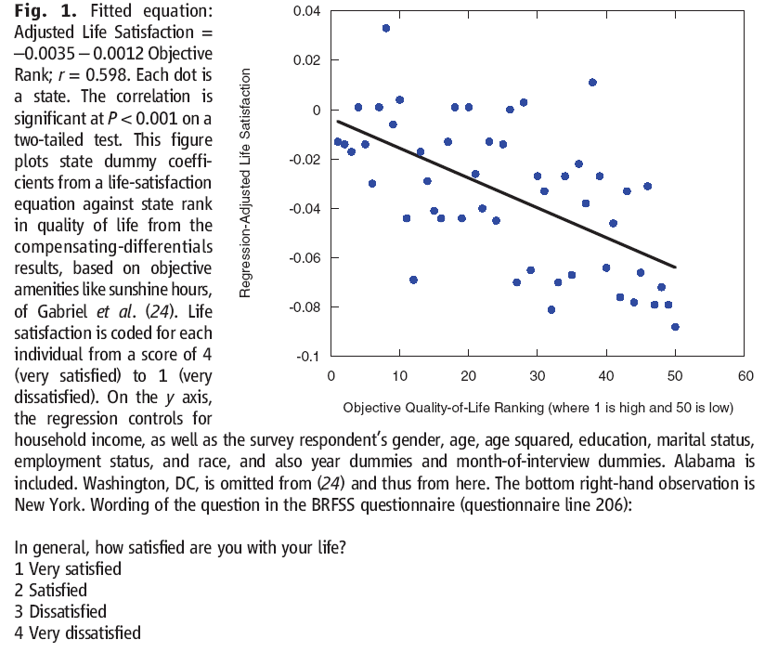
Are the objective and subjective figures regarding quality of life correlated?
119
Notes:
119
Also the self-reported measures correlate with certain physiological states (brain activty)
But empirical results differ depending on what outcome measure is used
e.g see the Borooah paper on the reading list
self-assessed happiness question
v. usage of tranquilisers and antidepressants
v. thoughts of self-harm (inc suicide)

Slide 120
Predicting Health Outcomes
Respondents seem to act on what they say, i.e. they behave as if they were maximising their subjective well-being
And the pattern of outcomes is “as if” those with low satisfaction scores really were not doing very well
The medical literature has found high correlations in the expected sense between low well-being scores and coronary heart disease, strokes, suicide and length of life.
Individuals with higher life satisfaction scores were less likely to catch a cold when exposed to a cold virus, and recovered faster if they did.
120
Notes:
120
Also the self-reported measures correlate with certain physiological states (brain activty)
But empirical results differ depending on what outcome measure is used
e.g see the Borooah paper on the reading list
self-assessed happiness question
v. usage of tranquilisers and antidepressants
v. thoughts of self-harm (inc suicide)

Slide 121
The Nun Study
A study of 180 nuns in Milwaukee examined the diaries of the sisters of Notre Dame when they joined back in the 1930s
Each nun was asked to write a short sketch of her life on this momentous occasion

Slide 122
One of the nuns wrote:
“God started my life off well by bestowing upon me grace of inestimable value… The past year which I spent as a candidate studying at Notre Dame has been a very happy one. Now I look forward with eager joy to receiving the Holy Habit of Our Lady and to a life of union with Love Divine”

Slide 123
Whilst another nun wrote:
“I was born on September 26, 1909, the eldest of seven children, five girls and two boys… My candidate year was spent in the motherhouse, teaching chemistry and second year Latin at Notre Dame Institute. With God’s grace, I intend to do my best for our Order, for the spread of religion and for my personal sanctification.”

Slide 124
After joining the order their lives were almost exactly the same - same food, same work, same routine
But not the same life expectancy…
Considering longevity 75-95, two thirds of the least positive quartile of nuns died before their 85th birthday; in the top quartile of nuns, 90% were still alive.

Slide 125
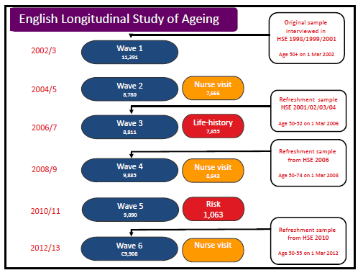

Slide 126
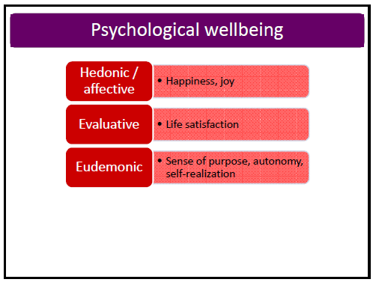

Slide 127
Wave 2 of ELSA took place in 2004/5.
This covers individuals aged 50 or over.
We can model deaths by Wave 7 ten years later.
Which measures of well-being at Wave 2 best predict future death?
This is work by Andrew Steptoe and colleagues at UCL, available from the ELSA website:
https://ifs.org.uk/sites/default/files/output_url_files/Steptoe_Wellbeing_Health.pdf
Notes:
127

Slide 128
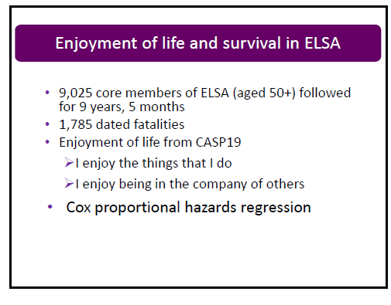

Slide 129
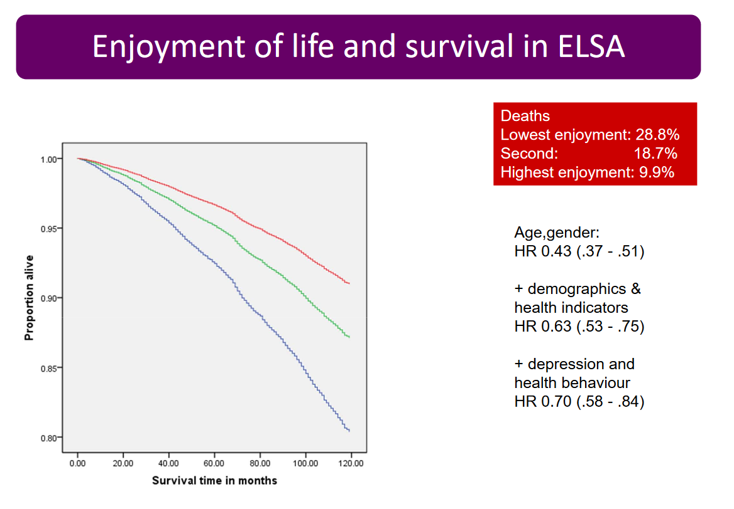
Plotted survival time adjusted for age and gender; hazard rate is highest vs. lowest

Slide 130
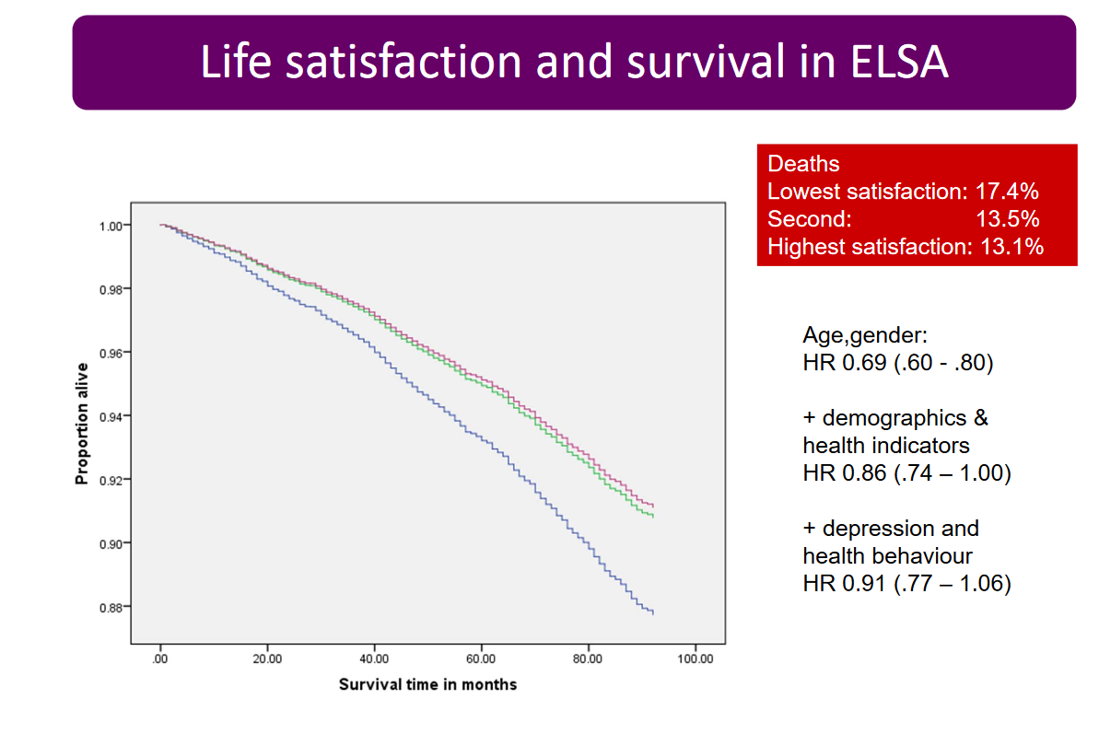
Plotted survival time adjusted for age and gender; hazard rate is highest vs. lowest

Slide 131
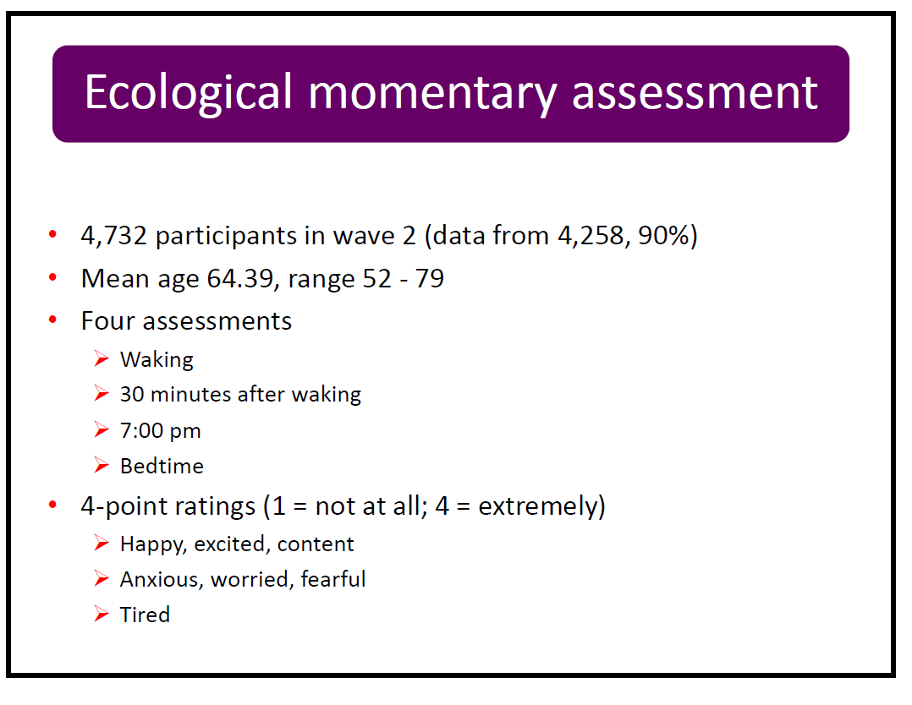

Slide 132
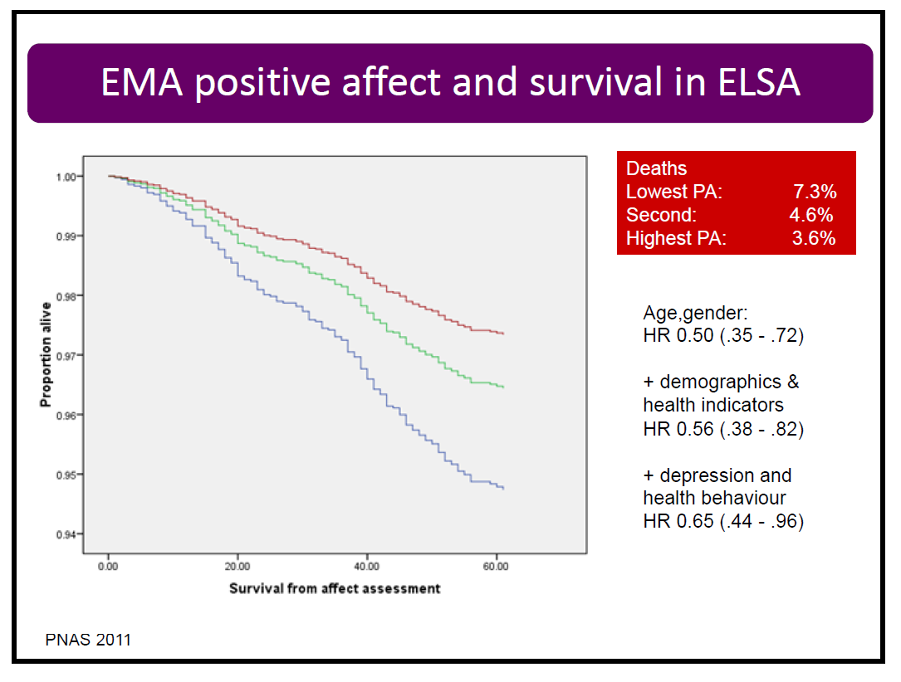

Slide 133
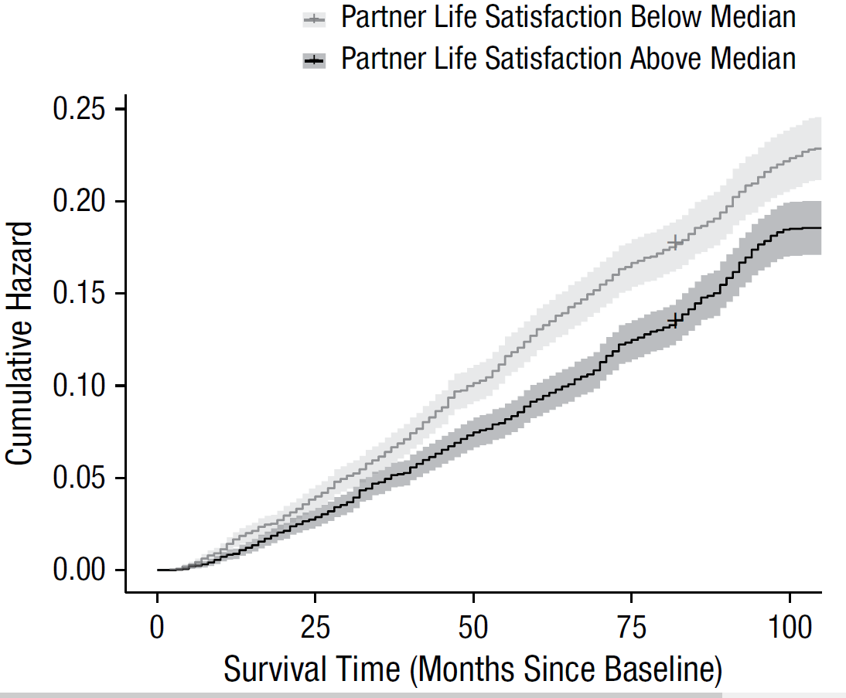
In Stavrova (2019), the same relationship is found between own mortality and partner life satisfaction in US Health and Retirement Study data

Slide 134
Predicting Labour Market Outcomes
Panel data studies have found that subjective well-being at time t predicts future behaviour
Individuals clearly choose to discontinue activities associated with low levels of well-being
In the labour market, job satisfaction at time t is a strong predictor of job quits, even when controlling for wages, hours of work and other standard individual and job variables.
134
Notes:
134
Also the self-reported measures correlate with certain physiological states (brain activty)
But empirical results differ depending on what outcome measure is used
e.g see the Borooah paper on the reading list
self-assessed happiness question
v. usage of tranquilisers and antidepressants
v. thoughts of self-harm (inc suicide)

Slide 135
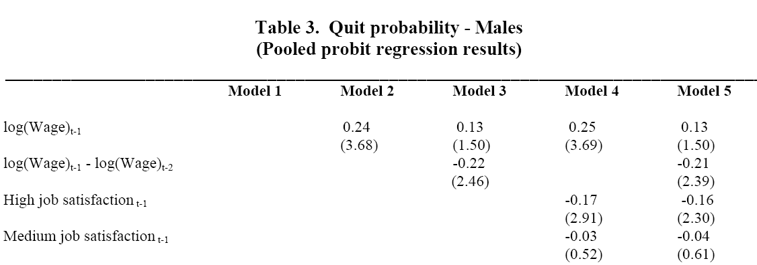
A first example using SOEP data: predict the probability that the individual has quit their job at the time of the next interview, at wave t+1.
High-satisfaction individuals quit less
135
Notes:
135
Also the self-reported measures correlate with certain physiological states (brain activty)
But empirical results differ depending on what outcome measure is used
e.g see the Borooah paper on the reading list
self-assessed happiness question
v. usage of tranquilisers and antidepressants
v. thoughts of self-harm (inc suicide)

Slide 136
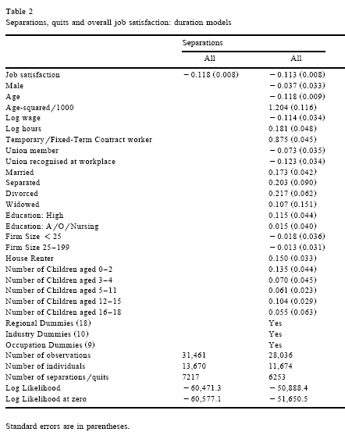
Also true in the BHPS when estimating duration models (predicting the order of quits)
136
Notes:
136
Also the self-reported measures correlate with certain physiological states (brain activty)
But empirical results differ depending on what outcome measure is used
e.g see the Borooah paper on the reading list
self-assessed happiness question
v. usage of tranquilisers and antidepressants
v. thoughts of self-harm (inc suicide)

Slide 137
Not only true for employees.
Analogous work in Georgellis et al. (2006) shows that job satisfaction predicts leaving self-employment.
Clark (2003) shows that the fall in well-being on entering unemployment predicts unemployment duration: those who suffered the sharpest drop in well-being upon entering unemployment were the quickest to leave it.
Even despite the obvious endogeneity bias (those who know their unemployment will be of short duration will be less worried about entering unemployment)
137
Notes:
137
Also the self-reported measures correlate with certain physiological states (brain activty)
But empirical results differ depending on what outcome measure is used
e.g see the Borooah paper on the reading list
self-assessed happiness question
v. usage of tranquilisers and antidepressants
v. thoughts of self-harm (inc suicide)

Slide 138
BHPS Results from Clark (2003)

Slide 139
SOEP Results from Clark et al. (2010)

Slide 140
Happiness and Productivity
It has often been shown in cross-section data that happy workers are more productive?
Problem of an omitted variable (firm size? Manager quality?)
Or reverse causality (productivity → income → happiness)
Need exogenous movements in happiness.
140
Notes:
140
Also the self-reported measures correlate with certain physiological states (brain activty)
But empirical results differ depending on what outcome measure is used
e.g see the Borooah paper on the reading list
self-assessed happiness question
v. usage of tranquilisers and antidepressants
v. thoughts of self-harm (inc suicide)

Slide 141
De Neve and Oswald (2012) use American Add Health data to predict income aged 29 from adolescent well-being variables (life satisfaction and the positive affect subscale of the CES-D during adolescence).
141
Notes:
141
Also the self-reported measures correlate with certain physiological states (brain activty)
But empirical results differ depending on what outcome measure is used
e.g see the Borooah paper on the reading list
self-assessed happiness question
v. usage of tranquilisers and antidepressants
v. thoughts of self-harm (inc suicide)

Slide 142
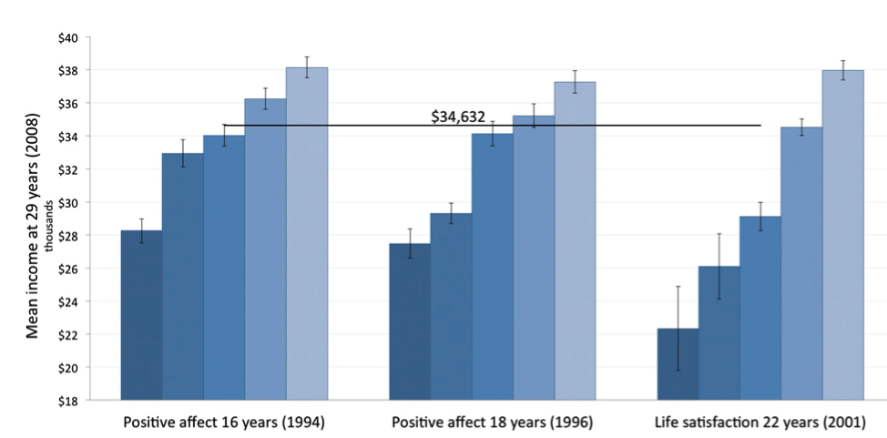
SWB at Work: Income
(DeNeve & Oswald Replication of Diener et al. study)
-- Early Subjective Well-Being and Later Earnings

Slide 143
Oswald, Proto and Sgroi (2015) establish causality using an experimental approach.
Two conditions associated with greater happiness (comedy clip; gift of chocolate, fruit and drinks) raise productivity.
Also measure productivity initially, and then interview respondents. Those who report recent tragic events in their lives have lower productivity levels.
143
Notes:
143
Also the self-reported measures correlate with certain physiological states (brain activty)
But empirical results differ depending on what outcome measure is used
e.g see the Borooah paper on the reading list
self-assessed happiness question
v. usage of tranquilisers and antidepressants
v. thoughts of self-harm (inc suicide)

Slide 144
Bellet et al. (2024): quasi-experimental.
Detailed administrative data on the behaviors and performance of all telesales workers at a large telecommunications company
Weekly survey reports of employee happiness
Variation in worker mood from visual exposure to weather—the interaction between call center architecture and outdoor weather conditions.
Happier workers convert more calls into sales, and (to a lesser extent) make more calls per hour
144
Notes:
144
Also the self-reported measures correlate with certain physiological states (brain activty)
But empirical results differ depending on what outcome measure is used
e.g see the Borooah paper on the reading list
self-assessed happiness question
v. usage of tranquilisers and antidepressants
v. thoughts of self-harm (inc suicide)

Slide 145
Predicting Marital Outcomes
It is commonly-found in the subjective well-being literature that the married are happier than singles.
Most of this correlation turns out to be a composition effect: it is the happy who are more likely to marry, rather than marriage producing happiness.
In other words, the singles who will to marry in the future are happier than the singles who will remain single
145
Notes:
145
Also the self-reported measures correlate with certain physiological states (brain activty)
But empirical results differ depending on what outcome measure is used
e.g see the Borooah paper on the reading list
self-assessed happiness question
v. usage of tranquilisers and antidepressants
v. thoughts of self-harm (inc suicide)

Slide 146
The same kind of analysis can be carried out with respect to children (Cetre et al., 2016).
The childless who will in the future have children are happier than the childless who will not have children.
146
Notes:
146
Also the self-reported measures correlate with certain physiological states (brain activty)
But empirical results differ depending on what outcome measure is used
e.g see the Borooah paper on the reading list
self-assessed happiness question
v. usage of tranquilisers and antidepressants
v. thoughts of self-harm (inc suicide)

Slide 147
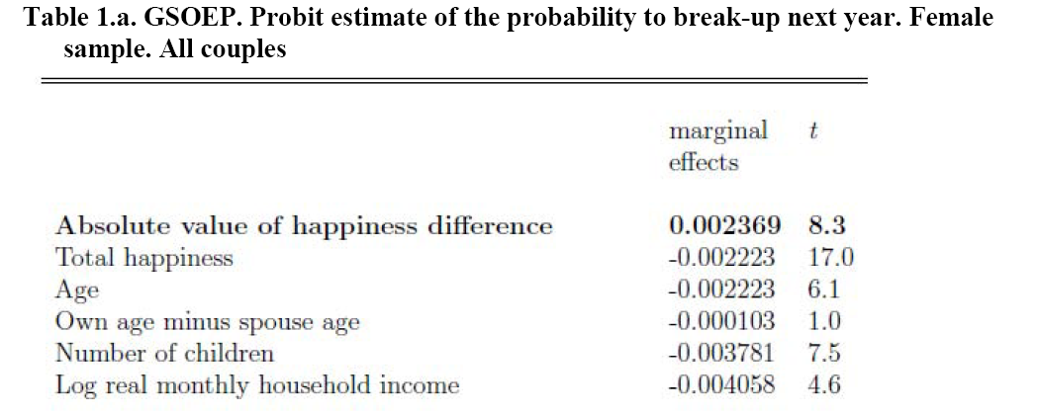
In panel data, those with higher well-being at time t are less likely to divorce at t+1.
The same results are found in both BHPS and HILDA
147
Notes:
147
Also the self-reported measures correlate with certain physiological states (brain activty)
But empirical results differ depending on what outcome measure is used
e.g see the Borooah paper on the reading list
self-assessed happiness question
v. usage of tranquilisers and antidepressants
v. thoughts of self-harm (inc suicide)

Slide 148
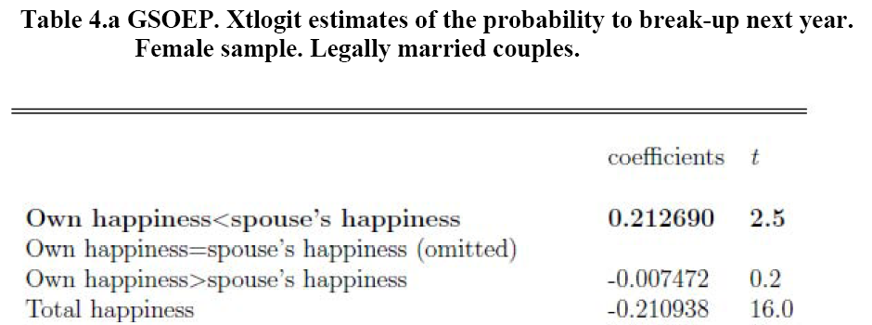
Last Points
1) The gap between individuals
Not only does the level of happiness predict divorce, so does the gap between the man and the woman
Divorce is more likely in unhappy households, and when the woman is unhappier than the man
148
Notes:
148
Also the self-reported measures correlate with certain physiological states (brain activty)
But empirical results differ depending on what outcome measure is used
e.g see the Borooah paper on the reading list
self-assessed happiness question
v. usage of tranquilisers and antidepressants
v. thoughts of self-harm (inc suicide)

Slide 149
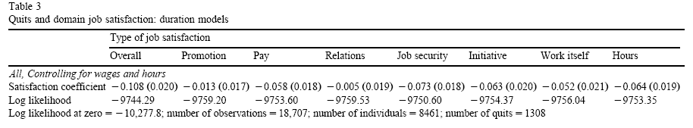
2) Which satisfaction domain is most important?
With multiple well-being measures we can see which predicts behaviour the best (as in Benjamin et al.)
The least negative log-likelihood (the regression with the greatest explanatory power) is that including overall job satisfaction, as might be hoped.
With respect to the seven domain satisfaction variables, the most powerful is satisfaction with job security.
149
Notes:
149
Also the self-reported measures correlate with certain physiological states (brain activty)
But empirical results differ depending on what outcome measure is used
e.g see the Borooah paper on the reading list
self-assessed happiness question
v. usage of tranquilisers and antidepressants
v. thoughts of self-harm (inc suicide)

Slide 150
Green (2010) uses panel data from the UK Skills Survey.
Measures there are of job-related subjective well-being involving both an overall measure of job satisfaction, and items to construct two Warr scales measuring job-related well-being along the Depression–Enthusiasm and the Anxiety–Comfort axes.
150
Notes:
150
Also the self-reported measures correlate with certain physiological states (brain activty)
But empirical results differ depending on what outcome measure is used
e.g see the Borooah paper on the reading list
self-assessed happiness question
v. usage of tranquilisers and antidepressants
v. thoughts of self-harm (inc suicide)

Slide 151
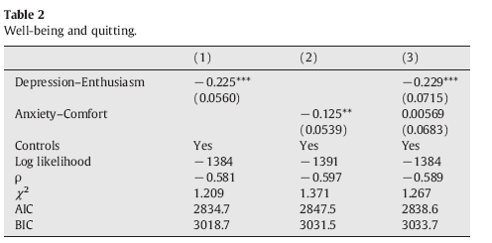
Both depression-enthusiasm and anxiety-comfort predict future quitting
151
Notes:
151
Also the self-reported measures correlate with certain physiological states (brain activty)
But empirical results differ depending on what outcome measure is used
e.g see the Borooah paper on the reading list
self-assessed happiness question
v. usage of tranquilisers and antidepressants
v. thoughts of self-harm (inc suicide)

Slide 152
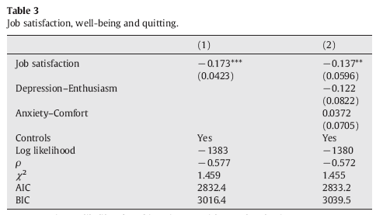
But job satisfaction is the best predictor of quitting.
Once job satisfaction is controlled for, depression-enthusiasm and anxiety-comfort play no significant role in predicting future quitting
152
Notes:
152
Also the self-reported measures correlate with certain physiological states (brain activty)
But empirical results differ depending on what outcome measure is used
e.g see the Borooah paper on the reading list
self-assessed happiness question
v. usage of tranquilisers and antidepressants
v. thoughts of self-harm (inc suicide)

Slide 153
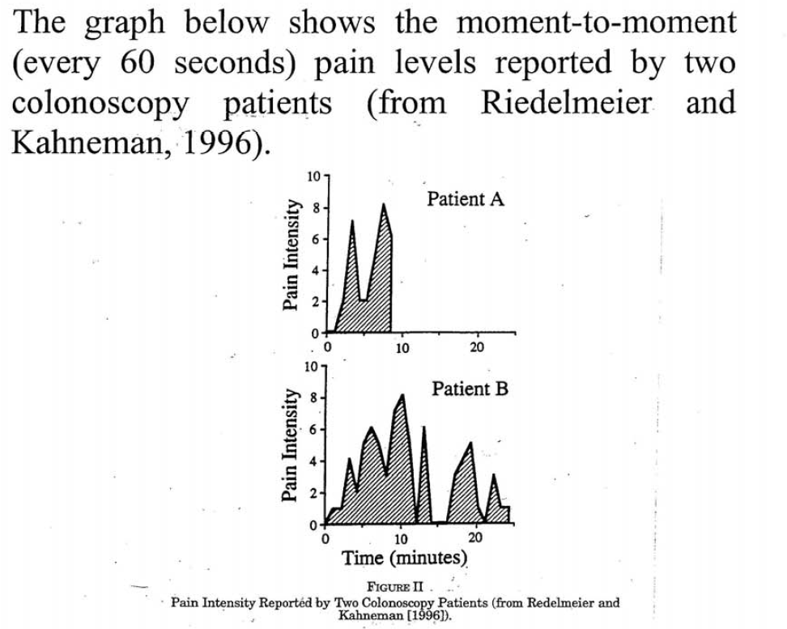
3) Is Decision Utility the Sum of Experienced Utility?
It is tempting to think that our overall satisfaction is the sum of all the moments we have lived.
153
Notes:
153
Also the self-reported measures correlate with certain physiological states (brain activty)
But empirical results differ depending on what outcome measure is used
e.g see the Borooah paper on the reading list
self-assessed happiness question
v. usage of tranquilisers and antidepressants
v. thoughts of self-harm (inc suicide)

Slide 154
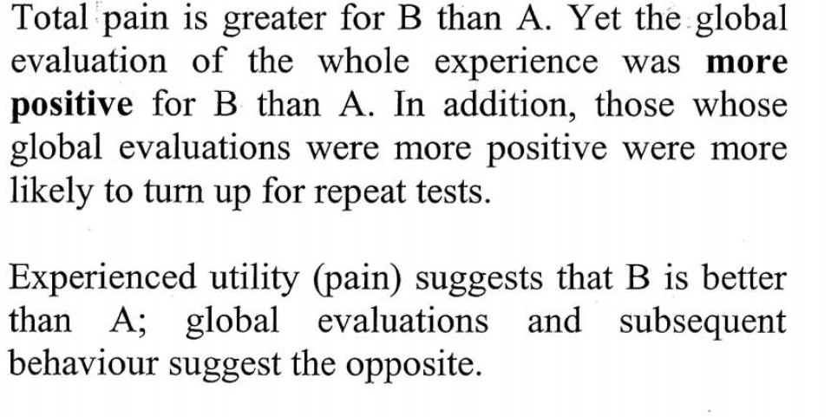

Slide 155
Peak-end evaluation:
“The remembered utility of pleasant or unpleasant episodes is accurately predicted by averaging the Peak (most intense value) of instant utility (or disutility) recorded during an episode and the instant utility recorded near the end of the experience” (Kahneman, Wakker and Sarin, QJE, 1997, p. 381).
Apply this to quitting decisions using panel data with a history of job satisfaction scores

Slide 156
We are currently unsure how stable this is…

Slide 157
References
Bellet, C., De Neve, J.-E., and Ward, G. (2024). "Does Employee Happiness have an Impact on Productivity?". Management Science, forthcoming.
Benjamin, D., Heffetz, O., Kimball, M., and Rees-Jones, A. (2012). "What Do You Think Would Make You Happier? What Do You Think You Would Choose?" American Economic Review, 102, 2083-2110.
Cetre, S., Clark, A.E., and Senik, C. (2016). "Happy People Have Children: Choice and Self-Selection into Parenthood". European Journal of Population, 32, 445–473.
Clark, A.E. (2001). "What Really Matters in a Job? Hedonic Measurement Using Quit Data". Labour Economics, 8, 223-242.
Clark, A.E. (2003). "Unemployment as a Social Norm: Psychological Evidence from Panel Data". Journal of Labor Economics, 21, 323-351.
Clark, A.E., Flèche, S., Layard, R., Powdthavee, N., and Ward, G. (2018). The Origins of Happiness: The Science of Well-Being over the Life-Course. Princeton NJ: Princeton University Press.
Clark, A.E., Frijters, P., and Shields, M. (2008). "Relative Income, Happiness and Utility: An Explanation for the Easterlin Paradox and Other Puzzles". Journal of Economic Literature, 46, 95-144.
Clark, A.E., and Georgellis, Y. (2007). "Kahneman meets the Quitters: Peak-End Behaviour in the Labour Market". PSE, mimeo.
Clark, A.E., and Georgellis, Y. (2013). "Back to Baseline in Britain: Adaptation in the BHPS". Economica, 80, 496-512.
Clark, A.E., Georgellis, Y., and Sanfey, P. (1998). "Job Satisfaction, Wage Changes and Quits: Evidence from Germany". Research in Labor Economics, 17, 95-121.

Slide 158
Clark, A.E., Knabe, A., and Rätzel, S. (2010). "Boon or Bane? Others' Unemployment, Well-being and Job Insecurity". Labour Economics, 17, 52-61.
Clark, A.E., and Senik, C. (2011). "Is Happiness Different From Flourishing? Cross-Country Evidence from the ESS". Revue d'Economie Politique, 121, 17-34.
Conti, G., and Pudney, S. (2011). "Survey design and the analysis of satisfaction". Review of Economics and Statistics, 93, 1087-1093.
D’Ambrosio, C., Clark, A.E., and Barazzetta, M. (2018). "Unfairness at Work: Well-Being and Quits". Labour Economics, 51, 307-316.
Danner, D., Snowdon, D., and Friesen, W. (2001). "Positive Emotions in Early Life and Longevity: Findings from the Nun Study". Journal of Personality and Social Psychology, 80, 804-813.
Deaton, A. (2012). "The financial crisis and the well-being of Americans". Oxford Economic Papers, 64, 1–26.
De Neve, J.-E., and Oswald, A. (2012). "Estimating the Influence of Life Satisfaction and Positive Affect on Later Income Using Sibling Fixed-Effects". Proceedings of the National Academy of Science, 109, 19953-19958.
Diener, E., Inglehart, R., and Tay, L. (2013). "Theory and Validity of Life Satisfaction Scales". Social Indicators Research, 112, 497-527.
Diener, E., and Tay, L. (2014). "Review of the Day Reconstruction Method (DRM)". Social Indicators Research, 116, 255-267.
Di Tella, R., MacCulloch, R.J., and Oswald, A.J. (2001). "Preferences over Inflation and Unemployment: Evidence from Surveys of Happiness". American Economic Review, 91, 335-341.

Slide 159
Fleurbaey, M., and Blanchet, D. (2013). Beyond GDP: Measuring Welfare and Assessing Sustainability. Oxford: Oxford University Press.
Georgellis, Y., Sessions, J., and Tsitsianis, N. (2006). "Pecuniary and non-pecuniary aspects of self-employment survival". Quarterly Review of Economics and Finance, 47, 94-112.
Green, F. (2010). "Well-being, job satisfaction and labour mobility". Labour Economics, 17, 897-903.
Helliwell, J., and Wang, S. (2012). "The State of World Happiness". In J. Helliwell, R. Layard, and J. Sachs (Eds.), World Happiness Report. New York: Columbia Earth Institute.
Hendriks, M., Burger, M., and Takahashi, Y. (2024). "The comparability of differently worded subjective well-being measures". Erasmus University, mimeo.
Huppert, F., and So, T. (2011). "Flourishing across Europe: application of a new conceptual framework for defining well-being". Social Indicators Research, 110, 837-861.
Kahneman, D. (2000). "Experienced Utility and Objective Happiness: A Moment-Based Approach". In D. Kahneman and A. Tversky (Eds.), Choices, Values and Frames. New York: Cambridge University Press and the Russell Sage Foundation.
Kahneman, D., Krueger, A., Schkade, D., Schwarz, N., and Stone, A. (2004). "A Survey Method for Characterizing Daily Life Experience: The Day Reconstruction Method". Science, 3 December 2004, 1776-1780.
Kahneman, D., Stone, A., Krueger, A., Schkade, D., and Schwarz, N. (2006). "A new measure of daily time allocation and emotion: the U-index". Princeton University, mimeo.

Slide 160
Kahneman, D., and Sugden, R. (2005). "Experienced Utility as a standard of policy evaluation". Princeton University, mimeo.
Kahneman, D., Wakker, P.P., and Sarin, R. (1997). "Back to Bentham? - Explorations of experienced utility". Quarterly Journal of Economics, 112, 375-405.
Klein-Flügge, M., Jensen, D., Takagi, Y., Priestley, L., Verhagen, L., Smith, S., and Rushworth, M. (2022). "Relationship between nuclei-specific amygdala connectivity and mental health dimensions in humans". Nature Human Behavior, 6, 1705-1722.
Lucas, R., and Lawless., N. (2014). "Does Life Seem Better on a Sunny Day? Examining the Association Between Daily Weather Conditions and Life Satisfaction Judgments". Journal of Personality and Social Psychology, 104, 872-884.
Lucas, R.E. (2018). "Reevaluating the strengths and weaknesses of self-report measures of subjective well-being". In E. Diener, S. Oishi, and L. Tay (Eds.), Handbook of Well-Being. Salt Lake City: DEF Publishers.
New Economics Foundation (2008), National Accounts of Well-being: bringing real wealth onto the balance sheet. www.nationalaccountsofwellbeing.org.
Nussbaum, M. (2000). Women and Human Development. The Capabilities Approach. Cambridge: Cambridge University Press.
Odermatt, R., and Stutzer, A. (2019). "(Mis‐)Predicted Subjective Well‐Being Following Life Events". Journal of the European Economic Association, 17, 245–283.
Oswald, A.J., Proto, E., and Sgroi, D. (2015). "Happiness and Productivity". Journal of Labor Economics, 33, 789-822.

Slide 161
Oswald, A. and Wu, S. (2010). "Objective Confirmation of Subjective Measures of Human Well-being: Evidence from the USA", Science, 327, 576-579.
Ravallion, M. (2012). "Troubling tradeoffs in the Human Development Index". Journal of Development Economics 99, 201-209.
Redelmeier, D., and Kahneman, D. (1996). "Patients' memories of painful medical treatments: real-time and retrospective evaluations of two minimally invasive procedures". Pain, 66, 3-8.
Ryff, C. (1989). "Happiness is everything, or is it? Explorations on the meaning of psychological well-being". Journal of Personality and Social Psychology, 57, 1069-1081.
Schwarz, N., and Strack, F. (1999). "Reports of subjective well-being: Judgmental processes and their methodological implications". In D. Kahneman, E. Diener, and N. Schwarz (Eds.), Well-being: The foundations of hedonic psychology. New York: Russell Sage Foundation.
Sen, A. (1985). Commodities and Capabilities. Amsterdam: North-Holland.
Senik, C., Stichnoth, H., and Guven, C. (2012). "You can't be happier than your wife. Happiness Gaps and Divorce". Journal of Economic Behavior and Organization, 82, 110–130.
Stavrova, O. (2019). "Having a Happy Spouse Is Associated With Lowered Risk of Mortality". Psychological Science, 30, 798–803.
Stone, A., Schwartz, J., Schwarz, N., Schkade, D., Kahneman, D., and Krueger, A. (2006). "A Population Approach to the Study of Emotion: Diurnal Rhythms of a Working Day Examined With the Day Reconstruction Method". Emotion, 6, 139-149.

Slide 162
Urry, H., Nitschke, J., Dolski, I., Jackson, D., Dalton, K., Mueller, C., Rosenkranz, M., Ryff, C., Singer, B., and Davidson, R. (2004). "Making a Life Worth Living: Neural Correlates of Well-Being". Psychological Science, 15, 367-372.
Wells, J.L., Haase, C.M., Rothwell, E.S., Naugle, K.G., Otero, M.C., Brown, C.L., Lai, J., Chen, K.-H., Connelly, D.E., Grimm, K.J., Levenson, R.W., and Fredrickson, B.L. (2022). "Positivity resonance in long-term married couples: Multimodal characteristics and consequences for health and longevity". Journal of Personality and Social Psychology, 123, 983–1003.
Yin, R., Clark, A.E., D’Ambrosio, C., and Lepinteur, A. (2023). "Life Satisfaction and the Human Development Index across the World". Journal of Cross-Cultural Psychology, 54, 269–282.

Slide 163
But there are also Concerns about using the sum of individual subjective well-being scores as a measure of social welfare
Concern:
Does it make sense to treat the happiness or life satisfaction scores as if they were cardinal?
Reality:
Econometric models assuming cardinality and ordinality give roughly same results
Meaning: people “split up” verbal labels into roughly equal blocks
Notes:
Remember that the ordinalist revolution in economics at the beginning of the 20th Century rejected cardinal utility

Slide 164
Concern:
Are the life satisfaction or happiness questions reliable? Are they valid? Can people recall?
Reality:
Sensitive to wording, and question ordering.
Can be experimentally manipulated (Schwarz’s dime on the photocopier: but recent work by Rich Lucas has not been able to replicate this)
As noted above, correlate well with proxies of well-being.
Notes:
Reports can be influenced by current mood and the immediate context
Also we are influenced by comparisons with other people and with our own historical experiences
Framing effects – how you phrase the question, what questions come before it etc
can alter what people focus their attention on and thus result in different answers
Validity
Do the questions reflect the concept they are meant to reflect?
Mental state accounts seem to have face validity – they are easily understandable and intuitively appealing.
Reliability
Extent to which two or more measures designed to measure the same thing agree with one another.
e.g. do ythe happiness and satisfaction questions gives similar results?

Slide 165
Concern:
If happiness and life satisfaction became the policy maximand, one effective intervention might be to dampen peoples’ expectations; or give out happiness pills.
Reality:
People care about the causes and processes of higher/lower life satisfaction (Nozick: brain in a vat, and the Experience Machine), and having challenges/being deserving.
Notes:
But SWB measures can still guide policy

Slide 166
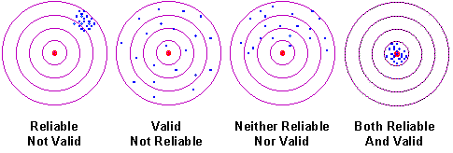
We would like a scale to be both reliable and valid
Pretests for the European Social Survey suggested that reliability and validity were higher using an 11-point scale compared to a four-point scale.
166
Notes:
166

