Slide 1
Self-Employment, Well-Being, Rents and Matching
Andrew E. Clark (Paris School of Economics - CNRS)
http://www.parisschoolofeconomics.com/clark-andrew/

Slide 2
The History of SE in OECD
Countries: Rates are Falling, or have plateaued
2019
12.1
9.6
15.6
6.1

Slide 3
Wide disparity between countries

Slide 4
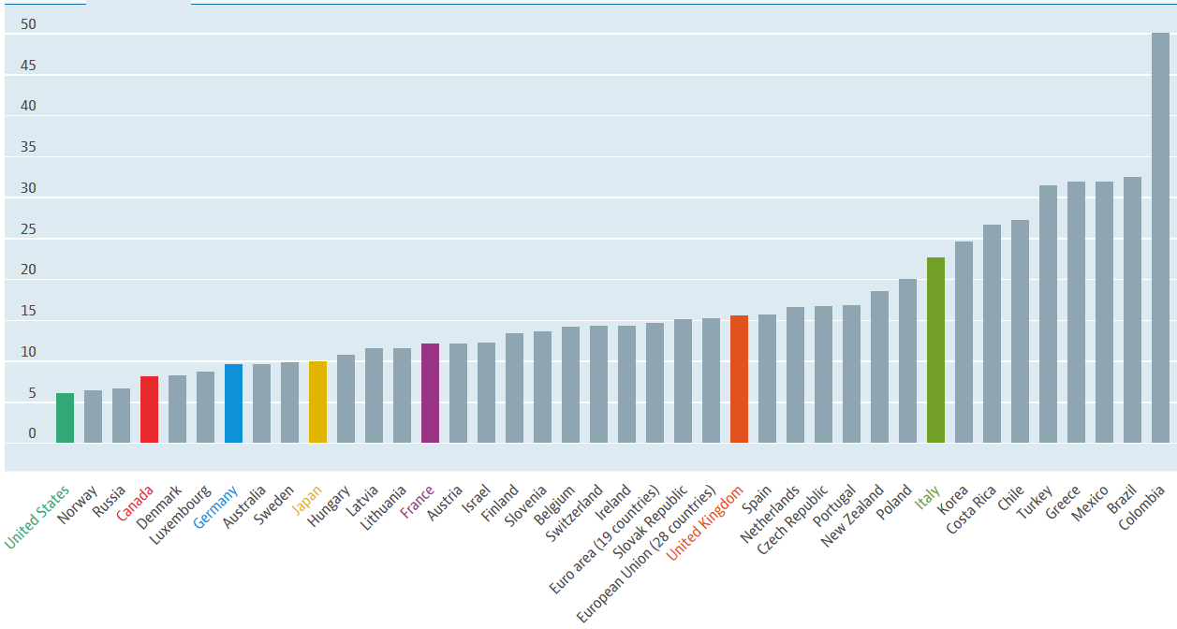
The situation in 2019

Slide 5
In 2019, the share of self-employed workers in total employment (men and women together) ranged from 6% in the United States and Norway to well over 30% in Greece, Mexico, and Turkey.
In general, self-employment rates are highest in countries with low per capita income although Italy, with a self-employment rate of around 23%, is an exception.
So should we think of self-employment in terms of a lack of employment opportunities?

Slide 6
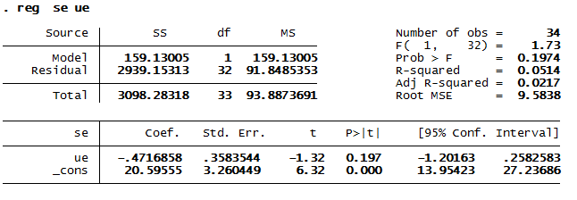
Self-employment and unemployment rates were not correlated in 2015
Which they would NOT be in equilibrium, if self-employment acted to mop up the lack of employment (but they would be during the adjustment period)

Slide 7
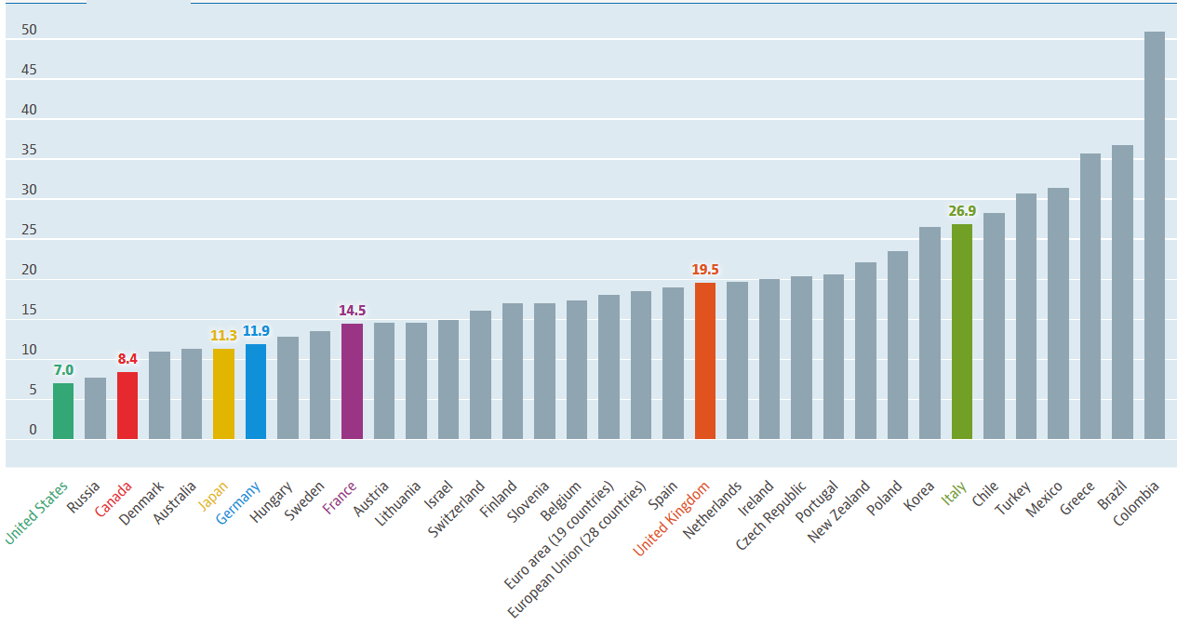
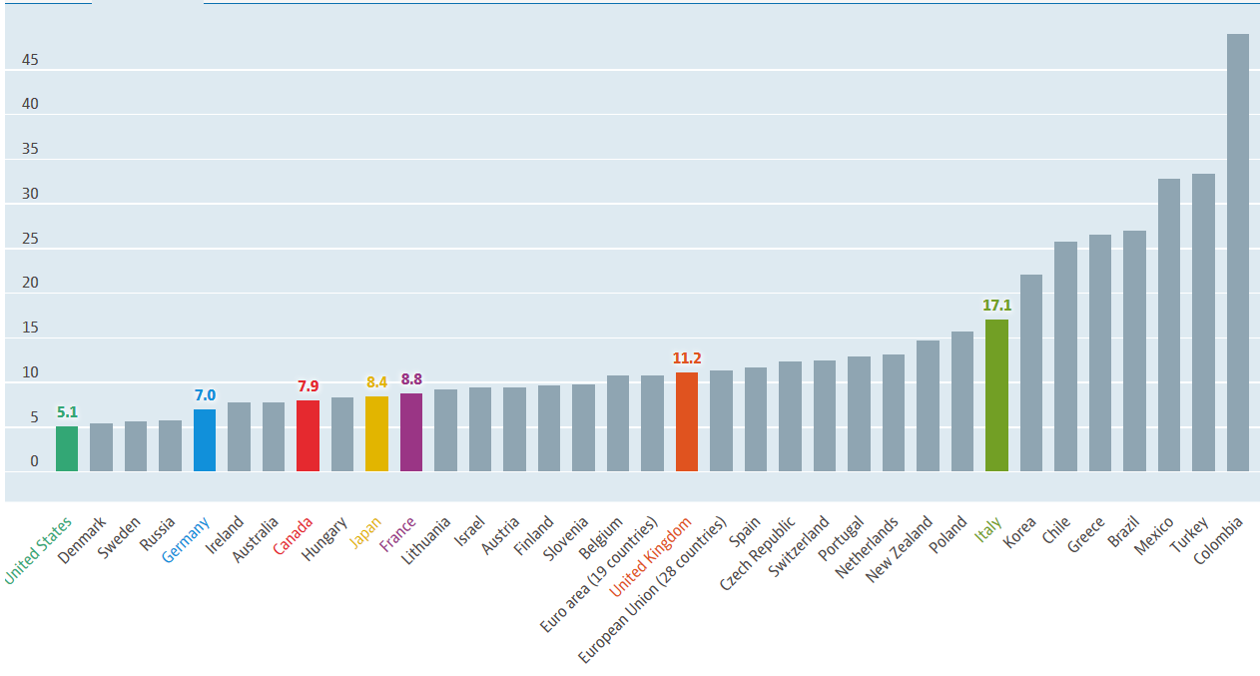
Men are far more likely to be SE than are women

Slide 8
When there are a number of different types of employment on the labour market, and workers can choose freely between them, we’d expect them to provide the same utility (for homogeneous workers).
How do we know if W(SE) is greater than or less than W(E)?

Slide 9
In Economics, we rely on revealed preference: everyone chooses the status that suits them best (= brings the highest level of welfare).
Or we can make lists of the various aspects of the different kinds of jobs.
Or compare the reported subjective well-being of individuals in the different labour-market states (or in panel data, the well-being of individuals who change states)

Slide 10
If there is a well-being gap between the labour-market statuses, then either
There are rents: E would like to become SE, but can’t. Which means that “revealed preference” is not actually revealing preferences.
or
People are very different, and those who are in one type of employment are happier there than those in another: but the latter do not want to leave (optimal matching)

Slide 11
Why should we get so excited about the difference between rents and matching?
Because in the first case there is some grit or imperfection in the market that is preventing clearing (some people would like to become SE but can’t). There is then scope for interventions that can raise welfare.
In the second case everyone is making an unconstrained choice, and there is no role for policy.

Slide 12
Revealed preferences do not help if choice is not free (i.e. there are rents).
So let’s make lists, and see whether SE is better or worse than E.
Before we actually turn to the people who are in these different types of employment, and ask them what they think about their jobs.

Slide 13
Job Characteristics: SE vs E.
Wages. W_{SE} < W_{E}. And wage growth lower for SE than for E.
Issue of self-selection (panel) for wage levels
Wage growth might show
Incentive contracts for E (Akerlof and Katz)

Slide 14
Dynamic incentive-compatible contracts.
A worker earns less than her productivity up to t* (lends to the firm)
A worker earns more than her productivity after t* (the firm pays back)
Those caught shirking are fired, and lose the money “lent” to the firm
Need employment protection to stop the firm reneging after t*
And need a pre-defined end to the contract: mandatory retirement at t’

Slide 15
Notes:
Wages are almost never equal to VMPL at any point in time
But ∑w_{t} = ∑VMPL_{t}
Don’t need this structure in SE, as incentives are internalised (don’t need to motivate yourself): hence the flatter earnings profile

Slide 16
Job Characteristics: SE vs E.
Wages. W_{SE} < W_{E}. And wage growth lower for SE than for E.
Issue of self-selection (panel) for wage levels
Wage growth might show
Incentive contracts for E (Akerlof and Katz)
Workers learning quality of E job match over time, and quitting low-quality matches

Slide 17
Job Characteristics: SE vs E.
Wages. W_{SE} < W_{E}. And wage growth lower for SE than for E.
Issue of self-selection (panel) for wage levels
Wage growth might show
Incentive contracts for E (Akerlof and Katz)
Workers learning quality of E job match over time, and quitting low-quality matches
SE requires higher levels of human K. Returns to latter are concave.

Slide 18
SE have more HK. Returns to HK concave: slope for SE is lower than that for E. Note that, ceteris paribus, this implies that W_{SE} > W_{E}, which we do NOT find.
$
E
SE
Human
Capital

Slide 19
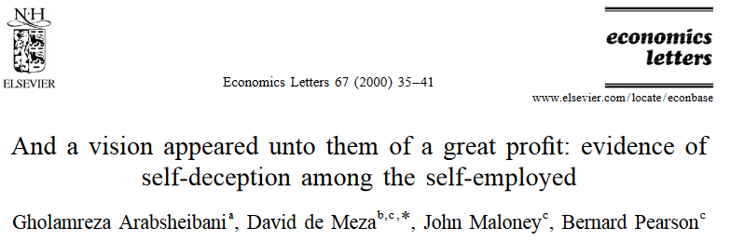
Job Characteristics: SE vs E.
Of course, decisions regarding labour-force status are made using expectations.
Which allows me to shoe-horn in one of my favourite article titles…
So there’s probably learning and quitting from SE too

Slide 20
Job Characteristics: SE vs E.
Hours. ESS data.
E: 40 hours per week (including OT)
SE: 51 hours per week
Job Security. You can’t sack yourself…but then again firms can insure you (an implicit contract).
BHPS. Satisfaction with job security (1-7 scale)
Employees = 5.30
Self-Employed = 5.08
T-statistic = 11 for the difference in means

Slide 21
Job Characteristics: SE vs E.
Risk.
dW/dShock is three times larger for the SE than for E.
There is therefore less insurance for the SE (as utility functions are concave)
UK figures in 2014
Two-thirds of self-employed workers have no pensions

Slide 22
Job Characteristics: SE vs E.
US Failure Rates for Start-ups
1 year 25%
2 years 36%
3 years 44%
4 years 50%
.
.
.
8 years 66%

Slide 23
Job Characteristics: SE vs E.
Sociability.
SE are often on their own.

Slide 24
Measuring Well-being: The Day Reconstruction Method
Respondents reconstruct the previous day.
Split into a sequence of episodes.
Respondents report the key features of each episode, including
(1) When the episode began and ended
(2) what they were doing
(3) where they were
(4) Whom they were interacting with, and
(5) how they felt on multiple affect dimensions

Slide 25
For each of the episodes that individuals identify during the day, they are asked the following questions:

Slide 29
Job Characteristics: SE vs E.
Autonomy.
This is obviously where the SE win.
Autonomy is one of the four core job characteristics identified in Schjoedt, L. (2009). "Entrepreneurial Job Characteristics: An Examination of Their Effect on Entrepreneurial Satisfaction". Entrepreneurship theory and practice, 33, 619-644.

Slide 30
Job Characteristics: SE vs E.
The other three are
Variety
Task identity: “the degree to which the job requires completion of a ‘whole’ and identifiable piece of work; that is, doing a job from beginning to end with a viable outcome”
Feedback: “the degree to which carrying out the work activities required by the job results in the individual obtaining direct and clear information about the effectiveness of his or her performance”
SE are argued to have more of these three than do E

Slide 31
Job Characteristics: SE vs E.
Overall Conclusion.
SE do worse than E by a lot of the counts above.
Old question in labour: how can we add up the different domains to produce an overall index of job quality?
My answer: We might not need to. Let’s ask individuals to do it for us by reporting their own evaluation of their job: their job satisfaction.
Job Satisfaction_{SE} > Job Satisfaction_{E}
In raw data
With controls in (pooled) cross-section

Slide 32
Job Characteristics: SE vs E.
This looks like a mystery.
SE do worse than E by many of the counts that economists think are important.
But they’re more satisfied…
Maybe we shouldn’t believe satisfaction scores, but instead ask a direct hypothetical preference question. This one comes from the “Work Orientations” module of the ISSP:
“Suppose you were working and could choose between different kinds of jobs. Which of the following would you personally choose?”

Slide 34
The SE are therefore more satisfied than the employed, and the percentage saying they would prefer to be SE is systematically three to four times higher than the percentage who actually are.
How can we have U_{SE} > U_{E} in equilibrium?
Three possible explanations
Capital constraints
Matching by Know-How
Matching by Risk-Aversion

Slide 35
1) Capital constraints
As epitomised in Blanchflower and Oswald. Journal of Labor Economics (1998)
Being SE requires capital. Not all SE have enough to set up on their own and have to borrow. Asymmetric information between entrepreneurs and banks: the latter cannot evaluate how good the entrepreneur’s project is.
As a result, some profitable projects may not be funded.
Two possibilities
If the market clears, then U_{SE} = U_{E}
If the market does not clear, then U_{SE} > U_{E}
In the latter case, the utility gap should fall with entrepreneurs’ own capital. The more entrepreneurs are able to self-finance their projects, the less banks matter, and the smaller is the utility gap.

Slide 36
Formal model in Evans and Jovanovic (1989):
Shows not only the decision to become SE, but also the resulting size of the SE firm
Household Choice:
Become a worker: Earn wage: (wζ)
where: θ is entrepreneurial ability (known when making choice – no learning about mistakes)
k is capital necessary to start a business
α is returns to scale on capital:
Note: Assume innovations to w and y are uncorrelated.
Assume that ability (θ) is uncorrelated with market wage.
Assume risk neutrality.
Static model: People are endowed with initial wealth z.

Slide 37
Evans and Jovanovic (1989)
Total entrepreneurial income:
where: z is initial wealth
Constraint:
Firms can at most borrow λ times their initial wealth to fund their capital project.
Note: Borrowing rate = lending rate = r (same for everyone).

Slide 38
Choice of Optimal Entrepreneurial Capital Stock

Slide 39
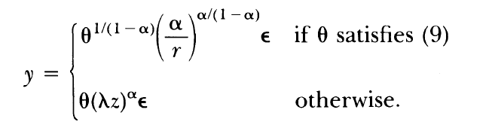
Finish Solving The Model: Part 1
Entrepreneurial Income as a function of constrained/unconstrained k.
In the first case, you can borrow all that you want.
In the second case you are credit-constrained (would like to borrow more).

Slide 40
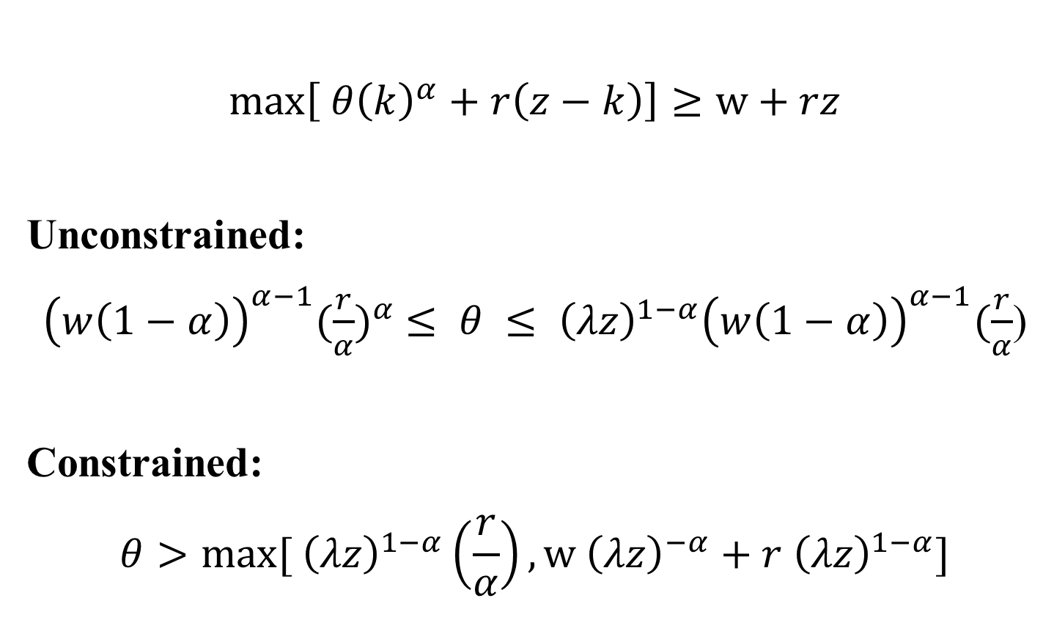
Finish Solving the Model: Part 2
Compare Entrepreneurial Earnings to Wages
$$\max\left[ {θ\left(k\right)}^{α}+r\left(z−k\right)\right]≥w+rz$$
Unconstrained:
${\left(w\left(1−α\right)\right)}^{α−1}{(\frac{r}{α})}^{α} ≤ θ ≤ {\left(λz\right)}^{1−α}{\left(w\left(1−α\right)\right)}^{α−1}(\frac{r}{α}$)
Constrained:
$$θ>max⁡[ {\left(λz\right)}^{1−α}\left(\frac{r}{α}\right), w {\left(λz\right)}^{−α}+r {\left(λz\right)}^{1−α}]$$

Slide 41
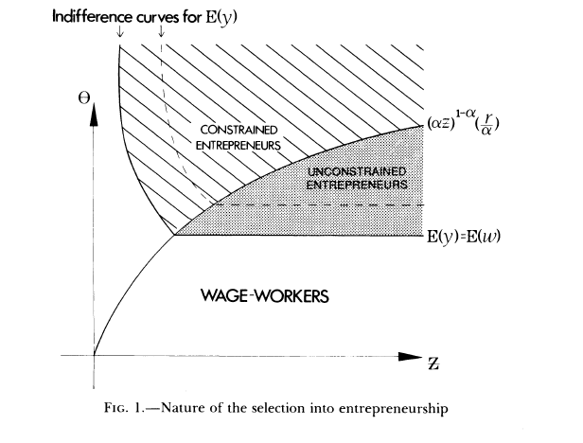
Implication of the Model:
Probability of Entrepreneurship Increasing in Wealth
This should be (λz)
This line is horizontal because E(y)=θk^{α}, and k does not depend on Z (can borrow as much as you want)

Slide 42
Implication of the Model:
Probability of Entrepreneurship Increasing in Wealth
This should be (λz)
Higher wages shift the E border out NE:
Some previously SE now prefer E

Slide 43
Implication of the Model:
Probability of Entrepreneurship Increasing in Wealth
This should be (λz)
Higher λ shifts the constraint NW:
Some previously constrained SE now unconstrained
Note that it will also shift out the indifference curve above the constraint (as E(y) depends on λ there

Slide 44
Evans and Jovanovic Conclusions
Richer households are less bound by liquidity constraints and as a result
are more likely to enter entrepreneurship.
Should see a positive relationship between initial wealth and entry into
small business ownership.
Smaller firms will grow faster; once they reach the unconstrained region assets no longer increase investment in the business
Increasing θ won’t increase SE if z is low enough
Subsidising borrowing won’t increase SE if θ is low enough

Slide 45
We do indeed see that the SE are wealthier than are the employed, which is consistent with the above analysis.
But it is also consistent with the expected returns to SE being higher than the returns to employment (so that SE leads to wealth, instead of wealth leading to SE).
We have a potential endogeneity problem…
So we instrument!
Look for exogenous movements in wealth.

Slide 46
Empirical Test in Blanchflower and Oswald
NCDS Data. Covers all GB children born between the 3rd and 9th of March 1958. Surveys carried out when children were aged 7, 11, 16, 23, 33 and 42.
NCDS at ages 23 and 33 used. Percentage of SE rises from 6% (1981) to 14% (1991) – life cycle and macro effects.
Key variable measures capital constraints: did the respondent receive an inheritance of > £500?
Bivariate evidence. At age 33:
14% of those without an inheritance were self-employed
22% of those with an inheritance of £10K-£20K were self-employed
33% of those with an inheritance of £50K+ were self-employed

Slide 47
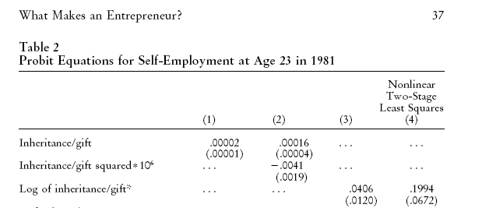
Regression for P(SE)
P(SE) rises with inheritance. Col. 4 instruments for inheritance via death of parents. Shows the importance of capital constraints.

Slide 48
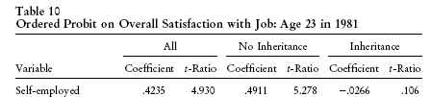
There is also direct evidence. 50% of the employed who had thought about becoming SE (but didn’t) cite lack of capital (BSA data)
Blanchflower and Oswald also look at job satisfaction.
Job satisfaction is higher for the SE. But only for the SE without inheritance. The SE with inheritance are just as satisfied as employees (as if the labour market cleared for them). This is consistent with capital constraints.

Slide 49
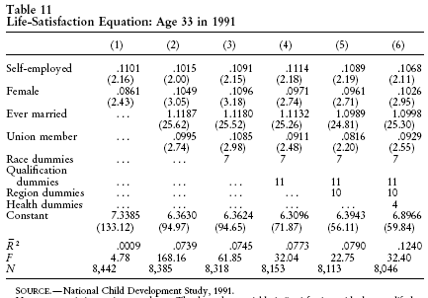
Job Satisfaction might go up… but life satisfaction go down (job really great, but spend no time at home and no leisure). Check via life satisfaction.

Slide 50
While the following paper does not look for exogenous movements in wealth, but rather in access to borrowing (the λ in the model above)

Slide 51


Housing Collateral, Credit Constraints and Entrepreneurship:
Evidence from a Mortgage Reform
Thais Jensen, University of Copenhagen
Søren Leth-Petersen, University of Copenhagen
Ramana Nanda, Harvard Business School
Paris
January, 2015

Slide 52
NB. Now called “Financing Constraints, Home Equity and Selection into Entrepreneurship”, and
forthcoming in the Journal of Financial Economics

Slide 53
Motivation
Entrepreneurs wealthy
  Have more wealth (Gentry and Hubbard 2004)
  More likely to start businesses (Hurst and Lusardi, 2004; Hvide and Møen, 2010)
Why?
  Credit constraints: wealthy people less restricted
  Entrepreneurship is a consumption good: “preference for being ones own boss that is correlated with wealth” (Hurst and Lusardi, 2004; Hurst and Pugsley, 2012)
Why important to resolve?
  Wealth may drive entrepreneurship even if constraints are not important
  if binding for less wealthy but productive (potential) entrepreneurs then potential gain is large (Evans and Jovanovic, 1989)

Slide 54
Motivation
Approaches to measuring importance of constraints: shocks to personal wealth
  Lottery winnings Lindh and Ohlsson(1996)
  Inheritances Blanchflower and Oswald (1998), Holtz-Eakin, Joulfaian and Rosen (1994), and Andersen and Nielsen (2012)
  House prices shocks and collateralized credit Schmalz, Sraer and Thesmar (2014), Harding and Rosenthal (2013), Fairlie and Krashinsky (2012) and Adelino, Schoar, Severino (2014)
  Problem: potentially confounds wealth and liquidity
Need change in access to finance that does not change wealth

Slide 55
This study
How does an exogenous increase in access to collateralized credit impact entrepreneurship?
Focus on an institutional change rather than shocks to individual wealth
  Danish 1992 mortgage reform that for the first time allowed home owners to borrow against equity for other things than buying a house
  Exogenous increase in access to credit that did not lead to a wealth effect

Slide 56
Summary of findings
The reform unlocked a large amount of credit
  Equivalent to 1 years income for the median individual who was eligible
  Those with high levels of ETV (equity-to-value) at the time of the reform significantly increased their debt relative to those with low levels of ETV
We see a (small) positive impact on entrepreneurship for treated group
  4% increase in net entrepreneurship following the reform
  Driven by existing firms more likely to survive and by an increase in entry rates
  The increase in entry rates came primarily from greater entry into more capital intensive industries
On average, however, these seem to be lower quality entrants
  Majority of the increase was due to entrants that failed within the first two years of entry
  sales and profits were lower (for both exits + survivors), increased entry came from people starting firms in industries where they had no experience

Slide 57
Consider the last finding of Jensen et al.:
“On average, however, these seem to be lower quality entrants”
This is what you would expect from Evans and Jovanovic.
At a given level of wealth, those with high enough ability (θ) are already entrepreneurs.
Changing constraints will bring in entrepreneurs of marginal ability.

Slide 58
We can also think of λ as some general measure of the ease of access to Banks…
like how far away they are, and therefore how easy it is to enter into negotiations about lending

Slide 59
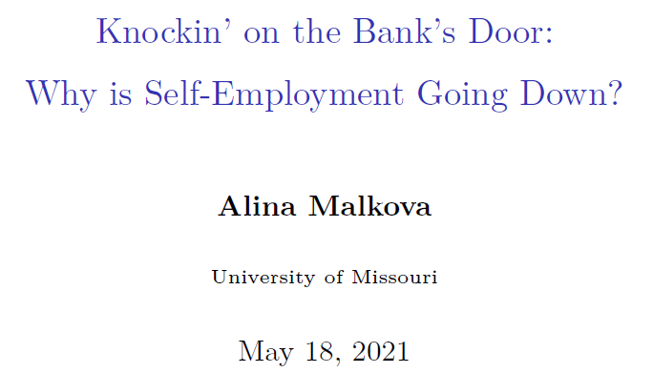
This paper relates the fall in SE in the US to the increase in borrower-lender distance due to the shrinking of the U.S. branch network.

Slide 60
Credit approvals primarily rely on soft information about the borrower.
Few small or large banks accept small business loan applications online (11%).
Personal presence during a loan transaction can play an essential role.
A greater borrower-lender distance should discourage SE, especially for those who need loans.

Slide 61
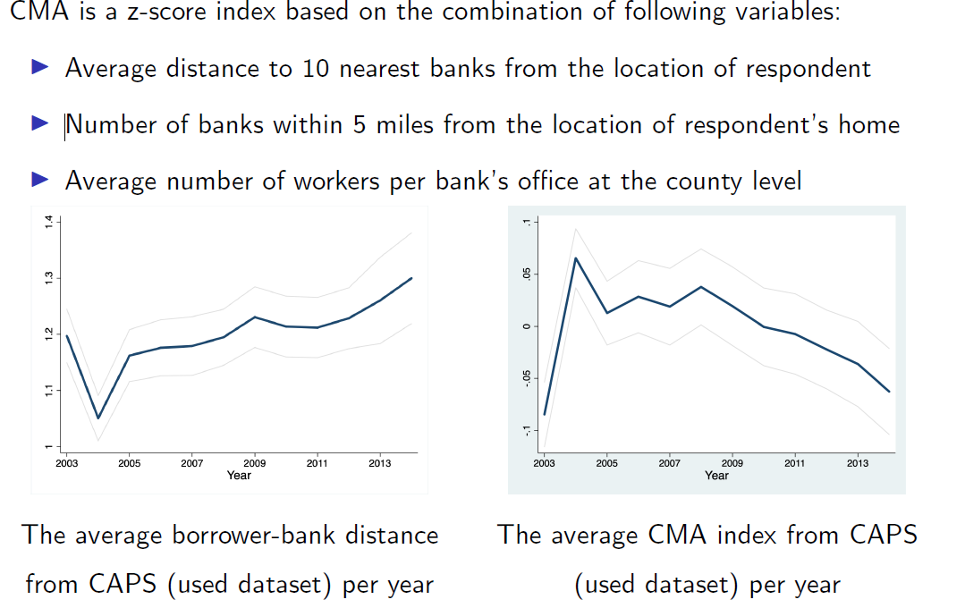
Geo-coded data on individuals and banks

Slide 62
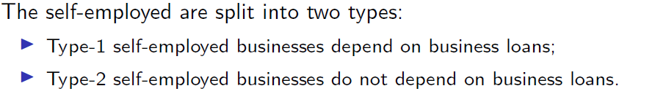
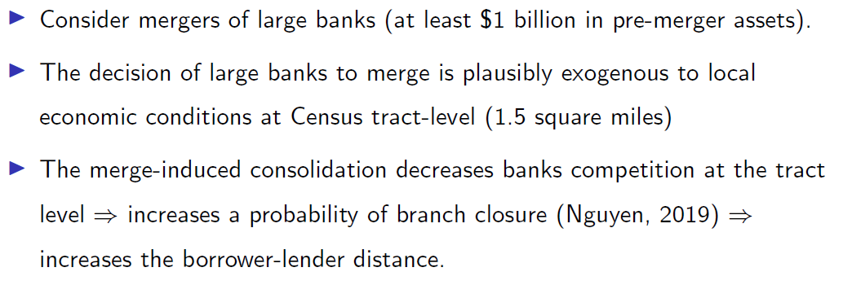
Bank location is endogenous: they will appear where the demand for loans is higher. This produces a reverse-causality bias (similar in nature to police and crime).
What to do? We instrument distance by bank mergers, which lead to branch closure

Slide 63
Results: The resulting worse credit-market access reduces the self-employment of those who need loans
(the type-1 firms), but NOT that of those who do not (the type-2 firms).
In the spirit of a DiD analysis

Slide 64
2) Intellectual Capital or “Know-How”
Based on work by Masclet and Colombier.
Again, intergenerational transmission: but this time not of money but of ability, which affects individual productivity when they are self-employed.
Productivity when self-employed, θ, partly comes from one’s parents.
Data from the French component of the ECHP (1994-2001), aged 18-64. Gives 45,000 observations on E and 5,500 on SE (self-employment rate of 12%).

Slide 65
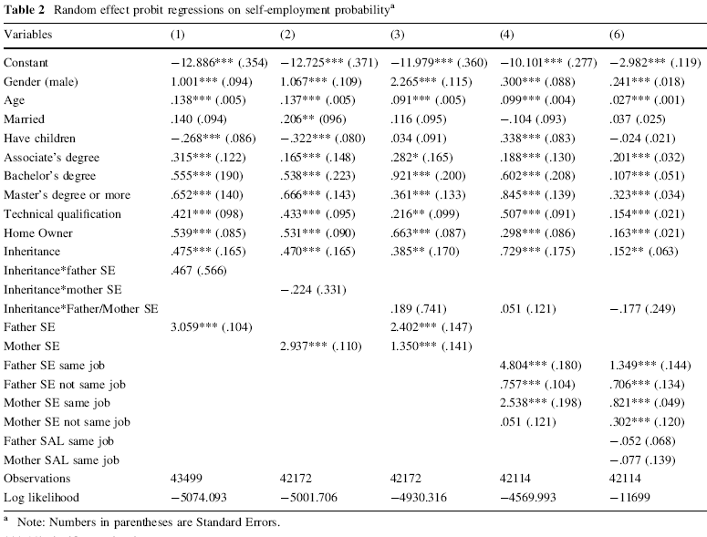
P(SE) rises with inheritances, as in 1), and with own human capital (education). But also rises with parents’ SE status, and especially if parents were SE in the same profession. The effect is stronger for men than for women.

Slide 66
Note that this is a matching/sorting story, and does not reflect rents… in the sense that those who are E do not want to become SE.

Slide 69
A’s choice
E
SE
Sorting
A chooses E, B chooses SE
Both E
Both SE
w_{SE}
(1/θ_{B})X
(1/θ_{A})X
E
SE
B’s choice (B’s have higher ability in SE)

Slide 72
An example of productivity matching (Einav and Yariv, JEP, 2010)
Winners of the John Bates Clark Medal (US economist < 40)
2007 Acemoglu
2008 Athey
2009 Saez
2010 Duflo
2011 Levin
2012 Finkelstein
2013 Chetty
2014 Gentzkow
2015 Fryer
2016 Sannikov
2017 Donaldson
2018 Pathak
2019 Nakamura
2020 Dell
2021 Andrews

Slide 73
An example of productivity matching
Winners of the John Bates Clark Medal
2007 1 Acemoglu
2008 1 Athey
2009 19 Saez
2010 4 Duflo
2011 12 Levin
2012 6 Finkelstein
2013 3 Chetty
2014 7 Gentzkow
2015 6 Fryer
2016 19 Sannikov
2017 4 Donaldson
2018 16 Pathak
2019 14 Nakamura
2020 4 Dell
2021 1 Andrews
Average 7.8

Slide 74
And here is the
population distribution of surnames in the US

Slide 75
Why do we see this pattern when productivity is randomly-distributed (names change through marriage)?
The practice of alphabetical ordering in publications (50% of Top-5 publications are co-authored).
There is no such name effect in Psychology (which doesn’t use alphabetical ordering)
Behavioural response (if your name is Zgaga or Zylberberg)
- write papers where there is not alphabetical ordering
- write sole-authored papers
And this is what we see in practice

Slide 76
3) Risk-Aversion
Are the self-employed less risk-averse than the employed?
Survey evidence from the GSOEP in 2004 (Dohmen et al.). 22 000 individuals asked about “willingness to take risks” in different domains. Scale of 0 to 10: 0 = “unwilling to take risks” and 10 = “fully prepared to take risk”
Risk Type SE Coefficient
General 0
Car Driving 0
Financial Matters +ve
Career +ve
Health 0

Slide 77
Survey evidence from Finland (Ekelund et al., Labour Economics, 2005). 1966 Birth Cohort Study.
Questionnaire measure of harm avoidance (7 questions on worry and risk): 1-7 scale.
Formalise via a probability of self-employment equation.

Slide 78
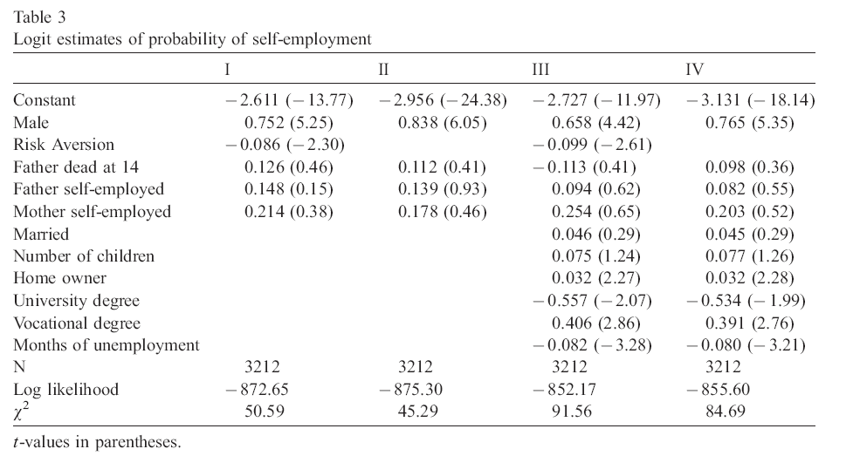
The coefficient of 0.100 (roughly) means that moving from 1 to 7 on the risk-aversion scale produces a change in the likelihood of self-employment as large as that between men and women.

Slide 79
Experimental. This involves far smaller N, but real decisions (Colombier et al., Journal of Economic Behavior & Organization). Holt-Laury measure of risk via lotteries.
Individuals choose between two lotteries, A and B. The key element here is that lottery B is riskier than is lottery A.

Slide 80
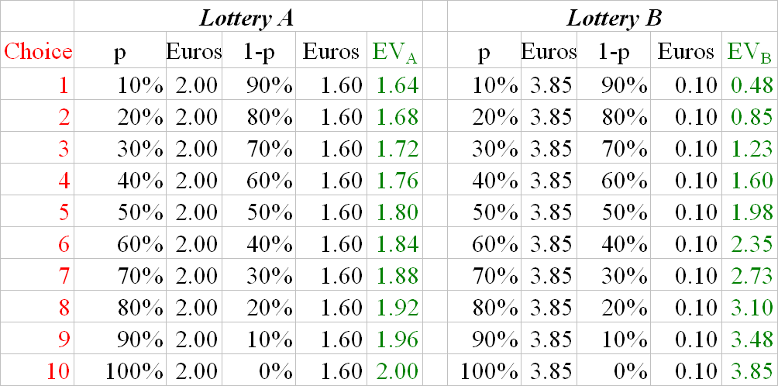

Slide 81
For the first choices, the EV of A is greater than that of B; as the probabilities of winning the larger amount increase, the EV of B finally becomes greater than that of A.
The point where individuals change between A and B shows their risk-aversion.
Someone who is RN chooses according to EV: they choose A for the first four choices, and then B thereafter.
Someone who is RA will change later. At choice 5 the EV of B is greater than that of A, but the RA will still go for A (because they are scared of getting the small prize, 0.1, in lottery B)
Someone who is RL will change earlier.

Slide 82
Main Result: the (real-life) E are more risk-averse than the (real-life) SE
All three explanations are consistent with U_{SE} > U_{E}.
The first is a rent story; the second two are matching.
Apply these results to two empirical phenomena.
SE rates have been falling
France is not entrepreneurial
The SE decision is based on the comparison of the value of V_{SE} to V_{E}.
1) Jobs have become of better quality (?) and French jobs are really good (??).
2) Constrained access to employment, so choose SE. So unemployment has been falling (Yes) and France has low unemployment (No)

Slide 83
V_{SE} has been falling because tastes have changed: increasing taste for leisure (SE hours higher) or increasing taste for income (SE income lower).
Capital constraints have increased, and are particularly large in France.
Sorting: less know-how handed down (because jobs change so quickly now??) and less know-how in France. But that only explains low current French SE by low past French SE….
Sorting: Risk-aversion has been rising, and the French very risk-averse. (RA does rise with GDP: l'Haridon and Vieider)
I like no. 4), but the analysis of self-employment, particularly cross-country, is still wide open for further research.

Slide 84
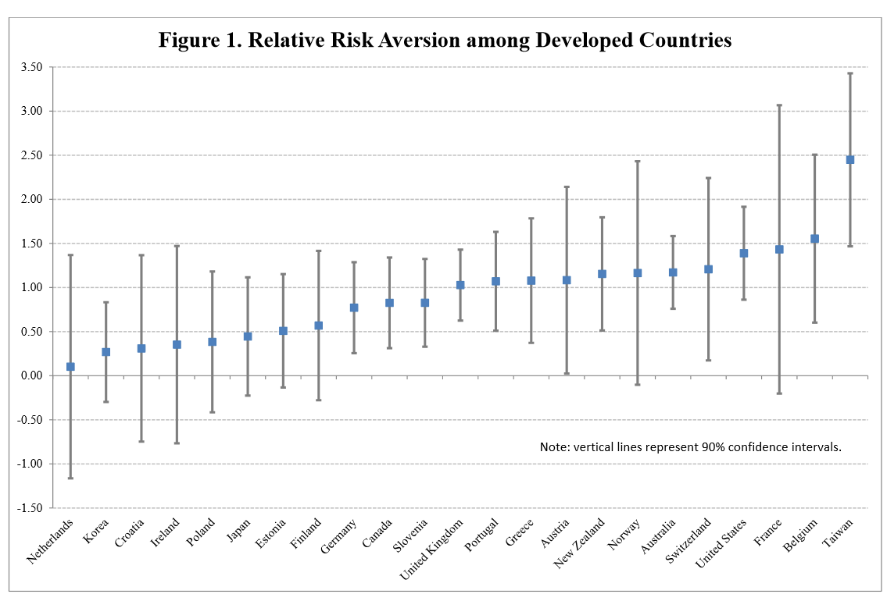
Risk Aversion at the Country Level, Gandelman and Hernández-Murillo, FRB St.Louis, 2014 [Beware of confidence intervals…. like journal rankings]

Slide 85
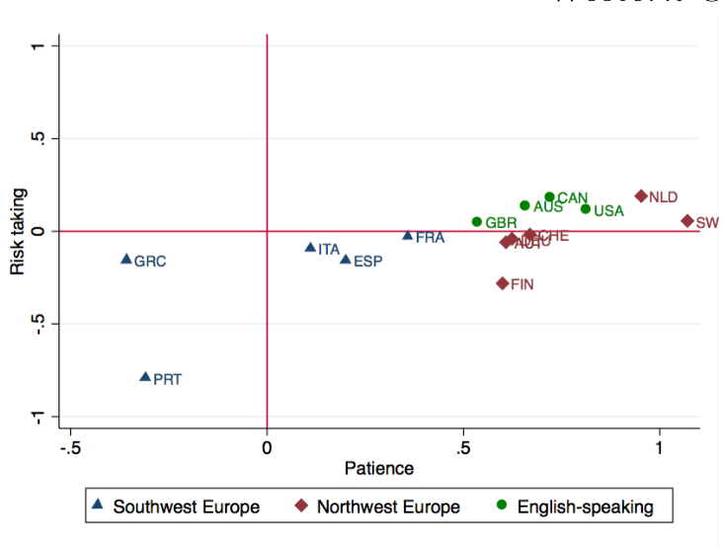
Falk, A., Becker, A., Dohmen, T., Enke, B., Huffman, D., and Sunde, U. (2015). "The Nature and Predictive Power of Preferences: Global Evidence". IZA, Discussion Paper No. 9504.
Risk aversion measured by five lottery versus sure payment questions

Slide 86
There are many other potential explanations of the choice of SE
Particularly across country, work (Torrini, Labour Economics, 2005) has emphasised the role of
Trust/Social capital
The Public Sector (crowds out self-employment? Employer of the last resort?)
Corruption (potential for tax evasion?)

Slide 87
Factoids
As individuals become richer they are less capital-constrained and so P(SE) rises.
Poor countries have more SE than do rich countries; as GDP rises P(SE) falls.
A sort of SE Easterlin Paradox?

Slide 88
The answer, as is often the case, is in an omitted variable.
As countries grow over time, something else changes which affects P(SE).
Corruption falls
The public sector becomes larger
Trust falls (?)
Risk-aversion rises (?)
The quantity and quality of paid employment in general rises (as in Bianchi, 2012).

Slide 89
There is certainly differential entry into SE by the level of country development
Self-employed Literacy test scores - Below vs. above median income countries
Atallah, M. (2018). "Skills & Self-Employment in Developing Countries". PSE, mimeo.

Slide 90
The SE well-being boost may only be temporary.
See Hanglberger, D., and Merz, J. (2015). "Does self-employment really raise job satisfaction? Adaptation and anticipation effects on self-employment and general job changes". Journal for Labour Market Research.
SOEP data 1984-2009. They find an average SE gap of one quarter of a life satisfaction point.

Slide 91
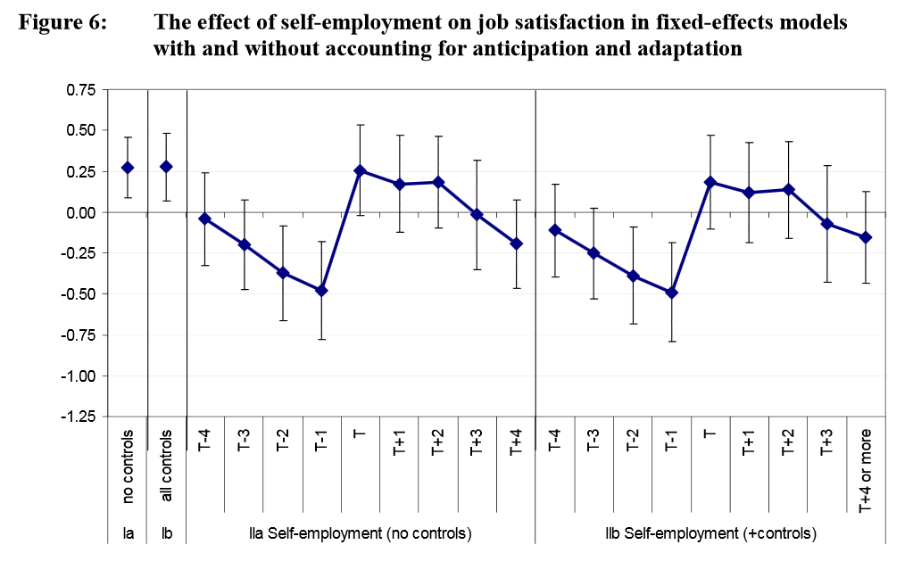

Slide 92
Most of this effect seems to come from the comparison of dissatisfied employment before the job change, and a rise in satisfaction after the change.
There is a well-known honeymoon effect following any kind of job change.
So is their result above particular to self-employment, or is it found for any kind of job change?

Slide 93
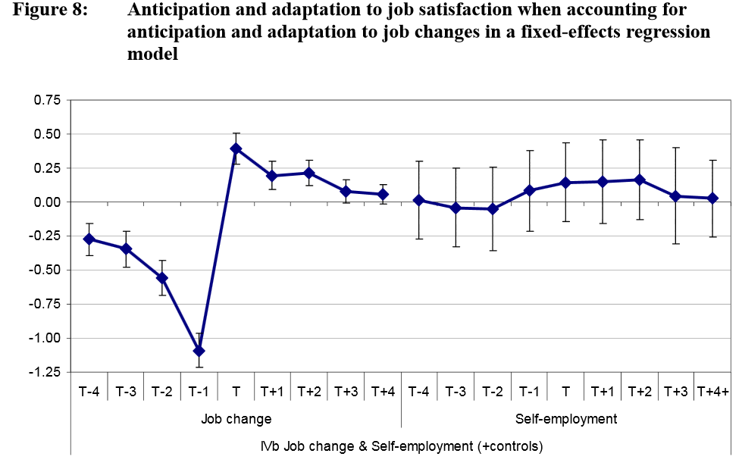

Slide 94
We can make this fit with the Blanchflower and Oswald findings of greater SE and greater satisfaction as follows.
The Blanchflower and Oswald findings picked up new changers to SE, who had shorter tenure (hadn’t adapted yet)
If they had compared new SE to new E, they might not have found a difference.
The adaptation findings are within-subject; the typical SE premium is cross-section. We can make the two consistent via a selection of the satisfied into SE (see Stutzer and Frey, 2006, for the same argument applied to marriage).

Slide 95
In particular, beware of the dreaded “OECD-country generality”. This assumes that “any result I’ve found in the UK must necessarily generalise worldwide”.
This point is really well brought out in Bianchi (2010). Financial development eases the capital constraints to becoming self-employed. That’s what we have already understood.
However, it does something else as well: it affects both the classic labour market and the product market. The satisfaction differential between the self-employed depends on three things:
SE profit
SE non-pecuniary return (value of autonomy)
Employed wages.
Financial development affects all three, especially in developing countries).

Slide 97
Another factoid: Self-employment is more satisfactory than employment… and becoming more so
This is consistent with entry barriers to self-employment rising over time:
The self-employment rate is falling;
More people want to be self-employed than are actually self-employed; and
The satisfaction “premium” from self-employment is on the rise

Slide 98
References
Akerlof, G.A., and Katz, L.F. (1989). "Worker's Trust Funds and the Logic of Wage Profiles". Quarterly Journal of Economics, 104, 525-536.
Atallah, M. (2018). "Skills & Self-Employment in Developing Countries". PSE, mimeo.
Bianchi, M. (2012). "Financial Development, Entrepreneurship and Job Satisfaction". Review of Economics and Statistics, 94, 273-286.
Blanchflower, D.G., & Oswald, A.J. (1998). "What Makes an Entrepreneur?". Journal of Labor Economics, 16, 26-60.
Blanchflower, D.G., Oswald, A.J., & Stutzer, A. (2001). "Latent Entrepreneurship Across Nations". European Economic Review, 45, 680-691.
Clark, A.E. (2010). "Work, Jobs and Well-Being Across the Millennium". In E. Diener, J. Helliwell, and D. Kahneman (Eds.), International Differences in Well-Being. Oxford: Oxford University Press.
Clark, A.E., Colombier, N., and Masclet, D. (2008). "Never the Same After the First Time: The Satisfaction of the Second-Generation Self-Employed". International Journal of Manpower, 29, 591-609.
Clark, A.E., & Senik, C. (2006). "The (Unexpected) Structure of "Rents" on the French and British Labour Markets". Journal of Socio-Economics, 35, 180-196.

Slide 99
Colombier, N., Denant-Boemont, L., Lohéac, Y., and Masclet, D. (2009). "Group and Idividual Risk Preferences: A Lottery-Choice Experiment with Self-Employed and Salaried Workers". Journal of Economic Behavior & Organization, 70, 470-483.
Colombier, N., and Masclet, D. (2008). "Intergenerational Correlation in Self-employment: Some Further Evidence from ECHP Data". Small Business Economics, 30, 423-437.
Dohmen, T., Falk, A., Huffman, D., Sunde, U., Schupp, J., and Wagner, G. (2010). "Individual Risk Attitudes: New Evidence from a Large, Representative, Experimentally-Validated Survey". Journal of the European Economic Association, 9, 522-550.
Earle, J., and Sakova, Z. (2000). "Business start-ups or disguised unemployment? Evidence on the character of self-employment from transition economies". Labour Economics, 7, 575-601.
Einav, L., and Yariv, L. (2006). "What's in a Surname? The Effects of Surname Initials on Academic Success". Journal of Economic Perspectives, 20, 175-187.
Ekelund, J., Johansson, E., Järvelin, M.-R., & Lichtermann, D. (2005). "Self-employment and risk-aversion - evidence from psychological test data". Labour Economics, 12, 649-659.

Slide 100
Evans, D., and Jovanovic, B. (1989). "An Estimated Model of Entrepreneurial Choice under Liquidity Constraints". Journal of Political Economy, 97, 808-827.
Frey, B.S., and Benz, M. (2008). "Being Independent Is a Great Thing: Subjective Evaluations of Self-Employment and Hierarchy". Economica, 75, 362-383.
Hanglberger, D., and Merz, J. (2015). "Does self-employment really raise job satisfaction? Adaptation and anticipation effects on self-employment and general job changes". Journal for Labour Market Research, 48, 287-303.
Hyytinen, A., and Rouvinen, P. (2008). "The labour market consequences of self-employment spells: European evidence". Labour Economics, 15, 246-271.
Jensen, T., Leth-Petersen, S., and Nanda, R. (2021). "Financing Constraints, Home Equity and Selection into Entrepreneurship". Journal of Financial Economics, forthcoming.
Kahneman, D., Krueger, A., Schkade, D., Schwarz, N., & Stone, A. (2004). "A Survey Method for Characterizing Daily Life Experience: The Day Reconstruction Method". Science, 3 December 2004, 1776-1780.
Kawaguchi, D. (2003). "Human capital accumulation of salaried and self-employed workers". Labour Economics, 10, 55-71.

Slide 101
Kihlstrom, R., & Laffont, J.-J. (1979). "A General Equilibrium Entrepreneurial Theory of Firm Formation Based on Risk Aversion". Journal of Political Economy, 87, 719-48.
l'Haridon, O., and Vieider, F. (2019). "All over the map: A worldwide comparison of risk preferences". Quantitative Economics, 10, 185-215.
l'Haridon, O., and Vieider, F. (2019). "All over the map: A worldwide comparison of risk preferences". Quantitative Economics, 10, 185-215.
Malkova, A. (2021). "Knockin’ on the Bank’s Door: Why is Self-Employment Going Down?". University of Missouri, mimeo.
OECD. (2000). "The Partial Renaissance of Self-Employment". OECD Employment Outlook.
Torrini, R. (2005). "Cross-country differences in self-employment rates: the role of institutions". Labour Economics, 12, 661-683.
Wasmer, E., & Weil, P. (2004). "The Macroeconomics of Labor and Credit Market Imperfections". American Economic Review, 94, 944-963.

